Slide 1
Adverts for booklet

Slide 2


Slide 3


Slide 4


Slide 5


Slide 6
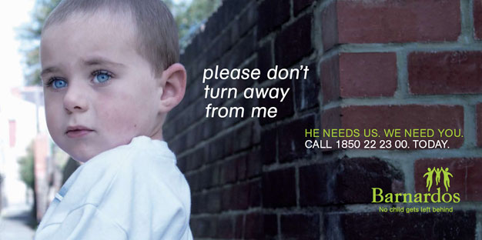

Slide 7
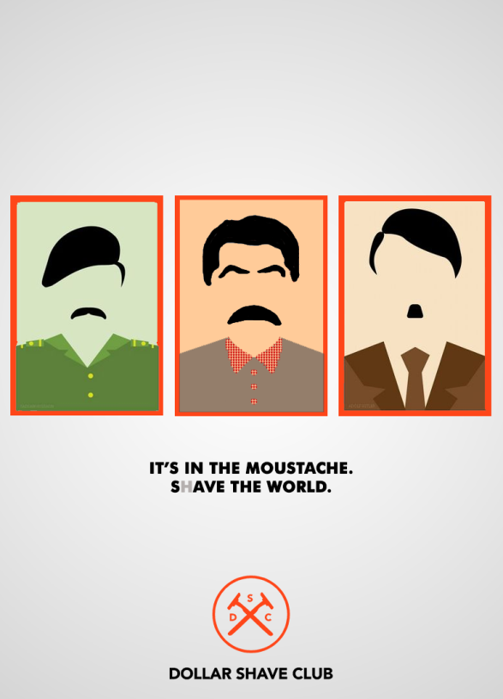

Slide 8


Slide 9
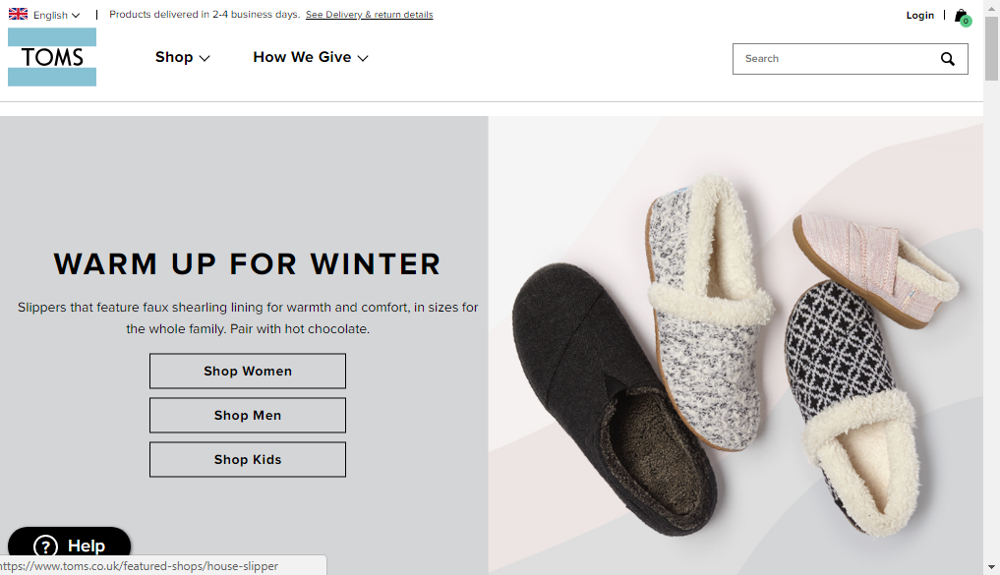

Slide 10
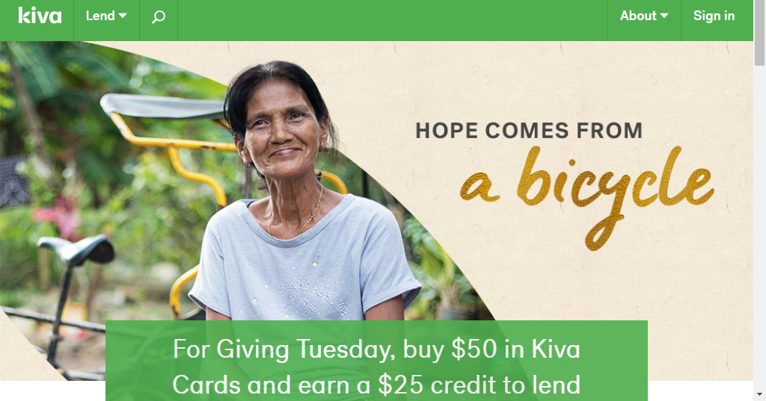

Slide 11
Task
In groups of 2 or 3, create a print advert for one of Mrs B’s random products.
You should try to consider the following things in you advert:
Colour
Framing of image
Use of font
Action line
Z rule
Pack shot
Direct gaze.

Slide 12
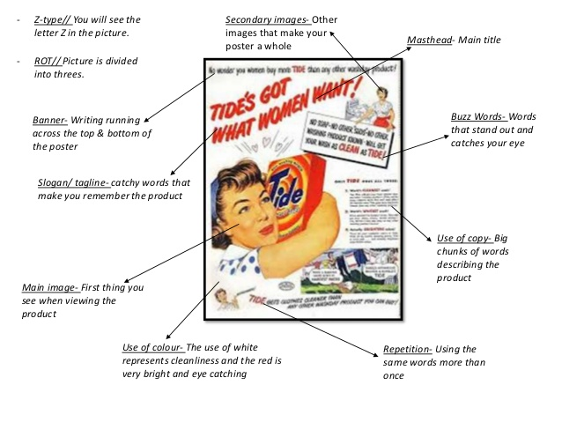
When you have completed...
When you have finished your advert you need to do the following:
Stick your advert to an A3 piece of paper.
Using the list of Media Language from the board, label and analyse the effect of your advert.

Slide 13
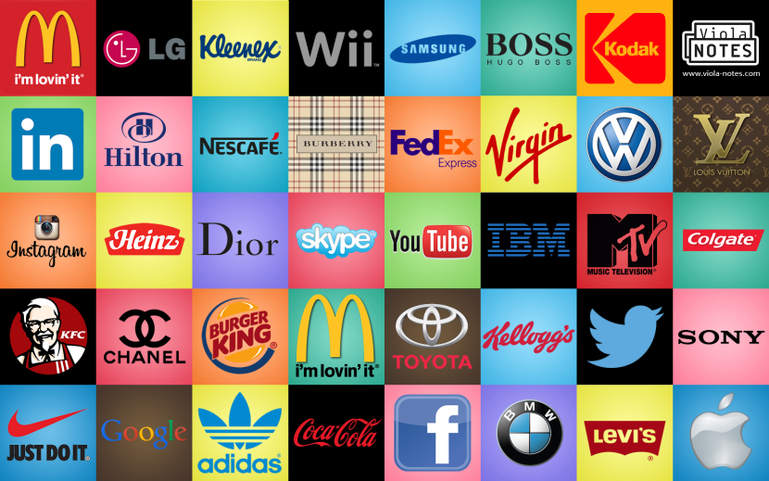

Slide 14
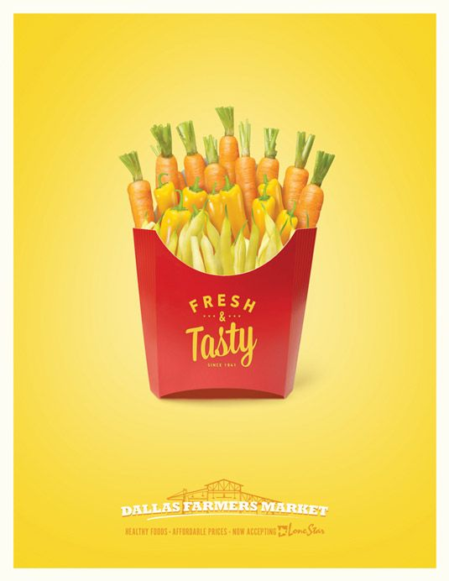
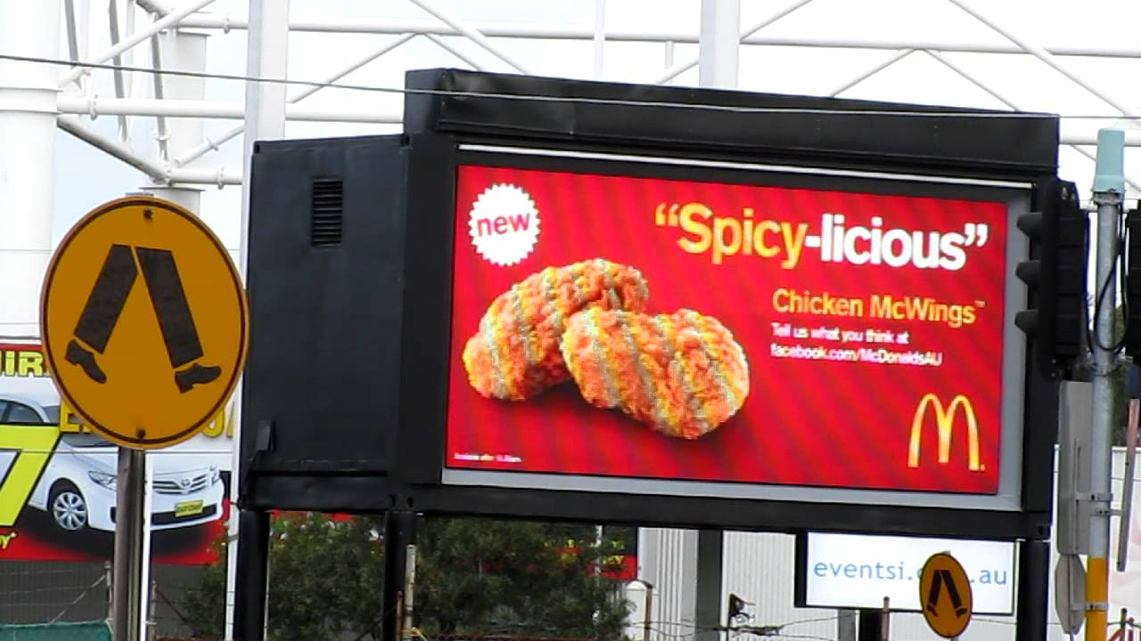
Print and Outdoor adverts

Slide 15
Broadcast
https://www.youtube.com/watch?v=bq5SGSCZe4E

Slide 16
Covert and Product Placement
https://www.youtube.com/watch?v=_3FLKuQa62c

Slide 17
Public Service
https://www.youtube.com/watch?v=Vb00H6mCTM8
https://www.youtube.com/watch?v=SI6LGjqqscs

Slide 18
Marketing Campaign Research
Over the years there have been several very high profile marketing campaigns which have captured the public’s imagination. You are going to research and produce a presentation about one of them.
You will need to include the following in your presentation:
Print adverts
Moving image adverts
Other aspects of the campaign
Information about who created the campaign and what else they have done
Information about the company being advertised
Whether the campaign was successful
Suggested campaigns:
Nike ‘Just do it’
Dove ‘Real Beauty’
Budweiser ‘Wassup’
Metro Trains ‘Dumb Ways to Die’
Wonderbra ‘Hello Boys’
Apple ‘Get a Mac’
Coke ‘Holidays are coming’
John Lewis ‘Monty the Penguin’
Levi’s 501s ‘Laundrette’
Cadburys ‘Gorilla’

Slide 19
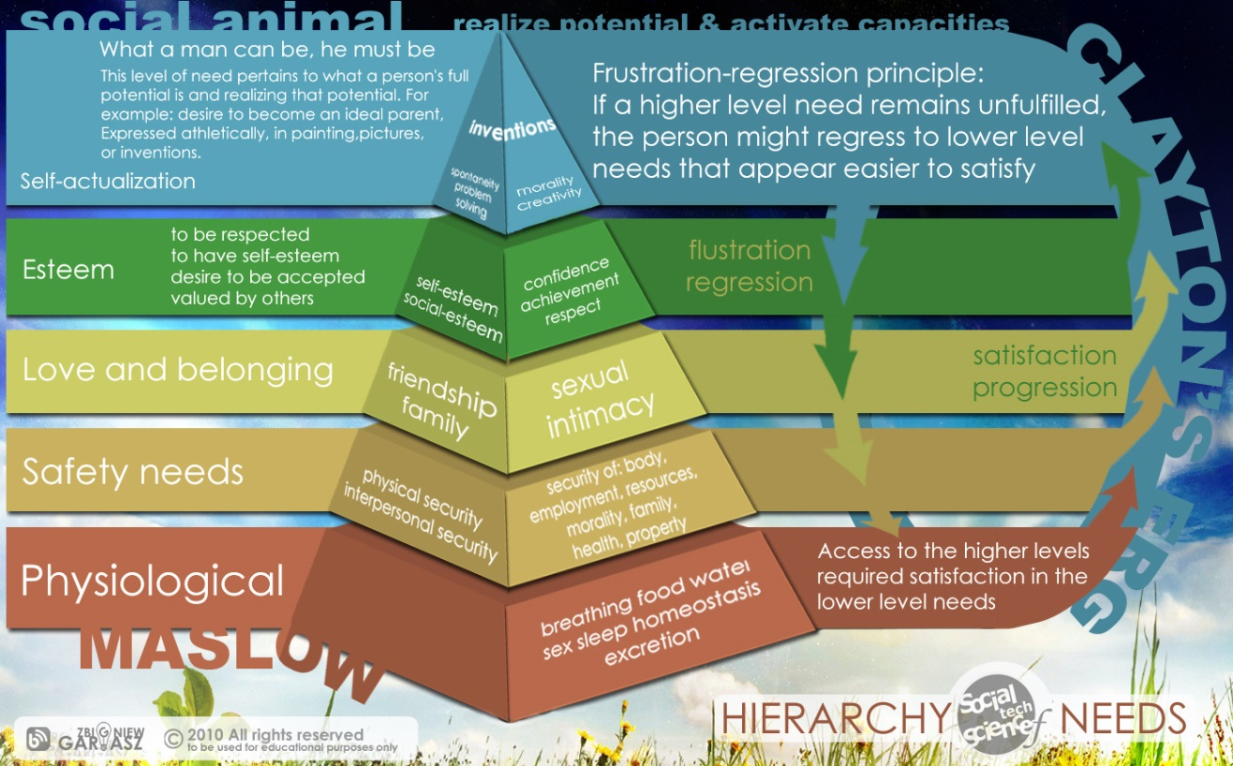

Slide 20


Slide 21


Slide 22


Slide 23
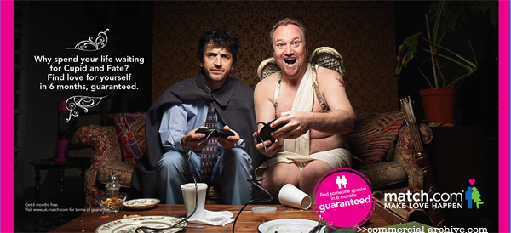

Slide 24
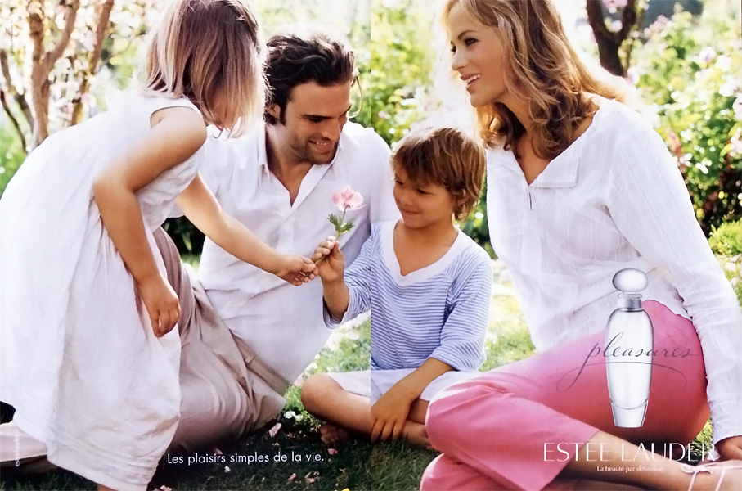

Slide 25


Slide 26


Slide 27
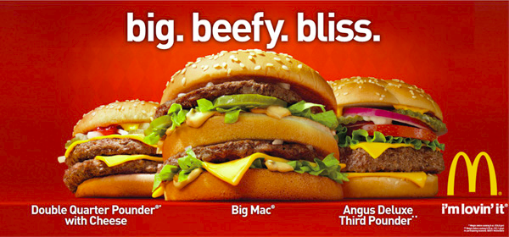

Slide 28
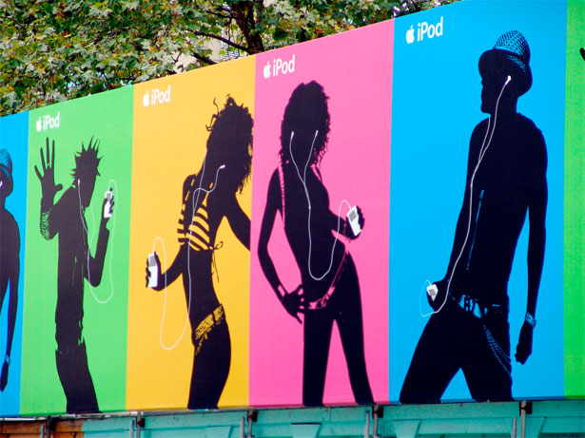

Slide 29
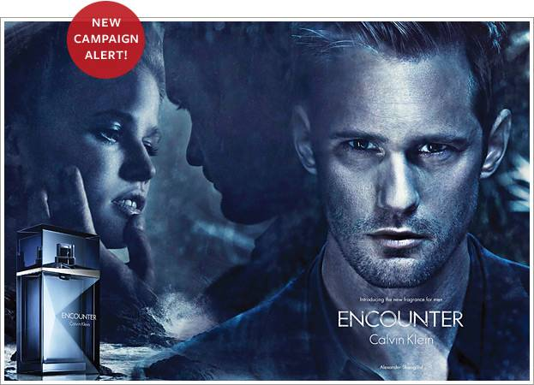

Slide 30
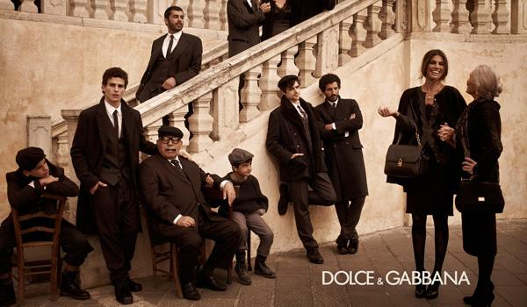

Slide 31


Slide 32


Slide 33
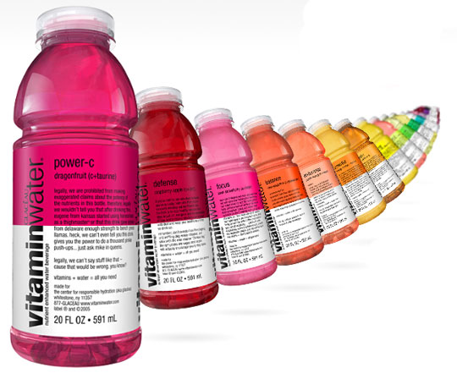

Slide 34


Slide 35


Slide 36
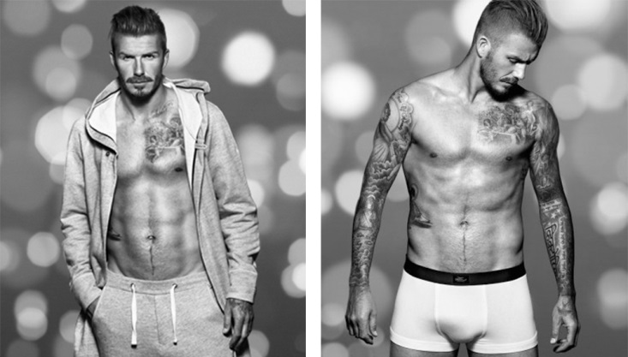

Slide 37
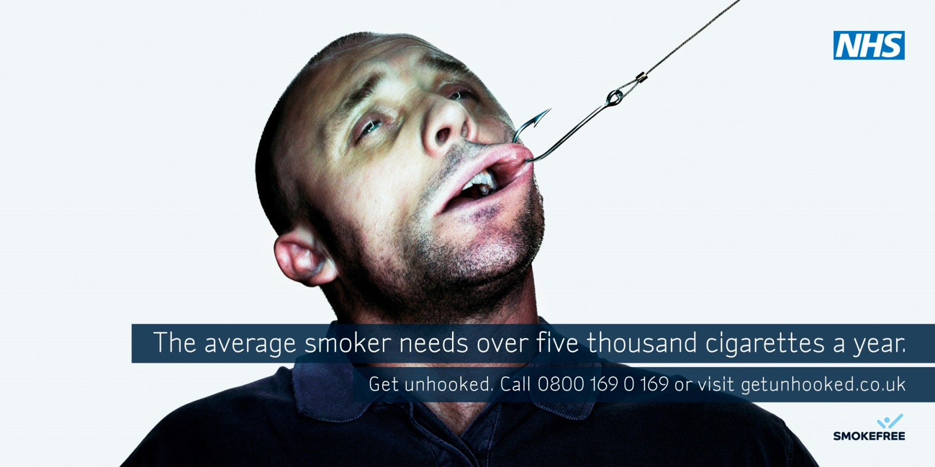

Slide 38


Slide 39
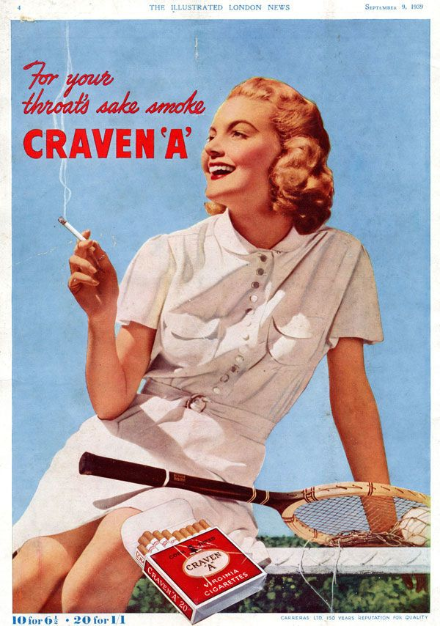
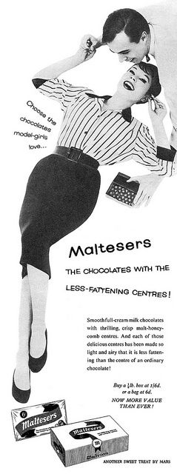

Slide 40
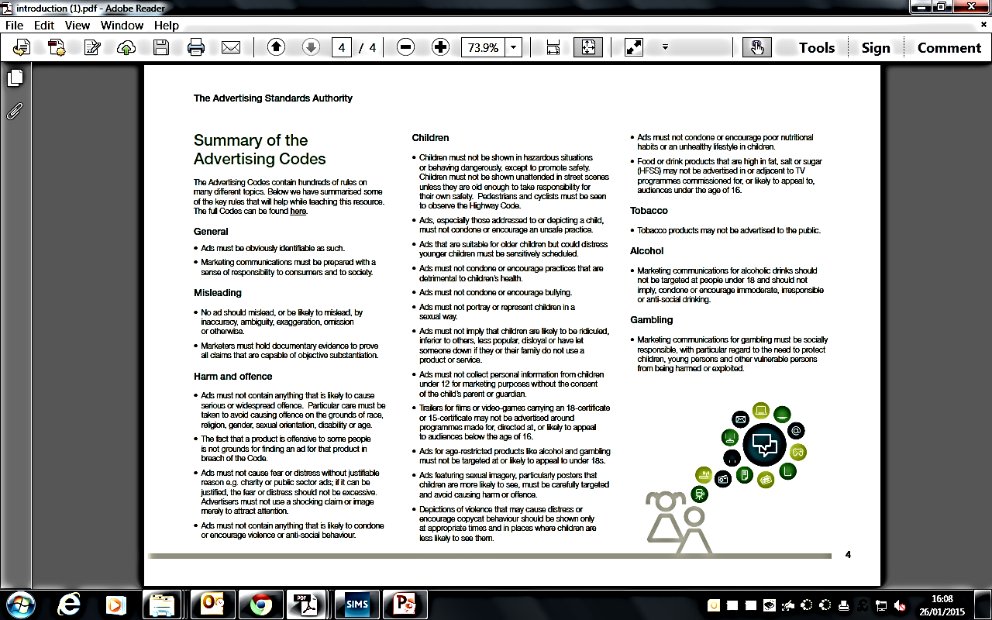

Slide 41
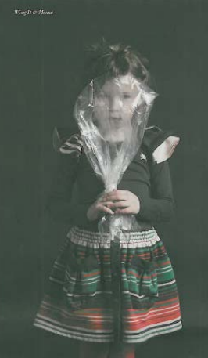

Slide 42
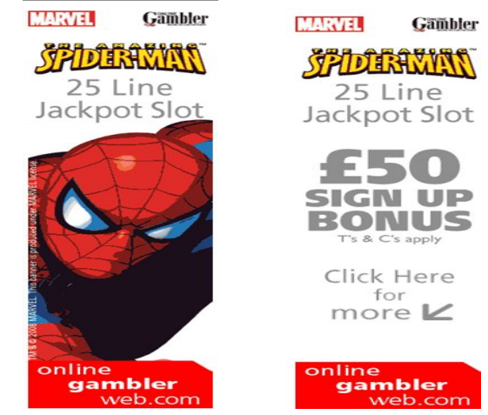

Slide 43
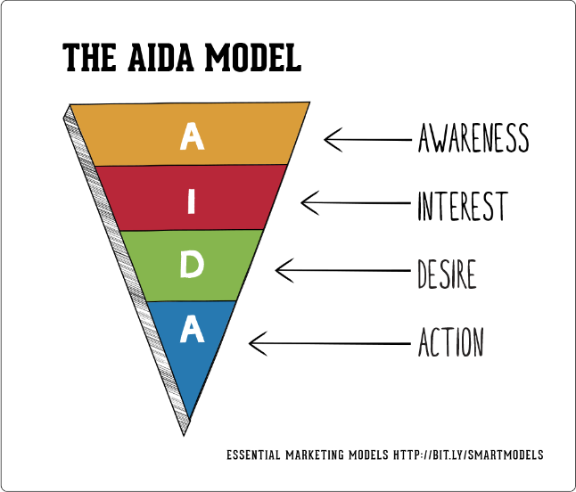

Slide 44


Slide 45
Set Adverts

Slide 46
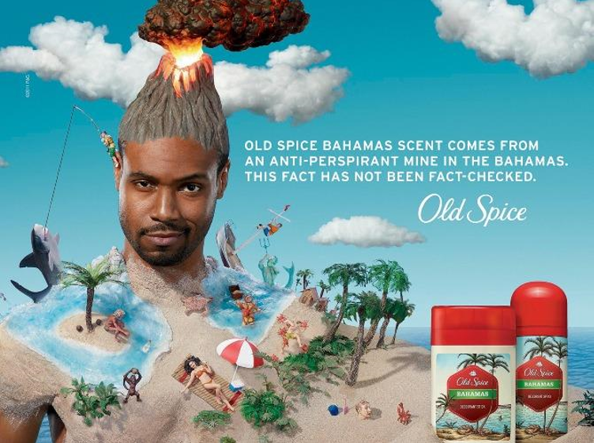

Slide 47


Slide 48
