Slide 1
Big Issue - set issue 2
Neighbours - 25th July 2022

Slide 2


Slide 3

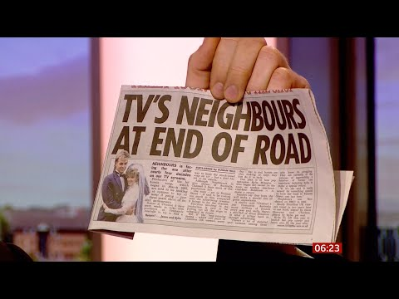
Neighbours

Slide 4
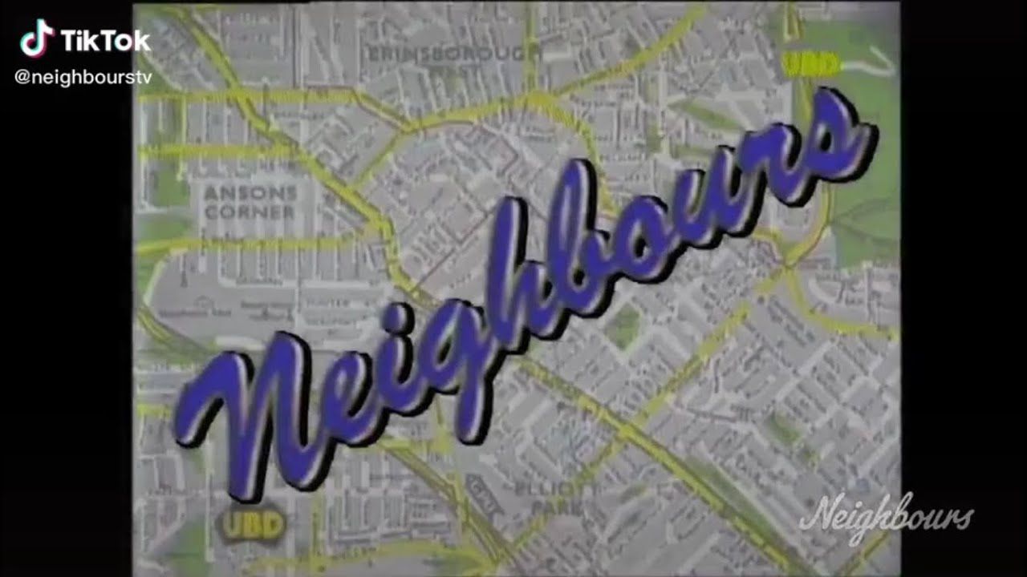
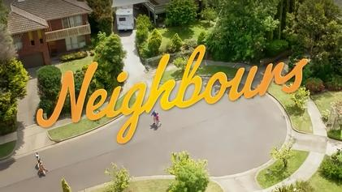

Font

Slide 5
Cultural impact…
https://www.insider.com/stars-who-started-on-neighbours-home-and-away-2017-9

Slide 6
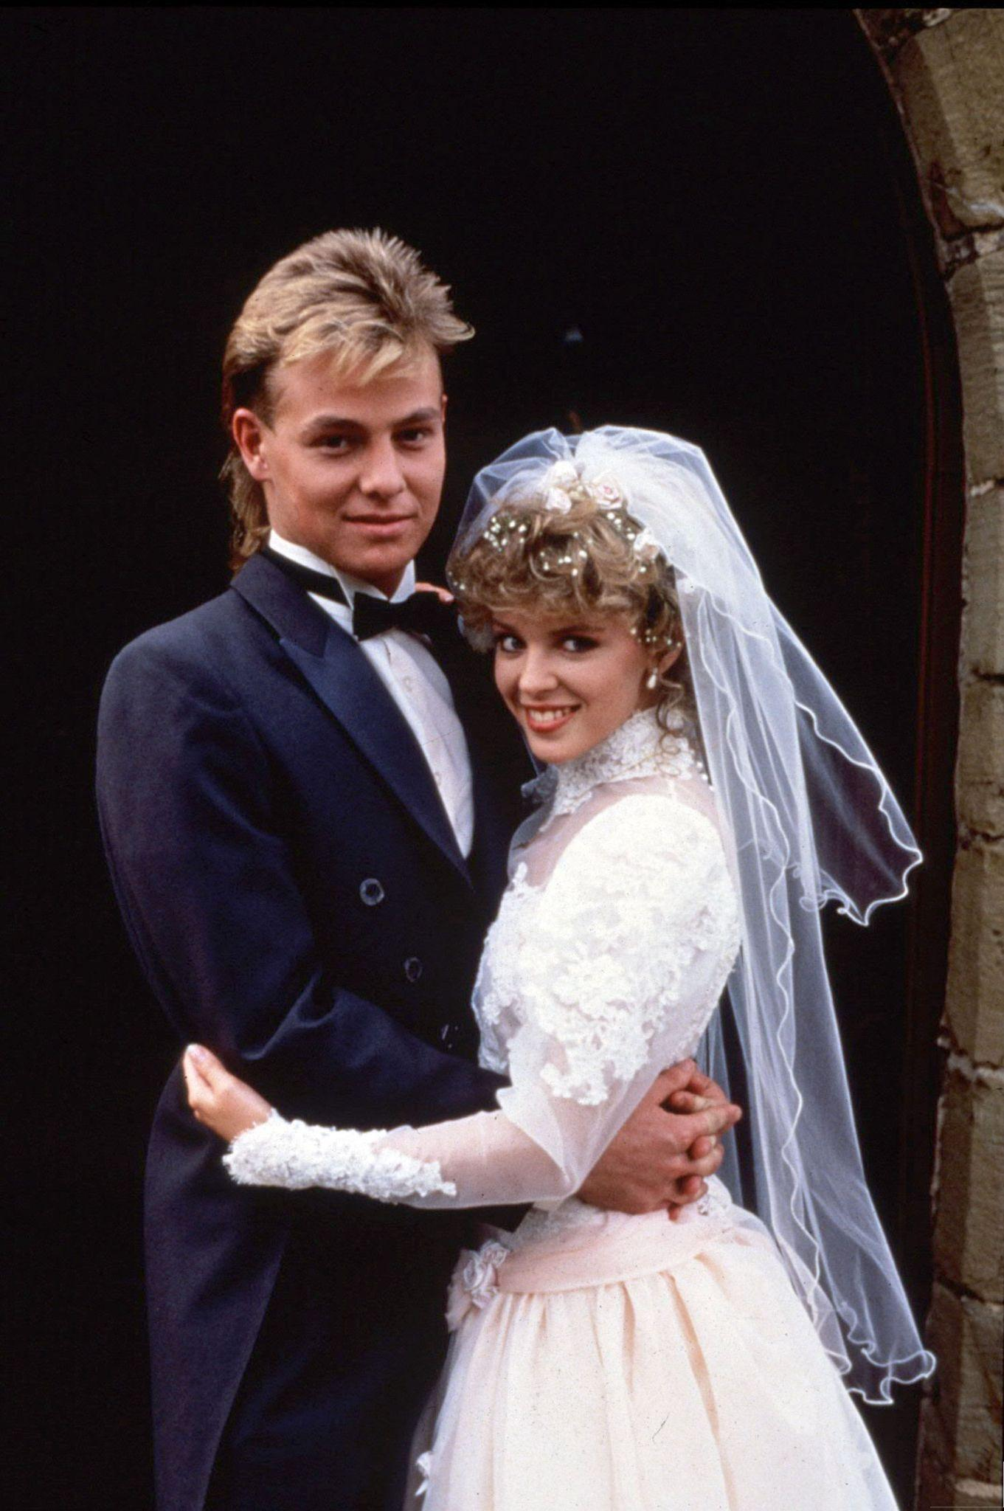
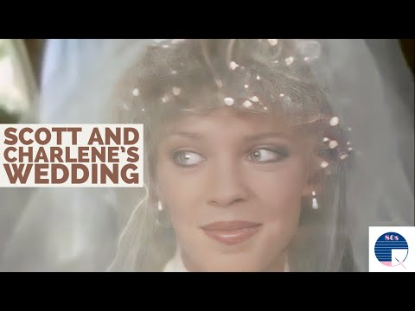
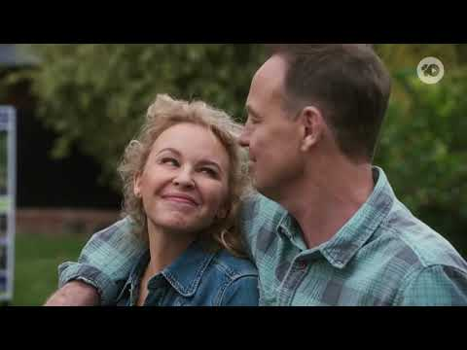
Scott and Charlene
https://en.wikipedia.org/wiki/Scott_%26_Charlene%27s_Wedding

Slide 7
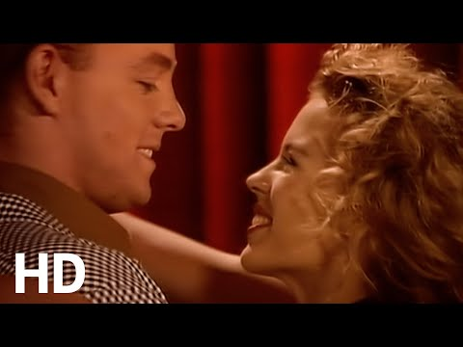
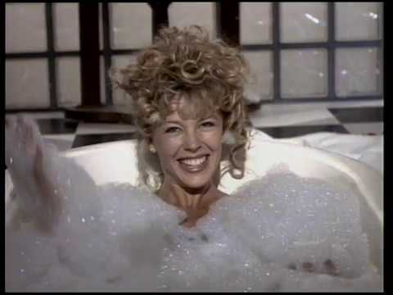
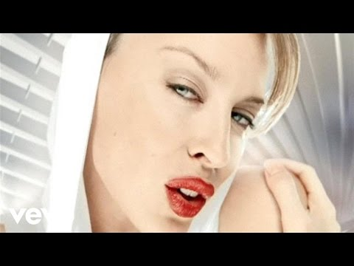
Kylie Minogue
https://en.wikipedia.org/wiki/Kylie_Minogue

Slide 8

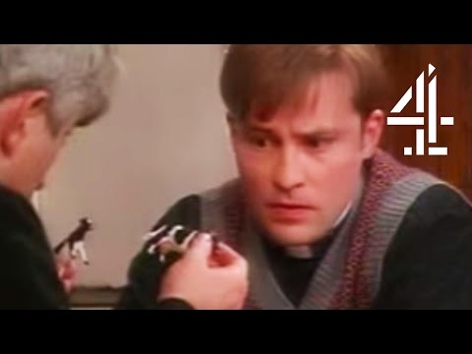
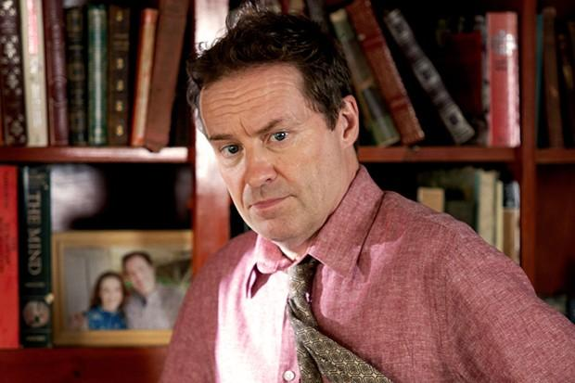
Ardal O’Hanlon
https://en.wikipedia.org/wiki/Ardal_O%27Hanlon

Slide 9
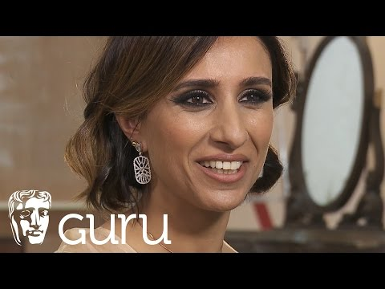
Anita Rani
https://en.wikipedia.org/wiki/Anita_Rani

Slide 10

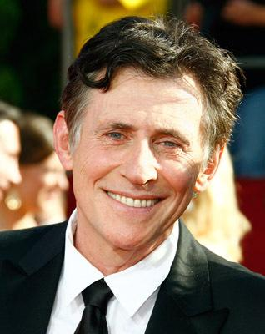
Gabriel Byrne and Leonard Cohen
https://www.imdb.com/name/nm0000321/?ref_=nv_sr_srsg_0

Slide 11

The sound of black holes…

