Slide 1
Big Issue - set issue 1
Michael Palin 15th August 2022

Slide 2
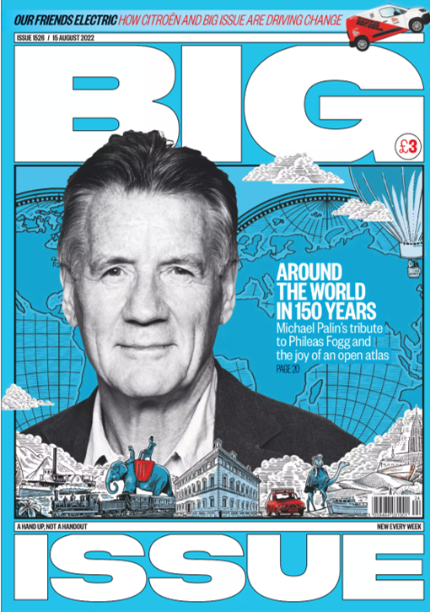

Slide 3

New design…
https://www.fipp.com/news/big-issue-undergoes-redesign-to-mark-30-years-of-publication/

Slide 4

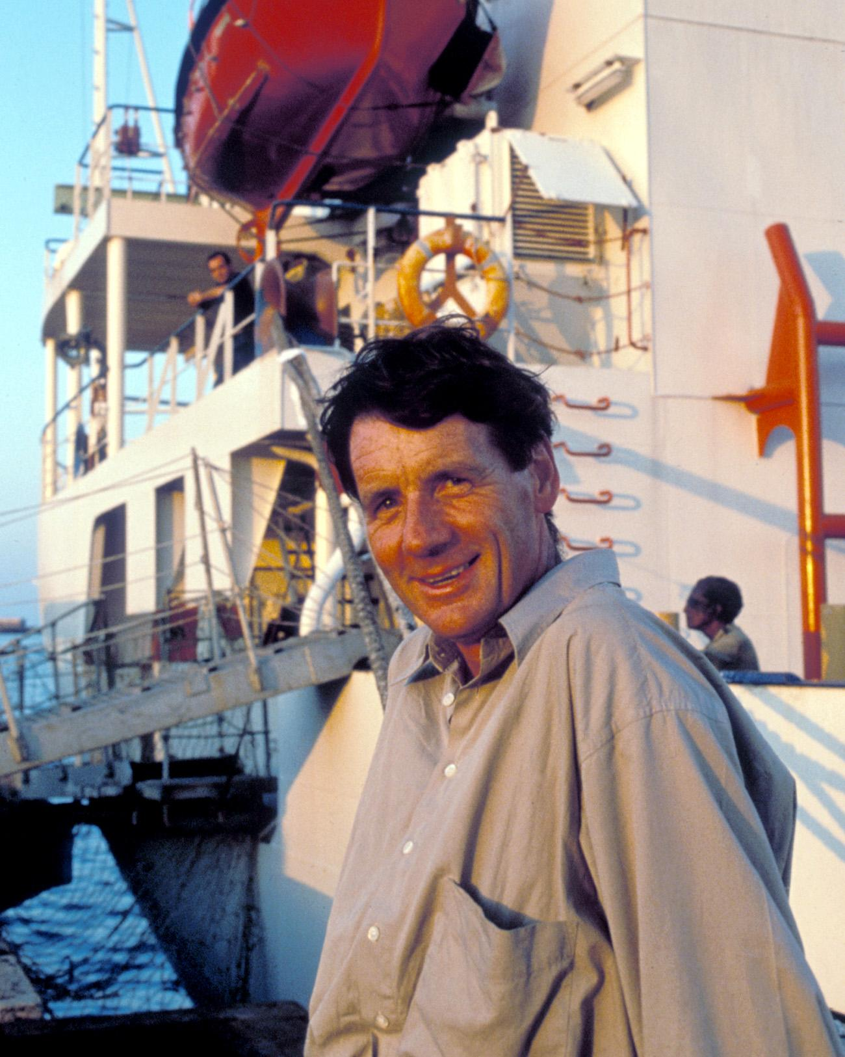
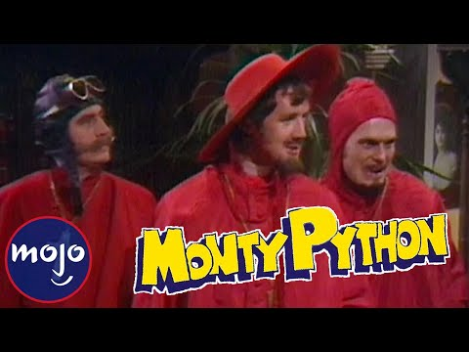

Sir Michael Palin
https://en.wikipedia.org/wiki/Michael_Palin

Slide 5


Sir Michael Palin - globetrotter
Around the World in 80 Days
Pole to Pole
Full Circle
Hemingway Adventure
Sahara
Himalaya
New Europe
Brazil
North Korea
Iraq

Slide 6




The novel:
Around the World in 80 Days
by Jules Verne
https://en.wikipedia.org/wiki/Around_the_World_in_Eighty_Days

Slide 7







Adapted… a lot!

Slide 8

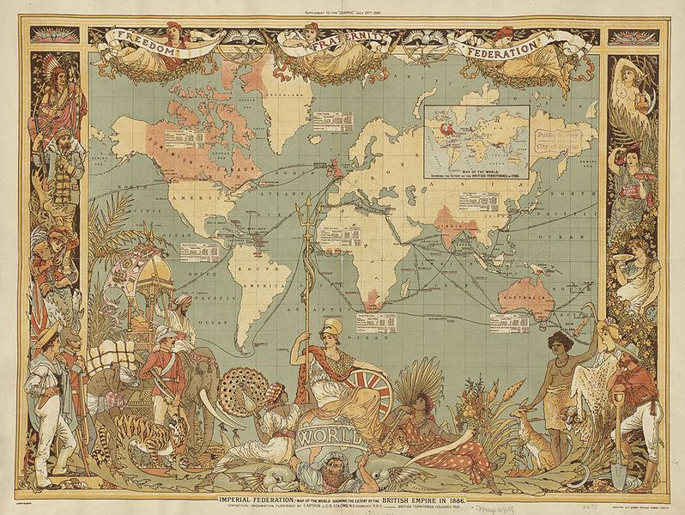

Lithography and old maps
https://en.wikipedia.org/wiki/Lithography

Slide 9
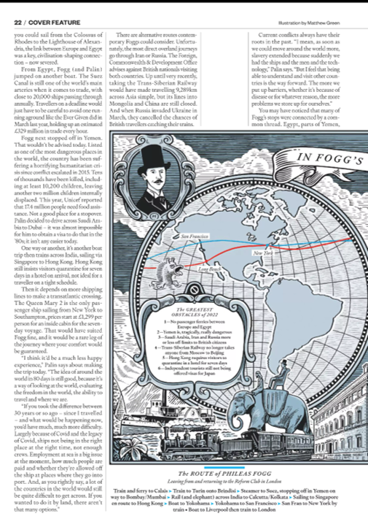
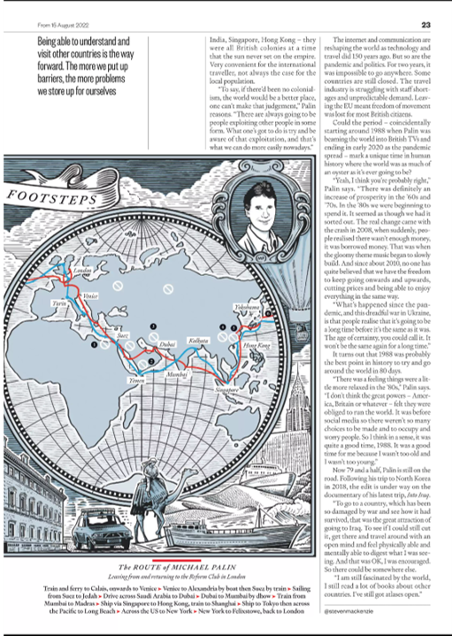

Slide 10

The Citrëon bit…

