Slide 1
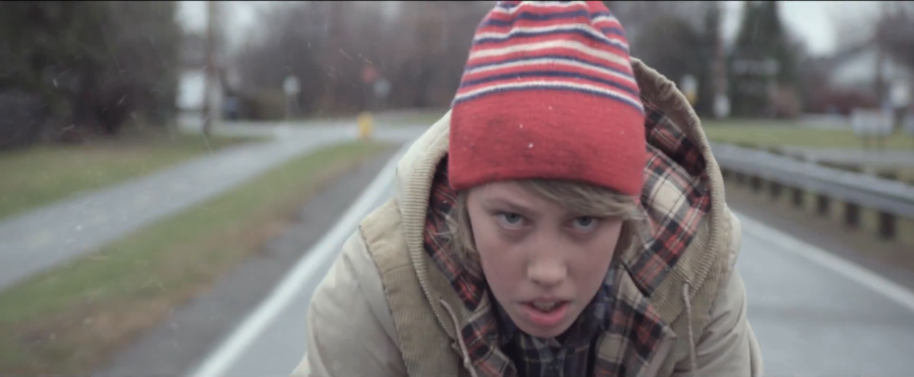
Postmodernism & Titanium

Slide 2
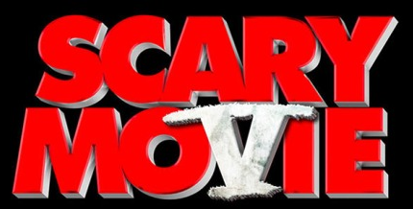
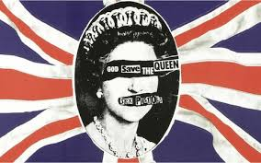
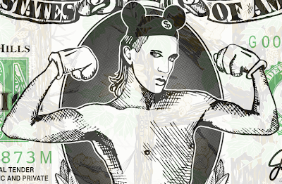
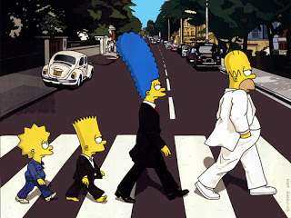
Lesson Starter #1.
Parody / Pastiche - a comical imitation, a simplification of core elements of a genre/text. It can be a light-hearted, tongue in cheek imitation of another’s style.
Bricolage - borrowing from the ‘debris’ of other texts to create something new
Intertextuality - meaning is given to a text by it referencing, knowingly, other texts

Slide 3
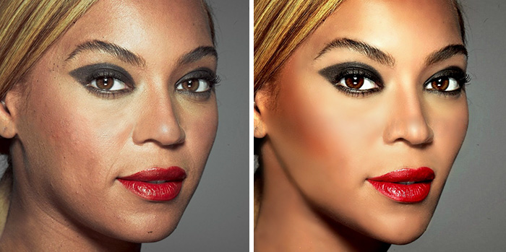
Lesson Starter #2. Jean Baudrillard - Hyper Reality
What is it? Use the images to help you create a definition.

Slide 4
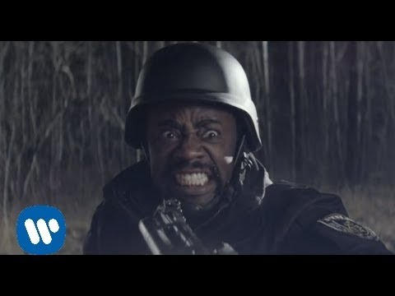
Task 1. Initial thoughts.
Watch the music video.
How could you argue Titanium is postmodern?
Are there any examples of intertextuality or bricolage?
Consider genre / films / tv shows / directors / characters
Feedback to create a class spider diagram

Slide 5
Bricolage from the Sci-fi genre
Quick 10 minute task. Research the repertoire of sci fi films / TV dramas.
What elements of the repertoire have been used in this music video in order to create something new?
Consider thematic and stylistic elements.
FEEDBACK

Slide 6
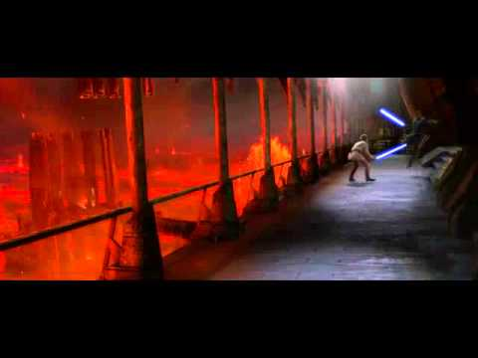
Stars Wars
The protagonist uses telekinesis to move the keys. Very reminiscent of the pose Anakin Skywalker/Darth Vader is famous for pulling.
Anakin turns to the Dark Side of course because he feels a) scared of losing his wife Padme, and b) misunderstood by the Jedi around him (for example when they refuse to grant him the rank of Master even though he's on the Jedi Council). It's really similar to the protagonist in the video - he is misunderstood and failed by the education establishment (made evident when the teacher shuts the door on him and presumably reports him to the police for whatever outburst of his caused the destruction we see at the start). A long shot that puts him right in the middle of the destroyed corridor, like he's lost in the mess.
Both characters are going on a similar, tragic journey, because the boy is effectively turning to the Dark Side.
First 30 seconds.

Slide 7
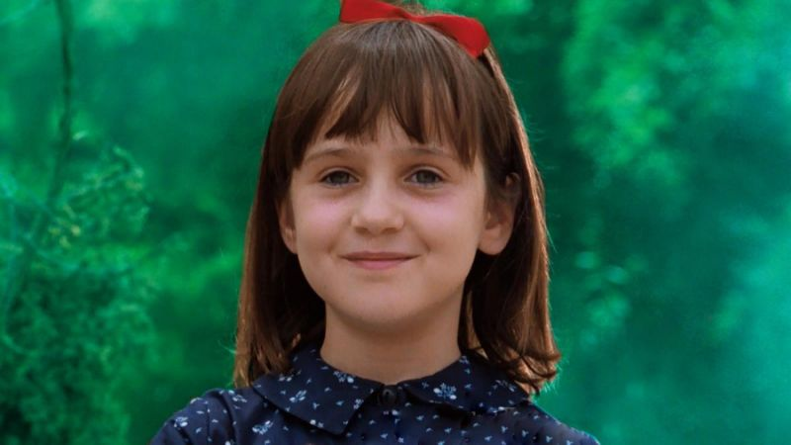
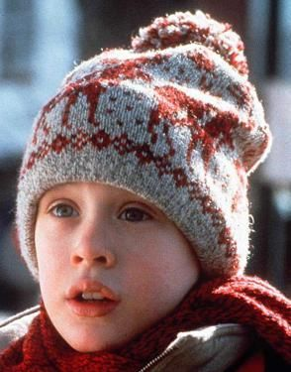
Titanium uses bricolage to other texts that have a narrative focus on children overcoming tragedy and adversity by believing in themselves.

Slide 8
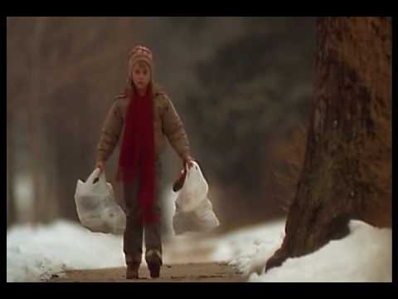
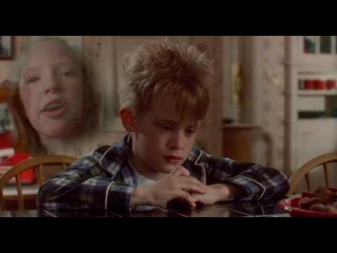
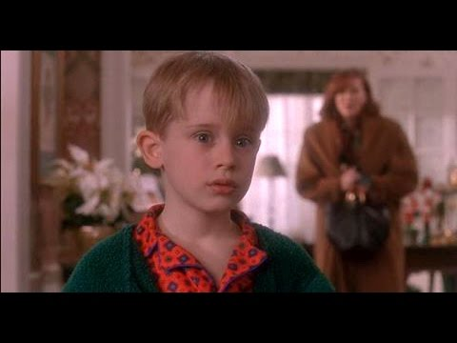
Reference to Kevin in Home Alone.
Stylistically the character looks like Kevin.
Thematic link - Kevin feels isolated from his family.
He is alone and fending for himself.
Triumph over tragedy - he defeats the burglars and manages to look after himself.

Slide 9
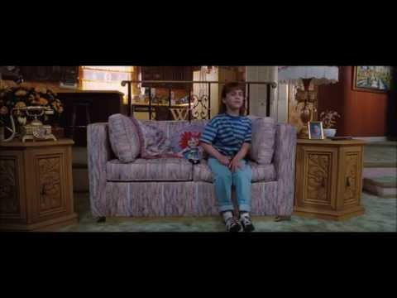
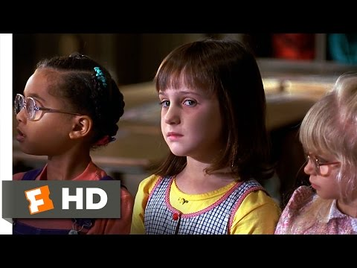
Reference to Matilda
Child isolated from her family. Made to be an outcast.
Uses her powers and ability to overcome tragedy.
Believes in herself.
Story of triumph over tragedy

Slide 10
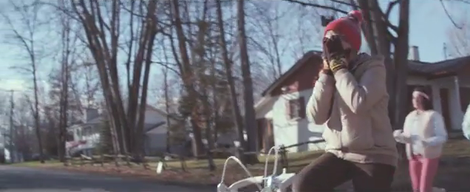
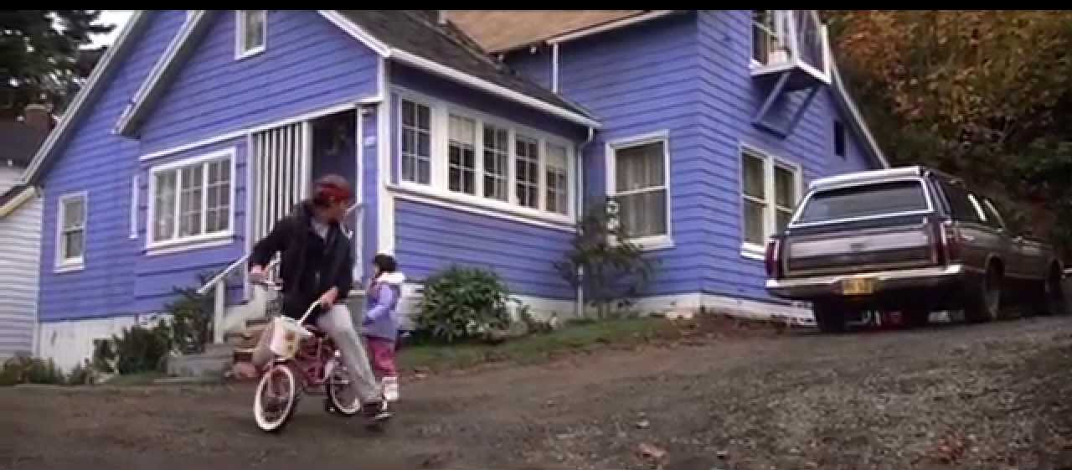
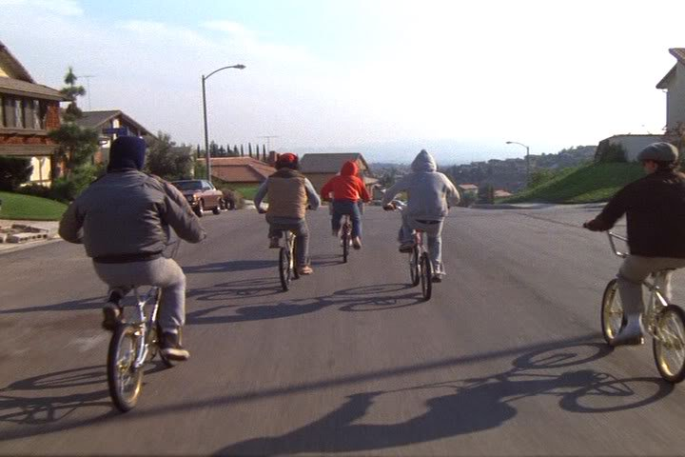
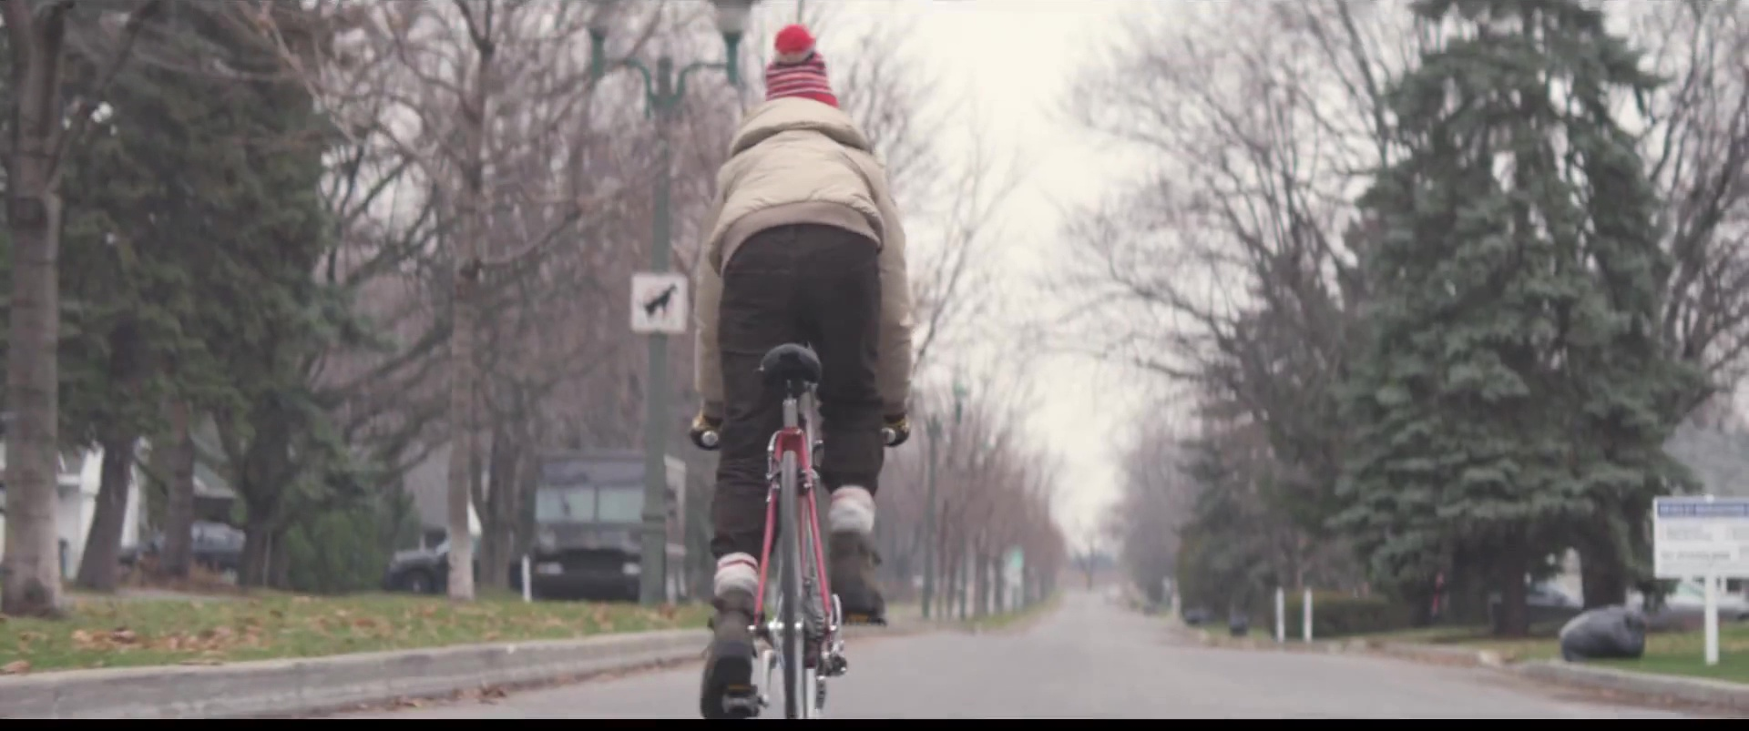
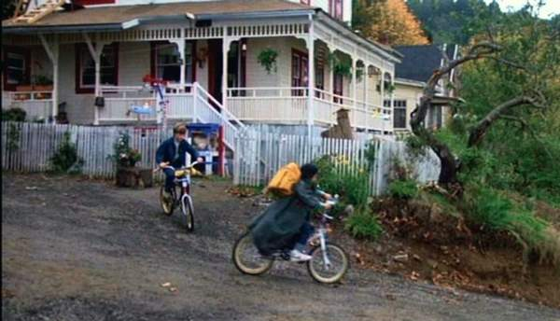
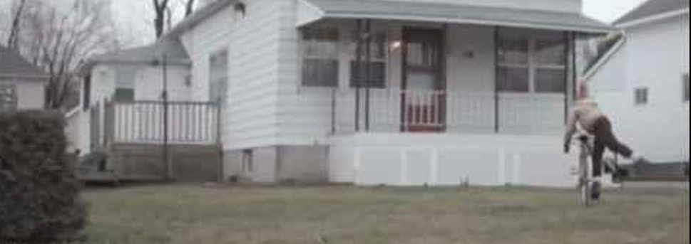
The cinephiliac recreation of Spielbergian 80s suburban America in Titanium
Cinephiliac - is the term used to refer to a passionate interest in films, film theory, and film criticism. The term is a portmanteau of the words cinema and philia, one of the four ancient Greek words for love.

Slide 11
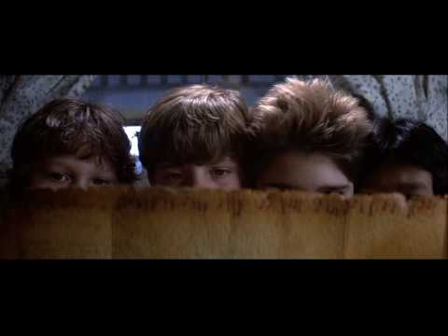
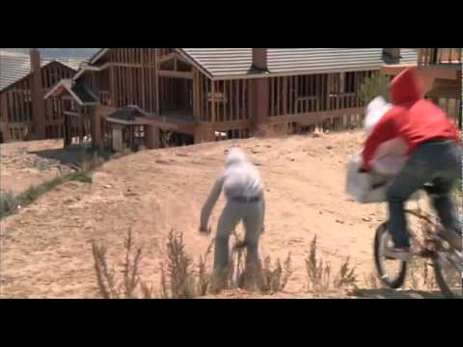
How is this achieved stylistically?
What stylistic elements of Spielberg's work are similar to Titanium?
Note at least 3 things on your whiteboards to share with the class.

Slide 12
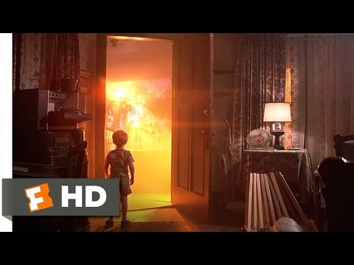
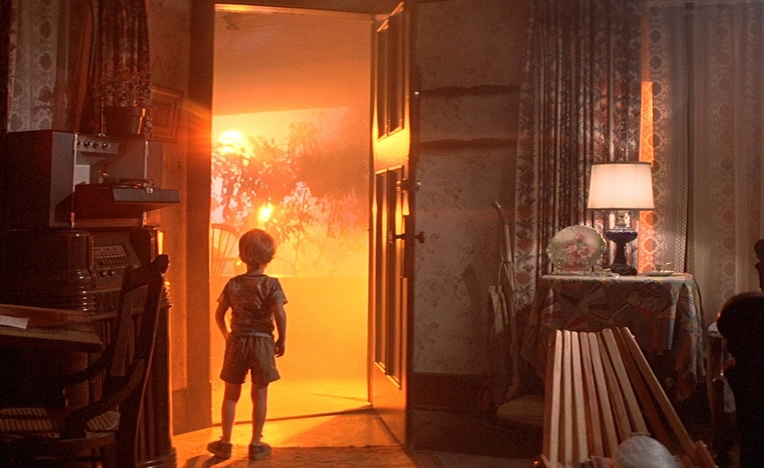
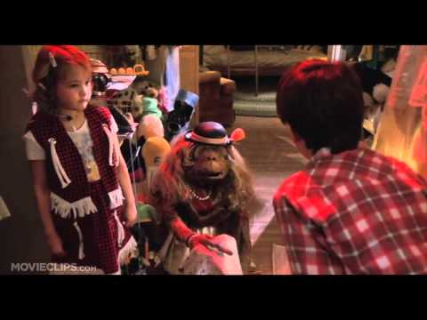
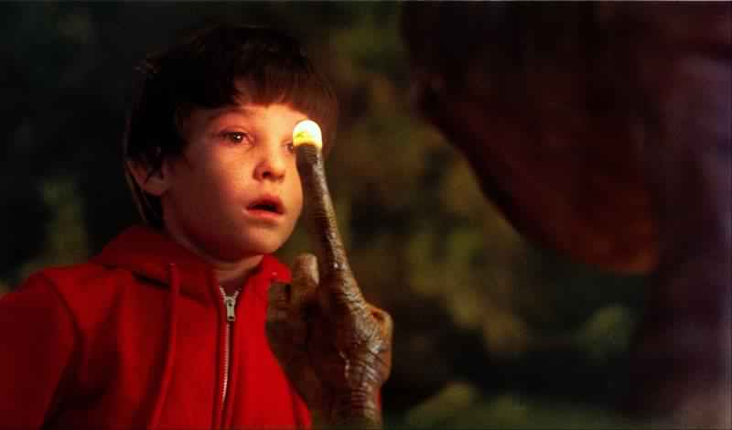
Why represent Spielbergian suburbia?
Dichotomous relationship between the familiar image of the family home and that of an unfamiliar presence.
It creates suburban disruption
The idea of the ‘family home’ being disrupted by something ‘other’.
How does this relate to Titanium?

Slide 13
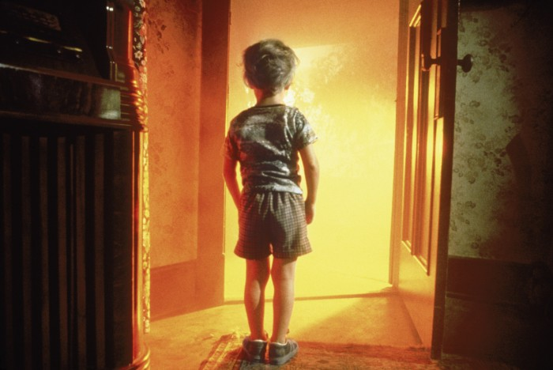
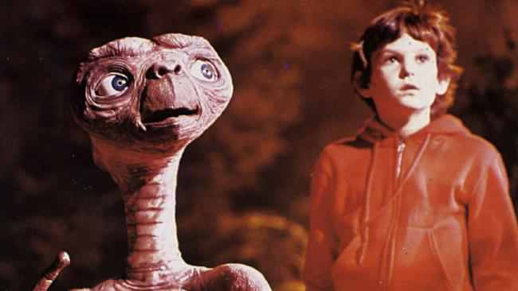
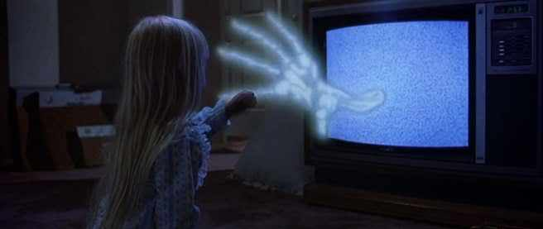
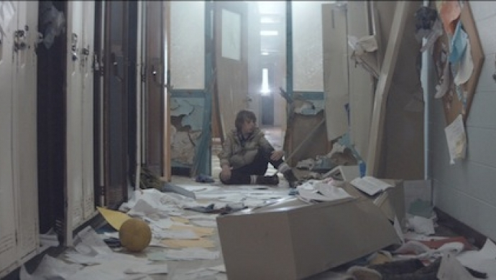
Spielberg's representation of the family
The nuclear, functional family is often torn apart.
Spielberg introduces the supernatural and extraterrestrial into domestic, suburban settings.
He comments on family breakdown: absent mothers / fathers and feelings of abandonment.
Children that feel alone and isolated.
How does this relate to Titanium?

Slide 14
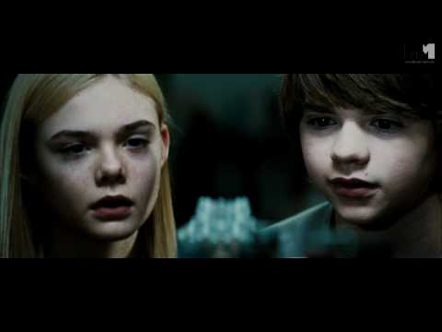
Ryan Lee (actor) from Super 8 (2011) (produced by Steven Spielberg)
During the summer of 1979, a group of friends witness a train crash and investigate subsequent unexplained events in their small town.
Why use Ryan Lee in the video?

Slide 15
Offering a commentary on nostalgia?
A lot of contemporary media texts offer references to the 1980’s…….why?
“Ah, the good old days. Remember those? That's the time when just about everything was better than it is today: music, movies, food, the environment, people, culture, life generally. We didn't have the imminent destruction of the planet looming over our heads, caused by the excesses of modern living. We didn't have to worry about greedy corporations poisoning our food supply, hoarding all our wealth, and dumbing down our culture. Government was kinder and gentler, with leaders that we respected and admired. Family values weren't under constant threat, as they are today. People led happier lives, untainted by the decay brought on by today's societal ills.” (the armchair skeptic .com)
Armchair nostalgia - making the 1980’s seem idealistic for people who didn’t live through it - for millennials. A time before social media and digital technologies dominated the landscape.
What is the video suggesting about nostalgia? Is it trying to romanticse the 1980’s or it is suggesting we should be skeptical of nostalgia? How does the homage to Spielberg fit with this?

Slide 16
Task
How does Titanium offer a cinephiliac recreation of Spielbergian 80s America? Refer to the stylistic and thematic.
Pick out key shots and aspects of the camerawork and mise-en-scene to support your points.
Can you find similar shots from some of his 1980s films?

