Slide 1
Regulation of the press

Slide 2
From the syllabus
The impact of the regulatory framework on the newspaper industry
Impact of online news, and social and participatory media on regulation

Slide 3
The regulatory framework
How it works
Its impact on the newspaper industry
How online, social and participatory media has impacted on regulation

Slide 4
Press freedom
The UK operates as a democracy
A cornerstone of any democracy is a free press, who are free to report stories that criticise those in power and hold them to account
Traditionally the UK Press is known for standing up for those without power and constantly checking on the behaviour of those who do have power.
https://www.youtube.com/watch?v=f6LKl4RKIew&t=191s (Crash Course)
https://youtu.be/dyK5NZIm1X4 (Channel 4)

Slide 5
Self-regulation
Any statutory (legal) restrictions on press reporting are considered contrary to this principle
Press regulation in the UK is post-publication and operates voluntarily, as opposed to being enshrined in law.
So rather than be statutorily censored, the UK press follows a system of robust self-regulation

Slide 6

The regulatory framework
https://hackinginquiry.org/
Since 2007 when the phone-hacking scandal came to light, newspapers and the regulator have come under intense scrutiny and have faced a loss of public confidence
https://www.theguardian.com/media/2012/nov/28/leveson-inquiry-press-police-politicians
Despite the Leveson Enquiry’s recommendation in 2014 that press regulation should be underpinned by the law, the press and IPSO have stood firm against this and to date, press regulation is entirely independent from government/ statutory influence.

Slide 7
The legal framework
All reporting must remain within the law of the land however
Laws in regard to libel and slander, privacy, injunctions, contempt of court and clandestine devices must be followed
Over time newspapers have become more responsible in the light of stricter sanctions, court cases against them, public distaste of sensationalised and invasive reporting, phone-hacking etc

Slide 8
The Regulatory framework
Media regulation is about the enforcing of certain rules in order to maintain standards, protect the public and to ensure material published is within the law.
The newspaper industry has its own ‘Editor’s Code of Practice’ that all journalists are expected to follow, online and in print.
Over 90% of all the UKs national, regional and local newspapers and magazines are voluntarily signed up to regulated by IPSO (Independent Press Standards Organisation)

Slide 9
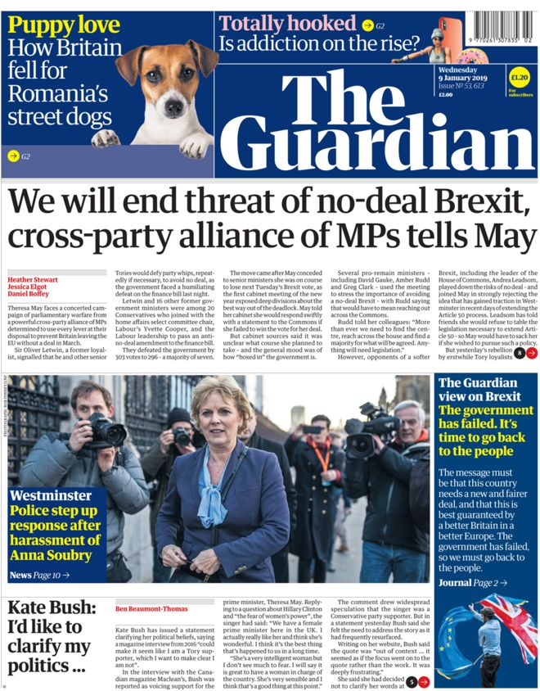
The regulatory framework
IPSO is responsible for maintaining journalistic standards and good practice in the industry
IPSO also investigates complaints about breaches of the Editor's Code of Practice.
Anyone can complain and IPSO will investigate
IPSO also provides low-cost arbitration for the public (from May 2018)
The Guardian, Observer, FT and Evening Standard have not signed up to IPSO

Slide 10


Complaints
Complaints generally focus on inaccurate reporting, invasion of privacy, intrusion into grief and shock
Complaints are usually resolved fairly quickly between the editor and the complainant, with IPSO providing mediation
IPSO will sometimes need to make a judgement and issue a ruling
Most complaints are not upheld

Slide 11
Complaints
Where they are upheld, the newspaper will be required to publish a correction or an apology, or remove the article from their website.
Newspapers have a strong image to uphold (family values, reporters of ‘truth’, trustworthy quality reporting etc) and are highly motivated to follow the code, and avoid negative publicity
Taste (offensiveness) is considered subjective and is not something that IPSO regulate for
https://tabloidcorrections.wordpress.com/

Slide 12

Regulatory framework online
The Editor’s code was adapted in 2009 in order to cover newspapers online as well as in print
Today, both print and online newspapers are regulated by IPSO
All blogs, tweets, comments by professional journalists working for an IPSO newspaper are also covered

Slide 13
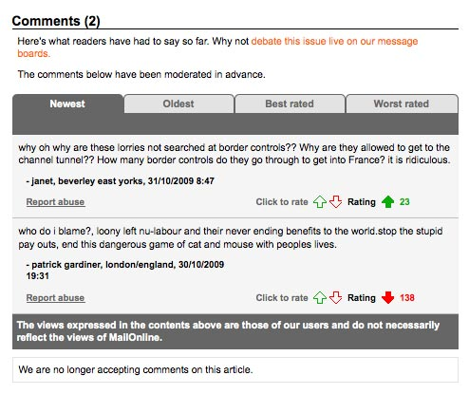
Regulatory framework online
User generated comments are covered on all sites that are pre-moderated by the newspaper
But they are not covered if they have been shared and complained about from another website
Citizen journalist content (eye witness accounts, phone video footage etc) is covered if used on a professional newspaper site
Enforcing the regulatory framework online is more of a challenge than in print

Slide 14
Regulatory framework online
Under the traditional regulatory framework, newspapers are responsible for the comments/reactions to stories posted by their readers
Newspapers have had to adapt to this and create internal codes of conduct to encourage readers to post and comment responsibly
Their social media teams are responsible for heavily moderating comments to avoid complaints to IPSO (hate crime, libel etc)

Slide 15
Regulatory framework online
This is a tricky balancing act
Readers like to comment, express opinions, interact with other users
Comments pages provide an important social function – they inspire debate and discussion
Free speech is all about being able to express an opinion that other people don’t want to hear

Slide 16
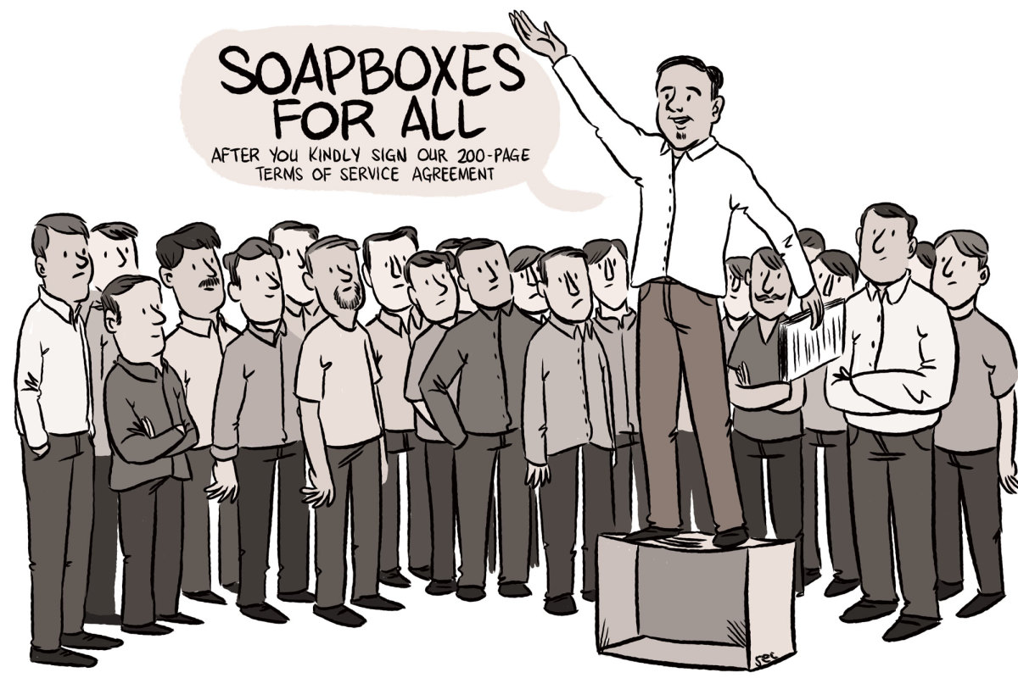
Regulatory framework online
But free speech is not an automatic right
If your free speech invades someone else’s privacy/incites hatred/libels someone or is offensive to the values the newspaper upholds then the newspaper have the right to censor your comments ie remove them
This curtails free speech but is a necessary part of newspaper’s self-regulation

Slide 17
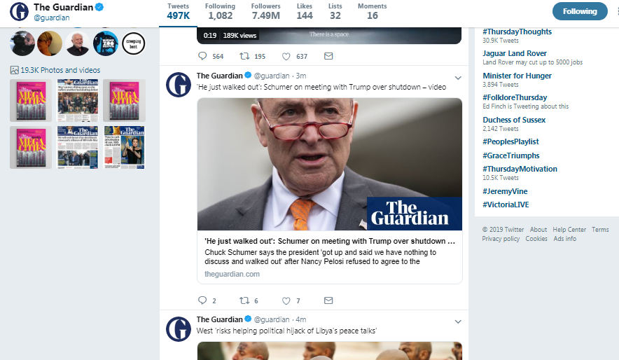
Regulatory framework online
Also a story or comment can be re-tweeted and can go globally viral instantly
Once an article has been shared, if the content is misleading, inaccurate or invasive the ‘damage’ to the victim has already been done, even if article, comment or tweet is then removed

Slide 18
Regulatory framework online
So regulating news online is fraught with difficulty and traditional regulatory approaches have limited effectiveness online
Although laws apply in practice the internet is difficult to police
The major online newspapers usually have a global presence as well as national. IPSO’s jurisdiction and the Editor’s Code is arguably only applicable on UK specific content

Slide 19
Regulatory framework online
News means something different today in the online age
News is a fast-moving medium. Online news is instantaneous, the news agenda shifts constantly and stories are constantly updating
News can be gathered and shared by anyone
Social media users don’t always consider what is legal or factual before posting or re-tweeting
IPSO is an industry regulator NOT an audience regulator

Slide 20
Regulatory framework online
The public are required to be responsible, to ‘self-regulate’ and follow the law of the land in the virtual world, as well as in the real world.
Social media users don’t always know the law, ignore it, don’t think it applies to them or assume that ‘free speech’ is an automatic right
Consumers source news from a range of different sites such as blogs, many unregulated (bloggers are not ‘the press’ so don’t come under IPSO’s remit)
https://www.theguardian.com/law/2014/jun/13/jail-someone-for-being-offensive-twitter-facebook

Slide 21
Impact
The rise of citizen journalism and fake news has left the public confused about who or what to trust
Audiences have less trust in professional news agencies today as a result
This is somewhat ironic as fake news is being generated by non-journalists as a disruptive tool for political reasons
https://www.youtube.com/watch?v=1aTApGWVGoI (fake news)
https://www.youtube.com/watch?v=UQcCIzjz9_s (TED)

Slide 22

Fake news
Regulation of fake news - a ‘by-’product’ of the freedom of the internet - has largely been left to the major tech companies (eg Facebook, Google) who until recently have done little to attempt to regulate content
The major newspaper brands have used the problem of fake news to reassure readers that the professionally driven, trusted brands are the best way to receive news
Paradoxically this reinforces the power and control of the major conglomerates (Curran and Seaton)

