Slide 1
Representation through Media Language
Look at the following images - analyse how representation is constructed. Focus particularly on the camera shot and angle and mise-en-scene (everything in frame) that gives us clues about how audiences should read the text.

Slide 2
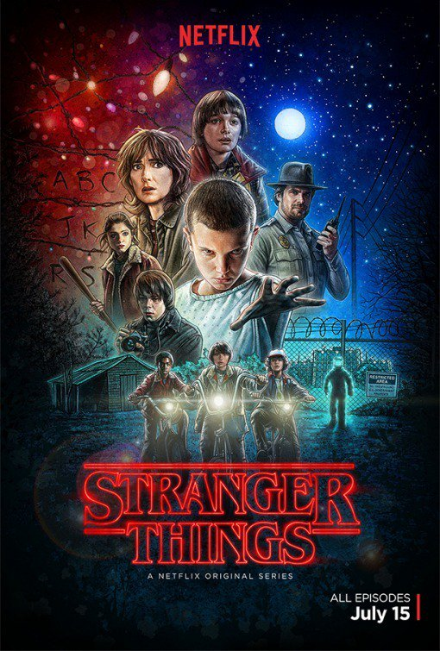
Annotate to highlight representations

Slide 3
CAMERA SHOTS AND ANGLES
The following shots are taken from episode 1, series 1, of Stranger Things.
Analyse the effects created by each image. Whilst you cannot see the sound and editing, try to remember what is happening in each scene.
We need to look at:
  Cinematography
  Editing
  Sound
  Mise-en-scene

Slide 4
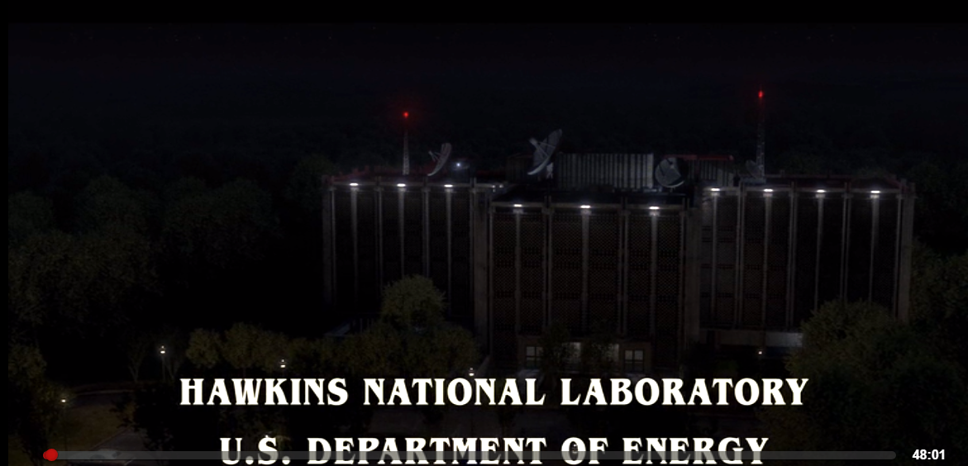
EXTREME LONG SHOT
The opening shot to stranger things is full of signs, symbols and codes.
The radars pointing to starts indicate sci-fi genre with red beacons foreshadowing danger.
The use of words ‘national’ and ‘U.S’ gives us sense of place.
Connotation of energy include power.
The building is surrounded (cut off) by woods.
XLS are often used to set the scene
They place the viewer into the drama straight away - text gives away clues (action codes) about what to expect and also shows mystery (enigma codes) about what might happen.

Slide 5
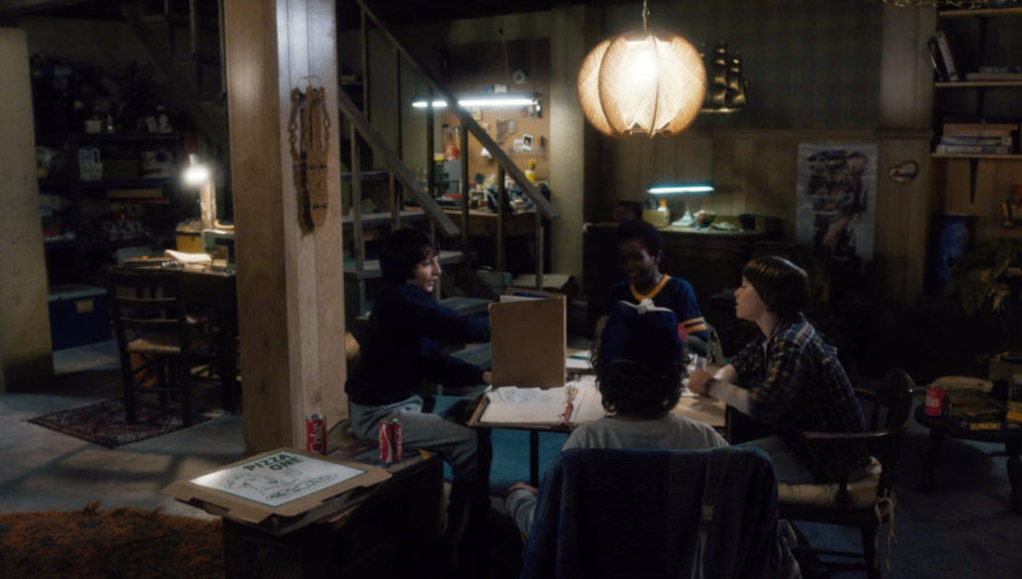
LONG SHOT
Is often used to set the scene in LFTV
Expectations are being built and key characters introduced. Remember, LFTV focus on characterisation rather than plot so it’s not uncommon to have lots of micro-openings within an episode.
Who? What? Where? Audiences are given clues about characters and their surrounding from the use of Long Shots.

Slide 6
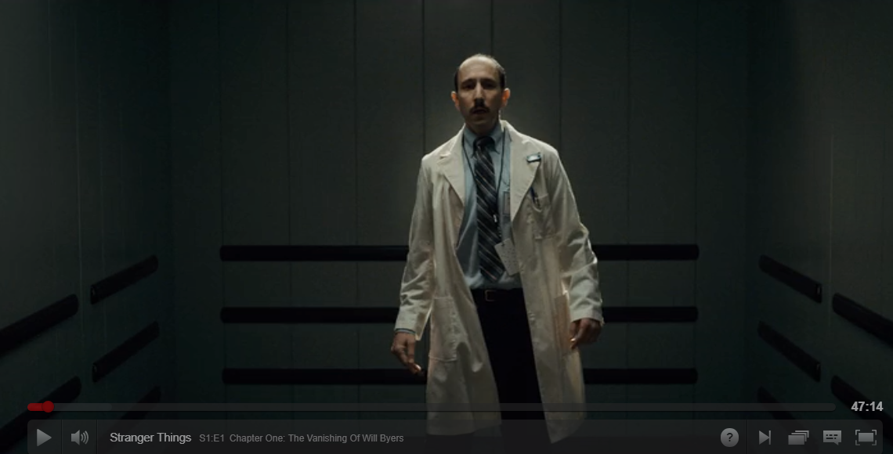
Medium Long Shot
How is the scientist represented?
Tips: why is he off center? Do all scientists look like this or is this a stereotype (think about his role in the whole episode).
What is the effect of this shot?

Slide 7
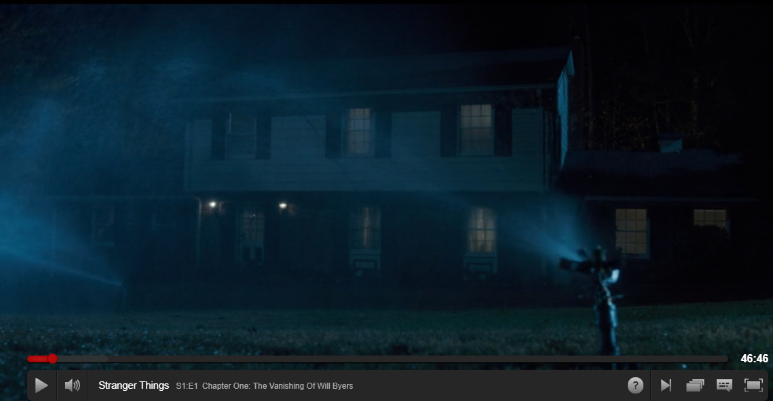
Wide Shot
How does this shot represent American Culture?
What stereotypes are used here?

Slide 8
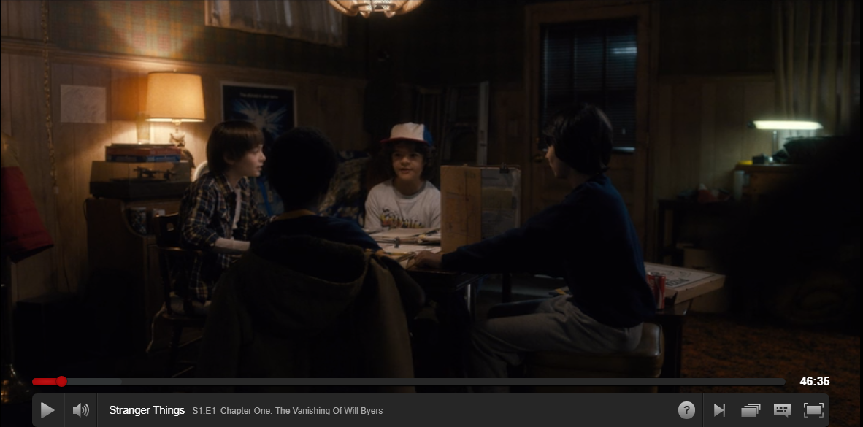
Long Shot
Analyse and explain how you reached conclusions.
Hint: Think about binary opposites, Mike and Will occupy opposite spaces, one is lit the other is dark (foreshadowing upside down versus reality).
How are Will and Mike represented in this scene?

Slide 9
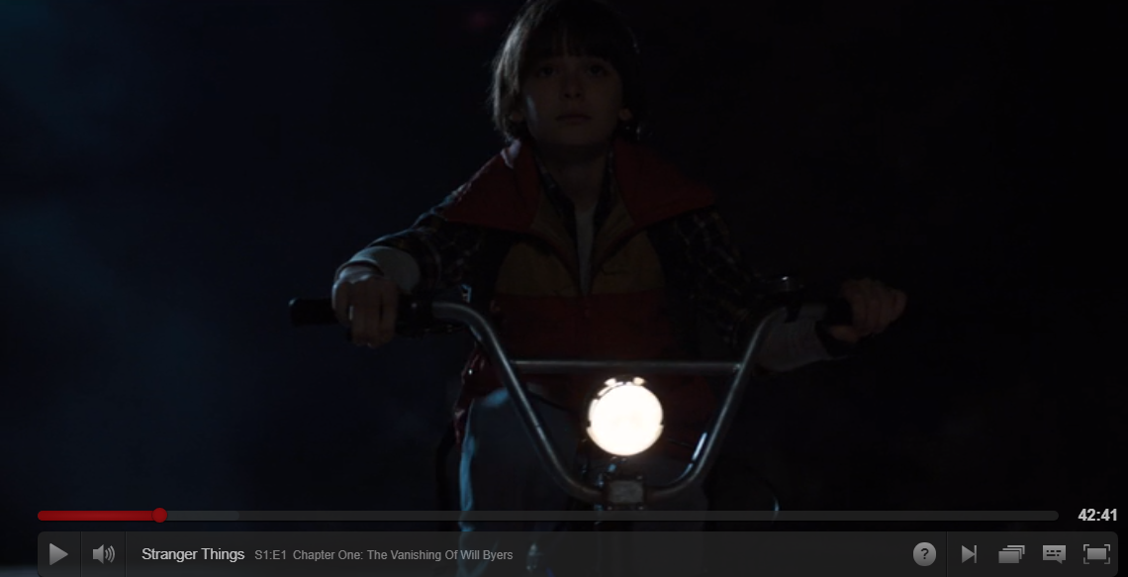
Shot type:
How are the audience to respond (read the text)? Consider Hall.
How is character represented?

Slide 10
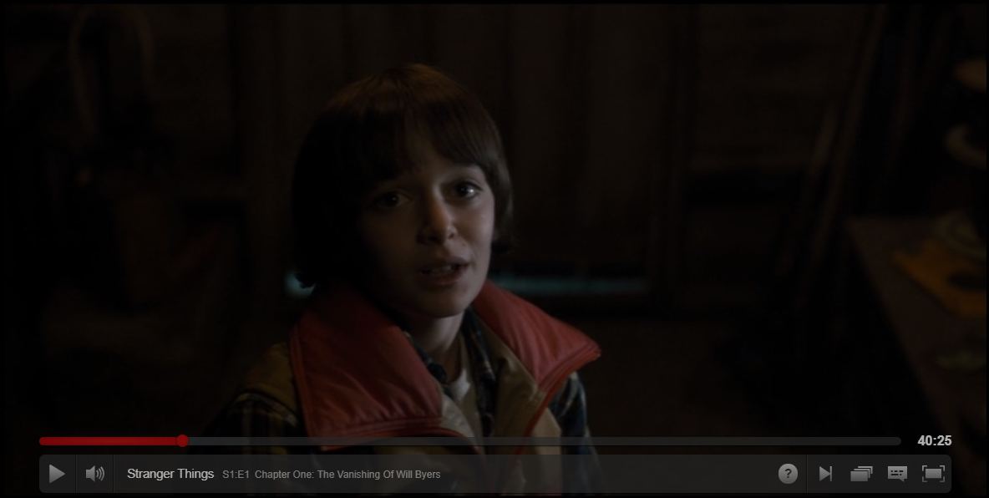
Shot type:
How are the audience to respond (read the text)? Consider Hall.
How is character represented?

Slide 11
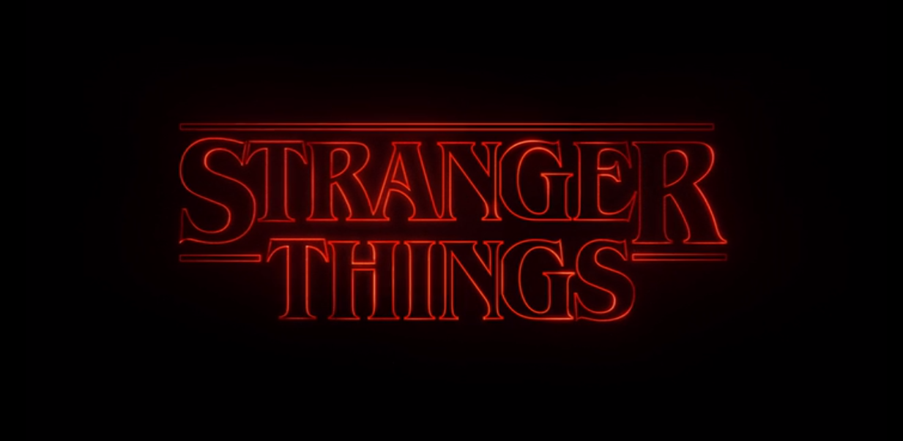
Shot type:
How are the audience to respond (read the text)? Consider Hall.
What ideas and messages are represented here?
Hint: think about intertextuality...

Slide 12
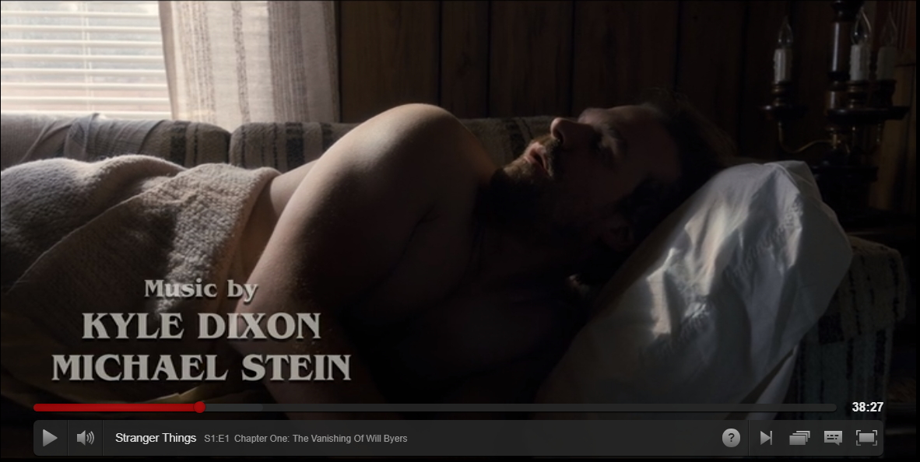
Shot type:
How are the audience to respond (read the text)? Consider Hall.
How is character represented?

Slide 13
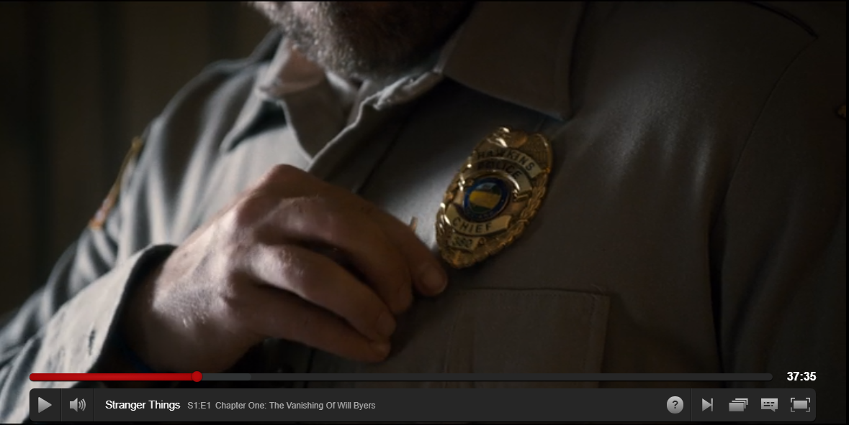
Shot type:
How are the audience to respond (read the text)? Consider Hall.
How is character represented?
Why is this shot significant?

Slide 14
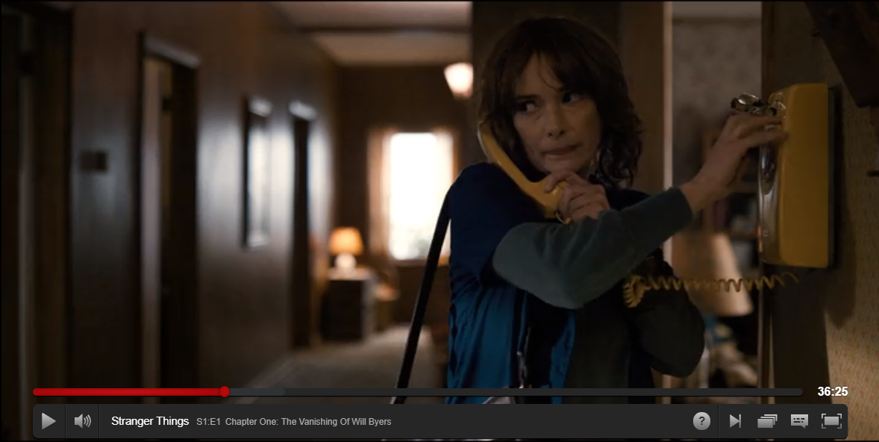
Shot type:
How are the audience to respond (read the text)? Consider Hall.
How is character represented?
Focus on the colour of home in other shots.

Slide 15
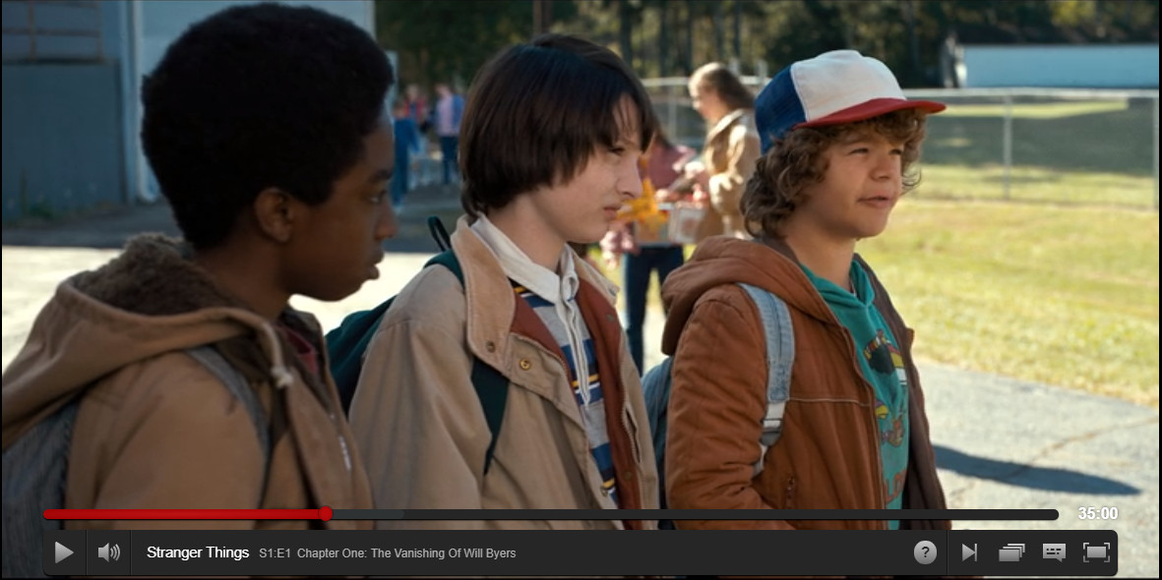
Shot type:
How are the audience to respond (read the text)? Consider Hall.
How is character represented?
Hint. why is Mike in middle?

Slide 16
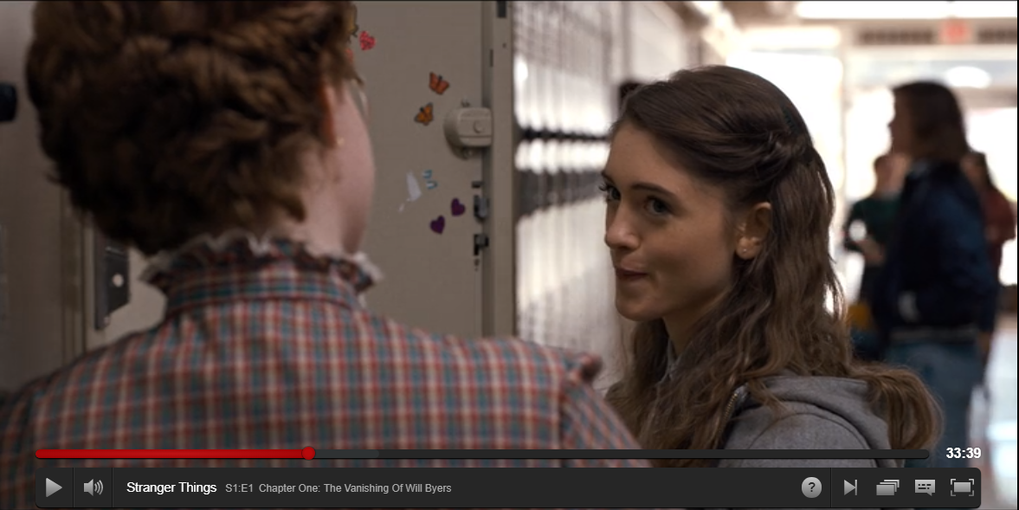
Shot type:
How are the audience to respond (read the text)? Consider Hall.
How is character represented?

Slide 17
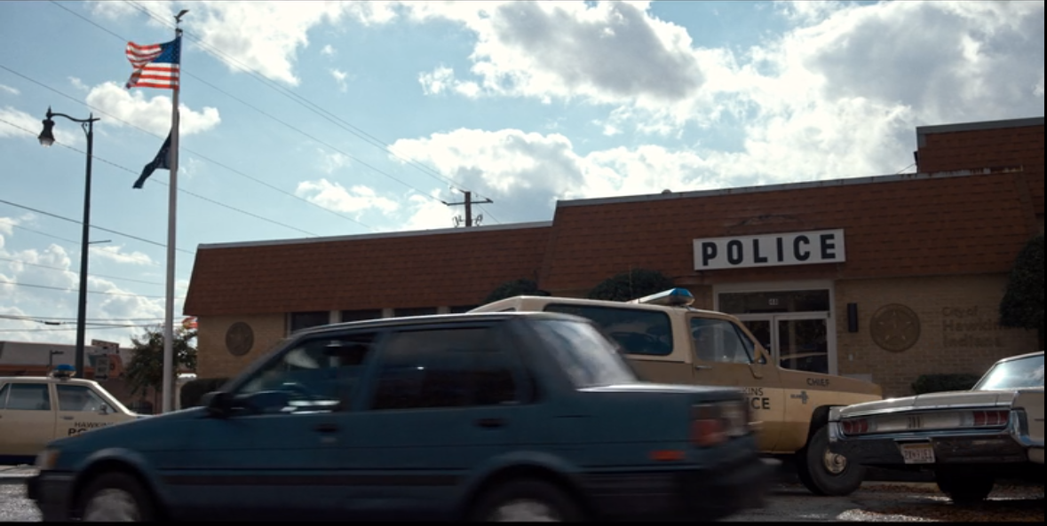
Shot type:
How are the audience to respond (read the text)? Consider Hall.
How is regional/national identity represented?

Slide 18
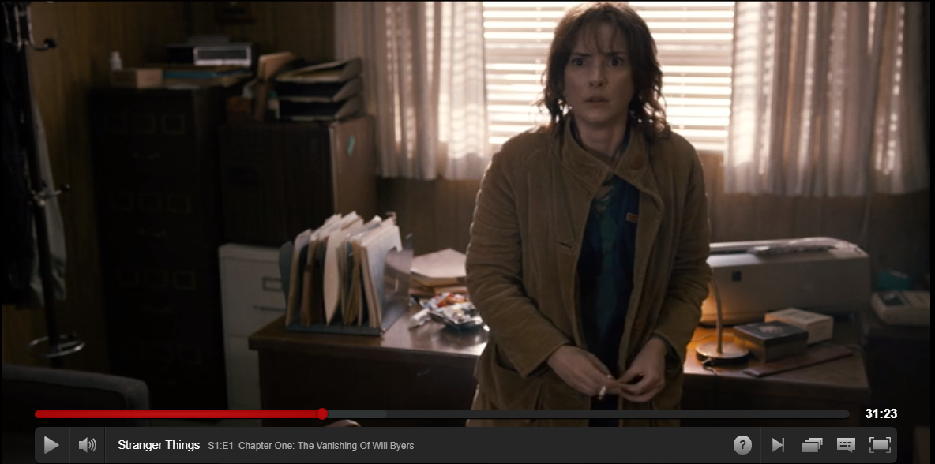
Shot type:
How are the audience to respond (read the text)? Consider Hall.
How is character represented?

Slide 19
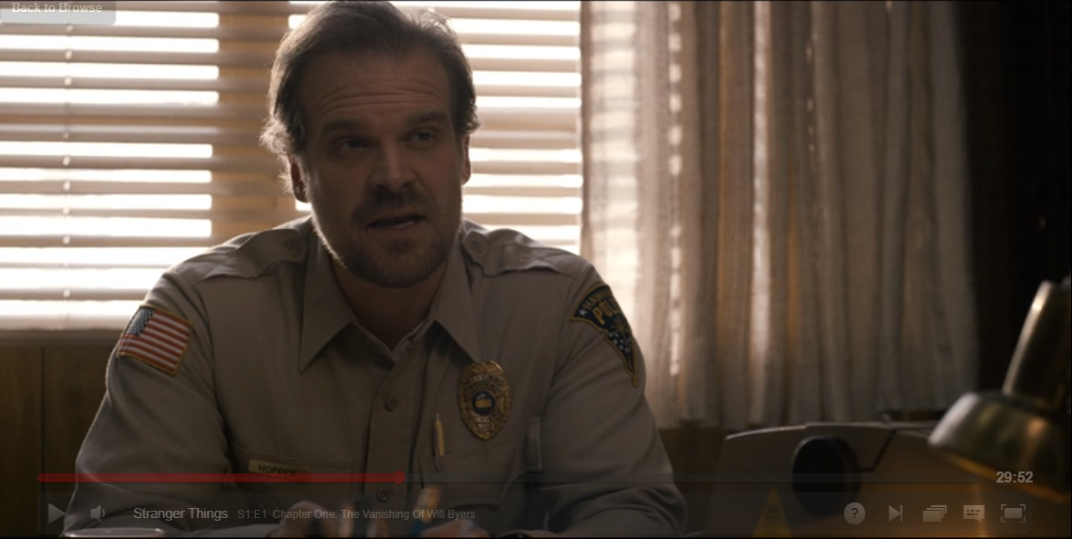
Shot type:
How are the audience to respond (read the text)? Consider Hall.
How is character represented?

Slide 20
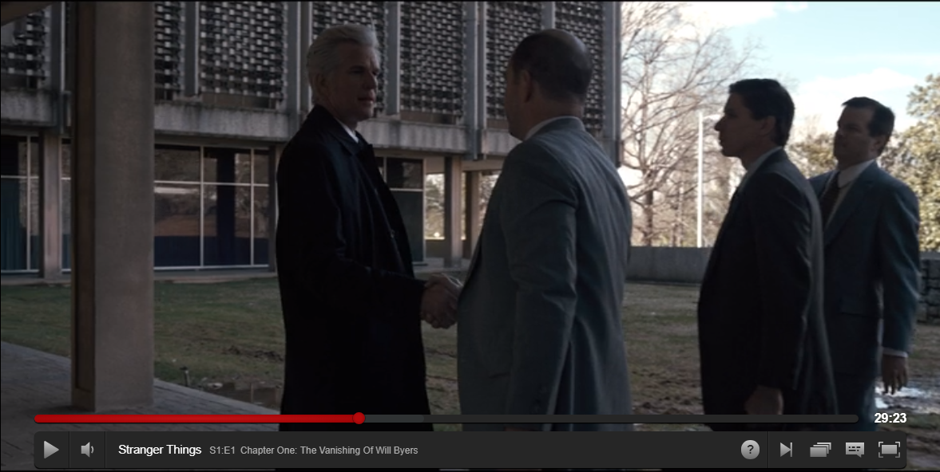
Shot type:
How are the audience to respond (read the text)? Consider Hall.
How is character represented?
This is the main villain (aside from monster).

Slide 21
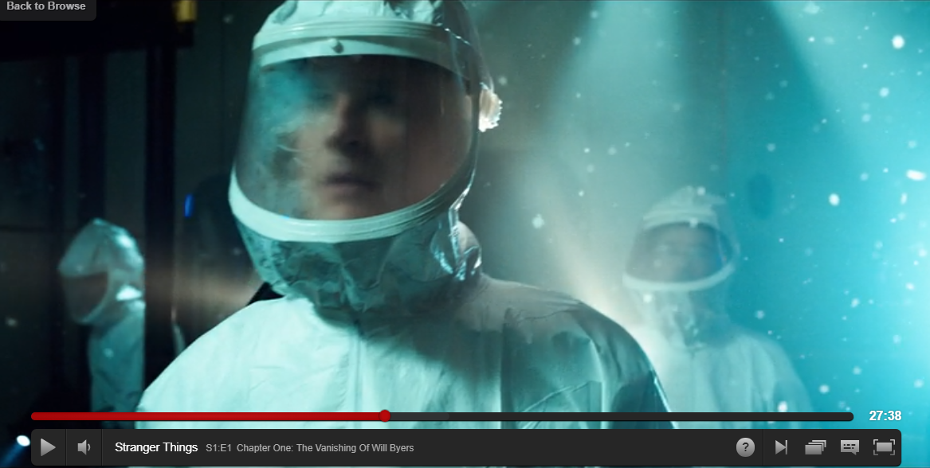
Shot type:
How are the audience to respond (read the text)? Consider Hall.
How is character represented?

Slide 22
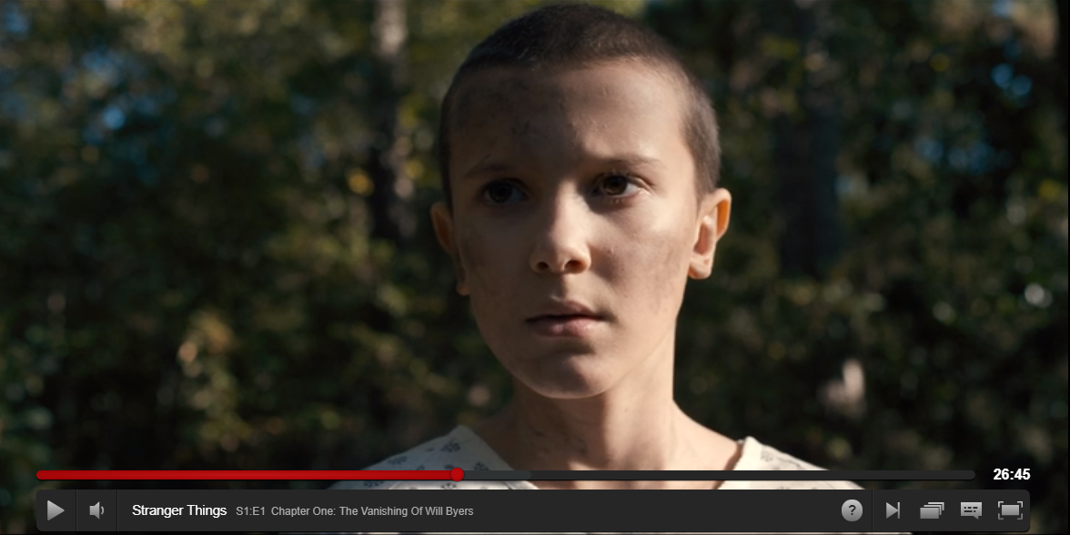
Shot type:
How are the audience to respond (read the text)? Consider Hall.
How is character represented?

Slide 23
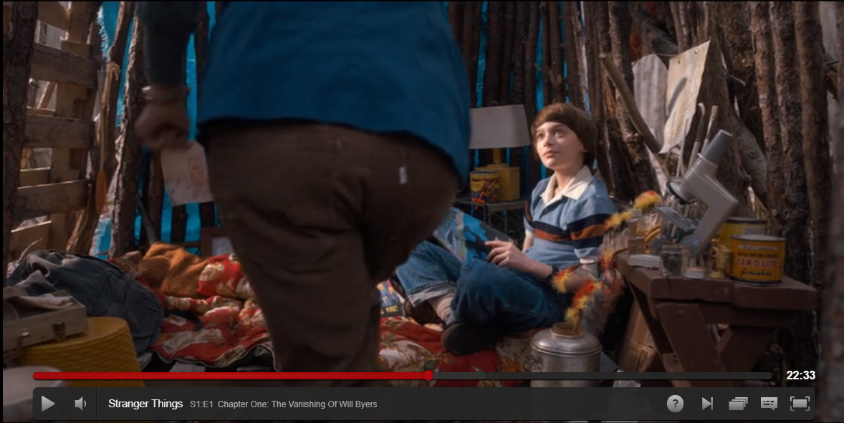
Shot type:
How are the audience to respond (read the text)? Consider Hall.
How is character represented?
This is a flashback scene - contrast with mise-en-scene. What are producers trying to show?

Slide 24
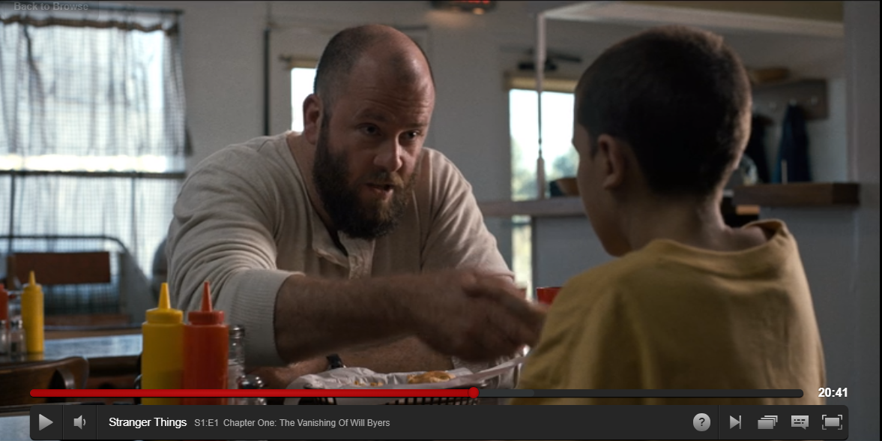
Shot type:
How are the audience to respond (read the text)? Consider Hall.
How is representations of masculinity challenged here?

Slide 25
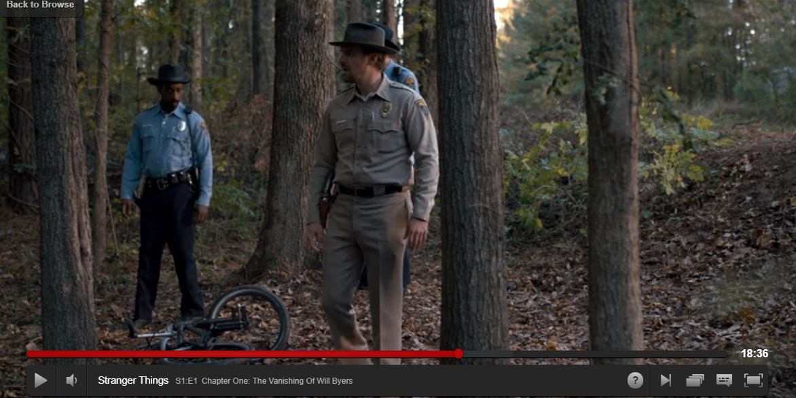
Shot type:
How are the audience to respond (read the text)? Consider Hall.
How is character represented?
Hint. Think about composition of frame and where actors are.

Slide 26
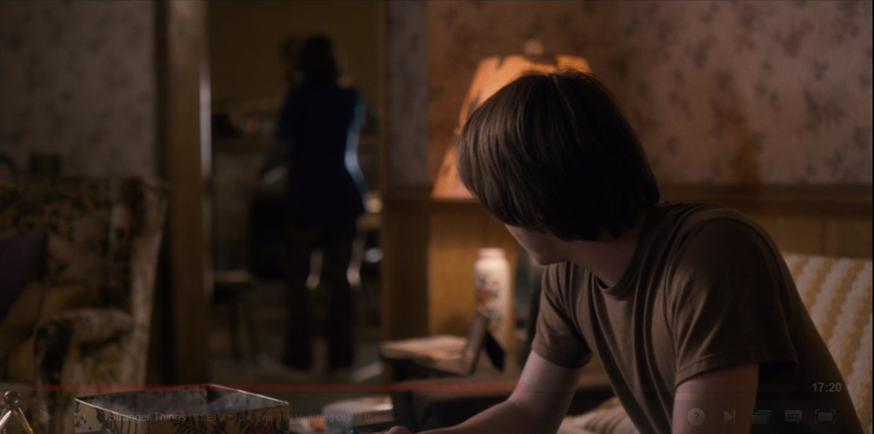
Shot type:
How are the audience to respond (read the text)? Consider Hall.
How is character represented?

Slide 27
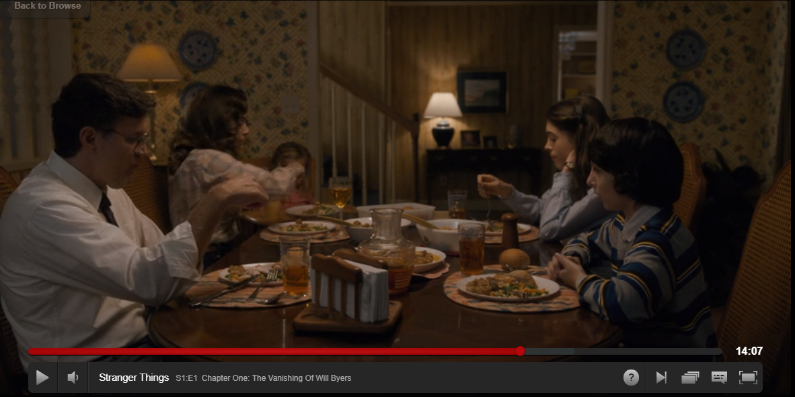
Shot type:
How are the audience to respond (read the text)? Consider Hall.
How is nuclear family represented?

Slide 28
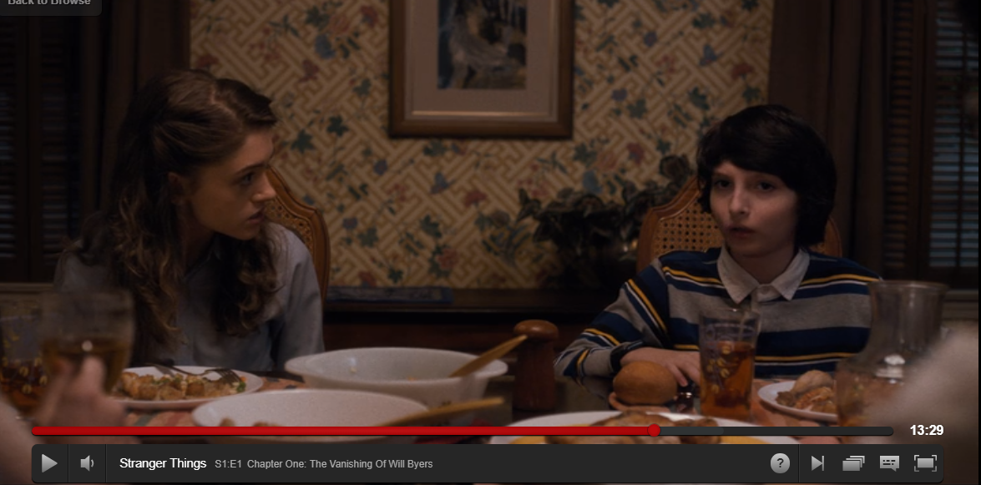
Shot type:
How are the audience to respond (read the text)? Consider Hall.
How is character represented?

Slide 29
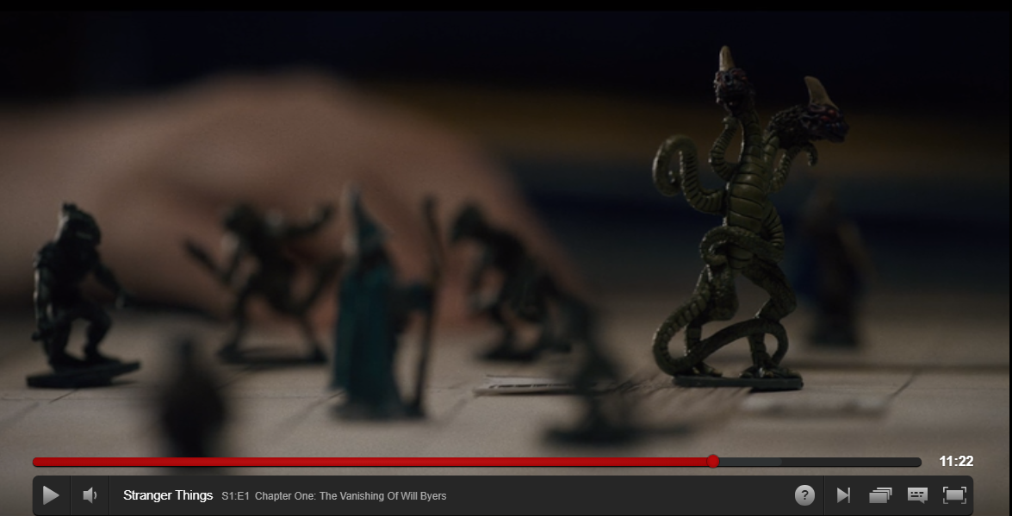
Shot type:
How are the audience to respond (read the text)? Consider Hall.
How is theme of episode represented?

Slide 30
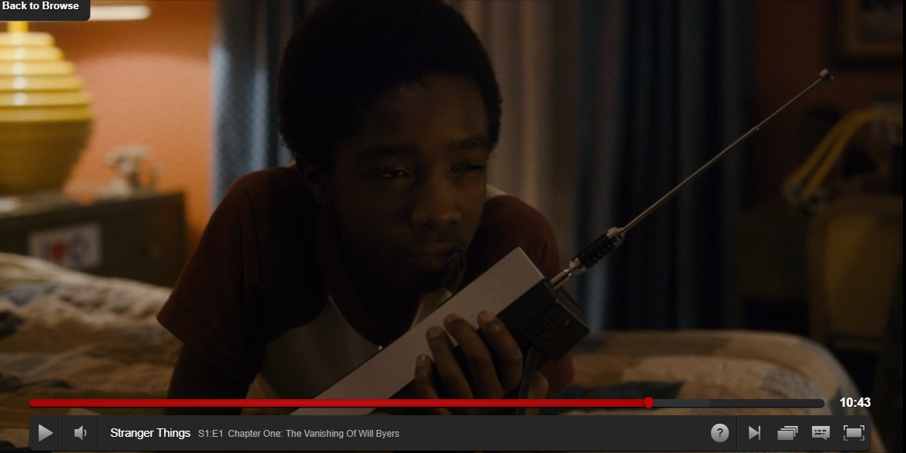
Shot type:
How are the audience to respond (read the text)? Consider Hall.
How is ethnicity represented?

Slide 31
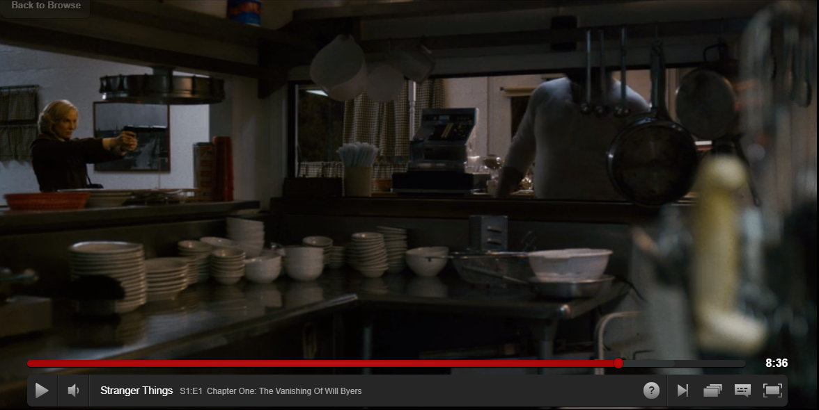
Shot type:
How are the audience to respond (read the text)? Consider Hall.
How is character represented?

Slide 32
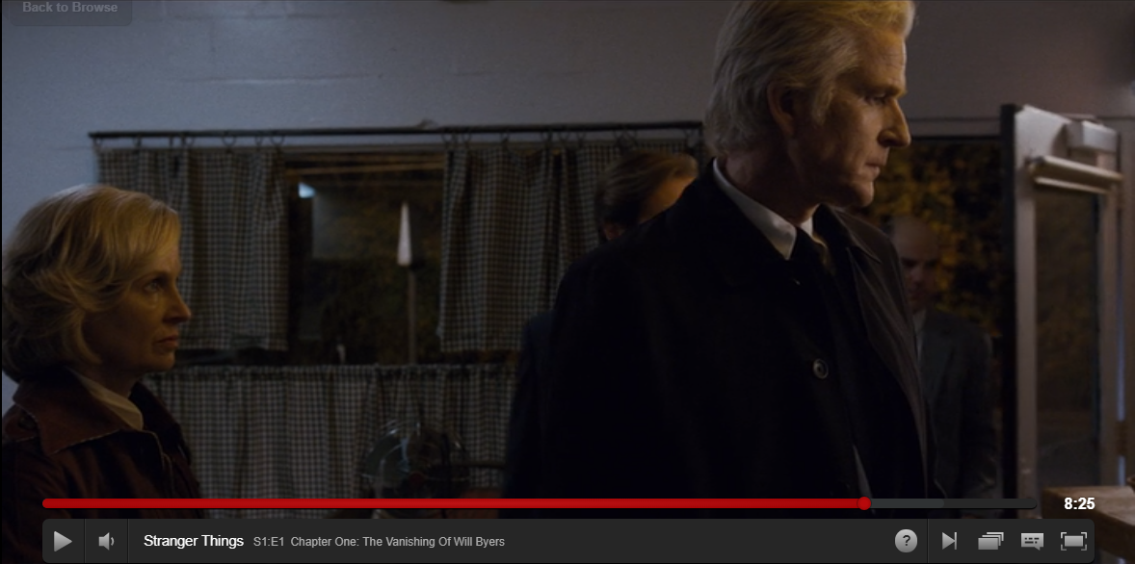
Shot type:
How are the audience to respond (read the text)? Consider Hall.
How is character represented?

Slide 33
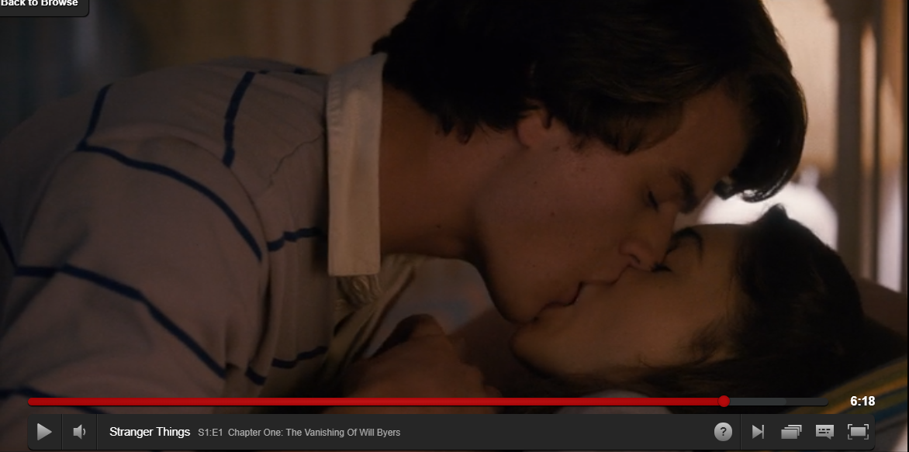
Shot type:
How are the audience to respond (read the text)? Consider Hall.
How is gender represented?

Slide 34
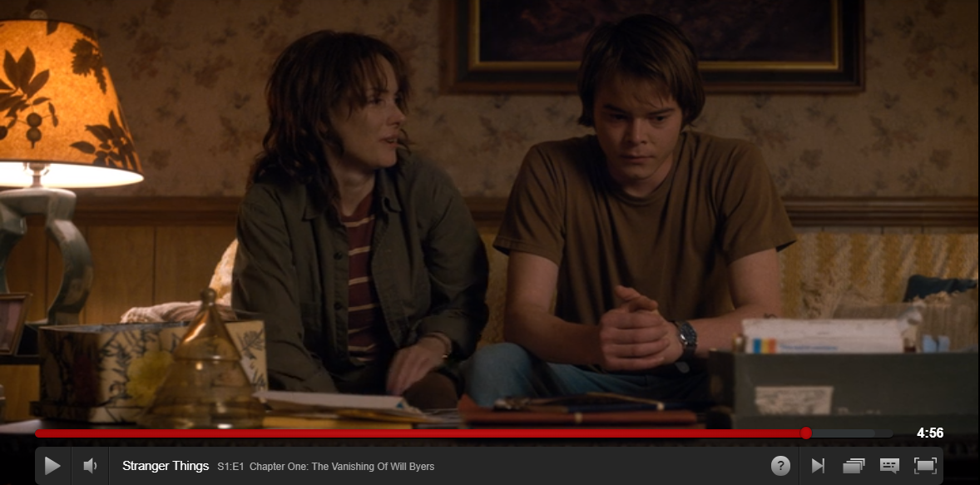
Shot type:
How are the audience to respond (read the text)? Consider Hall.
How is family represented?

Slide 35
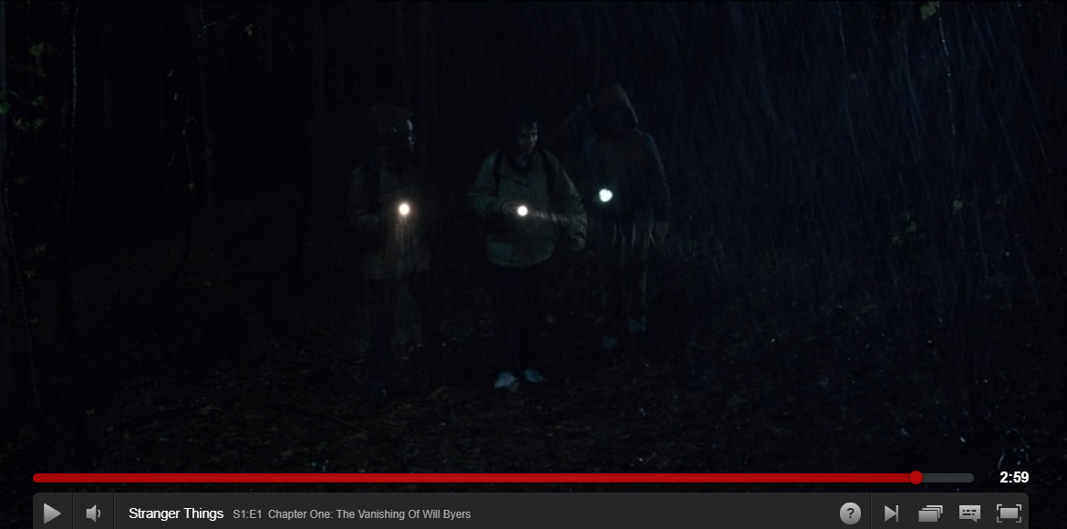
Shot type:
How are the audience to respond (read the text)? Consider Hall.
How is camaraderie represented?
Who is in middle again?

Slide 36
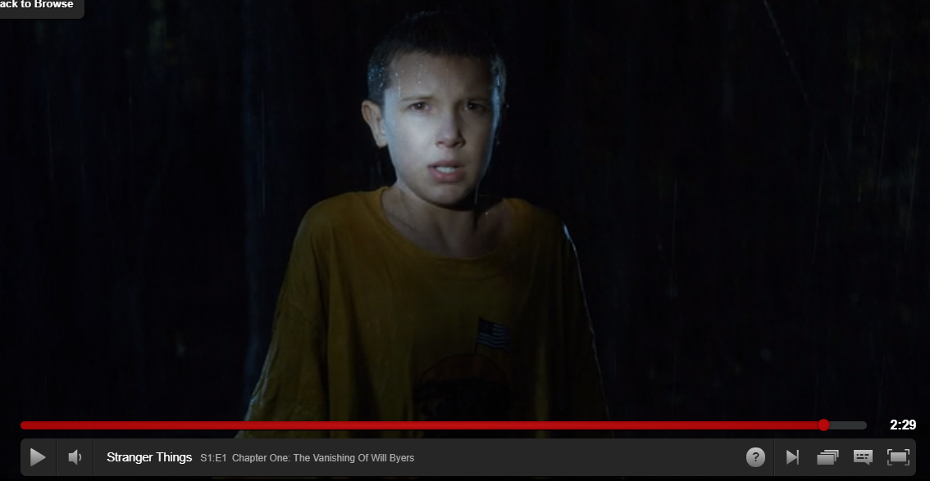
Shot type:
How are the audience to respond (read the text)? Consider Hall.
How is character represented?
What phase of narrative are we in in terms of Todorov? How can we show Propp’s role in this?

