Slide 1
Representation Theories

Slide 2
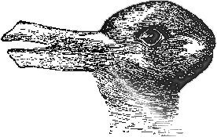
1
media representation processes
The media does not mirror real world events but produces an edited version of the events depicted.
Media representations are constructed through codes – through the use of language, imagery, layout, sound and editing.
The media plays a vital role in shaping our views of the wider world
stereotypes and power
Stereotypes are used by media producers to create instant characterisation.
Stereotypes reduce social groups to a few key traits or visual cues and suggest that those groups are naturally inclined towards a specific set of negative behaviours.
Stereotypes are mostly found where there are huge social inequalities. They exclude and demonise groups in a manner that both reflects and reinforces social hierarchies.
Social groups can internalise the behaviours inferred by stereotypes.
Stereotypes can be contested through transcoding strategies.
2
Stuart Hall: Representation
Two theorists who might challenge Halls thinking:
Stuart Hall: Strangely, Hall himself provides a substantial challenge to his own ideas. His reception theory model suggest that audiences can resist the effects of the media through the production of oppositional or negotiated readings.
Paul Gilroy: In many senses, Gilroy’s work picks up on many of the themes of Hall’s arguments – his analysis, however, suggest that racial stereotypes are framed by the wider cultural/historical forces of Empire. This makes I much harder for the media to contest black stereotypes because they are so deeply entrenched within the British cultural psyche.
?
R

Slide 3
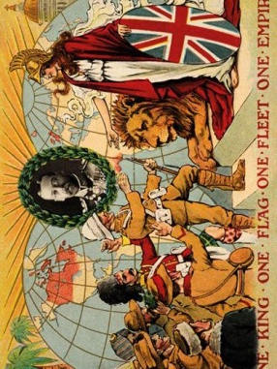
1
racial binaries, otherness and civilisationism
Black communities are constructed as an ‘other’ to white culture and are associated with criminal activity and lawlessness.
The media reflect civilsationist attitudes through simplistic reportage and the demonisation of Muslims – media products nurture fear and the idea that Muslims and Europeans are incompatible.
the enduring legacy of the British Empire on English identity
A deep-seated postcolonial melancholia infects the media as a result of Britain’s diminishing global importance.
Postcolonial melancholia prompts a nostalgic construction of Englishness.
Postcolonial melancholy produces a sense of English rootlessness and an anxiety surrounding British identity.
2
Paul Gilroy:
Postcolonial Theory
Two theorists who might challenge Gilroy’s thinking:
David Gauntlett: would present a far more optimistic picture of the media’s capacity to effect change or to enable positive identity construction. He would suggest that the variety of media representations available to contemporary audience is far greater than that outlined by Gilroy.
Henry Jenkins: would present a far more optimistic view regarding the current media landscape than Gilroy’s postcolonial assessment – suggesting that new technologies enable audiences to engage in participatory culture and to form online communities.
?
R

Slide 4
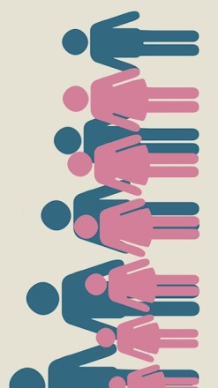
1
the female body as spectacle
The roles that females are expected to play within society vary enormously across different cultures and historical periods.
The dominant representational mode in Western culture positions women as an erotic spectacle.
Second wave feminists have challenged the dominance of men in society.
Third wave feminists have reasserted the right of women to occupy traditional female roles.
Fourth wave feminists continue to challenge male privilege using both mass media and social media forms.
2
masculinity in the media
Masculine depictions are note subject to the same objectification processes as females.
Male social dominance is reinforced using active representations of masculinity.
van Zoonen: Feminist Theory and Patriarchy
Two theorists who challenge van Zoonen’s thinking:
David Gauntlett: would argue that contemporary media products both online and mass media oriented, offer audiences a much wider diversity of gender-based identities than is suggest by van Zoonen. This enables audiences to shape their own identities and to resist the ideological pull of patriarchy.
Judith Butler: would agree with much of van Zoonen’s thinking, but would suggest further that the use of gender-based labels like ‘male’ and ‘female’ mask the complex nature of sexuality. She would also argue that individuals have resisted those conventional labels by engaging in ‘gender trouble’
?
R

Slide 5
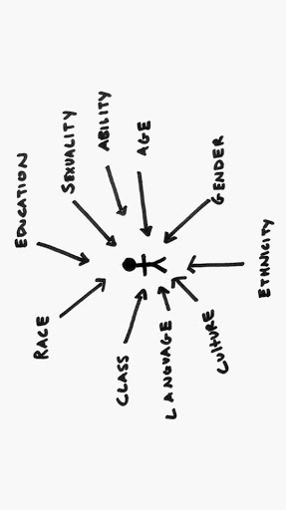
1
interconnected oppression
Representations of black women (and men) have been shaped by historical forces.
Feminist movements of the twentieth century have largely been dominated by a white viewpoint.
A social hierarchy exists that places white men at the top followed by white women, male ethnic minorities and, last, female ethnic minorities.
Oppression of minority groups (racism, sexism, ableism, homophobia) are constructs of a white male dominated social hierarchy.
The lack of black female power results in absent representations and a range of negative stereotypes that some black women have internalised.
2
from evaluation to actions, bell hook’s call to action
hook’s intersectional work does not just provide us with an analytical tool, but also prompts media producers to fashion their products in ways that draw attention to social inequality.
Intersectional media foregrounds the interconnected nature of inequality.
Intersectional media celebrates social diversity and gives voice to social groups that have been marginalised by white male power.
bell hooks:
Intersectionality
Two theorists who might challenge bell hook’s thinking:
Paul Gilroy: would not necessarily challenge hooks, but his work provide a more UK specific framework for evaluation the representation of black people. His analysis highlights the legacy effects of Empire on our notions of ethnicity and national identity.
Henry Jenkins: again, he would not challenge hooks directly, but would suggest that contemporary media products, through participatory culture, can circumvent established media power. Indeed, the online activism of #BlackLivesMatter provides a brilliant example of the power of participatory culture.
?
R

Slide 6
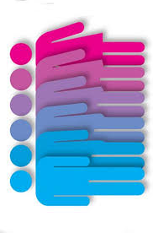
1
our gendered identities are not naturally given but constructed through repetition and ritual.
Our bodies or sex do not define our gendered identities.
Genders are not fixed by childhood experiences.
Gender is constructed by continuous repetition of micro-rituals.
Contemporary culture reinforces a traditional gender binary – identities that fall outside of that binary are constructed as subversive.
Heteronormativity is entrenched within society.
Non-heteronormative identities are marginalised or subjugated.
The media assists in the marginalisation of subversive identities through absent representations, abjection and parody.
The performance of gender trouble is a difficult, sometimes painful, process given the entrenched nature of heteronormativity.
2
Butler: Gender as performance
Two theorists who might challenge Butler’s thinking:
David Gauntlett: acknowledges much of the work of Butler, but wold suggest that contemporary media practices mean that heteronormativity does not completely dominate and that the media allows for diverse or fluid identity construction. He suggest that society has adopted a much more positive view of gender subversion than is presented by Butler.
van Zoonen: would agree with Butler’s assessment that gender is a social construct but would suggest that the media reinforces male power as a result of women internalising male power and assuming the same passivity that on-screen depiction of femininity construct.
?
R

Slide 7

1
traditional and post-traditional media consumption.
Gauntlett’s ideas build upon Anthony Giddens’ assertion that society has progressed to a stage Giddens calls ‘late modernity’.
The conditions of late modernity enable audience to escape the prescriptive identities that are constructed for them through localised social norms and traditional viewpoints.
Gauntlett argues that contemporary media has brought audiences into contact with a wider range of representations – and, importantly, that audience can consciously shape their own sense of self.
Reflexive identity construction
The media provides a variety of role models and lifestyle templates that audience use to guide their own outlooks.
Audiences are engaged in a continuous revision of their identities.
Media narratives mirror the process of identity through transformation.
Audience are in control of the media – adapting and assimilating ideas about themselves through the various representations that the media present.
2
Gauntlett: Media
and Identity
Three theorists who challenge Gauntlett’s thinking:
Stuart Hall: would argue that the media landscape is not diverse, but saturated with stereotypical portrayals that reflect wider social inequalities. This leads to a deeply problematic portrayal of minority groups of all persuasions.
bell hooks: hooks would argue that portrayals of black women are largely absent from the media and, when they are present, they are prone to produce overly sexualised portrayals.
Paul Gilroy: would argue that British media narrative doe not offer diversity but are stuck within a colonial mind-set that positions non-whites as threatening, primitive or uncivilised.
?
R

