Slide 1

To explore how music videos represent groups or individuals in society

Slide 2

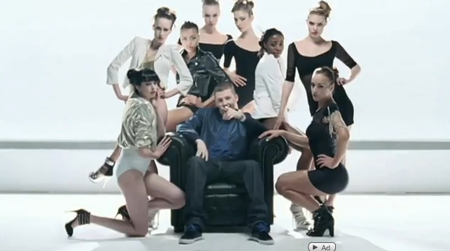
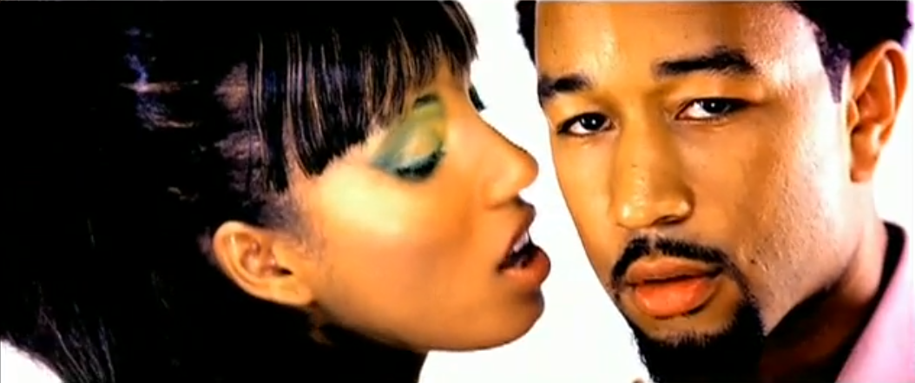
https://www.youtube.com/watch?v=OPf0YbXqDm0 https://www.youtube.com/watch?v=7Kk-dgcTSwY
Goffman looked at the gender differences between men and women in advertising, we could argue the same issues are present in music videos too.
Women are represented as being inferior to men
Oftentimes, women appear in the background
Women are seen reclining or laying down suggesting submissiveness
Women are ‘dismembered’ by the camera angles so we only see their bodies
Women are portrayed in an infantile way making them appear younger than their actual age

Slide 3
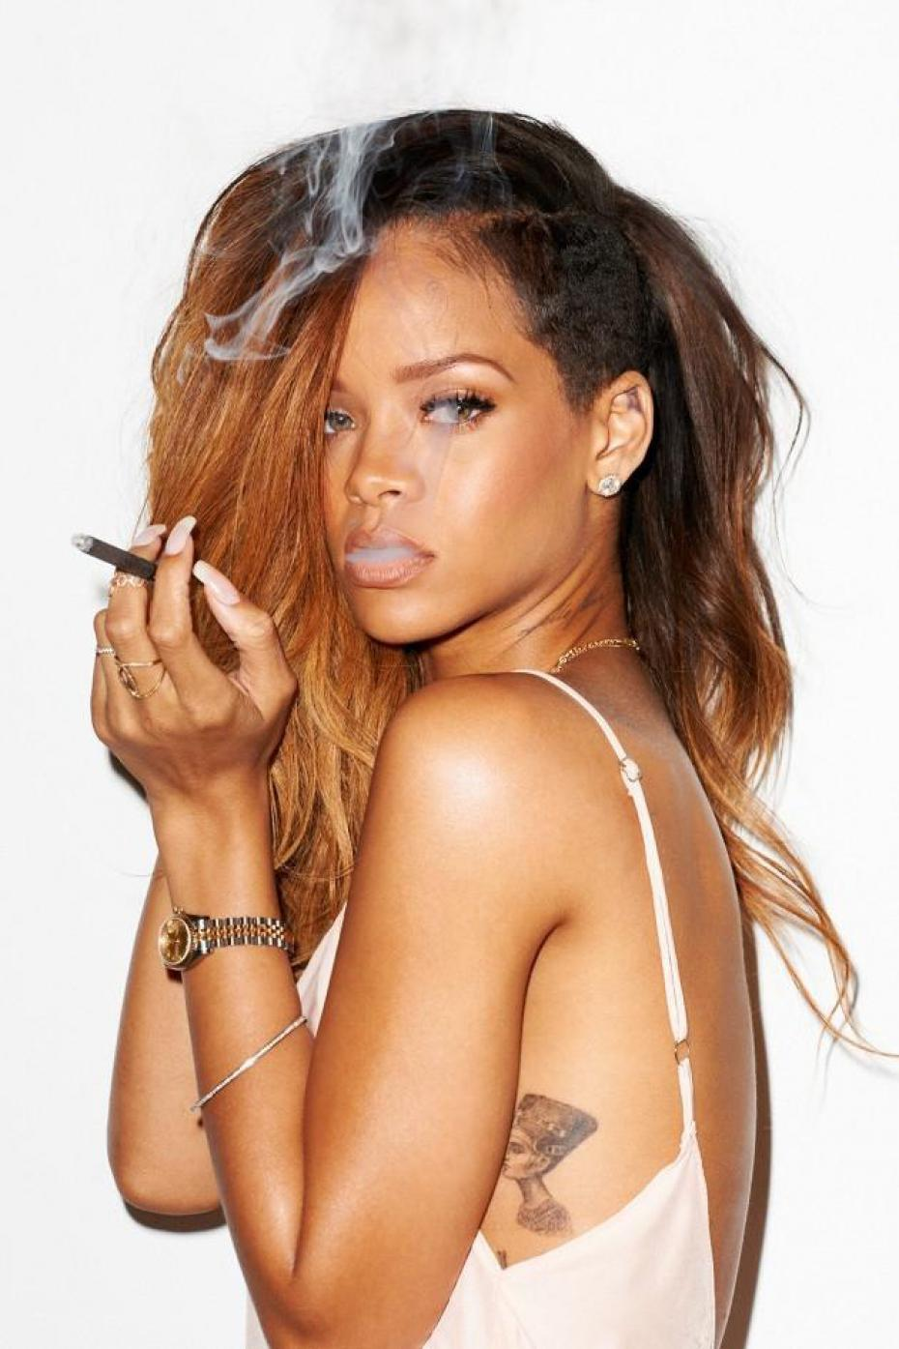

Representation of Women in Music Videos
https://www.youtube.com/watch?v=o3mP3mJDL2k
https://www.youtube.com/watch?v=YNSxNsr4wmA
https://www.youtube.com/watch?v=4m1EFMoRFvY
https://www.youtube.com/watch?v=VBmMU_iwe6U
Postmodern feminists, such as Angela McRobbie state that the modern day woman is liberated through her ability to choose how she dresses, acts and behaves.
She goes on to say how girls are sold the idea that their main quest in life is to find a man and seek happiness through marriage, so she would support women who take a different approach.
Women are often sexualised in the media however we could argue in music videos there seems to be a hyper-sexualisation that occurs.
Women are seen dancing provocatively, touching themselves, males or other females.
This creates a huge debate – Two schools of thought;
Women asserting their femininity and expressing themselves sexually
This is damaging and problematic as if males did this, it would be seen as offensive.

Slide 4
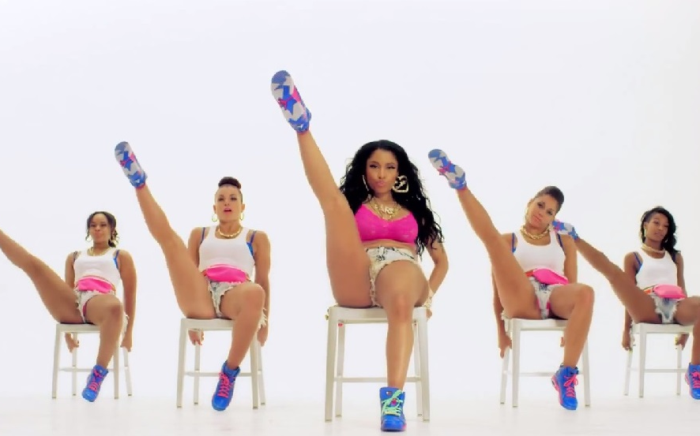

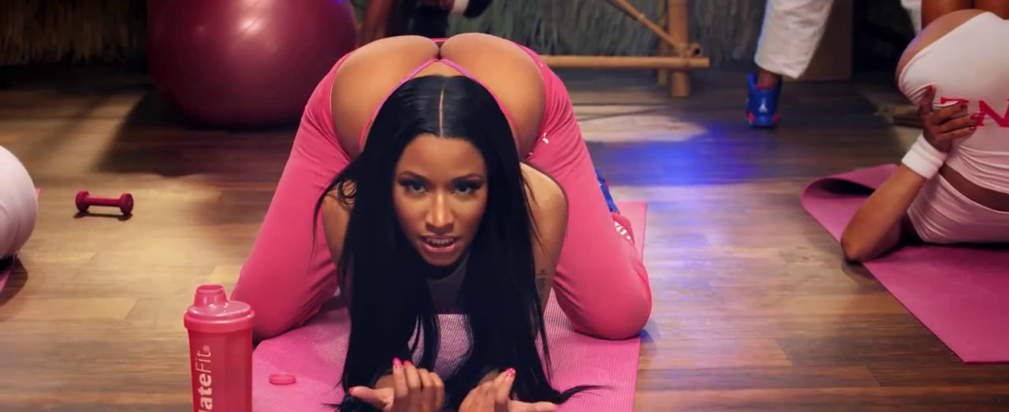
Is this necessary!?
Laura Mulvey
Mulvey’s work is influenced by the theories of Sigmund Freud and Jacques Lacan
She suggested that women are objectified and connoted “to-be-looked-at-ness” in films.
They become an object of desire and are positioned for the erotic pleasure of the male viewer.
They are positioned for the ‘male gaze’
Mulvey suggests that there were two distinct modes of the male gaze: "voyeuristic" (i.e. seeing women as 'whores') and "fetishistic" (i.e. seeing women as 'madonnas').
https://www.youtube.com/watch?v=LDZX4ooRsWs

Slide 5
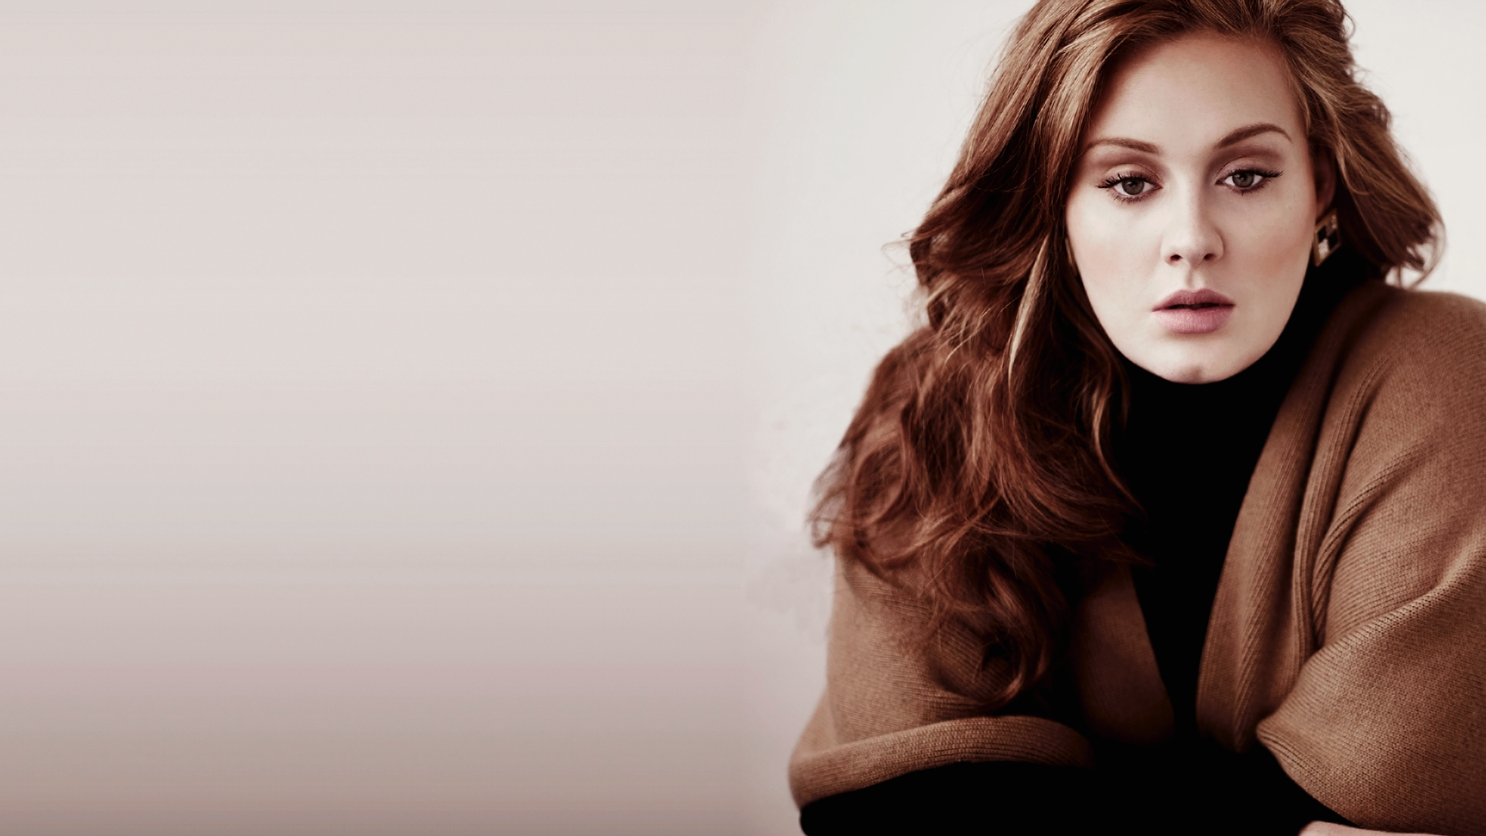
Challenging Representations
Some female artists challenge the stereotypes and are rarely sexualised e.g. Adele, Meghan Trainor and more recently Lorde.
These artists subvert expectations offering empowering lyrics and stunning vocals.
https://www.youtube.com/watch?v=7PCkvCPvDXk
https://www.youtube.com/watch?v=fk4BbF7B29w
https://www.youtube.com/watch?v=dMK_npDG12Q
https://www.youtube.com/watch?v=qrO4YZeyl0I
https://www.youtube.com/watch?v=pco91kroVgQ

Slide 6
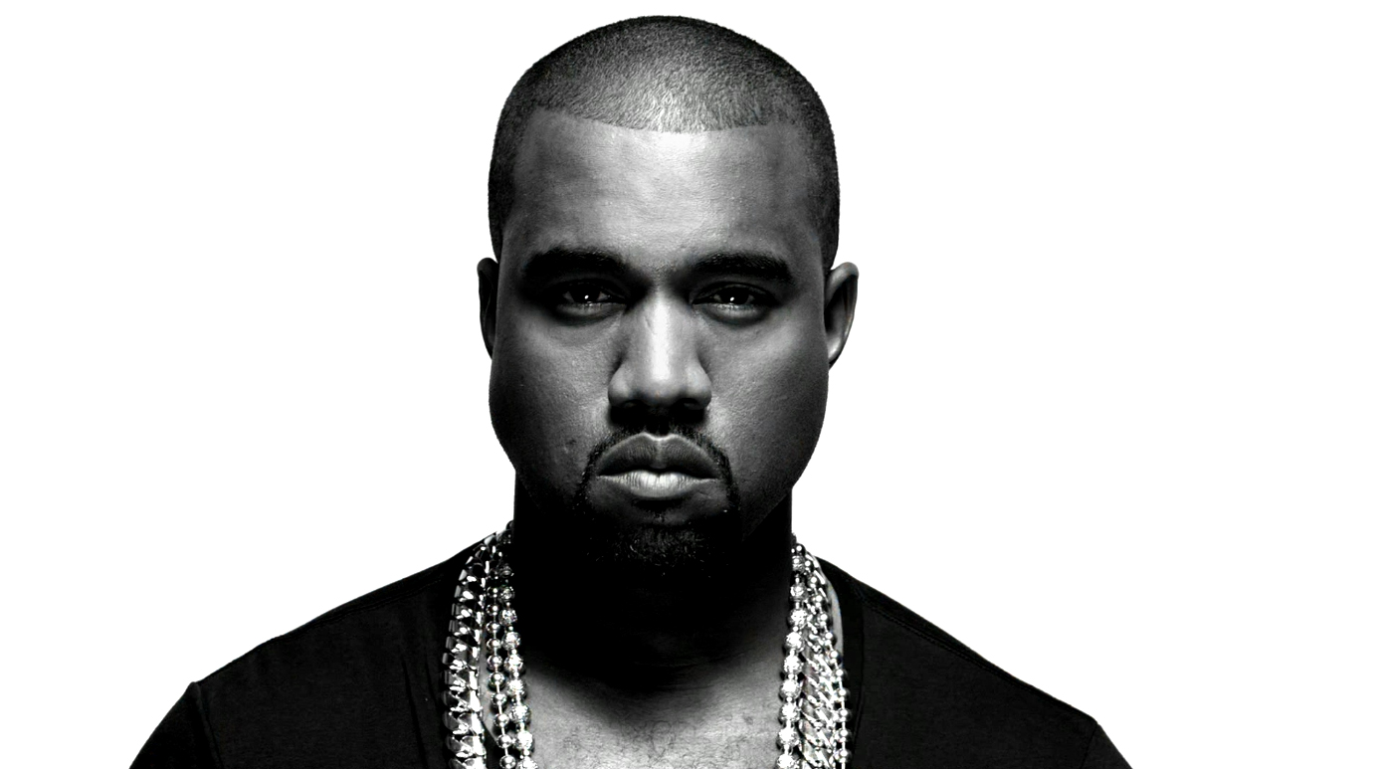
Masculinity
Do men suffer from the same demeaning representations in the media? Yes or no?

Slide 7
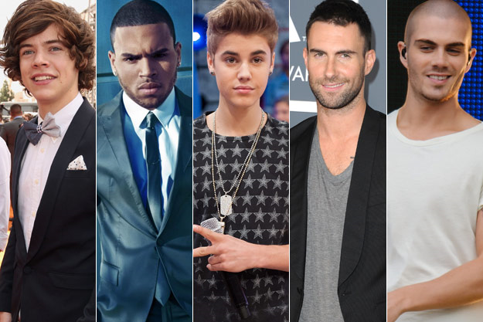
Raewyn Connell
Connell suggests that one version of masculinity is sanctioned as the one to which men should adhere to, which she termed hegemonic masculinity.
There has been little change in hegemonic masculinity over the years and a strong representation of the four themes of the male sex role (stoic, aggressive, dependable and not feminine).

Slide 8
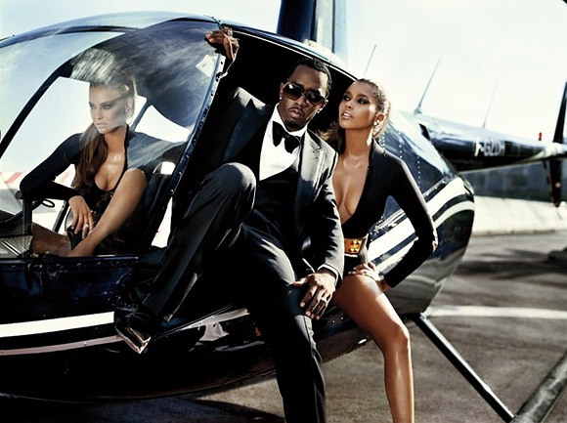
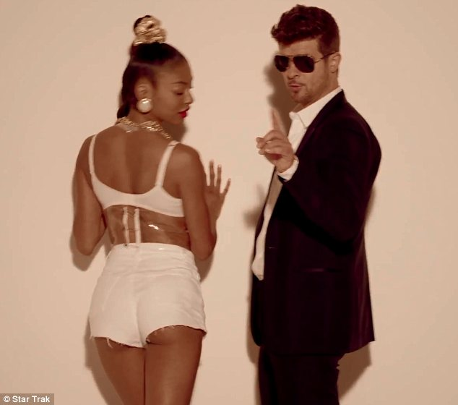
Hegemonic masculinity
Hegemonic masculinity is competitive and reflects a tendency for males to seek to dominate other males and subordinate females
Characteristics such as drive, ambition, claims to self-reliance, and heterosexuality.
McCormack defines other hegemonic traits: “homophobic, misogynistic, and aggressive”
Is this evident in rap and hip hop?
https://www.youtube.com/watch?v=uelHwf8o7_U
https://www.youtube.com/watch?v=5RDSkR8_AQ0

Slide 9
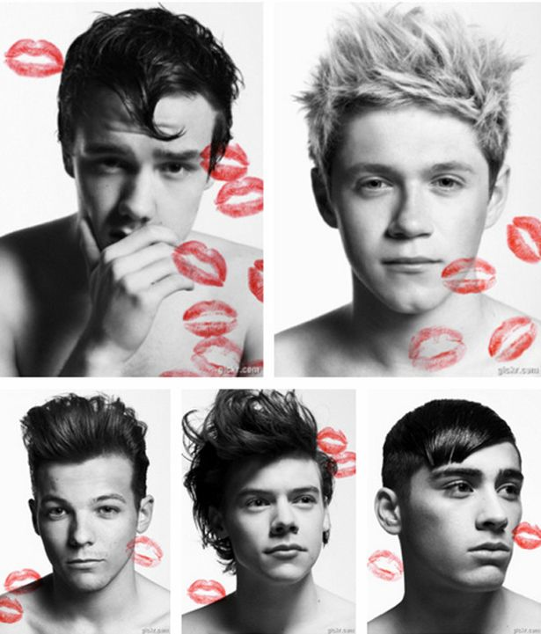
Homo-Eroticism
Sexual attraction between members of the same sex, either male–male or female–female. The concept differs from the concept of homosexuality: it refers specifically to the desire itself, which can be temporary, whereas "homosexuality" implies a more permanent state of identity or sexual orientation
https://www.youtube.com/watch?v=FuwTgZOKcf8
https://www.youtube.com/watch?v=jqNtYFy1KNs

Slide 10
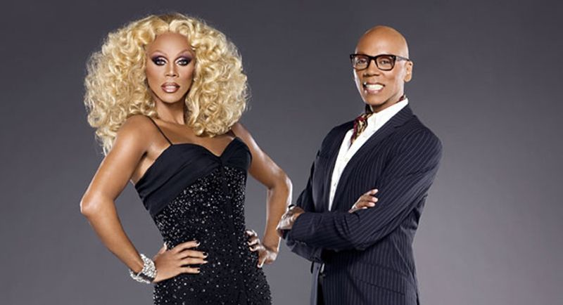
New representations?
https://www.youtube.com/watch?v=mPRy1B4t5YA
https://www.youtube.com/watch?v=wxIdKtrOtN8
https://www.youtube.com/watch?v=vatDGHG49y0
http://www.digitalspy.com/tv/reality-tv/feature/a851553/queer-eye-netflix-season-one-review/

Slide 11
You can choose to work with any one of the following videos:
‘Uptown Funk’ – Mark Ronson ft. Bruno Mars
‘Just be Good to Green’ – Professor Green ft. Lilly Allen
‘All about the Bass’ – Megan Trainor
‘The Man’ – The Killers
‘Run the World’ – Beyonce
‘Boys’ – Charli XCX
Task
Create a single sheet (A3) poster discussing the following:
Are there any issues of gender representation?
Can this be linked to wider expectations of the genre?
Have any expectations of gender been subverted?
Your poster should be full of screen shots and detail, I should be able to look at it and know you understand how your chosen videos links to the issues discussed.

