Slide 1
Radio lesson 2
Audiences

Slide 2
Lesson aims:
To identify and explore the audience for BBC Radio One Breakfast Show
To listen to a broadcast and note content
To link the content to the Radio One remit and audience tastes
To understand Radio One’s audience reach and ways that audiences can interact with the programme.

Slide 3
Who listens to the radio?
RAJAR

Slide 4
RAJAR: Radio Joint Audience Research
RAJAR is the official body in charge of measuring radio audiences
Data is obtained by asking participants to keep a diary over a 7 day period
  One adult (15+) and up to two children per household in the survey
  The paper diary is customised. Each participant is asked to sort through a set of cards with the names of all the radio stations in the area and invited to select all the stations which they might listen to or hear in various situations. All paper diaries are collected personally by interviewers at the end of the seven days.
  The online diary station selection is carried out by the participant, each person is asked to look through a set of station names onscreen that are available in the area and invited to select all the stations which they might listen to or hear in various situations
Each area of the UK is covered by the research. You cannot volunteer to participate – you are chosen and approached by researchers to take part.

Slide 5
Rajar listening figures: annual summary
Let’s look at the InfoGraphic from Rajar, summarizing annual Radio listener habits (next slide).
  What does this tell us about how and when people listen to the radio?
  Which is the most surprising fact for you on the InfoGraphic?

Slide 6
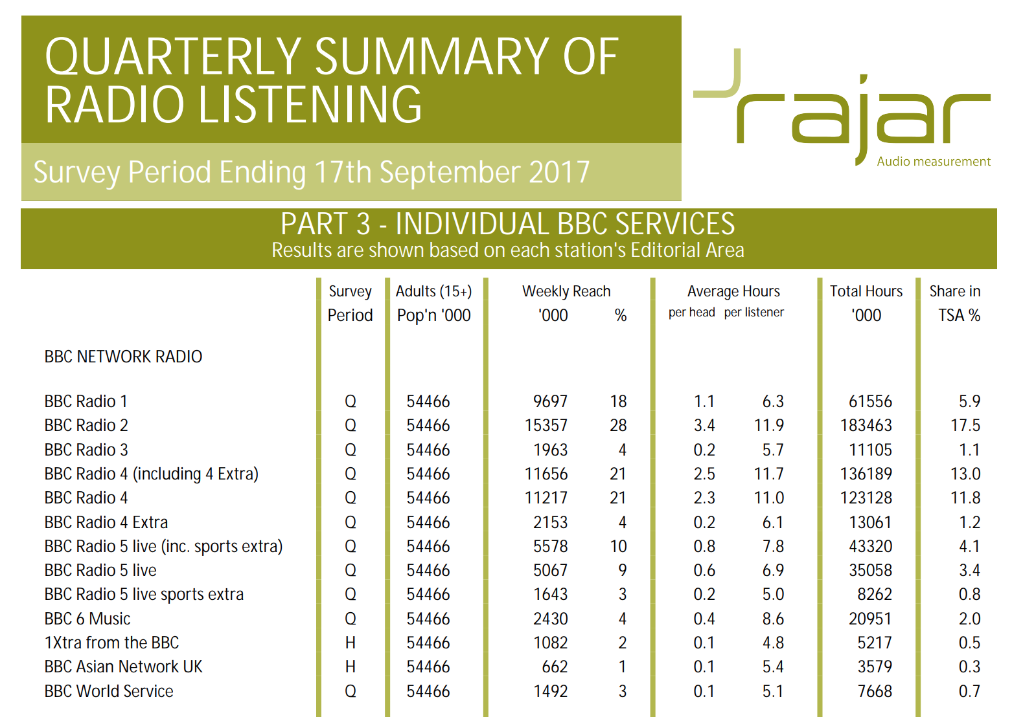
Let’s take a look at the RAJAR figures for the last quarter
WHo
Which BBC Radio station has the highest listening figures?
Why do you think this is?
Why do you think the listening figures for Radio One are low in comparison?
https://www.rajar.co.uk/listening/quarterly_listening.php

Slide 7
Audience for BBC Radio One: research task
Look at Radio One Breakfast Show website, associated Youtube and social media using the handout. Each person in your group should look at a different platform.
From this identify who the target audience is.
How does the programme attempt to interact with its listeners? Identify all the different ways that audience interaction can take place.

Slide 8
Feedback
What did you discover?

Slide 9
Listening to a broadcast
You will be placed in a group
Each group will listen to a separate 30 minute section from the Radio One Breakfast Show (22nd January 2018).
You will use the grid to identify all the contents of your section. You must pay attention to the Playlist for BBC Radio One and put a star next to any songs you hear that feature on this.
Once you’ve completed the grid, you must answer the questions.
Your grid will be given in and your teacher will make a copy of it.

Slide 10
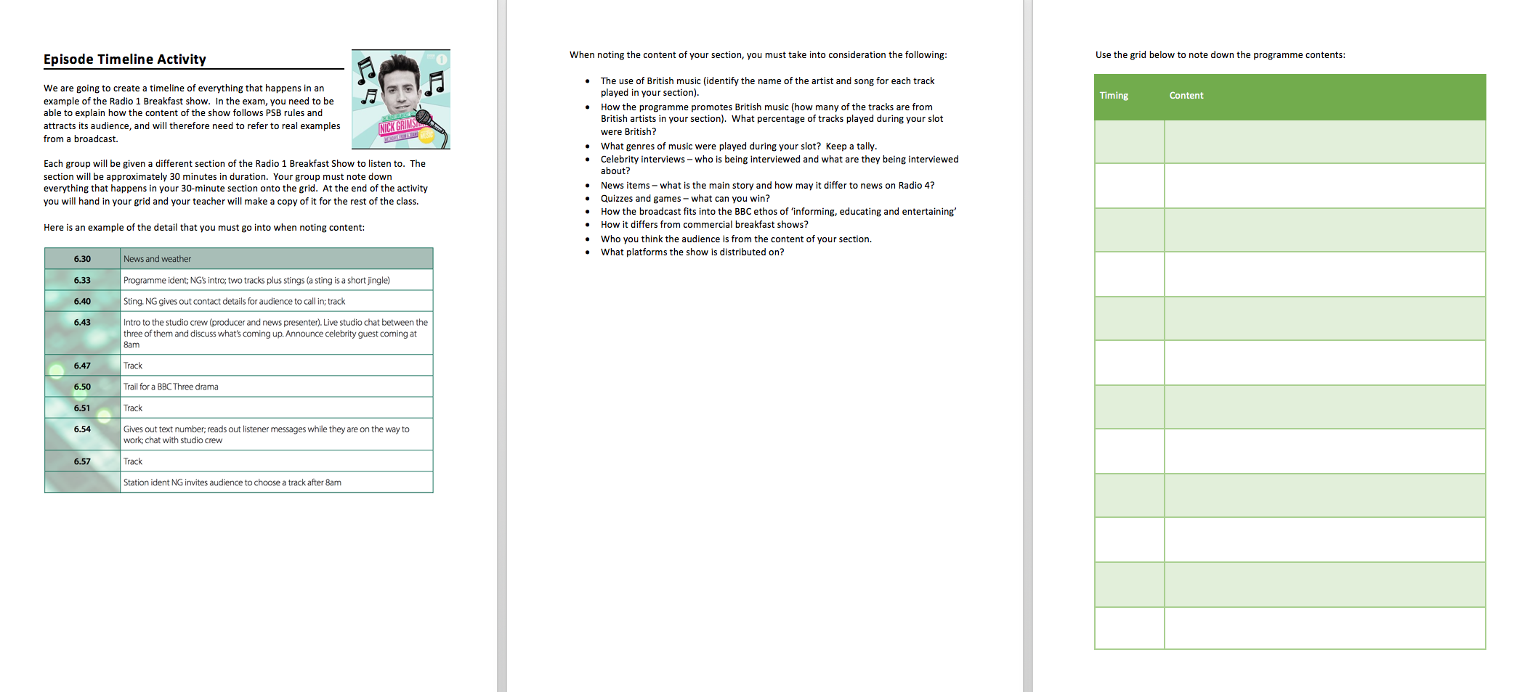
Task:

Slide 11
Feedback:
How does the programme promotes British music?
What percentage of tracks played during your slot were British?
What genres of music were played during your slot? Do a tally.
Celebrity interviews – who is being interviewed and what are they being interviewed about? How many of the interviews are with British people?
News items – list the stories and identify which relate to Britain.
Quizzes and games – what can you win?
How does the broadcast fits into the BBC ethos of ‘informing, educating and entertaining’?
How does it differ from commercial breakfast shows?
Who you think the audience is from the content of your section? What evidence do you have for this?
What platforms is the show is distributed on?

Slide 12
Putting the timeline together
Now that you have the whole timeline for the show, discuss the following question with your group:
  How does the Nick Grimshaw Radio One Breakfast show meet the Radio One service licence agreement? (Public purposes, remit and ethos). Identify at least three ways that it does this, with evidence. Be prepared to feedback to the board.
  Reminder of the public purposes:
  Impartial news and information
  Supporting learning for all ages
  Creative and highest quality distinctive output
  Reflect, represent and serve the diverse communities of the UK
  Reflect the UK, its culture and values.

Slide 13
How does the Radio One Breakfast Show reach its audience? Writing Task
To help you with this, refer to:
  BBC’s Mission, Values and Vision
  Your research into the Radio One Breakfast Show platforms
  Raja Statistics
  Your section of the running order (to illustrate your points).
You have 20 minutes to plan this (which you can do as a group) and then 25 minutes to answer it.

Slide 14
Homework:
Produce a detailed infographic of the audience for BBC Radio One Breakfast Show.

