Slide 1
MUSIC INDUSTRY
THE DIGITAL REVOLUTION
https://www.youtube.com/watch?v=aqz3DaisBz8

Slide 2
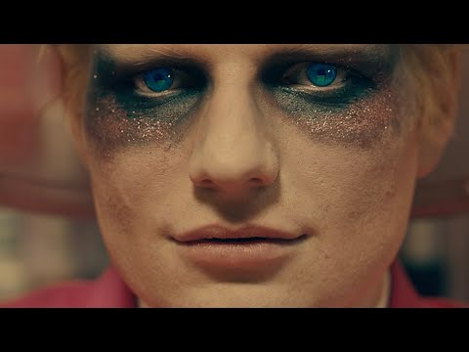
How does a song make money?
https://en.wikipedia.org/wiki/Bad_Habits_(Ed_Sheeran_song)#:~:text=In%20the%20United%20States%2C%20%22Bad,36%2D11%20on%20Radio%20Songs.

Slide 3
Sales, downloads, streams, radio play, tie ins (synchronization)
https://www.officialcharts.com/getting-into-the-charts/how-the-charts-are-compiled/
In the past a CD album sold for £10, an artist would see approx. £2-4 from every sale
https://www.bbc.co.uk/news/entertainment-arts-52652073
https://soundcharts.com/blog/music-streaming-rates-payouts
https://www.prescriptionmusicpruk.com/the-prescription/2016/7/22/how-to-make-sure-you-receive-the-radio-royalties-youre-owed#:~:text=PRS%20per%2Dplay%20payment%20examples&text=BBC%20Radio%201%3A%20%C2%A313.63,Music%3A%20%C2%A35.25%20per%20minute
The synchronization fees charged by music publishers for major studio films are usually between $15,000 and $60,000 (with the majority ranging from $20,000 to $45,000) but can be lower if the music budget is small or higher if the song is used several times in the motion picture,

Slide 4
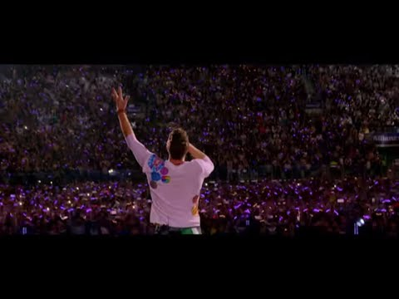

Performance...
£50 average ticket price
Average large stadium/arena 30,000
= £1.5 million a night
https://www.royaltyexchange.com/blog/costs-of-touring
https://www.officialcharts.com/chart-news/sir-paul-mccartney-tops-sunday-times-2021-music-rich-list-as-calvin-harris-and-ed-sheeran-vault-into-top-10__33205/
https://www.youtube.com/watch?v=c4-SAgfVLUY

Slide 5
Notes from documentary:

Slide 6
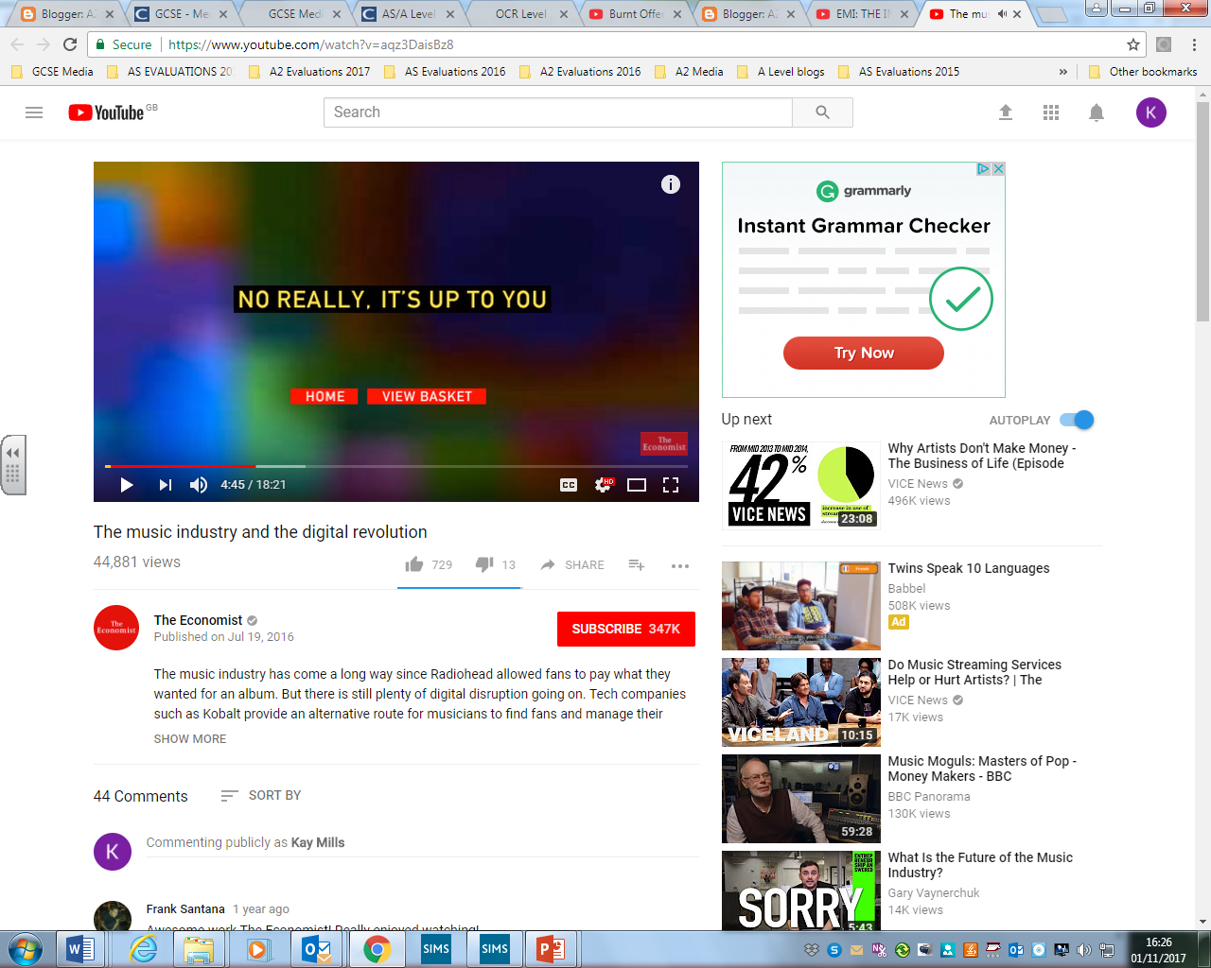
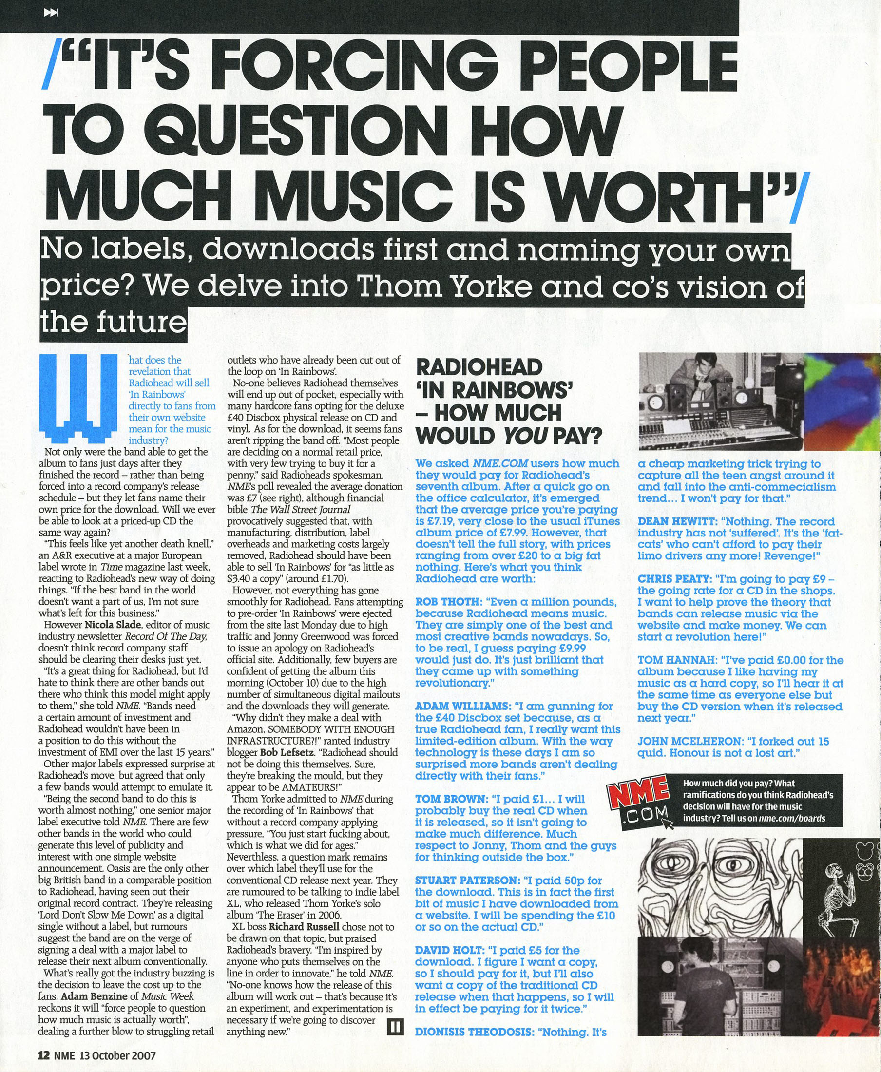
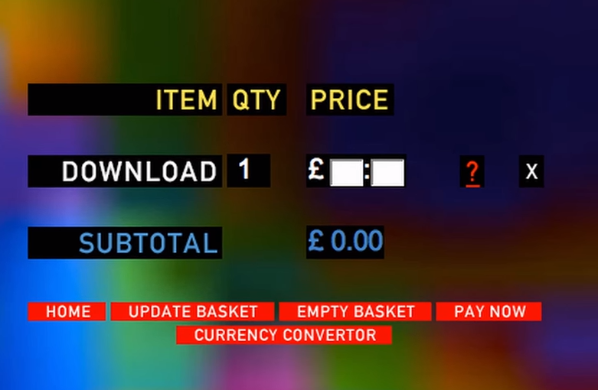
RADIOHEAD
The rise of digital music gave Radiohead the opportunity to challenge the status quo and try a new business model. At the end of their contract with EMI in 2007, they released their new album – ‘In Rainbows’ over the internet themselves and told fans to pay what they thought it was worth…worth…
The pioneering move was a critical AND commercial success. ‘In Rainbows’ earned them more digital income than all their other albums combined and stunned the entire industry…

Slide 7
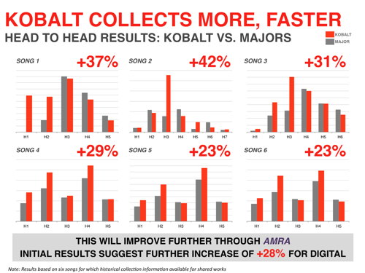

Allows more artists and writers to bypass the traditional industry model- a real threat to the traditional major record labels.
Mission: To take the music industry into the digital age
Transparent, open and fair- a revolution
Music downloads started to give way to a proliferation of streaming sites, like Deezer and Spotify –
Kobalt tells artists what they were being paid , chase rights percentages, monitor every digital download of a song and collects micropayments from every pay on a streaming site protecting the artist and giving them revenue…
Represents over 8000 artists and bands- through their superior software they can track all the music of an artist across multiple sites.
$1/4bn turnover
KOBALT ARE PROVIDING FACILITIES FOR ARTISTS TO RECORD AND DISTRIBUTE THEIR MUSIC, THE MAJOR DIFFERENCE BETWEEN THEM AND A RECORDING STUDIO IS THAT THE ARTISTS GET TO KEEP THE RIGHTS TO THEIR OWN MUSIC…
Yet to break a new act into the mainstream… RECORD COMPANIES ARE BETTER AT MOULDING AND DEVELOPING ARTISTS AS THEY HAVE THE CASH TO SUPPORT THEM WHILE THEY DEVELOP THEIR MUSIC…

Slide 8
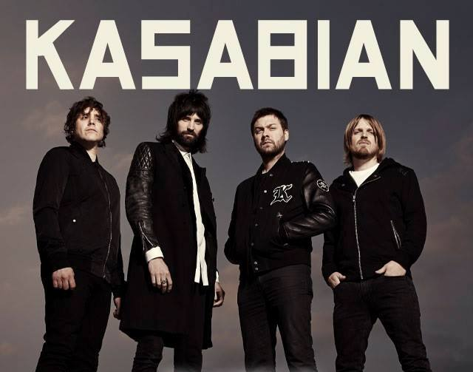

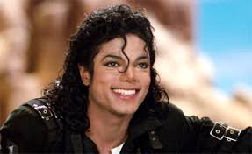
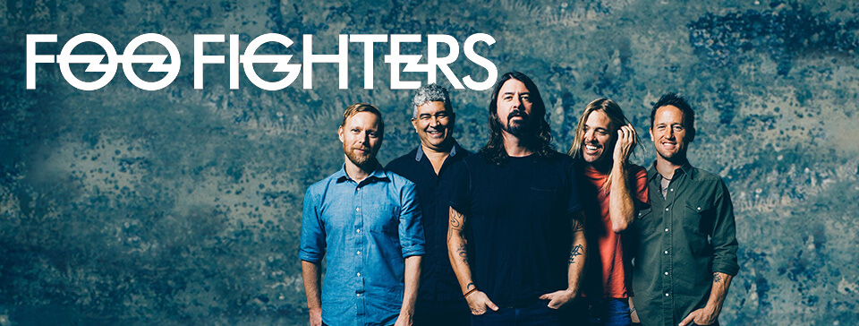

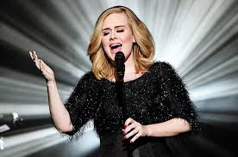
SONY MUSIC
Back catalogue over $1bn in revenue every year
This allows investment into new talent
A virtuous circle as the funds generated by back catalogues create new artists whose successful back catalogues then go onto earn…

Slide 9

SONY CELEBRATES A YEAR AT #1 IN THE UK
Below is a full breakdown of Sony/ATV’s yearlong stay at No. 1 in the UK:
I Took A Pill In Ibiza by Mike Posner (Sony/ATV writer(s) Mike Posner) four weeks at No.1
One Dance by Drake feat. Wizkid and Kyla (Drake, Ayodeji Balogun, Paul Jefferies aka Nineeten85, Errol Reid) 15 weeks
Cold Water by Major Lazer feat. Justin Bieber and MO (Ed Sheeran, Jamie Scott) five weeks
Closer by The Chainsmokers feat. Halsey (Andrew Taggart, Frederic Kennett, Isaac Slade, Joseph King) four weeks
Say You Won’t Let Go by James Arthur (James Arthur) three weeks
Shout Out To My Ex by Little Mix (Camille Purcell) three weeks
Rockabye by Clean Bandit feat. Sean Paul and Anne-Marie (Jack Patterson, Sean Paul) nine weeks
Shape Of You by Ed Sheeran (Ed Sheeran) nine weeks
Sony/ATV Music Publishing is celebrating a full year at No.1 on the UK singles chart, having published or co-published every chart-topper for the past 12 months.
Sony/ATV songwriter Ed Sheeran simultaneously secured his ninth and the publisher’s 52nd consecutive week atop the Official Singles Chart with Shape Of You in this week’s charts.
This company’s stellar run dates back to March 2016 Mike Posner spent the first of four weeks at No. 1 with his single I Took A Pill In Ibiza. Since then, Sony/ATV’s run has included Drake featuring Wizkid and Kyla’s 15-week chart-topper One Dance, as well as No. 1 hits by Major Lazer/Justin Bieber, The Chainsmokers, James Arthur, Little Mix, Clean Bandit and Ed Sheeran.
The landmark coincides with an incredible week for Sheeran. He not only extended his stay at the top of the singles chart to nine weeks with Shape Of You, but also occupies nine positions in the Top 10 and 16 in the Top 20 songs – a first in the history of the Official Charts.
Sheeran’s album ÷ has also enjoyed a multi-record-breaking week, shifting 671,542 copies in its first week and becoming the fastest selling record by a male solo artist of all time.
Sony/ATV chairman and CEO Martin Bandier, said: “We can’t underestimate this incredible accomplishment. It’s difficult enough to have one No. 1 but 52 weeks or a solid one year is unheard of. It proves our global approach to music with a strong local A&R presence is a successful strategy.”

Slide 10




THERE IS A GROWING NUMBER OF NEW ARTISTS THAT DON’T SEEM TO NEED THE RECORD COMPANIES AT ALL…
JACOB WHITESIDES BUILT HIS FANBASE HIMSELF, POSTING VIDEOS OF HIMSELF SINGING FROM THE AGE OF 13, PROMOTING HIS WORKTHROUGH SOCIAL MEDIA.
HE NOW HAS MORE TWITTER FOLLOWERS THAN MADONNA…
TWITTER 1.8M
FACEBOOK 1.5M
INSTAGRAM 1.8M
THIS IS A NEW GENERATION OF DIGITAL ARTISTS WHO DISMISS FORMER BUSINESS MODELS…

Slide 11
CHANGES
SONY ARE INVESTING IN NOT JUST THE ARTISTS BUT ALSO THE PLATFORMS THAT PLAY THEIR MUSIC
IT IS CLAIMED THAT SONY OWN 20% OF SPOTIFY, WITH AN ESTIMATED WORTH OF $1.5 BN
They have become more ‘service oriented’ focusing on how best to make artists’ work more commercial
Jacob Whitesides – Signed a record deal with BMG with terms that would have been unthinkable years ago and he retains all rights to his music:
‘FANS ARE MORE POWERFUL THAN ANY RECORD COMPANY…
They SAW how much leverage I had and that I didn’t really need them, it was more of a partnership type thing.
We’re in an age where people with nothing to do with music can build up a profile on social media and find success, not a disruption, an opportunity.
Flexibility is more necessary now than ever if labels are to stay on top
MOBY - MAJOR LABELS THOUGHT THAT THEY WERE MORE IMPORTANT THAN THE ARTISTS AND THEY NEVER WERE…AND NOW , AS THE ARTISTS LEAVE, THEY’RE BEGINNING TO SEE THAT IN THE WORLD OF MUSIC, NOTHING IS BIGGER THAN THE MUSIC ITSELF.

Slide 12
NEW BANDS
EMERGING ARTISTS SUPPORTING ESTABLISHED BANDS LIKE FAITHLESS
UNTIL THE RIBBON BREAKS RECENTLY SIGNED FOR SONY, THEIR PRAGMATIC DIGITAL APPROACH WAS THE MAJOR APPEAL FOR THE BAND.
IT’S NOW ABOUT MAKING A CAREER RATHER THAN HAVING A MOMENT AT THE TOP…

