Slide 1
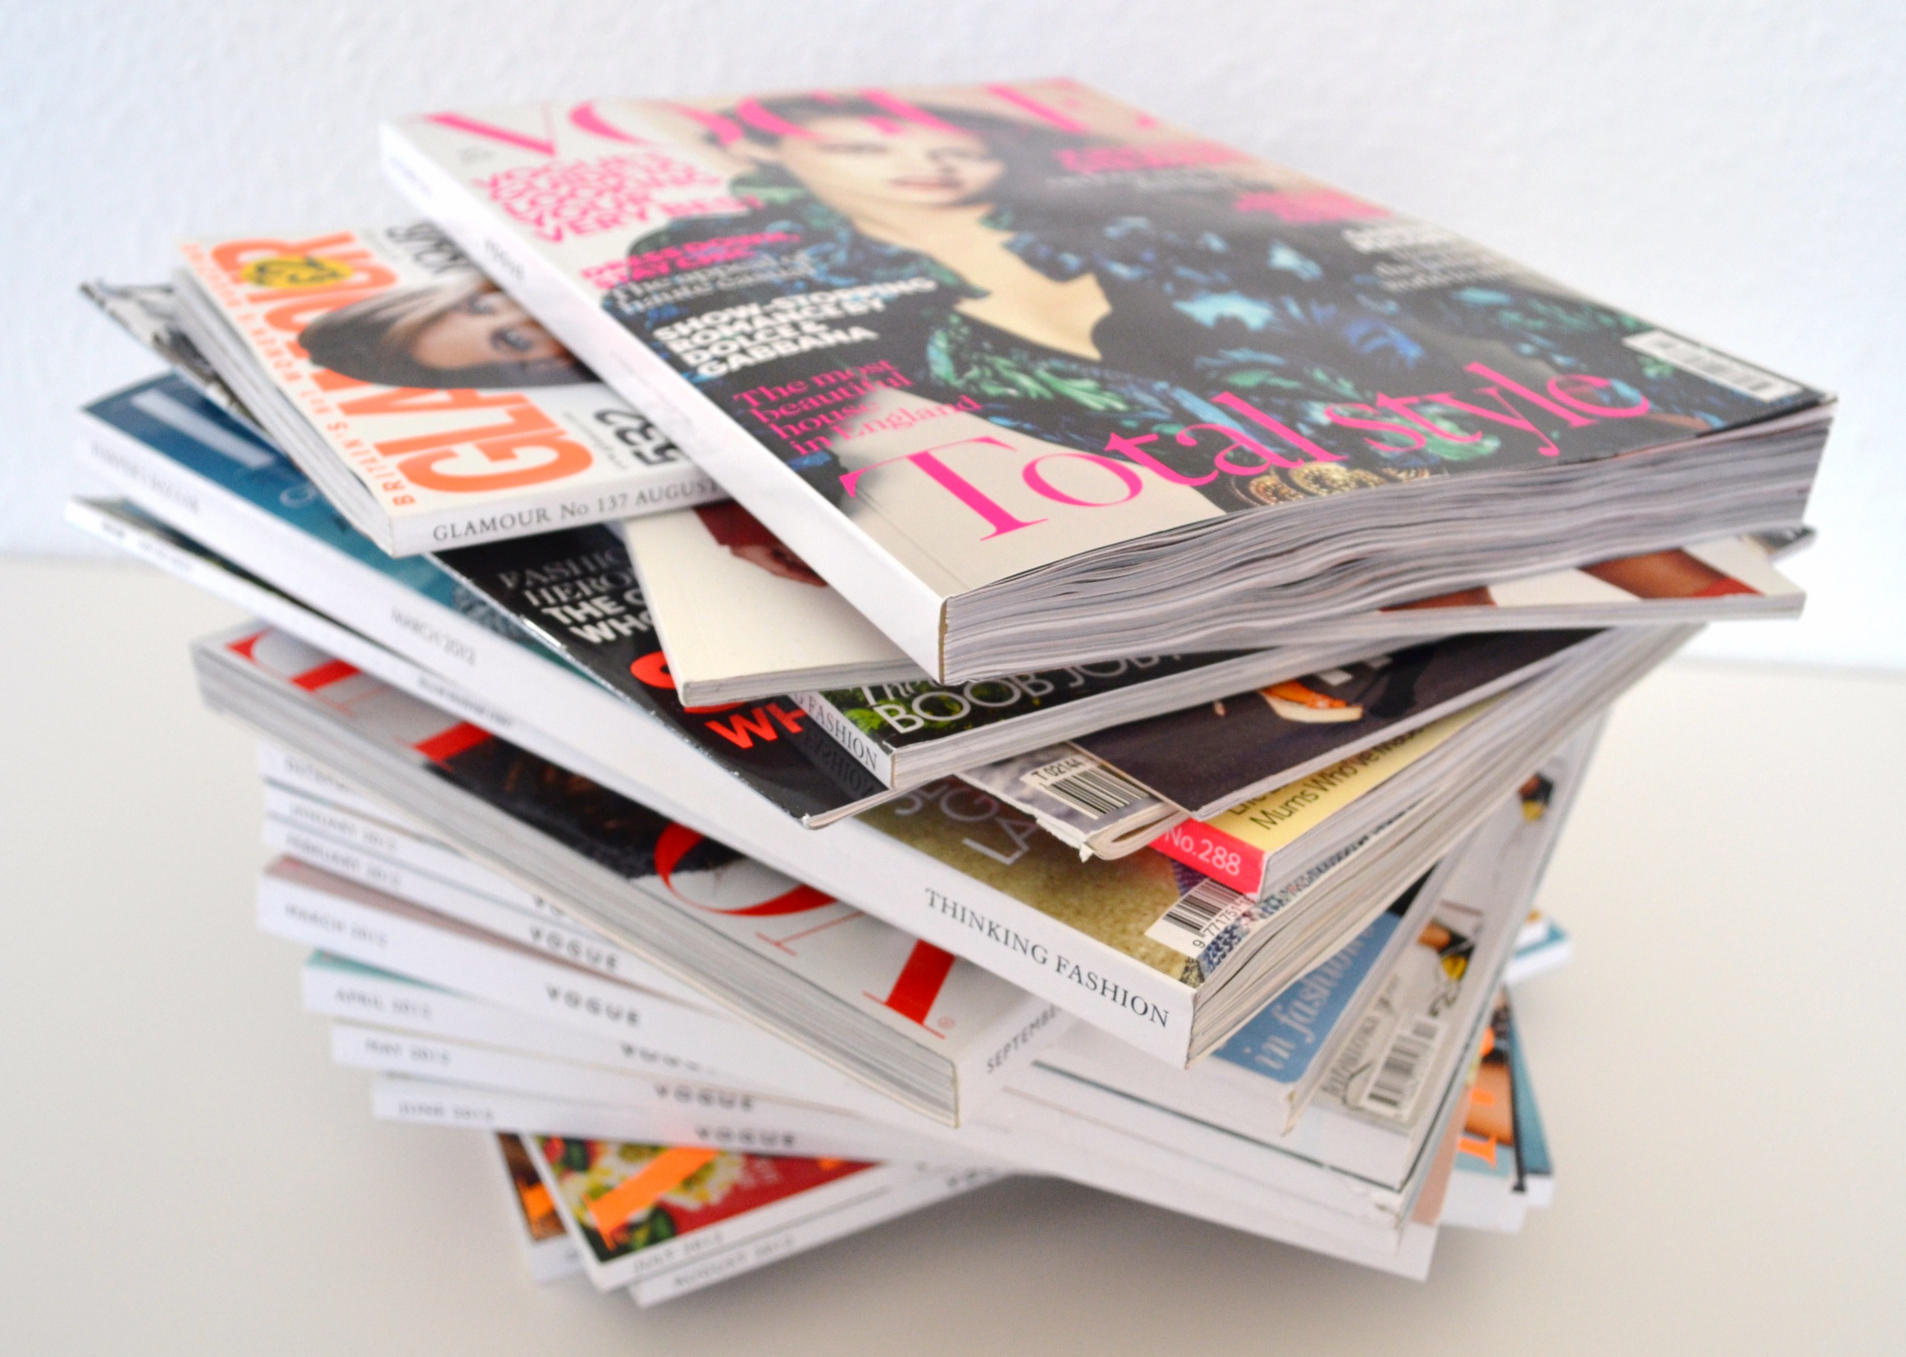
MAGS (with Big Issue)

Slide 2
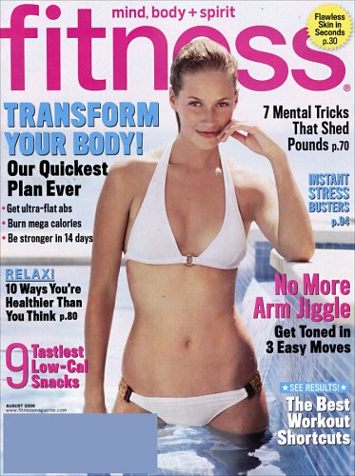
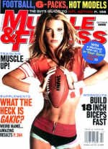
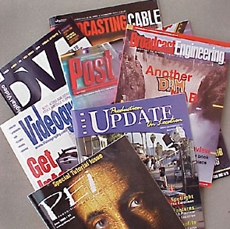
CATEGORISING MAGAZINES
Most magazines are CONSUMER MAGAZINES which are sold in shops and on news-stands for information and entertainment.
Consumer magazines are either aimed at the general public (GENERAL INTEREST) …
… or at niche audiences (SPECIALIST).
Over 5000 titles are TRADE MAGAZINES which are directed at business, industrial and professional groups and are bought by subscription or distributed for free – not sold to the general public.
Some other special interest magazines are sold only by SUBSCRIPTION.

Slide 3
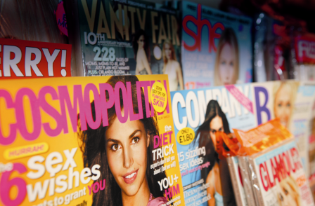
DEFINING MAGAZINES
The word ‘magazine’ comes from the Arabic word ‘makhazin’ which means ‘storehouse’.
A MAGAZINE is a collection of articles and stories, together with illustrations and photographs, mainly designed for reading as a leisure activity.
Magazines lose on average 5.9% of circulation every year. (2017 figs)
Only 60 of 422 titles audited in 2015 grew in sales.
Price-cuts and give-away copies help Cosmopolitan lead growth in women's fashion and lifestyle titles
Condé Nast produces fashion bible Vogue which turned 100 years old in 2016 and has 2.3 million followers on Twitter.
TV Choice is the UK’s biggest selling title at 50p. The Radio Times costs £1.80 and claims to be the best.
In the UK, there are approximately 2800 consumer magazine titles.

Slide 4
Look at the following and rank them with what you agree with most to least.
1. Magazines are a dying media platform. The total circulations in the marketplace tumbled by more than 15 million copies in 2014.
3. Print magazines are unique. They exist in the same physical space as us human beings, digital magazines don’t. Digital magazines are behind an “on” button on your tablet, or behind an app or a browser… they are not just ‘there’.
2. Print advertising is still effective. It is interruptive and in-your-face. Ads online lead to Banner Blindness, but readers can’t ignore the ads in a publication. The very physical act of having to turn a page ensures that.
4. If magazines are to survive, they need to provide the kind of content people can’t get online.
5. I’ve never paid for a magazine.
6 Magazines are boring, they are just things to look at in the Doctor’s waiting room.
7. It would be sad if magazines did not exist anymore.

Slide 5
KEY TERMS
circulation number of copies a magazine sells
readership not just who buys a magazine but the total number of people likely to read it
mass audience readership on a very large scale
niche audience narrow group of readers with a particular interest
subscription where a reader pays for a set number of copies of a magazine in advance at a lower price and receives them by post

Slide 6
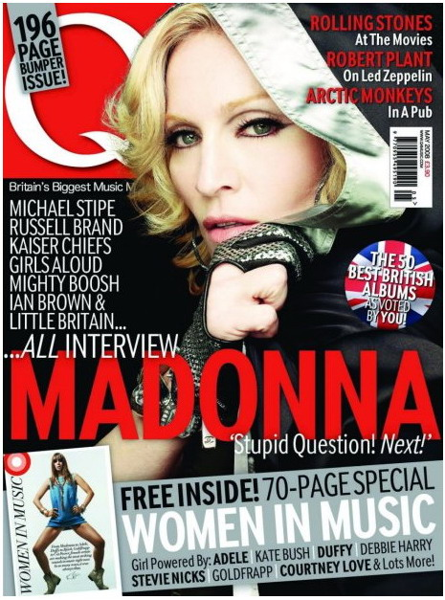
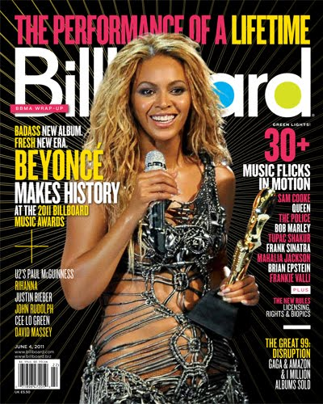
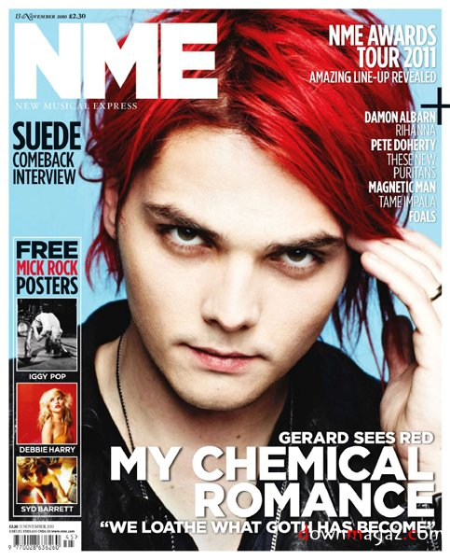
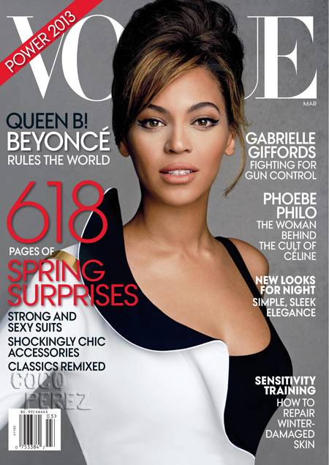

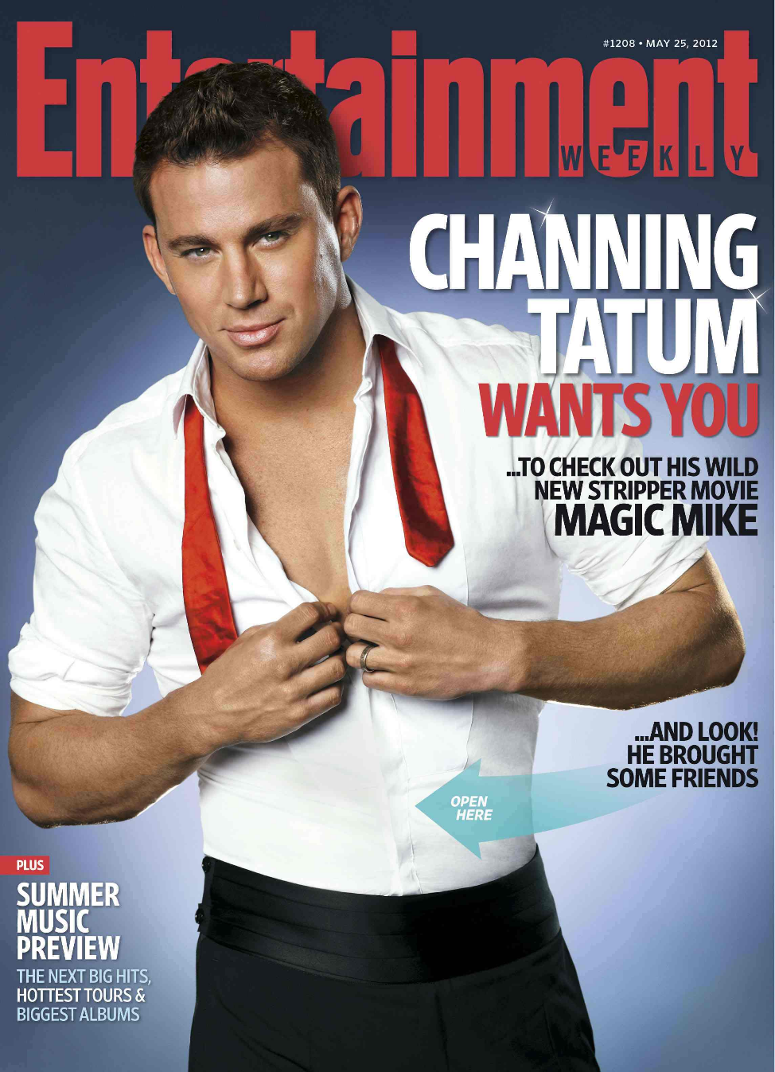
KEY TERMS
Masthead - the title of the magazine
Plug - text that ‘plugs’ a feature that will appear inside the magazine
Puff – an attention grabbing panel, often ‘puff’ shaped.
Cover Star – the ‘star’ featured on the cover
Anchorage Text - text that anchors the main image and gives it context/meaning
Banner – text that runs across the lower section of the cover
Strapline – text that runs across the top of the cover

Slide 7
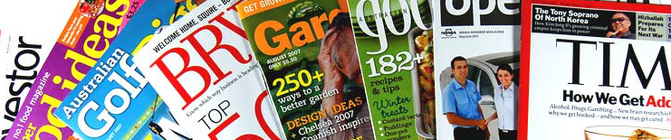
ADVERTISING IN MAGAZINES
Without advertising, no magazine could survive. If a magazine did not contain ads, then its COVER PRICE would be three or four times greater.
The INCOME for a magazine comes from both sales and advertising. On average, advertising accounts for 70% of magazine income.
A magazine with a small CIRCULATION is more dependent on advertising than one with a large circulation.

Slide 8
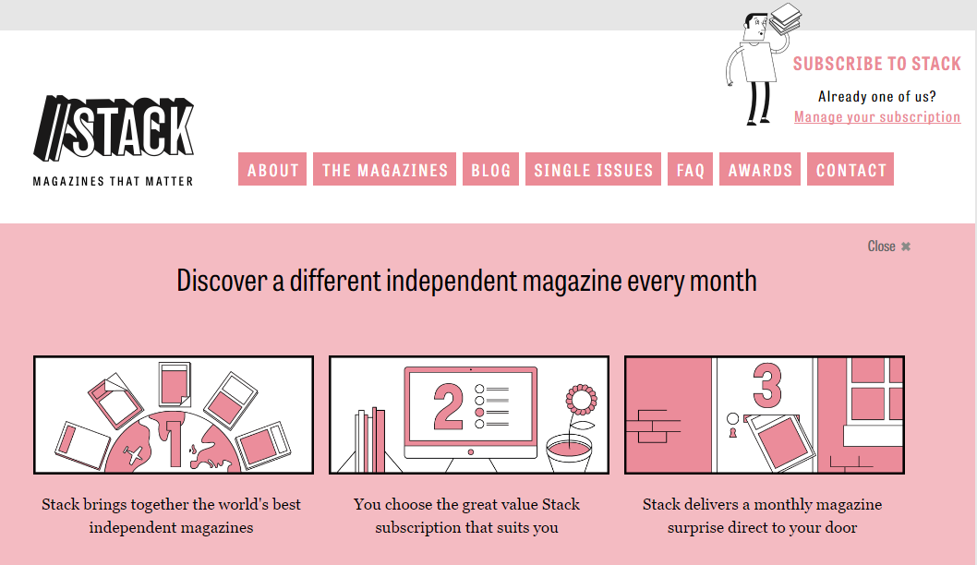
What is the future of print?
Steven Watson founded the innovative subscription service Stack – which transfers the lucky-dip principle of the vegetable box to the delivery of independent magazines.

Slide 9
Your turn...
You are going to create a magazine front cover for a new magazine of your creation.
Decide the area of interest your magazine will cover (genre).
Decide whom you think the audience will be for your magazine.
Decide how much you think you can charge for your magazine (look at other magazines in the genre for research).
Scavenge a cover star photo of someone or something appropriate from the web.
Use word, powerpoint, slides, publisher, pages or anything else you can to create the front cover of your new magazine.
It must include a masthead, plug, puff, cover star/image, anchorage text, banner and strapline. It can also include a barcode, dateline, coverline and price.
You have this lesson and prep to complete the task. You will be expected to present your cover to the rest of the class.

Slide 10


Who is the…
https://youtu.be/kYO-TeBzYWY
Make notes on the magazines aims
Circulation figures
https://metro.co.uk/2014/06/10/big-issue-4754765/

Slide 11


First published in 1991
Most widely circulated street newspaper
Hybrid genre (entertainment and social business)
Audience 18-49
Entertainment aspect attracts advertising revenue
Editorial content if often critical of big business, banking and champions the political cause and role of the individual within society
Costs £2-50 / £1-25 goes to the trader
Costs £3.00: £1.50 goes to the trader

Slide 12
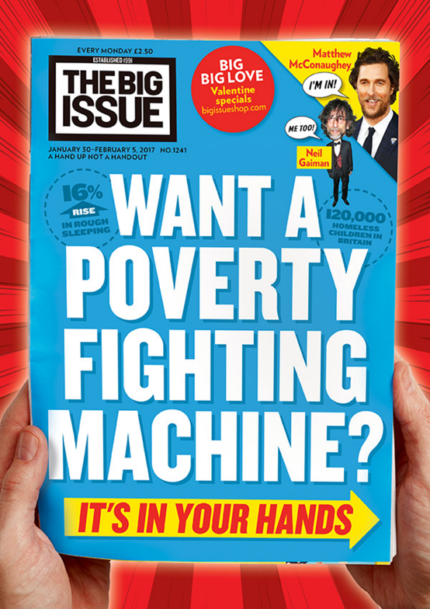
1500 vendors
Sold over 200 million copies
Inspired a network of 120 similar street magazines
Primary objective
Independent publication to offer a public service and to try and improve a social problem

Slide 13
“ETHICAL CAPITALISM”
- John Bird
What does it mean?

Slide 14
Social, Cultural and Political Contexts
MEDIA CONTEXTS

Slide 15

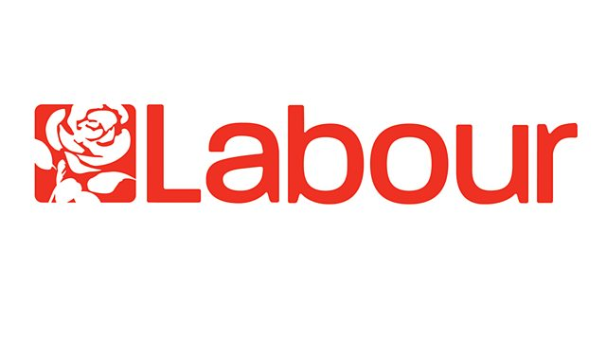

Political Context
What is politics?
Left and Right ideologies
https://www.youtube.com/watch?v=JlQ5fGECmsA
https://www.youtube.com/watch?v=rMXJOKhf_AA

Slide 16
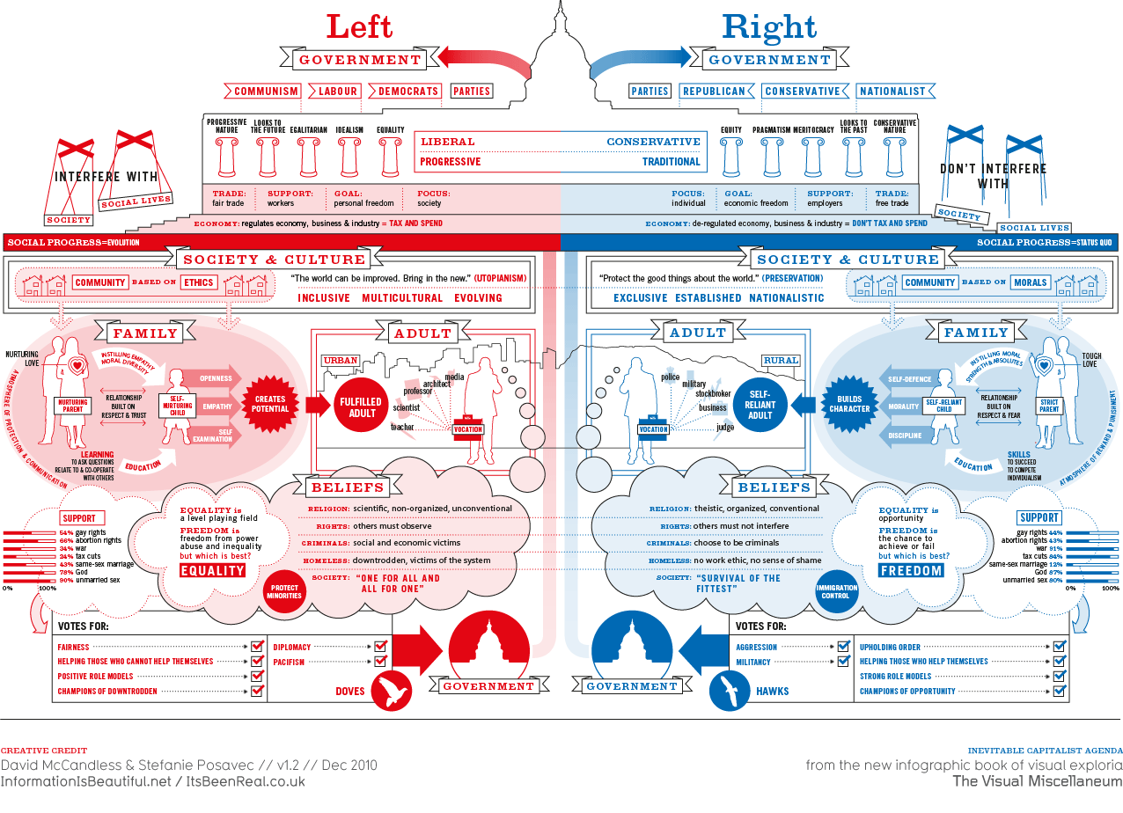

Slide 17
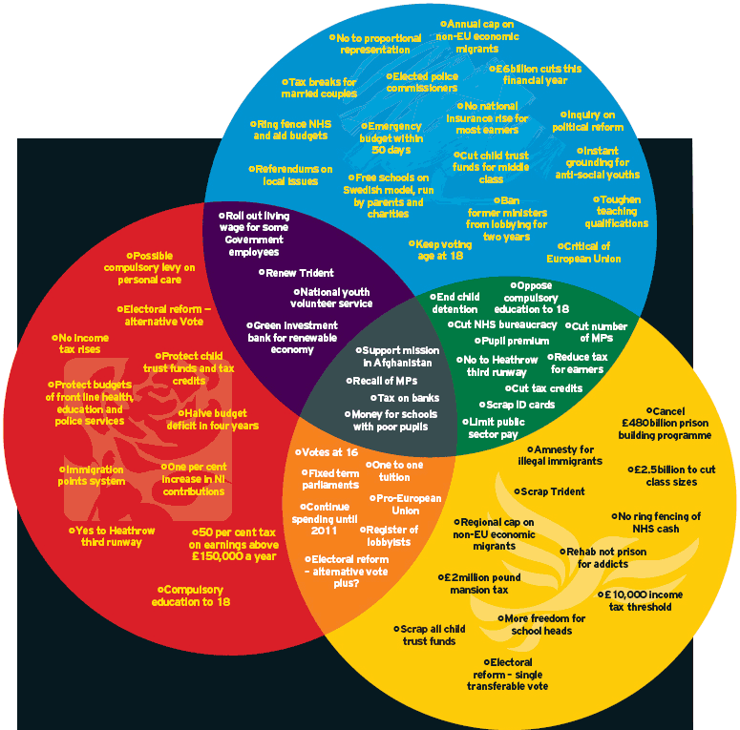

Slide 18


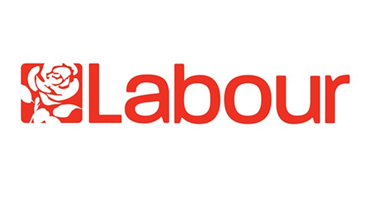
Political Context
Which political party reflects your values?
Current Leaders:
Conservative: Boris Johnson
Labour: Sir Keir Starmer
Liberal Democrats: Ed Davey
https://www.youtube.com/watch?v=XrBA_mKxW68
http://www.whoshouldyouvotefor.com/index.php

Slide 19
How are the following cover typical of what you would expect from the ‘Big Issue’

Slide 20
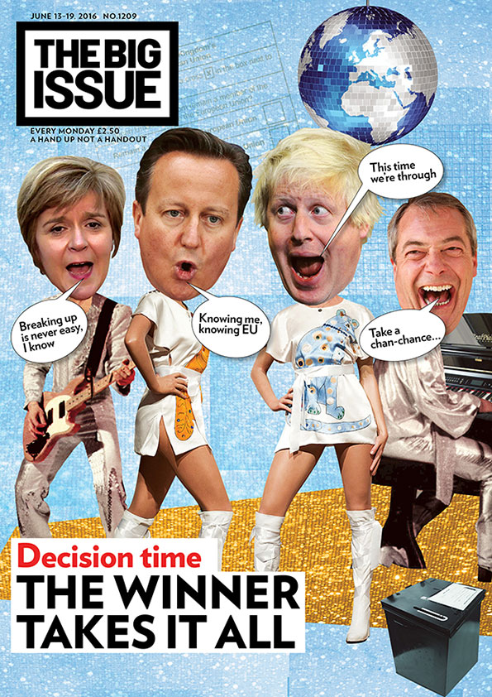

Slide 21
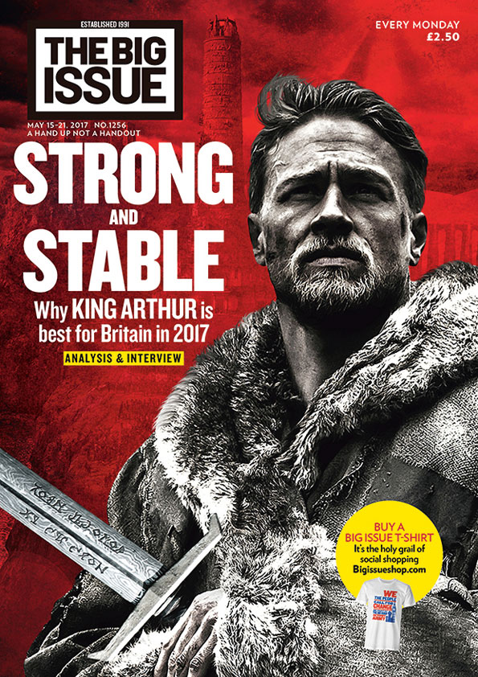

Slide 22


Slide 23
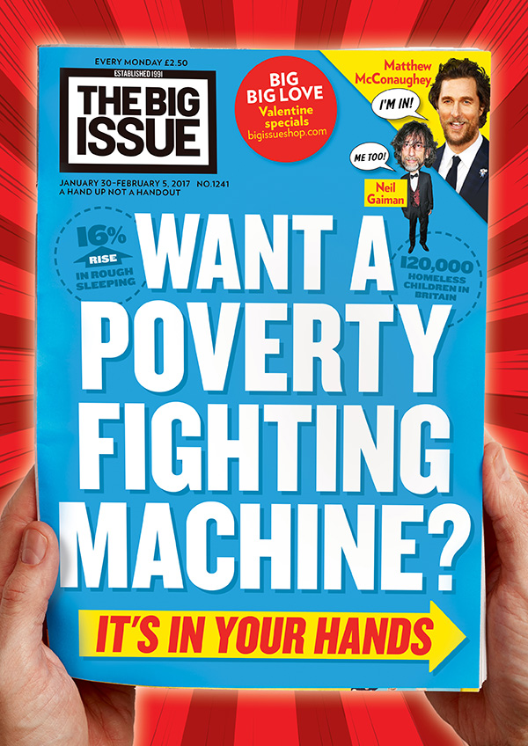

Slide 24
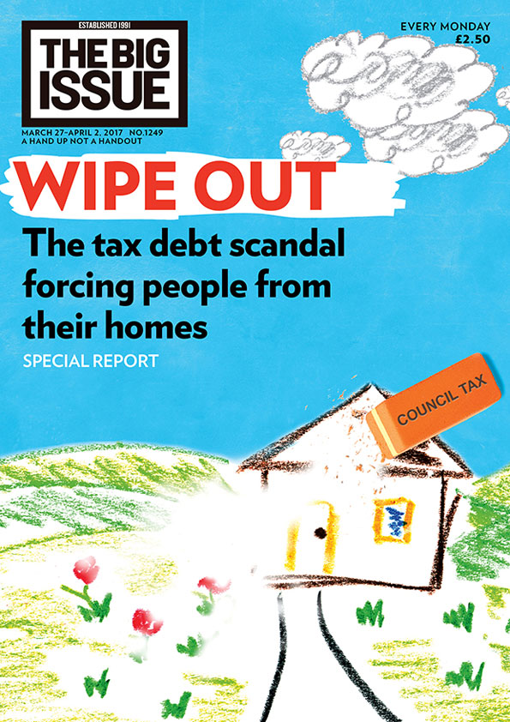

Slide 25
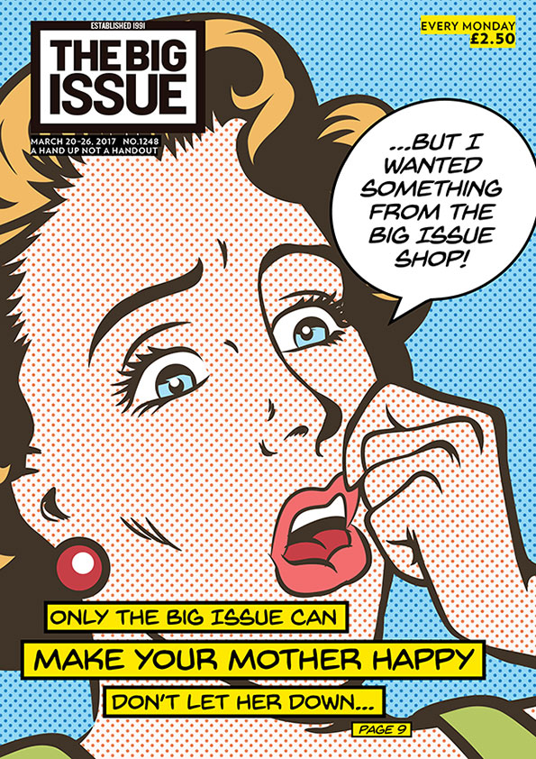

Slide 26


Slide 27
Questions

Slide 28
5 Explain how representations in magazines are chosen to promote idealogies and viewpoints of the magazine. Refer to one of the magazine covers you have studied to support your answer. [10]
5 Explain how viewpoints and ideologies are communicated by the media language used in magazine covers.
Refer to Source C to support your answer. [10]
6 Analyse why The Big Issue magazine has used an intertextual approach to the referendum on its front cover.
In your answer you must:
Analyse the use of intertextuality to create meaning in the source
make judgements and reach a conclusion about the advantages of this use of intertextuality to The Big Issue magazine. [15]
6 Analyse how individuals and social groups are represented through processes of selection and combination of text and image in Source D.
In your answer you must:
analyse how media representations are constructed in Source D through the selection and
combination of text and image
make judgements and draw conclusions on the effectiveness of the representation of gender
and identity through the media form. [15]

Slide 29
Your set covers…
The question may show you an unseen Big Issue cover, or it may ask you to talk about your ‘set’ covers.
(these may change if I find a better pair in the next few months)

Slide 30
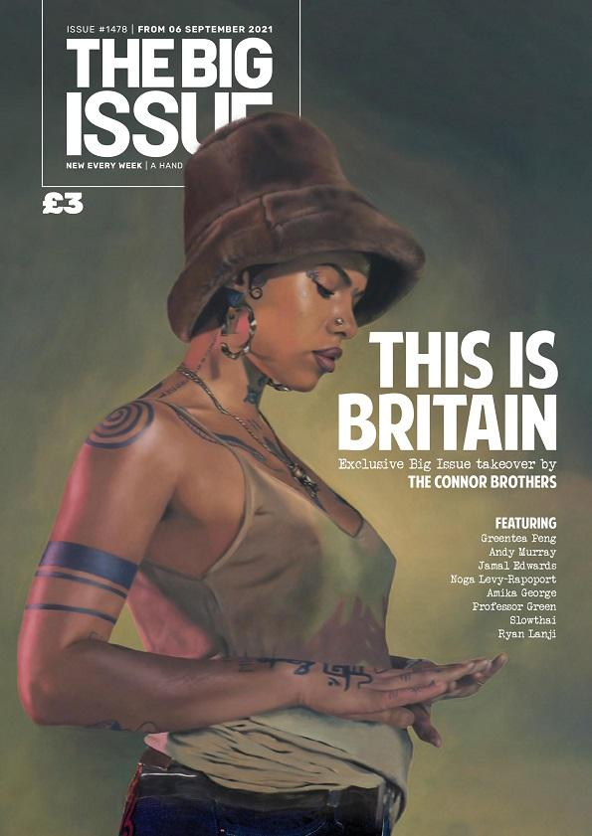

Slide 31
