Slide 1
Background to D83
The Cold War

Slide 2
We’re going to Watch some Videos...

Slide 3
Then I am Going to GO back over what they have said...

Slide 4
Then you are going to make a timeline!

Slide 5
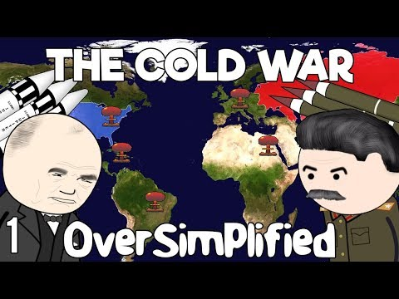
Cold War pt 1

Slide 6
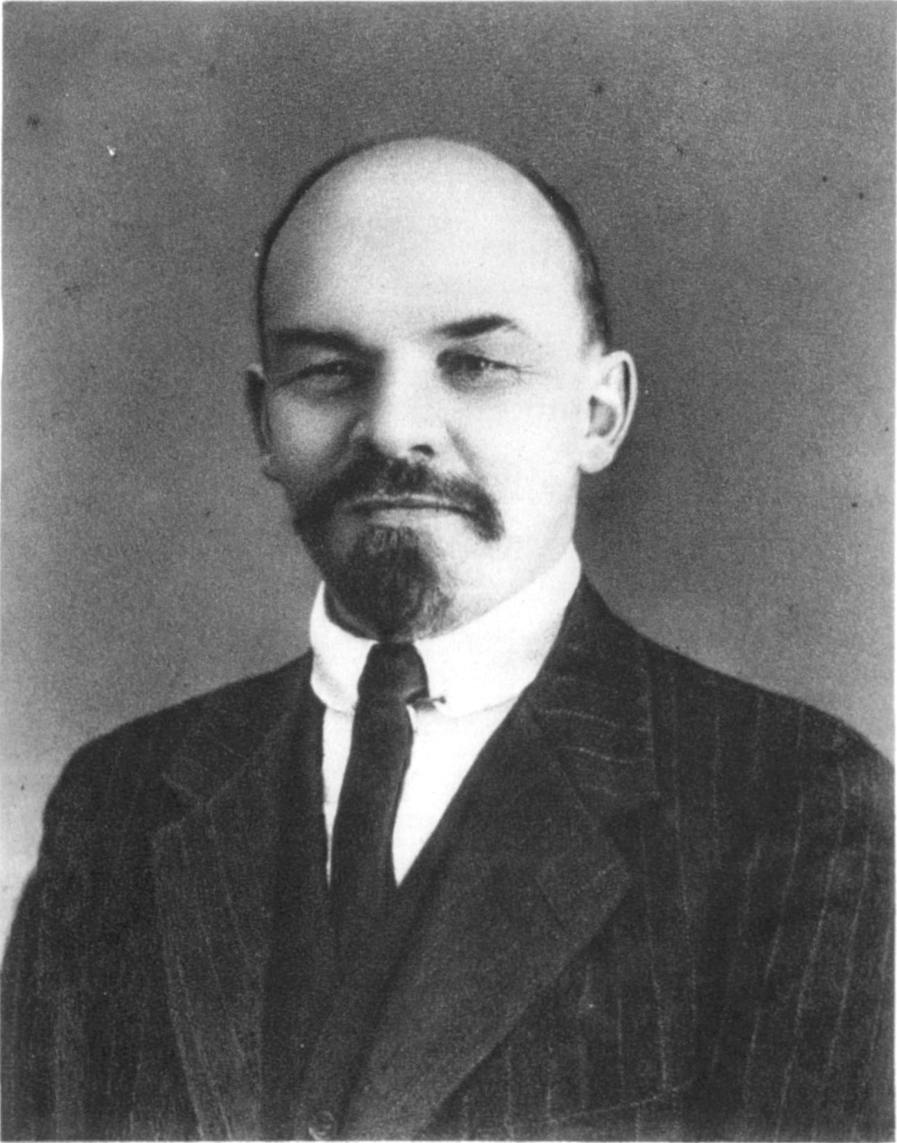
Key Points from Cold War Part 1 - 1917 to 1961
1917 - Germany release Lenin to allow him to go back to Russia and create trouble at home, so Russia pulls out of WW1.

Slide 7
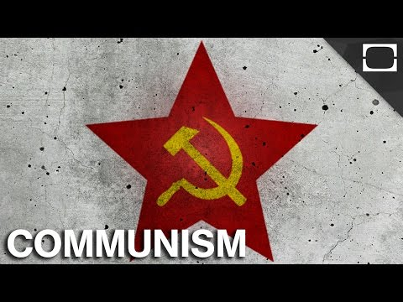
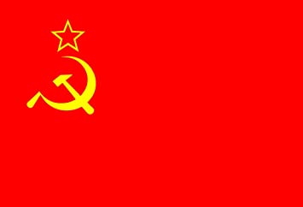
Russia becomes Communist and known as The Soviet Union

Slide 8
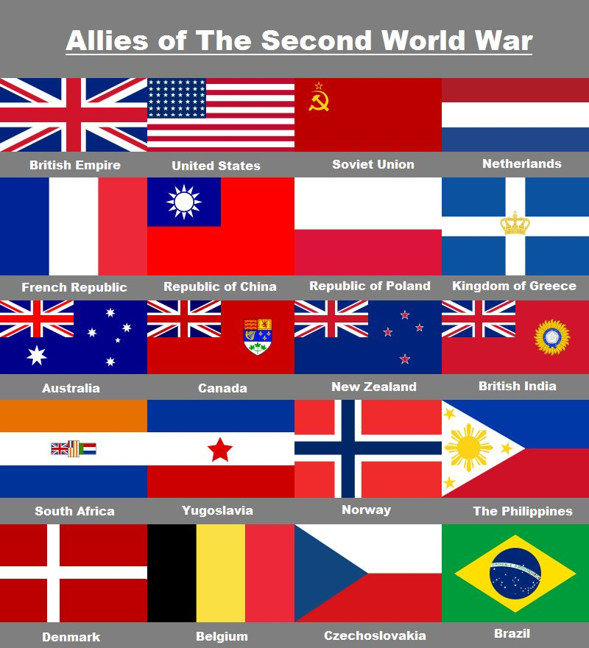
WW2
Stalin now in charge of the USSR.
After WW2 is ‘given’ eastern Europe, but instead of maintaining democracy in small states, creates the...

Slide 9
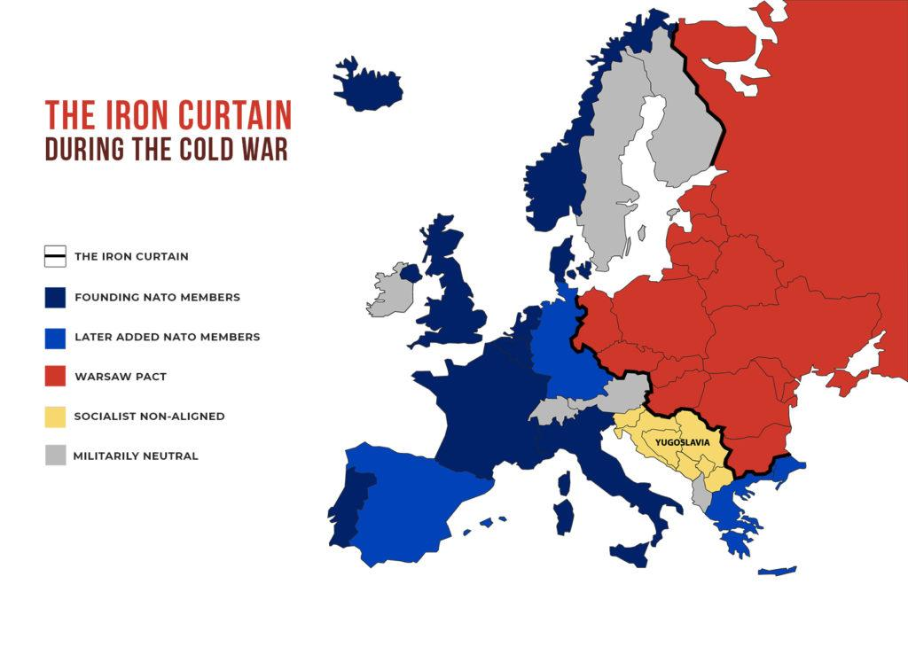
...Iron Curtain

Slide 10
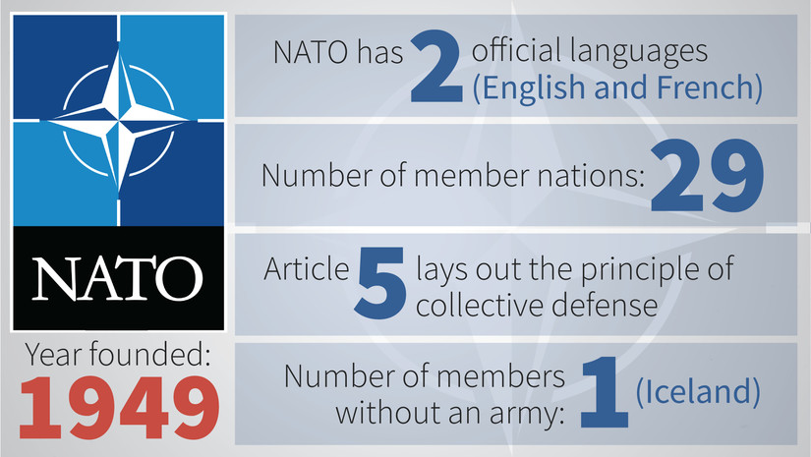
Nato Established 1949

Slide 11
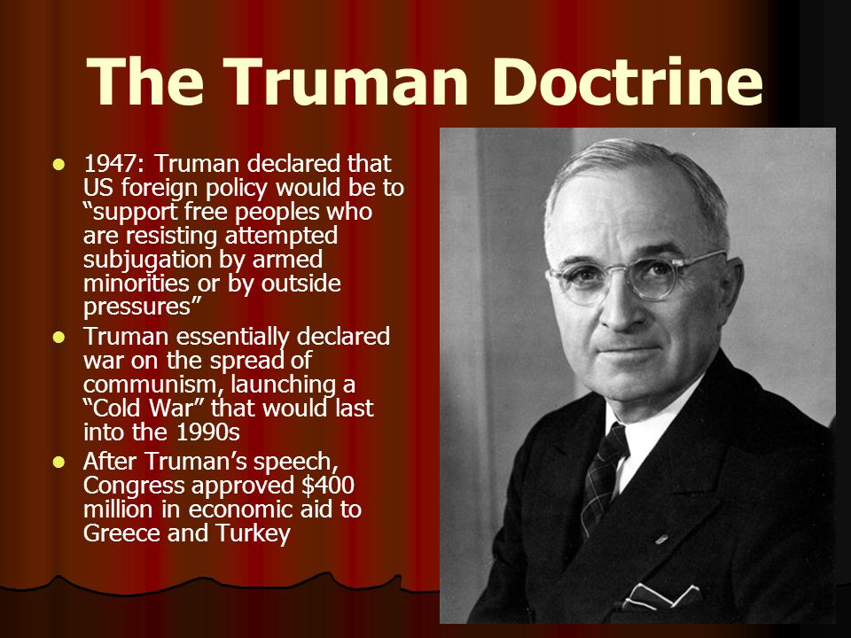

Slide 12

1948 - The Marshall Plan

Slide 13
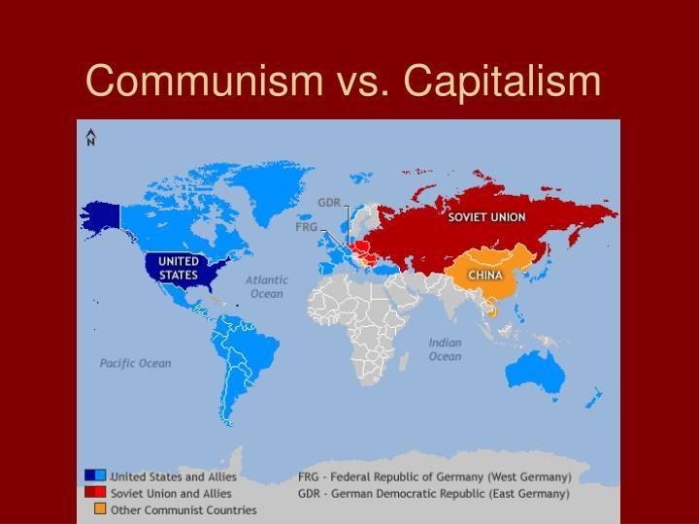

Slide 14
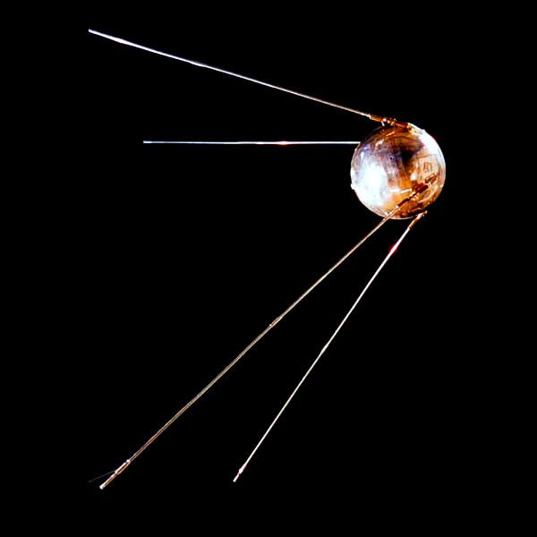
Cold War Produces:
Spies
Weapons race
Space race

Slide 15
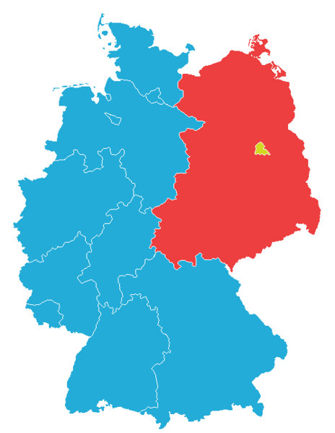
A divided Germany...

Slide 16
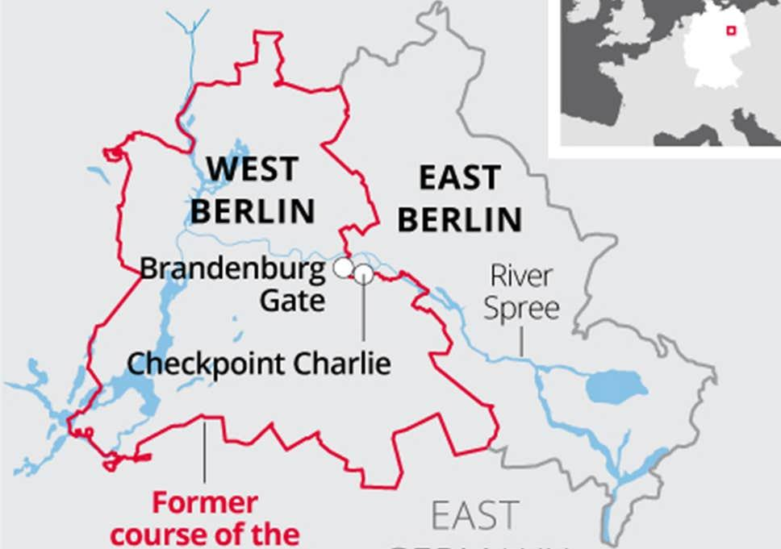
A divided Berlin
Free travel, showing those on the East what they are missing…

Slide 17
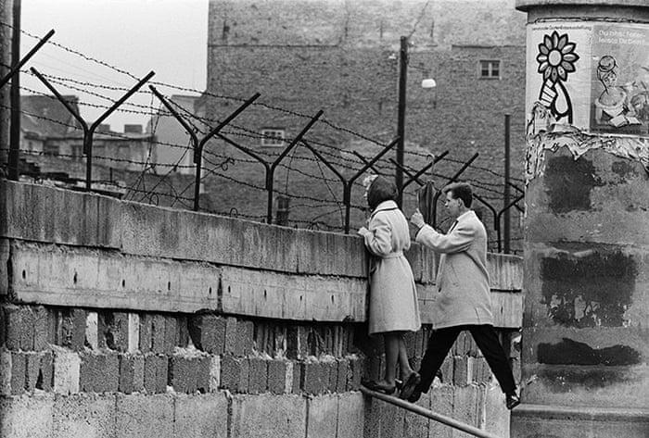
The BErlin Wall… AuGust 13th 1961
Families torn apart overnight.

Slide 18
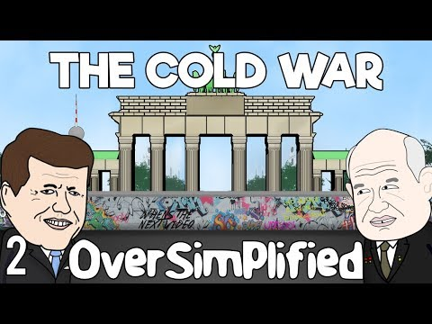
Cold War pt 2

Slide 19
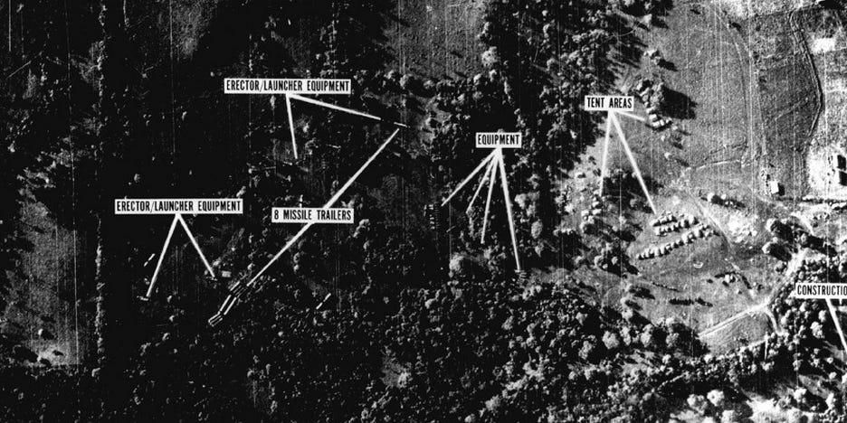
Key Points from Cold War Pt 2 1962 - today
Cuban Missile Crisis 1962

Slide 20
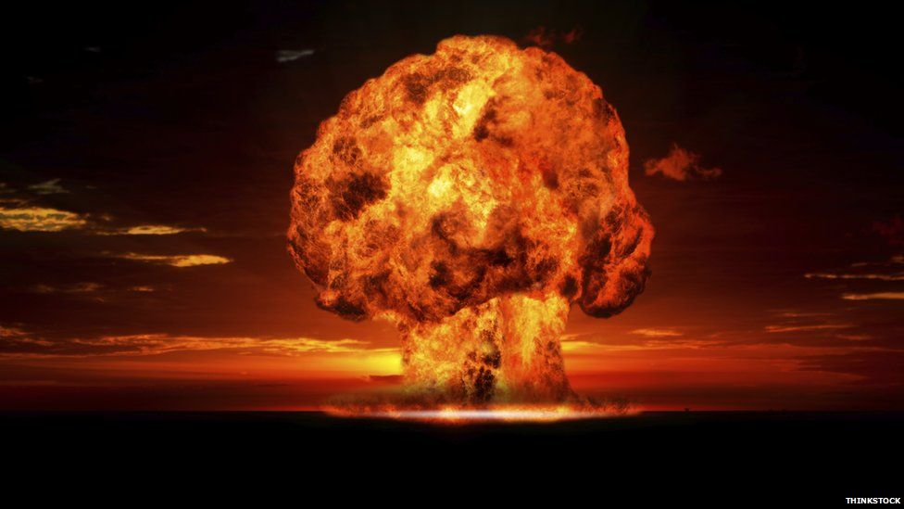
Test Ban Treaties 1963+
MAD
Mutually
Assured
Destruction

Slide 21
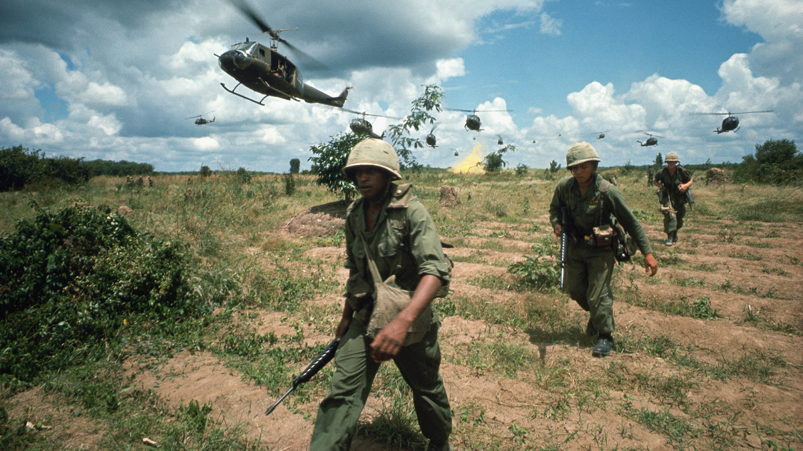
1965 - AMerican Involvement in Vietnam begins

Slide 22
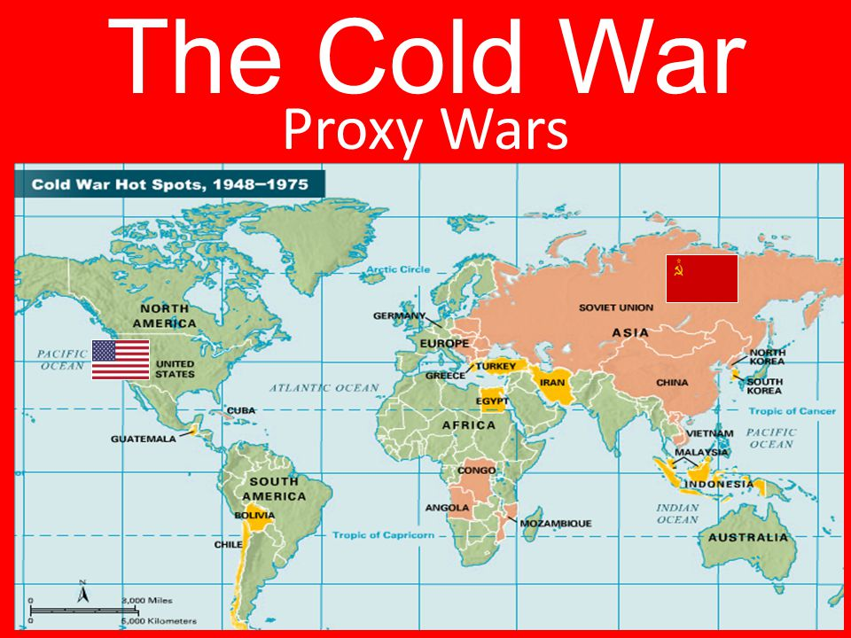
Sets a Pattern - no big wars, Just lots of involvement in little ones.

Slide 23
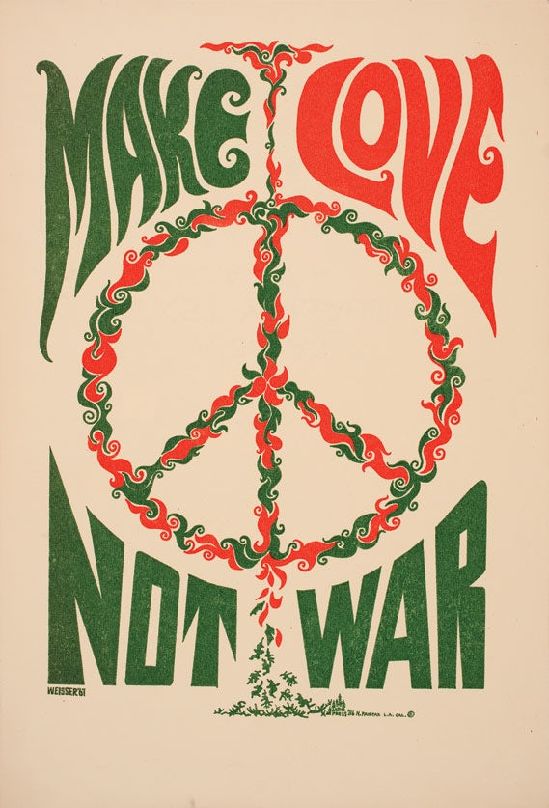

Slide 24
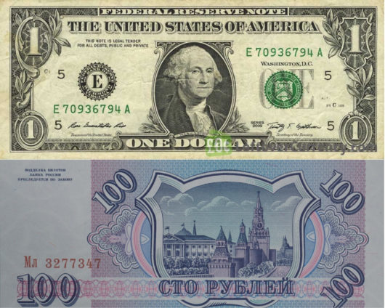
Cold War Was Expensive for both sides...

Slide 25
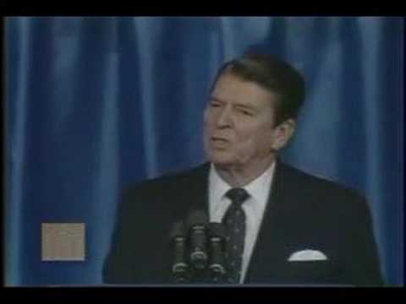
1980 - Reagan Elected
Republican - hawk
Space Defence Initiative (Star Wars)
1983 - Evil Empire speech

Slide 26
1983

Slide 27
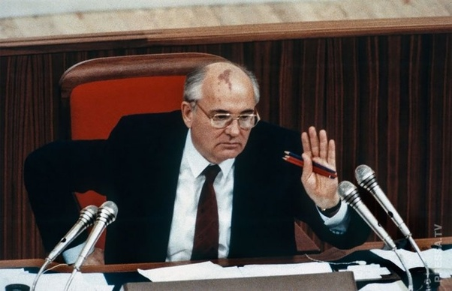

Slide 28
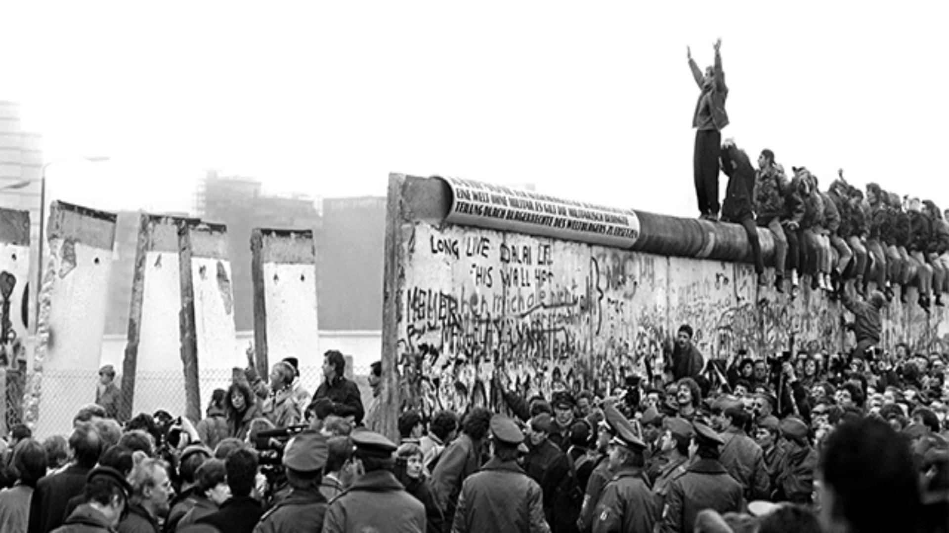
1989 - Berlin Wall Falls

