Slide 1
Component 02 Section A
Radio:
Radio 1 Breakfast Show

Slide 2
Lesson aims
To understand how radio fits into the exam and what you will be examined on
To briefly explore the history of the BBC
To understand the funding and regulation of the BBC
To understand the BBC’s PSB remit and to see how the remit influences broadcast content
To research the Radio 1 Breakfast Show

Slide 3
Radio – exam context
Component 02 Section A

Slide 4
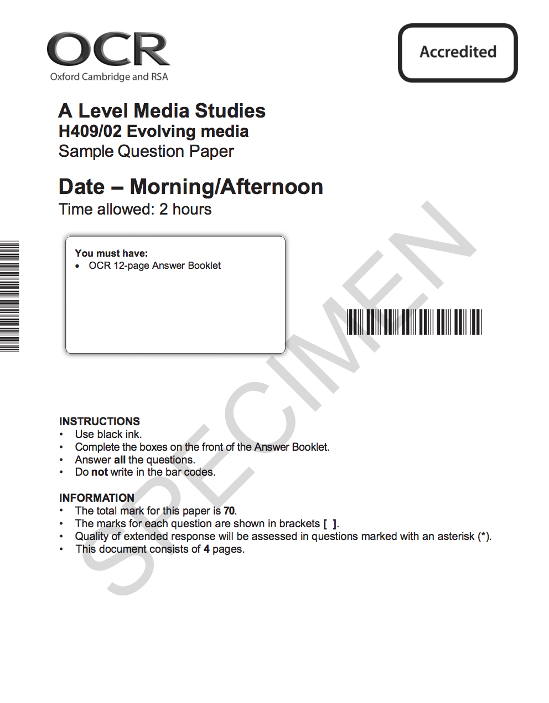
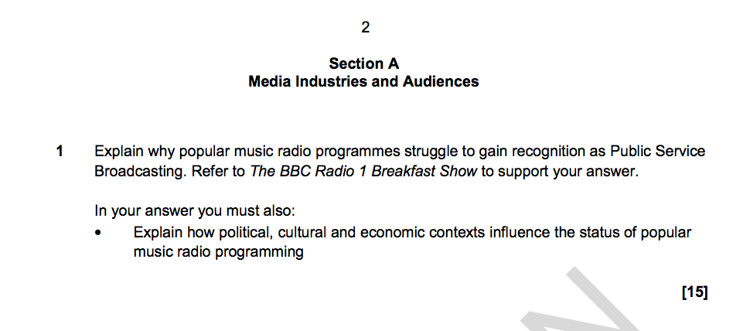
Exam Structure – Component 02 Section A
On same part of exam paper as Minecraft and Jungle Book
One 15 mark question
Knowledge of theoretical framework of Industries and Audiences being tested.
Need to refer to Radio 1 Breakfast Show, including examples from a broadcast, and to demonstrate your knowledge of the BBC.

Slide 5
What do you need to know for the exam?
You need to be able to discuss how the Radio 1 Breakfast Show
  Is regulated (industries)
  Reflects the BBC’s remit and public purposes (industries)
  Reaches and maintains its audience through the content of the show (audiences and industries)
  Uses technology to reach a wide audience and to respond to technological change (audiences and industries)

Slide 6
The Radio Industry

Slide 7

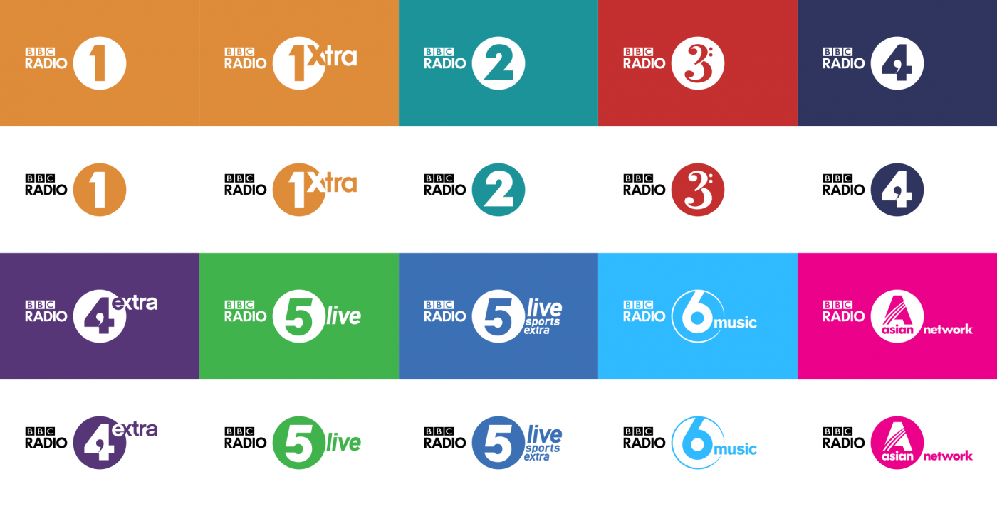

Slide 8
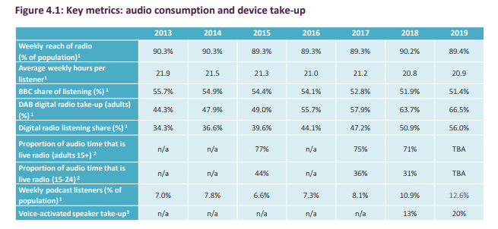
The Industry as a whole – Ofcom: Overall

Slide 9
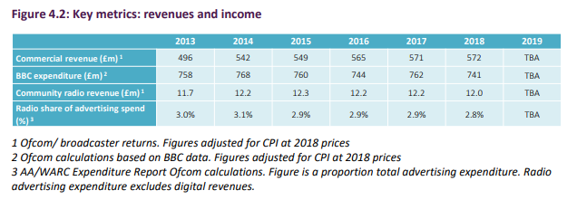
Ofcom: Radio spend

Slide 10
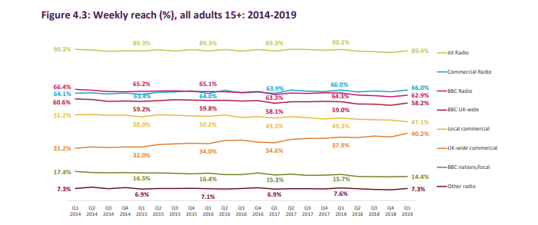
Ofcom: what types of radio do we listen to?

Slide 11
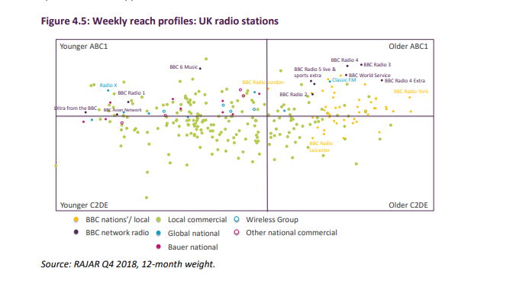
Ofcom: Who is listening to what?

Slide 12
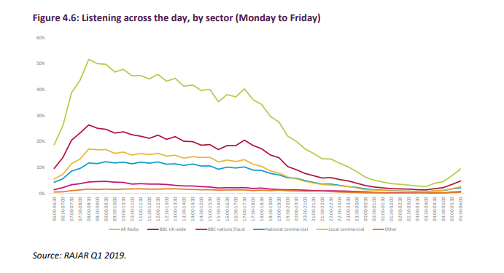
Ofcom: When?

Slide 13
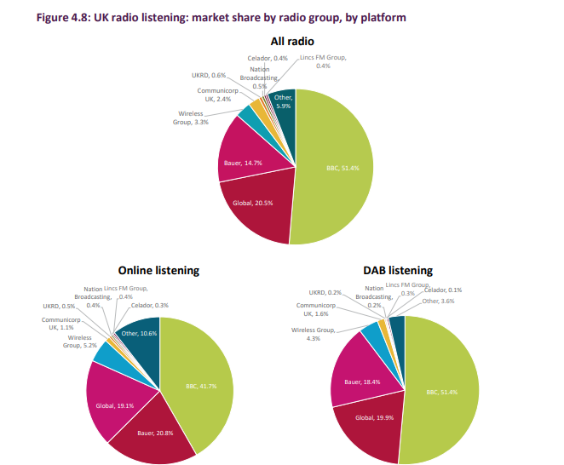
Ofcom: Made by whom and how access?

Slide 14
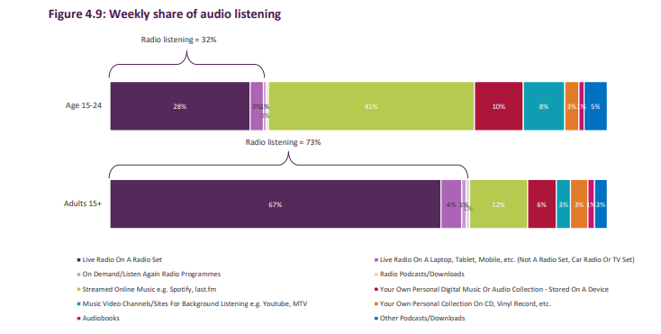
Ofcom: Things are changing

Slide 15
Who listens to the radio?
Table discussion
  When do you listen?
  Where do you listen?
  How do you listen?
  What do you listen to (commercial or BBC?)
  Why don’t you listen?
  Why is this a problem for the BBC?
Feedback

Slide 16
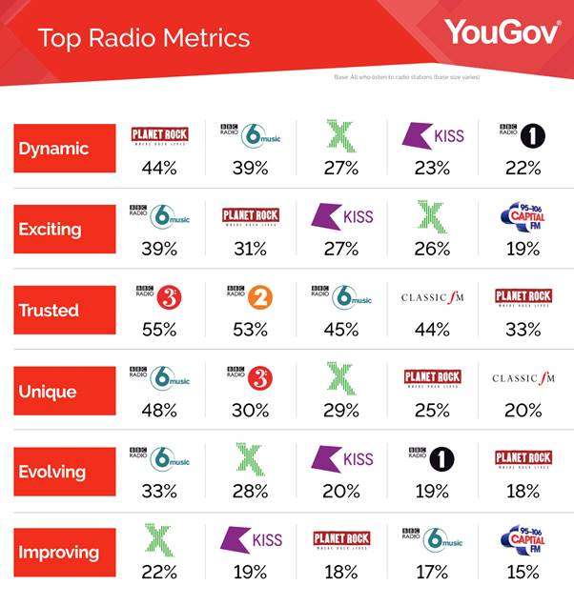
So much choice...

Slide 17
Group task – Create a new radio station
Using all the information from the Ofcom slides (which I have for you as a hard copy and are on the blog), create a pitch for a new commercial radio station.
In your pitch you must include:
  Title
  Logo
  Music genre
  Audience demographic and how you will attract them
  Broadcast platform
  What type of shows you will invest the most money on
  What additional platforms and services you will have a presence on
You will also need to explain your choices.
Best pitch wins funding (chocolate).

Slide 18

The

Slide 19
What is PSB or PBS
In the UK (PSB)
In the United Kingdom, the term "public service broadcasting" refers to broadcasting intended for public benefit rather than to serve purely commercial interests. The communications regulator Ofcom requires that certain television and radio broadcasters fulfil certain requirements as part of their license to broadcast. All of the BBC's television and radio stations have a public service remit, including those that broadcast digitally
In the US (PBS)
The Public Broadcasting Service (PBS) is an American public broadcaster and television program distributor. It is a nonprofit organization and the most prominent provider of educational television programming to public television stations in the United States

Slide 20
The BBC (British Broadcasting Corporation)
What facts or information do you know about the BBC?
  Discussion – write down on a mindmap everything that you know about the BBC.
  Feedback
You could have said
  Funded by licence fee (currently £147 a year for a colour licence)
  Follows a PSB remit (to entertain, educate and inform)
  Publicly owned
  Regulated by OfCOM (new development)
  Requirement to promote British ‘talent’
  It has a Royal Charter
  It’s old!
  Produces television, radio and online content
  Has BBC World Service that broadcasts overseas

Slide 21
Researching the BBC
Task: In pairs/groups you will conduct research into aspects of the BBC that are central to this unit.
You must use this research to answer the questions on the handout.
You have 30 minutes to complete and present the answers to the questions.

Slide 22
Presentation of research
Feedback

Slide 23
Reithianism
The term "Reithianism" describes certain principles of broadcasting associated with Lord Reith. These include an equal consideration of all viewpoints, probity, universality and a commitment to public service.
Audiences had little choice apart from the upscale programming of the BBC, a government agency which had a monopoly on broadcasting.
Reith, an intensely moralistic executive, was in full charge. His goal was to broadcast, "All that is best in every department of human knowledge, endeavour and achievement.... The preservation of a high moral tone is obviously of paramount importance.“
Reith succeeded in building a high wall against an American-style free-for-all in radio in which the goal was to attract the largest audiences and thereby secure the greatest advertising revenue. There was no paid advertising on the BBC; all the revenue came from a tax on receiving sets. Highbrow audiences, however, greatly enjoyed it.
At a time when American, Australian and Canadian stations were drawing huge audiences cheering for their local teams with the broadcast of baseball, rugby and hockey, the BBC emphasised service for a national, rather than a regional audience. Boat races were well covered along with tennis and horse racing, but BBC was reluctant to spend its severely limited air time on long football or cricket games, regardless of their popularity.

Slide 24
Discussion questions
Thinking about the public purposes of the BBC, what kind of content would you expect to find in a Radio 1 broadcast? Make a list of any relevant content.
What do you think some of the main differences are between PSB broadcasting and commercial broadcasting? Make a list.
What do you think are some of the biggest challenges for the BBC Radio 1 breakfast show today?
The BBC does not have the pressure of having to make money but it does have the pressure of needing to provide value for money. How do you think this affects radio programme content?

Slide 25
BBC Radio 1
BBC Radio 1 Breakfast Show

Slide 26
Research Task – History of Radio 1
Using this website: https://www.bbc.com/historyofthebbc/100-voices/radio-reinvented ...
...complete the research table on the History of Radio 1.
This should take you up to two hours. There is a lot of information, and you need to select what you think is the most important.

Slide 27
A documentary...
https://www.youtube.com/watch?v=G0pYk83_i5o

Slide 28

Where did it all start?
Click on the image to play the video
How many of the faces do you recognise?

Slide 29
Listening to the opening of The Radio 1 Breakfast show – first and most recent
We are going to listen to the first minute of the very first broadcast in 1967 and then the most recent from last Monday.
Compare their contents:
        What similarities do they contain?
        How do they differ?

Slide 30
BBC Radio 1 Breakfast Show- September ‘67
  The first ever broadcast on BBC Radio 1 was the Tony Blackburn Breakfast Show in September 1967. Let’s listen to the opening minutes (click on image: play from 1:18):
Tony Blackburn, along with several other DJs, had been poached from Radio Caroline. Radio Caroline was a pirate radio station with huge listening figures that was broadcast from a ship off the coast of Essex.
It was hoped that they would bring their audience with them to the BBC – and this proved to be true.

Slide 31

Radio 1 Breakfast Show: Greg James
Click on image: Play from start to around 1 minute 30.

Slide 32
https://www.youtube.com/watch?v=M5G8pfRowtU
https://www.bbc.co.uk/programmes/m0009zsj

Slide 33
Comparison
What do they have in common?
  ‘Chat’ – building a relationship with the audience (feels like they are talking directly to us)
  Jingle
  Sting (short burst of a music track)
  Introducing music
  Discussing items on the programme coming up.

Slide 34
Radio 1 Breakfast Show: Greg James
Greg James began his tenure as host of the breakfast show on 20 August 2018.. Features include Yesterday’s Quiz and the Ten Minute Takeover, alongside Game of Phones and Unpopular Opinions.
He took over from Nick Grimshaw who had been brought in in 2012 to help lower the age of the audience. (After Chris Moyles,who was in his late 30s by then). Nick Grimshaw struggles to bring down average age of audience from 31.
Is the most listened-to show on Radio 1, but in October 2017 his listening figures dropped to the lowest for a Radio 1 breakfast show since records began (dropped to 4.9m weekly listeners – to compare, Chris Evans on Radio 2 has 9.3m listeners)
  Radio 1 defended this by stating that it’s listeners don’t tend to tune into the radio (which is the only figure that RAJAR looks at) and instead listen via Youtube or social Media.

Slide 35
Radio 1’s ‘remit’:
To entertain and engage a broad range of young listeners with a distinctive mix of contemporary music and speech.
It should offer a range of new music, support emerging artists (especially those from the UK) and provide a platform for live music.
News, documentaries and advice campaigns should cover areas of relevance to young adults.

Slide 36
Reading:
Understanding the purpose of Radio 1
You will read through the Radio 1 Service Licence (2016)
You will annotate the article, identifying the key information under the following headings:
  Annual budget
  The objective of Radio 1
  Radio 1’s contribution to public life
  Radio 1’s contribution to promoting education and learning
  Radio 1’s contribution to the UK.
You will write notes under these key headings.

Slide 37
Board Game task
Create a board game to help you revise the Radio industry.
You should include all your knowledge on the radio industry, the BBC, BBC Radio 1 and the Radio 1 Breakfast Show.
You could base it on Monopoly, snakes and ladders, The Game of Life...

Slide 38
Prep Instagram Task
Your challenge (which you must accept), is to find a way to display all your knowledge about the Radio industry (general industry, BBC, BBC Radio 1, Radio 1 Breakfast Show), in a square that could be suitable to be put on Instagram.
This shape!
Due Friday!

Slide 39
Writing task:
Produce a side of A4 covering the following:
  Reasons why you think young people don’t actively listen to the radio
  What you think Radio 1 needs to do in order to increase its share of listeners and gain its audience.

Slide 40
Prep
To listen to the Radio 1 Breakfast Show from Friday 1st February. You will find this on the BBC Sounds section of the website (look in the schedule).

