Slide 1


Introduction to newsbrands

Slide 2





Table of contents
The newsbrands 3
What makes newsbrands different? 8
Key readership facts 12
Time spent/time of day 20
Engagement, content and attention 22
Effectiveness in a multimedia world 27
Business Effects 28
ROI 33
Brand building performance 37
Summary 41

Slide 3


The newsbrands
NEWS

Slide 4
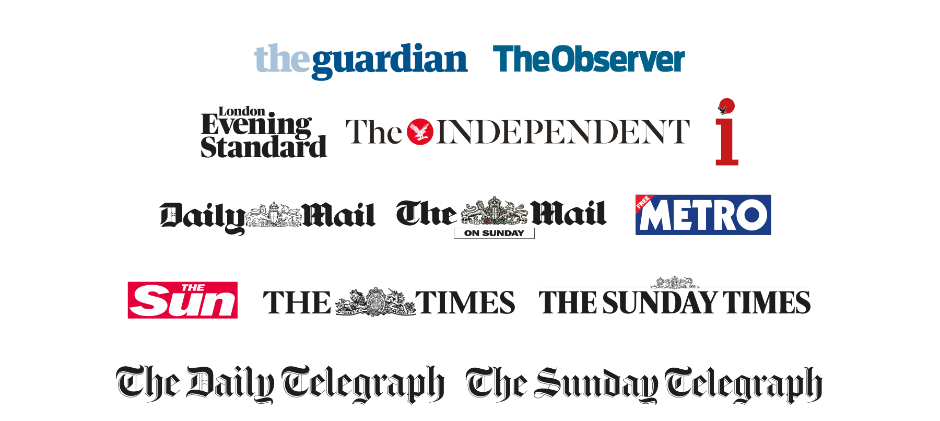


The market

Slide 5























The market
* Not Newsworks stakeholders
** Online only
Owners
Dailies
Sundays
DMG media
Guardian News & Media
ESI Media
News UK
Telegraph Media Group
Trinity Mirror
Johnston Press
Northern & Shell
Pearson PLC
**
*
*
*
*
*

Slide 6








The market
* Not Newsworks stakeholders
** Online only
Paid for
Free
*
**
*
*
*
*

Slide 7





The market
* Not Newsworks stakeholders
** Online only
Populars
Mid-market
Quality
*
**
*
*
*
*

Slide 8
What makes
newsbrands
different?

Slide 9



Newspapers in all their forms play a unique role in
people’s lives and they provide advertisers with a trusted
environment in which to connect with their consumers.
In a world of half attention,
newsbrands require your full attention
Newsbrands are more important
in an age of limitless choice
Newsbrands feed other media,
from Facebook to the BBC
Newsbrand audiences are growing

Slide 10

The UK newspaper market is unique
UK
13 national newspapers
France
9 national newspapers
Germany
9 national newspapers
USA
5 national newspapers

Slide 11





Newsbrands play different roles
within the media landscape
Fame
& stature
Newsbrands create the sense of a brand having momentum; of being an important brand that commands attention
Prompt
action
Newsbrands cause
consumer action,
directly or indirectly
impacting sales
Education & understanding
Newsbrands deepen
consumer understanding
of what a product, brand
or company is or does
Build
trust
Newsbrand advertising acts to consolidate or
develop a brand’s reputation
Address
an issue
Newsbrands are effective for brands
that need to focus on
a specific issue or event

Slide 12




Newsbrands reach
47.5 million
adults in the UK
That’s more than Google
Source: NRS PADD Apr 2016 – Mar 2017, comScore MMX Mar 2017
Notes:
Newsbrands reach 47,492,000 people a month across all platforms
Google.co.uk has a total monthly reach of 42,806,0000 people a month across all platforms

Slide 13



Newsbrands reach 97% of all millennials
That’s just under
14 million
18-34s every month
Source: NRS PADD Apr 2016 – Mar 2017
Notes:
5.1m, 36% of all 18-34 daily (print+pc)
8.4m, 56% of all 18-34 weekly (print+pc)
13.8m, 97% of all 18-34 monthly (print+pc+mobile)

Slide 14

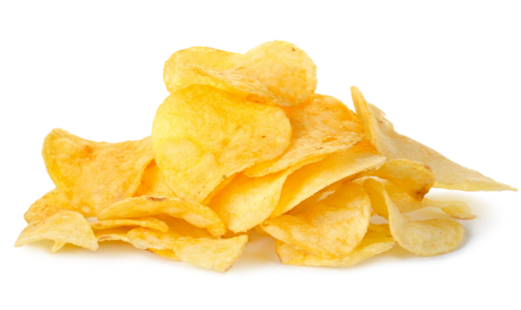

More people read newsbrands daily than eat
a packet of crisps
22 million
16.4 million
Source: NRS PADD Apr 2016 – Mar 2017
Notes:
Packets of crisps eaten annually: 6 billion
Packets of crisps eaten daily: 16,438,356
daily (print+pc): 21,594,000

Slide 15







Newsbrands readership by platform
Newspapers
32.6 million
Desktop
15.1 million
Mobile
37 million
Newsbrands
47.5 million
Source: NRS PADD Apr 2016 – Mar 2017

Slide 16
Total multi-platform reach
% of all adults
47.5m
33.1m
21.6m
31%
56%
67%
Source: NRS PADD Apr 2016 – Mar 2017

Slide 17
Multi-platform readership reach
By gender (millions)
92%
89%
67%
60%
45%
38%
Source: NRS PADD Apr 2016 – Mar 2017
Notes:
Doesn’t include Sunday titles

Slide 18
Multi-platform readership reach
By age (millions)
80%
96%
91%
70%
98%
95%
87%
51%
62%
58%
63%
68%
56%
40%
39%
46%
35%
34%
Source: NRS PADD Apr 2016 – Mar 2017

Slide 19
Newsbrands have a growing audience
Print
Reach PC adds to print
Reach phone/tablet adds to print and PC
47.3m
+ 9.2m
38.1m
+ 4.7m
39.7m
33.4m
Jan ‘07 - Dec ‘07
Jan ‘16 - Dec ‘16
Source: NRS PADD Jan 2016 – Dec 2016, NRS Jan 2007 – December 2007

Slide 20
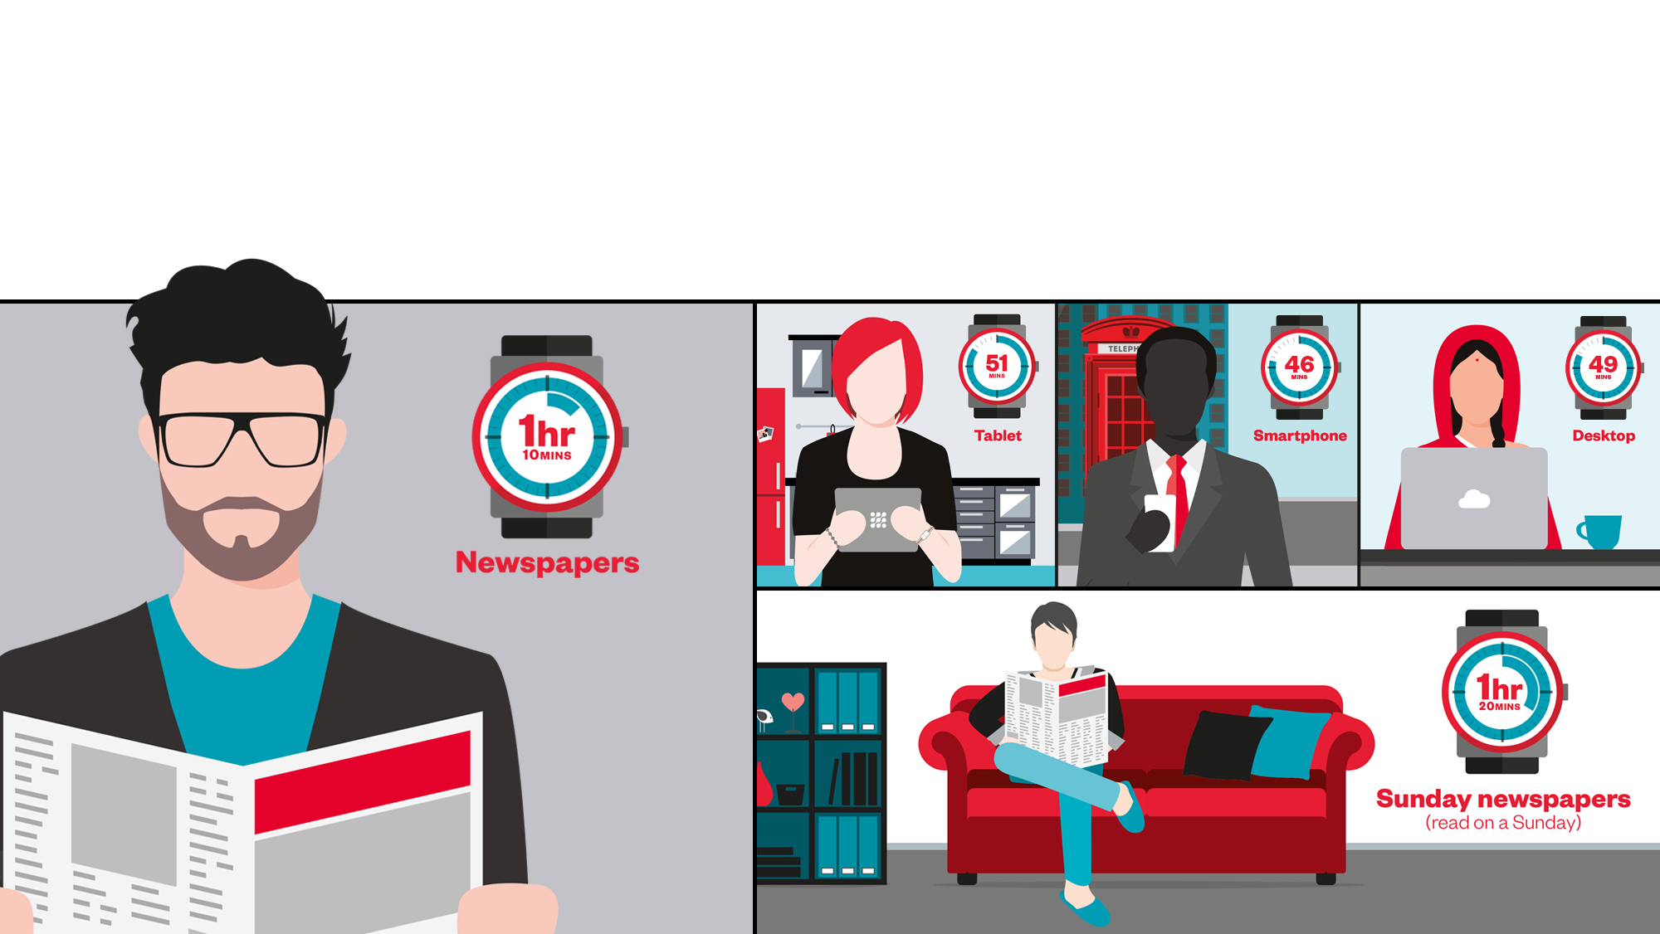
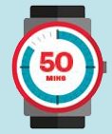
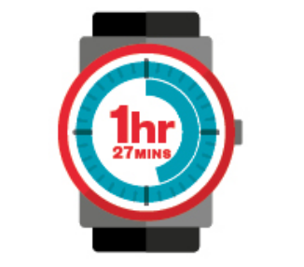
Readers spend a significant amount of time
with their newsbrand of choice
Time spent reading newsbrands on the days people read
Source: IPA TouchPoints 2016

Slide 21
Newsbrands are consumed at different points throughout the day
(Average weekday)
Source: IPA TouchPoints 2016

Slide 22

Regular newsbrand readers have a strong
connection to newsbrands
Personal identification
Engagement
Trust
Brand context effect
The more engaged the reader the stronger the effect
Source: Newsworks, The company you keep, 2015
Notes:
Newsbrand readers have very high levels of emotional engagement with their chosen newsbrand and attention levels are high – and that relationship is constantly being reinforced due to the frequency of reading. In the attention deficit age, could we measure the impact of highly focussed attention?
There are high levels of trust in the newsbrand they favour. The context in which the ads are seen is one that readers personally identify with, and that makes them feel part of a like-minded community – they see themselves as Mirror readers, or Guardian readers or Telegraph readers, for example.
Readers seem very aware that placement of ads in newsbrands imbues those ads with certain values.

Slide 23



People react positively to ads in the familiar
context of their favoured newspaper
Brand love
Buzz
Consideration
+12%
+15%
+25%
Regular newsbrand readers vs. non-readers
Source: Newsworks, The company you keep, 2015
Notes:
Results averaged to create 3 key metrics:
Brand love is a composite of 3 engagement metrics – how close people feel towards the brand, the warmth of their feelings, and the brands empathy with them.
Buzz shows how much people think the brands are talked about.
Consideration measures intent to purchase the next time people are in the market.

Slide 24
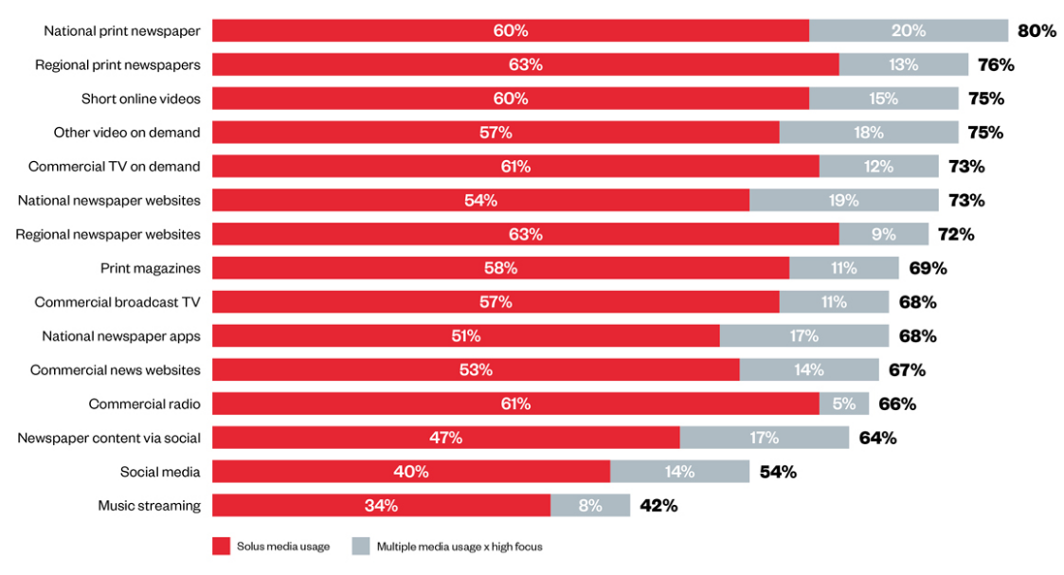
Newsbrands command a high level of attention
Attention = solus media + (multimedia x high focus)
Source: Newsworks, The battle for attention, 2016

Slide 25



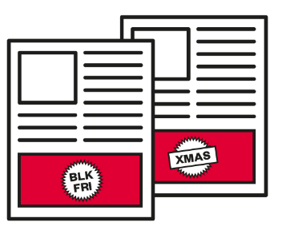

Eye-tracking demonstrates the attention paid to newspaper print ads
Print newsbrands deliver high standout and dwell time
75% of readers look at each print ad on average
Print newsbrand ads are viewed for 2 ½ times longer than an average digital ad
Larger sizes, special formats and multiple ads per issue increase impact and dwell times
Standout increases for Black Friday
event (84%) and Christmas period (86%)
Dwell times also increase:
Black Friday average 2.3”,Christmas average 2.6”
Best performing seasonal ads attract 100% attention for an average of 4-6 seconds
Newsbrands = theguardian.com, telegraph.co.uk, independent.co.uk, indy100.independent.co.uk, thetimes.co.uk, ft.com, dailymail.co.uk, mirror.co.uk, standard.co.uk, thesun.co.uk, dailystar.co.uk, metro.co.uk, express.co.uk, manchestereveningnews.co.uk, walesonline.co.uk, dailyrecord.co.uk. Others = msn.com, uk.yahoo.com, digitalspy.com, engadget.com, mashable.com, ibtimes.co.uk, thisismoney.co.uk, bleacherreport.com, pistonheads.com, weather.com, howtogeek.com, theregister.co.uk, sportinglife.com, channel4.com, itv.com, channel5.com, marieclaire.co.uk, timeout.com, trustedreviews.com, goodtoknow.co.uk, bbcgoodfood.com, pcadvisor.co.uk, nme.com, autoexpress.co.uk, forbes.com, radiotimes.com

Slide 26




Eye-tracking demonstrates the value of newsbrands’ quality digital environment
Digital newsbrands: a quality environment for ads
Double the viewing time
per page than non-newsbrand sites
60% higher viewable time
for ads
Ad viewing
2½ times more likely on a newsbrand site
Newsbrand digital readers 70% more likely to see MPUs with 30 seconds viewable time
Average ad dwell time 30% higher on newsbrand sites
Newsbrands = theguardian.com, telegraph.co.uk, independent.co.uk, indy100.independent.co.uk, thetimes.co.uk, ft.com, dailymail.co.uk, mirror.co.uk, standard.co.uk, thesun.co.uk, dailystar.co.uk, metro.co.uk, express.co.uk, manchestereveningnews.co.uk, walesonline.co.uk, dailyrecord.co.uk. Others = msn.com, uk.yahoo.com, digitalspy.com, engadget.com, mashable.com, ibtimes.co.uk, thisismoney.co.uk, bleacherreport.com, pistonheads.com, weather.com, howtogeek.com, theregister.co.uk, sportinglife.com, channel4.com, itv.com, channel5.com, marieclaire.co.uk, timeout.com, trustedreviews.com, goodtoknow.co.uk, bbcgoodfood.com, pcadvisor.co.uk, nme.com, autoexpress.co.uk, forbes.com, radiotimes.com

Slide 27
Effectiveness in a
multimedia world

Slide 28






Multi-platform newsbrands are delivering
widespread business effects for brands
Campaigns using newsbrands
are 43% more likely to deliver market share growth
Campaigns using newsbrands are more than twice as likely to deliver a reduction in price sensitivity
Campaigns using newsbrands are more than twice as likely to deliver an increase in customer loyalty
Campaigns using newsbrands are 36% more likely to deliver profit
Campaigns using newsbrands are 85% more likely to drive customer acquisition
Source: IPA Databank UK case studies 2012-2016 (52% of all cases)
Notes:
UK newsbrands are a powerful weapon in the battle against short-termism, because they deliver growth in very large business effects that are vital to long-term brand success. It’s not just about immediate sales at any cost. Campaigns that use newsbrands are significantly more likely to drive sustainable share growth, attracting new customers but also increasing loyalty among existing customers. They reduce price sensitivity and therefore reduce the need to rely on short-term cost-cutting promotions. This means bigger profits.
One of the key contributors to short-termism has been the rise of digital, with its instant numbers and real-time trackability. But not all digital is equal. Digital newsbrands work differently – they provide the right context to drive the same powerful business effects as print does. We know from Lumen eye-tracking research that newsbrand sites attract more in-depth attention, with double the viewing time per page than non-newsbrand sites, which in turn gives 60% higher viewable time for ads and an average dwell time per ad that is 30% higher. This quality, high attention context provides a favourable environment for delivering longer-term business effects as well as sales.
What’s more, UK newsbrands have a unique advantage – both print and digital platforms perform very well in delivering these important business effects, but the combination of print and digital formats provides advertisers with a very strong multiplier effect.

Slide 29


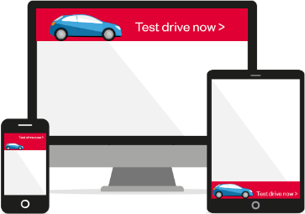

Multi-platform newsbrands boost the
effectiveness of other media
Newsbrands make TV
54% more effective
Newsbrands make online video 50% more effective
Newsbrands make online display
24% more effective
Newsbrands make social media twice as effective
Source: IPA Databank UK case studies 2012-2016 (52% of all cases)
Notes:
The updated analysis shows very clearly that newsbrands are a highly effective multiplier for other media. Not only do they drive effects such as share growth, penetration and profit in their own right, but they also make other media in the schedule perform more effectively. This is seen both with “Legacy” media such as TV, where newsbrands increase business effectiveness by 54% and with key digital media.
Once again, having the quality environment of newsbrands in the mix makes other digital media work harder. There are several potential reasons for this, which we will continue to explore. But we already have strong evidence that longer attention times (Lumen eye-tracking, MOAT for WMG) plus the impact on brand perceptions of the trusted newsbrand context (The company you keep research), might prime people to respond more positively to seeing the advertising in social media, other online display etc

Slide 30

There is a significant context effect
from using digital newsbrands
+
Adding online display to TV increases business effectiveness by 17%
+
+
Adding digital newsbrands increases the multiplier effect by 60%
Source: IPA Databank UK case studies 2012-2016 (52% of all cases)
Notes:
A really powerful example of the strength and difference of digital newsbrands is the impact they have in combination with TV advertising. When TV is coupled with online display on sites that are non-newsbrands the impact on business effects is much smaller than when digital newsbrands are included in the online mix. Given the issues surrounding programmatic and algorithms, there is a strong brand health case for being much more selective in digital media. This IPA databank analysis suggests that there is also a very strong business case.

Slide 31
Two are better than one, there is a significant multiplier effect from using print and digital in combination
Source: IPA Databank UK case studies 2012-2016 (52% of all cases)
Notes:
There is increasing evidence that using more than one newsbrand platform delivers more than the sum of two parts. In our 2016 multi-platform brand health study (newsworks.org.uk/effectiveness), we saw that print plus digital newsbrands produce a 3.4 times multiplier effect on brand health measures.
This is almost exactly mirrored by Peter Field’s latest analysis of the business effects delivered by newsbrands. Using both print and digital newsbrands in the campaign mix delivers 3.5 times the uplift in very large business effects of using just one platform.

Slide 32
And the multiplier effect is getting stronger
Two newsbrand platforms
Source: IPA Databank UK case studies 2012-2016 (52% of all cases)
Notes:
The multiplier effect is also growing. Just looking at the last two effectiveness awards, we can see that using both print and digital more than doubles the uplift in business effects compared with campaigns who don’t use newsbrands at all.

Slide 33





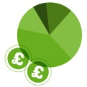




ADDING NEWSPAPERS
TO YOUR CAMPAIGN
BOOSTS ROI BY
^{Adding newspapers}
^{to a retail campaign}
increases effectiveness by 2.8 times
^{Adding newspapers}
to an automotive campaign increases effectiveness
^{by +71%}
^{Adding newspapers}
to a finance campaign increases effectiveness
^{by 5.7 times}
Adding newspapers to a travel campaign increases effectiveness by three times
^{Adding newspapers}
to a FMCG campaign increases effectiveness
^{by +20%}
TIMES
ON AVERAGE
Using digital newsbrands boosts
^{print ROI by up to five times}
Newspapers make TV twice as effective
and online display four times more effective
Source: Benchmarketing/BrandScience Results Vault, 2011 to 2015

Slide 34




Combined services
£12.22
£10.82
Print newsbrands
make TV spend
work twice as hard
£6.49
TV
revenue
ROI
£5.72
No print newsbrand spend
Low 2-10%
Medium 10-12%
High 12-18%
Print newsbrand % of total campaign spend in combined services
Source: Benchmarketing/BrandScience Results Vault, 2011 to 2015
Combined services includes: Finance, Retail, Telecoms, Travel & Leisure, Media, Government/Social/Political, Other services (online & offline)
Notes:
Comparing groups by level of spend in print newsbrands, we looked at the impact on the average TV revenue ROI.
The results showed that including print newsbrands in the mix make TV spend work twice as hard, doubling the average revenue per £1 spent on TV.

Slide 35
Combined services
£55.98
Print newsbrands
boost online display
and video by up to
four times
Online display revenue
ROI
£20.96
£17.42
£12.46
No print newsbrand spend
Low 2-10%
Medium 10-12%
High 12-18%
Print newsbrand % of total campaign spend in combined services
Source: Benchmarketing/BrandScience Results Vault, 2011 to 2015
Combined services includes: Finance, Retail, Telecoms, Travel & Leisure, Media, Government/Social/Political, Other services (online & offline)
Notes:
Comparing groups by level of spend in print newsbrands we looked at the impact on the average online display revenue ROI
The results showed that including print newsbrands in the mix makes online display spend work up to four times as hard.
Source: Results Vaults 2011 to 2015 – excludes outliers and incomplete models

Slide 36

Finance
Automotive
Combined services
Finance
2015 spend levels
7.9%
£55.82
£40.45
Combined services: print newsbrands boost radio revenue
by up to 10 times
Radio revenue ROI
£11.34
£4.02
No print newsbrand spend
Low 2-7%
Medium 7-22%
High 22-37%
Print newsbrand % of total campaign spend in combined services
Source: Benchmarketing/BrandScience Results Vault, 2011 to 2015
Combined services includes: Finance, Retail, Telecoms, Travel & Leisure, Media, Government/Social/Political, Other services (online & offline)
Notes:
The inclusion of print newsbrands in the mix, boosts radio revenue ROI by up to 10 times in combined services.
Combined services – radio total revenue ROI vs. print newsbrands % of spend
Source: Results Vaults 2011 to 2015 – excludes outliers and incomplete models

Slide 37






How newsbrands work across platform
Effective
brand
building
Even more effective brand building
Source: The multi-platform study, 2016
Notes:
We found a consistent pattern of responses across all 5 tests:
Print is the most effective single platform for brand building
But print plus digital is a more efficient combination
The print and digital newsbrand combination has a strong multiplier effect – bigger than the sum of the individual platforms
As we will see later, campaign data shows that newsbrands’ digital platforms also provide a high quality context for driving high levels of engagement and interaction.

Slide 38


+17%
Combining print + digital newsbrands gives you a 3.4 times multiplier effect
+5%
Average uplift across
brand health measures
Print
Print + digital
Source: The multi-platform study, 2016
Notes:
Across the five campaigns, we found that print newspapers increased brand health measures by 5%. There is also consistent evidence that exposure to print advertising primes readers to respond more positively to digital advertising. Print plus one other digital newsbrand platform increased brand health measures by an average of 17%.
It is not simply the effect of being exposed twice rather than just once – the uplift is almost 3 ½ times higher and is only seen when one of the exposures is print

Slide 39
Brand-building strengths of print newsbrands
• Salience
• Spontaneous awareness
• Innovative
Source: The multi-platform study, 2016
Notes:
Looking at the reasons why print is so powerful, we find that print solus is particularly effective at raising perceived brand salience (seen/heard a lot about) and spontaneous awareness. Perhaps contrary to assumptions, print is also the platform which most confers a sense of innovation on the advertised brand.

Slide 40



Brand-building strengths of multiple newsbrand platforms
+
+
+
• Salience +60%
• Salience +52%
• Salience +27%
• Innovative +34%
• Worth paying
extra for +43%
• Awareness +26%
• Awareness +31%
• Quality +24%
• Quality +31%
• Trustworthy +19%
• Awareness +31%
• Trustworthy +30%
Source: The multi-platform study, 2016
Notes:
Each print and digital combination builds slightly different brand strengths – although the powerful influence of print can be seen in all dual platform combinations with the strong impact on brand salience and spontaneous awareness.
Tablet is really interesting – on its own, it primarily affects brand quality perceptions – but in combination with print, it is the most powerful multiplier.
Print plus smartphone has the lowest multiplier effect on brand building measures – but that’s not really surprising as smartphone’s role is more suited to activation

Slide 41

Summary
Newsbrands
reach over 47m people per month
and reach people across all platforms
Readers have a strong connection to newsbrands and newsbrands command a high level of attention
Multi-platform newsbrands boost business effectiveness by 56% and the business effectiveness of TV and digital media
Adding newspapers to your campaign boosts ROI by 3 times on average and makes other media work harder
NEWS

