Slide 1
Intertextuality in
STRANGER THINGS
...and why it’s important

Slide 2
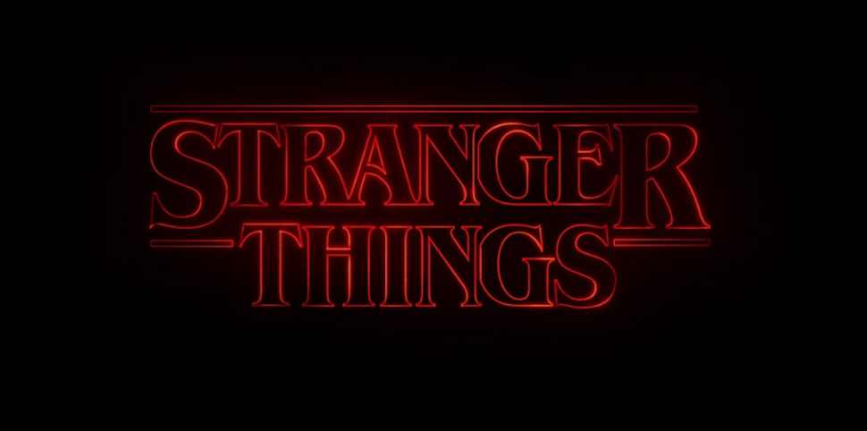


Titles
https://www.artofthetitle.com/title/stranger-things/
Font = ICT Benguait

Slide 3
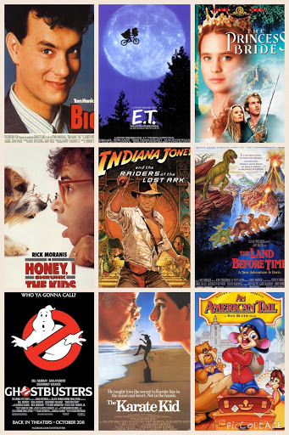
Media Language refs to 70s and 80s films...
https://www.youtube.com/watch?v=wBjgFt6lVHM
https://youtu.be/AwTpsw-ufDA

Slide 4
Even more...
https://www.vulture.com/2016/07/stranger-things-film-reference-glossary.html

Slide 5
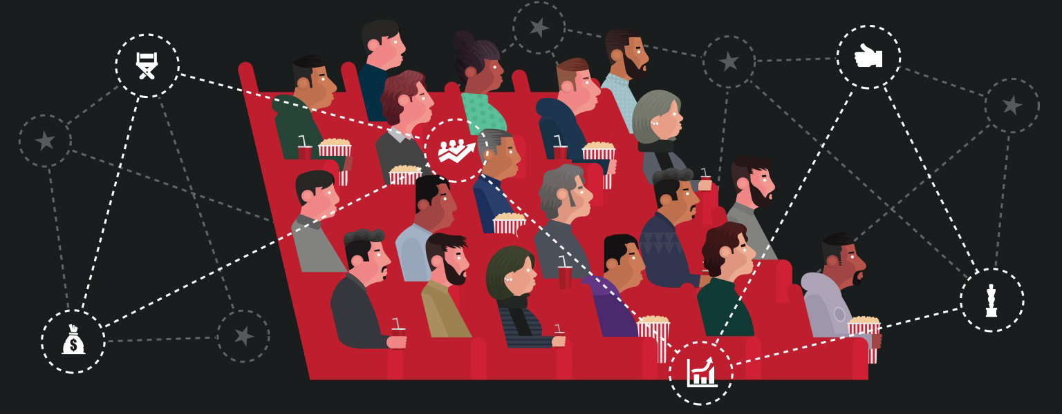
Why?
Industry
Audience

Slide 6
Industry and Audience

Slide 7
Broadcast
Netflix – 15th July 2016
8 episodes (not the norm for US TV drama)
Written and directed by Matt and Ross Duffer (The Duffer Brothers)

Slide 8
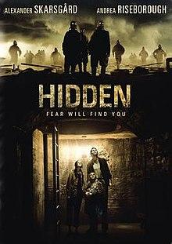
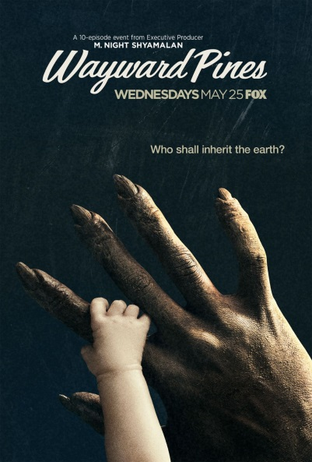
The Duffer Brothers
Hidden (2015) film
https://www.youtube.com/watch?v=e5HvOjois-E
Wayward Pines (2015) TV – M. Night Shyamalan
https://www.youtube.com/watch?v=RsQ9Fl0VCkk

Slide 9
The idea - Project MKUltra
Project MKUltra (or MK-Ultra), also called the CIA mind control program, is the code name given to a program of experiments on human subjects that were designed and undertaken by the U.S. Central Intelligence Agency—and which were, at times, illegal. Experiments on humans were intended to identify and develop drugs and procedures to be used in interrogations in order to weaken the individual and force confessions through mind control. The project was organized through the Office of Scientific Intelligence of the CIA and coordinated with the United States Army Biological Warfare Laboratories. Code names for drugs-related experiments were Project Bluebird and Project Artichoke.
The operation was officially sanctioned in 1953, was reduced in scope in 1964, further curtailed in 1967, and recorded to be halted in 1973. The program engaged in many illegal activities, including the use of U.S. and Canadian citizens as its unwitting test subjects, which led to controversy regarding its legitimacy. MKUltra used numerous methods to manipulate people's mental states and alter brain functions, including the surreptitious administration of high doses of psychoactive drugs (especially LSD) and other chemicals, electroshocks, hypnosis, sensory deprivation, isolation, verbal and sexual abuse, as well as other forms of torture.
The scope of Project MKUltra was broad with research undertaken at 80 institutions, including colleges and universities, hospitals, prisons, and pharmaceutical companies. The CIA operated through these institutions using front organizations, although sometimes top officials at these institutions were aware of the CIA's involvement.

Slide 10
Production and Distribution
Produced by 21 Laps
Commissioned and paid for by Netflix, and exclusively distributed by them.
Ranked the most popular digital series in the US, after only a week of release.
Binge-ability and storytelling time.

Slide 11
Budgets
https://variety.com/2017/tv/news/tv-series-budgets-costs-rising-peak-tv-1202570158/
‘The first season of its supernatural sensation “Stranger Things” was shot to look like a 1980s Steven Spielberg movie and came with a price tag of $6 million an episode for season one, rising to $8 million in season two. Netflix’s sumptuous period drama “The Crown” cost an estimated $10 million an episode.’
https://youtu.be/xkIdAA7zto4

Slide 12
Audiences
How many different audience groups could enjoy Stranger Things and why?
  Primary/secondary
  Demographics
  Psychographic
  Uses and gratifications

Slide 13
Marketing
Twitch tie in – Haunted Basement
Cinematic trailer - https://www.youtube.com/watch?v=mnd7sFt5c3A
VR - https://startvr.co/stranger-things-vr/

Slide 14

Marketing – Social Media
https://www.facebook.com/StrangerThingsTV/
https://twitter.com/Stranger_Things
https://www.youtube.com/channel/UChmpTxQ0Gp8KEJKsqzeg9Lg
https://www.instagram.com/strangerthingstv/?hl=en

Slide 15


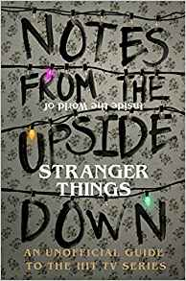
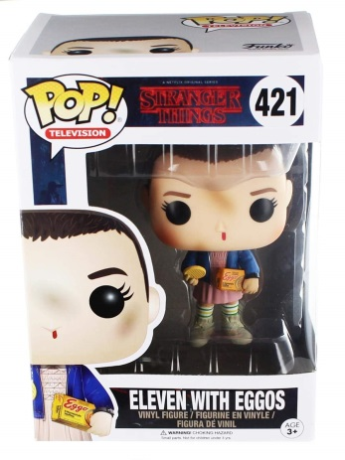
Fandom and Merch
https://strangerthings.fandom.com/wiki/Stranger_Things_Wiki
https://www.tumblr.com/tagged/stranger-things
https://www.fanfiction.net/tv/Stranger-Things-2016/
https://www.deviantart.com/search?q=stranger%20things
https://www.redbubble.com/shop/stranger+things+fandom
#justiceforbarb

Slide 16
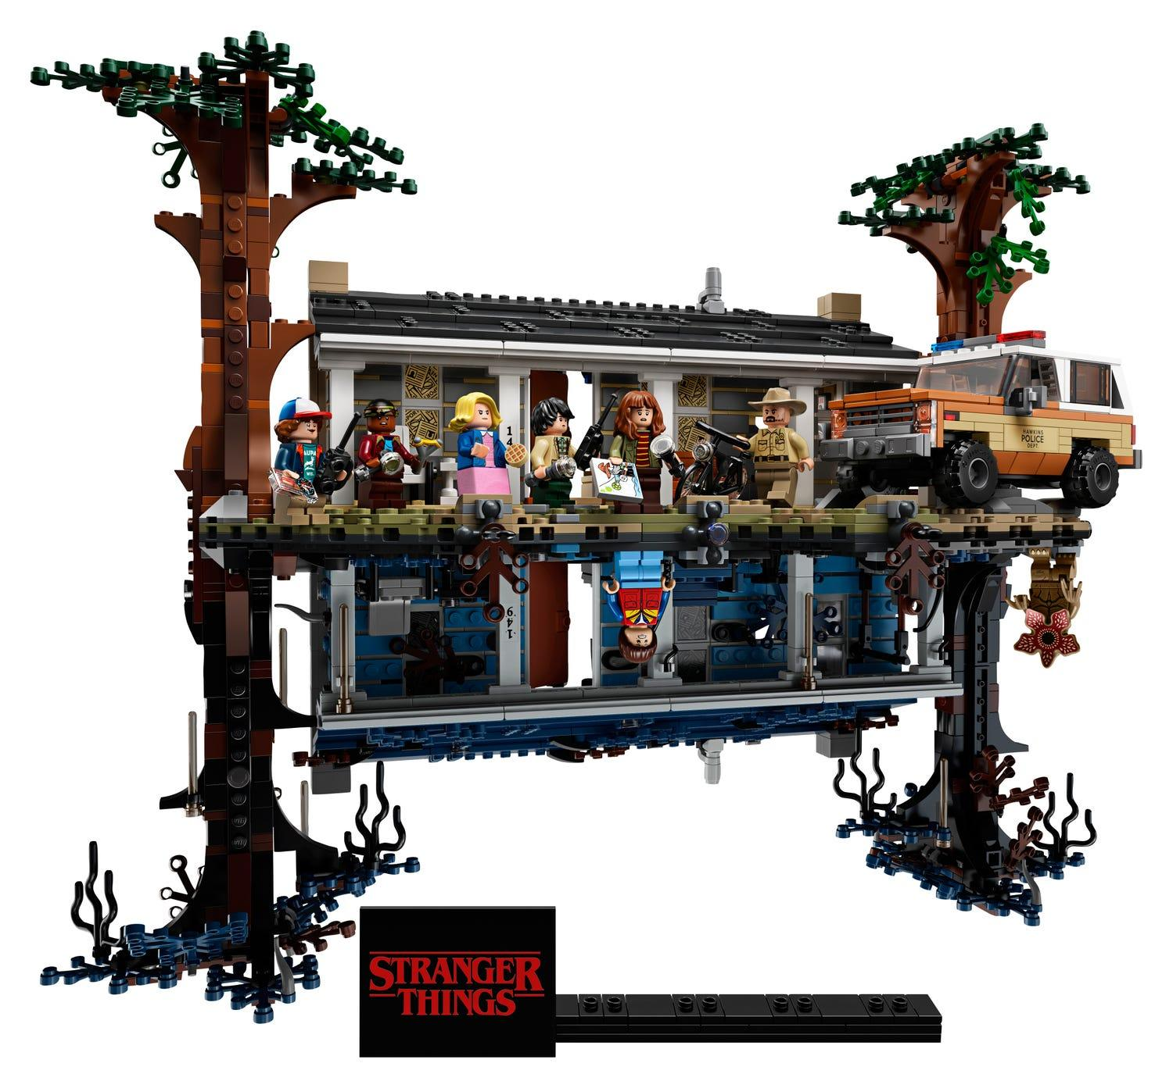
https://www.lego.com/en-gb/product/the-upside-down-75810

Slide 17
Nostalgia Marketing
Millenianls - Millennials, also known as Generation Y (or simply Gen Y), are the demographic cohort following Generation X and preceding Generation Z. Researchers and popular media use the early 1980s as starting birth years and the mid-1990s to early 2000s as ending birth years, with 1981 to 1996 a widely accepted definition. Millennials are sometimes referred to as "echo boomers" due to a major surge in birth rates in the 1980s and 1990s, and because millennials are often the children of the baby boomers. The characteristics of millennials vary by region and by individual, and the group experiences a variety of social and economic conditions, but they are generally marked by their coming of age in the Information Age, and are comfortable in their usage of digital technologies and social media.

Slide 18
Genre and Representation

Slide 19
Genre
How does genre help audiences?
How does genre help industry (like Netflix)?
Why is innovation important to genre?
How does the 1980s setting appeal to many audiences?
What could be the risk of labelling the series a ‘horror’?
How does the narrative challenge the audience expectations?

Slide 20
Representations
Gender

Slide 21
Representations
Age

Slide 22
Representations
Authority

Slide 23
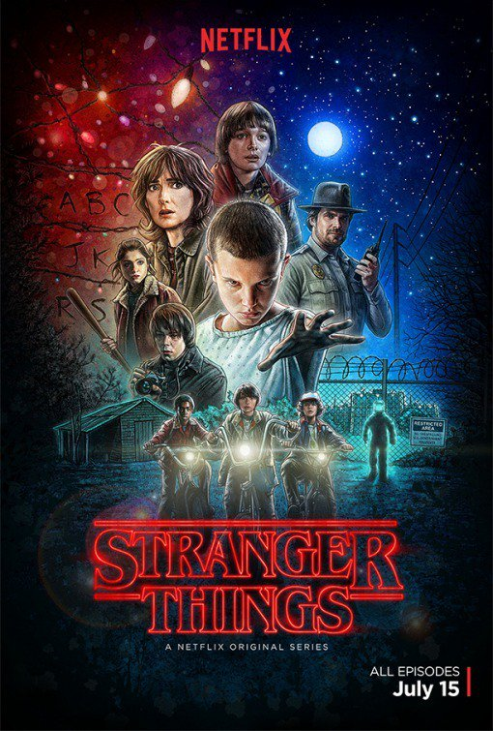
Annotate to highlight representations

Slide 24
CAMERA SHOTS AND ANGLES
The following shots are taken from episode 1, series 1, of Stranger Things
Analyse the effects created by each image. Whilst you cannot see the sound and editing, try to remember what is happening in each scene.

Slide 25
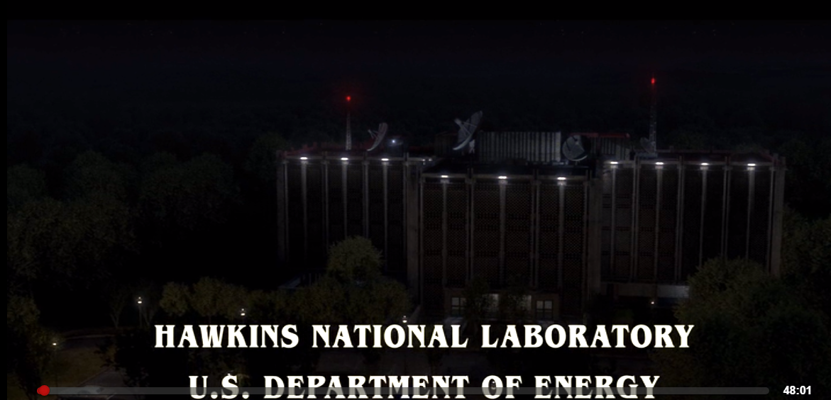
EXTREME LONG SHOT
The opening shot to stranger things is full of signs, symbols and codes.
The radars pointing to starts indicate sci-fi genre with red beacons foreshadowing danger.
The use of words ‘national’ and ‘U.S’ gives us sense of place.
Connotation of energy include power.
The building is surrounded (cut off) by woods.
XLS are often used to set the scene
They place the viewer into the drama straight away - text gives away clues (action codes) about what to expect and also sows mystery (enigma codes) about what might happen.

Slide 26
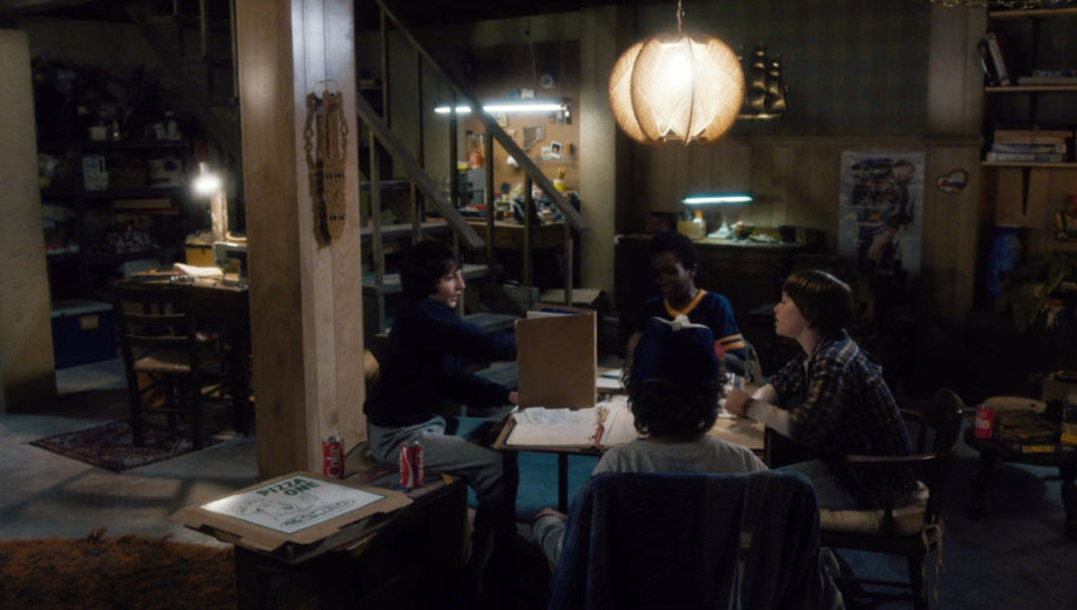
LONG SHOT
Is often used to set the scene in LFTV
Expectations are being built and key characters introduced. Remember, LFTV focus on characterisation rather than plot so it’s not uncommon to have lots of micro-openings within an episode.
Who? What? Where? Audiences are given clues about characters and their surrounding from the use of Long Shots.

Slide 27
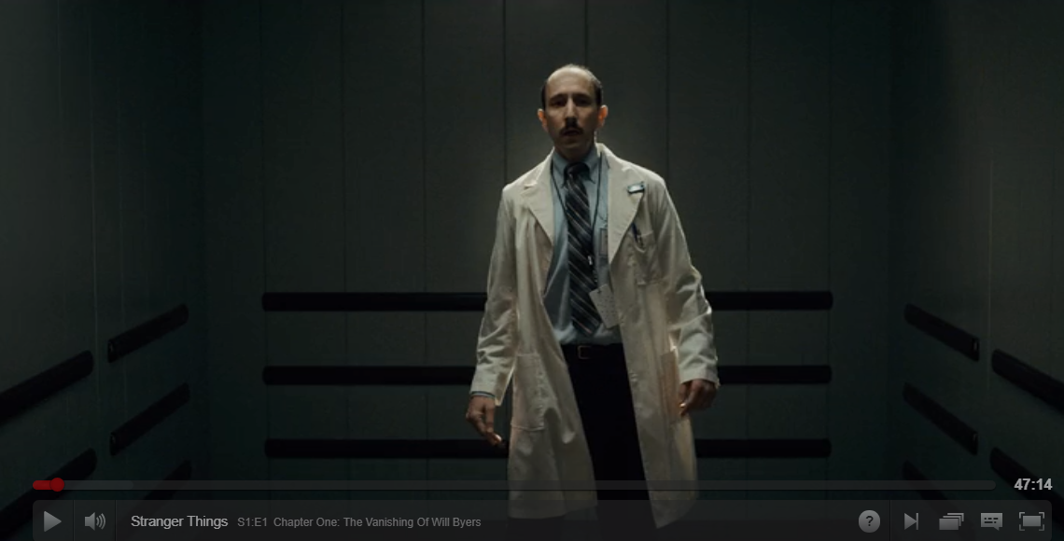
Medium Long Shot
How is the scientist represented?
Tips: why is he off center? Do all scientists look like this or is this a stereotype (think about his role in the whole episode).
What is the effect of this shot?

Slide 28
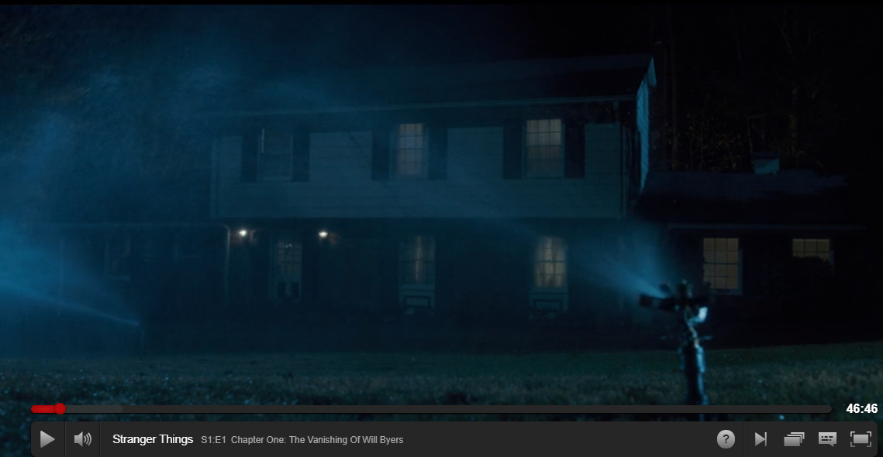
Wide Shot
How does this shot represent American Culture?
What stereotypes are used here?

Slide 29
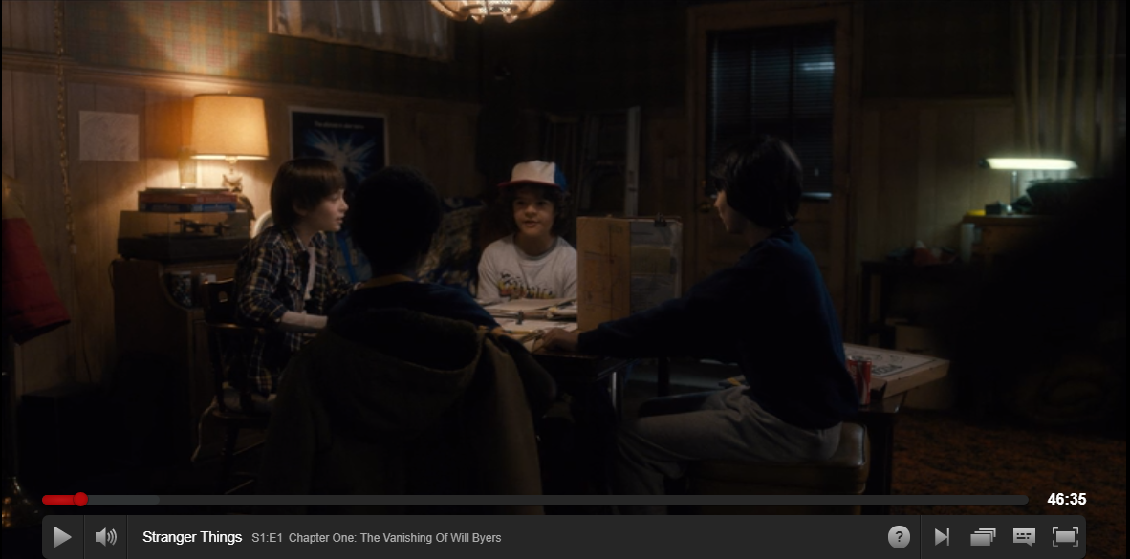
Long Shot
Analyse and explain how you reached conclusions.
Hint: Think about binary opposites, Mike and Will occupy opposite spaces, one is lit the other is dark (foreshadowing upside down versus reality).
How are Will and Mike represented in this scene?

Slide 30
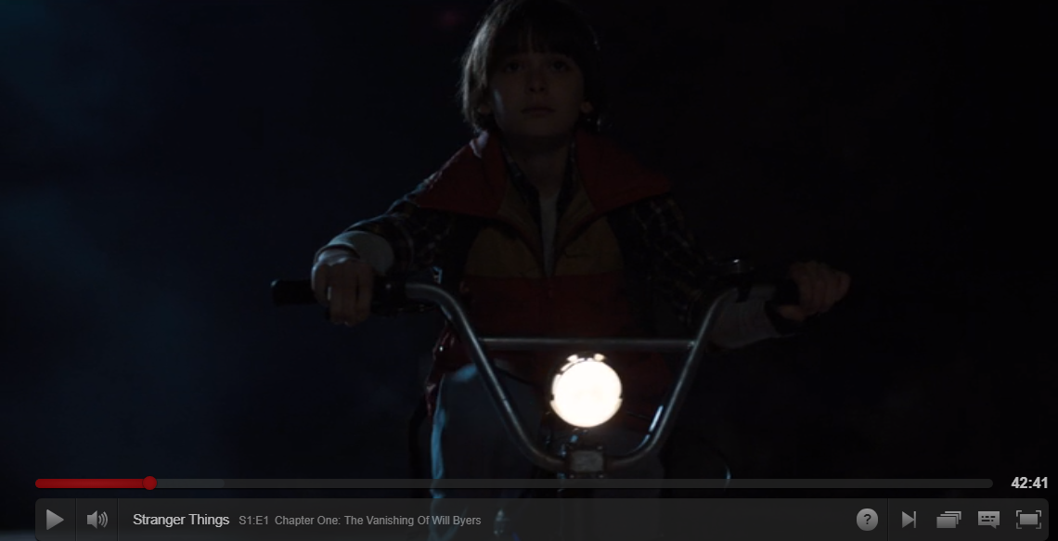
Shot type:
How are the audience to respond (read the text)? Consider Hall.
How is character represented?

Slide 31
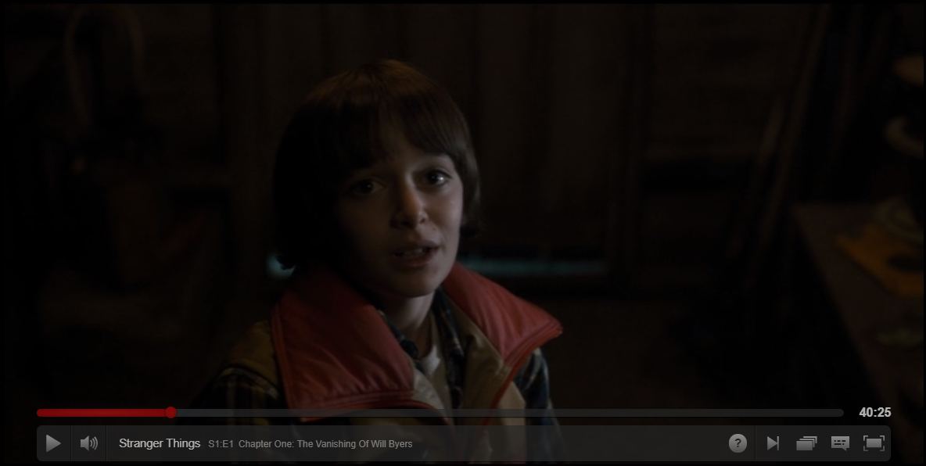
Shot type:
How are the audience to respond (read the text)? Consider Hall.
How is character represented?

Slide 32
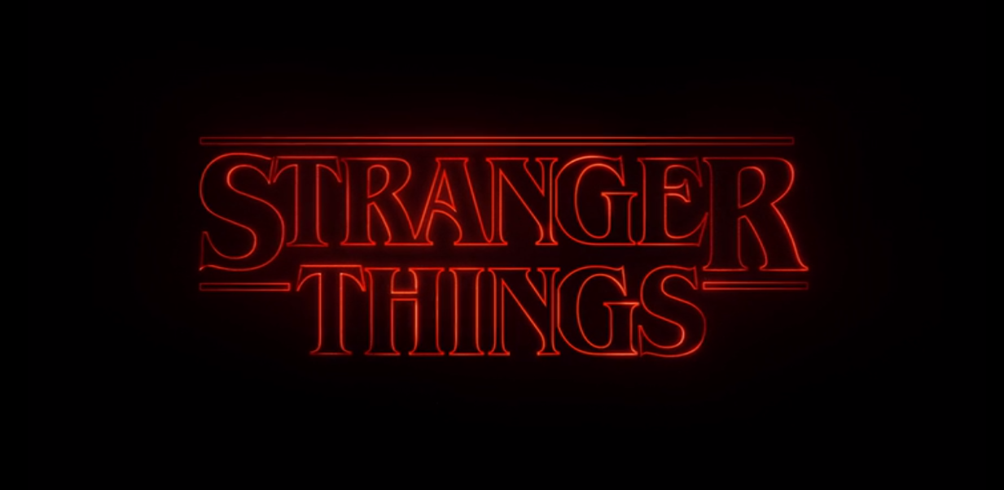
Shot type:
How are the audience to respond (read the text)? Consider Hall.
What ideas and messages are represented here?
Hint: think about intertextuality...

Slide 33
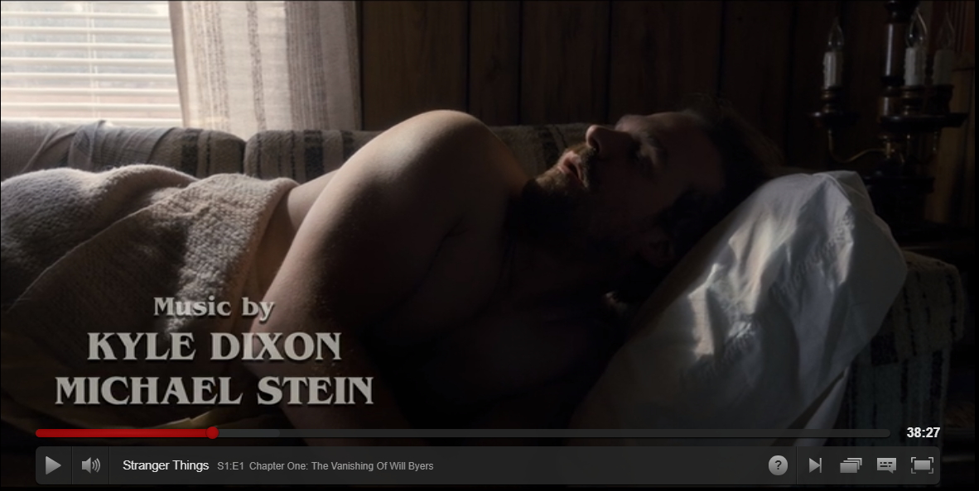
Shot type:
How are the audience to respond (read the text)? Consider Hall.
How is character represented?

Slide 34
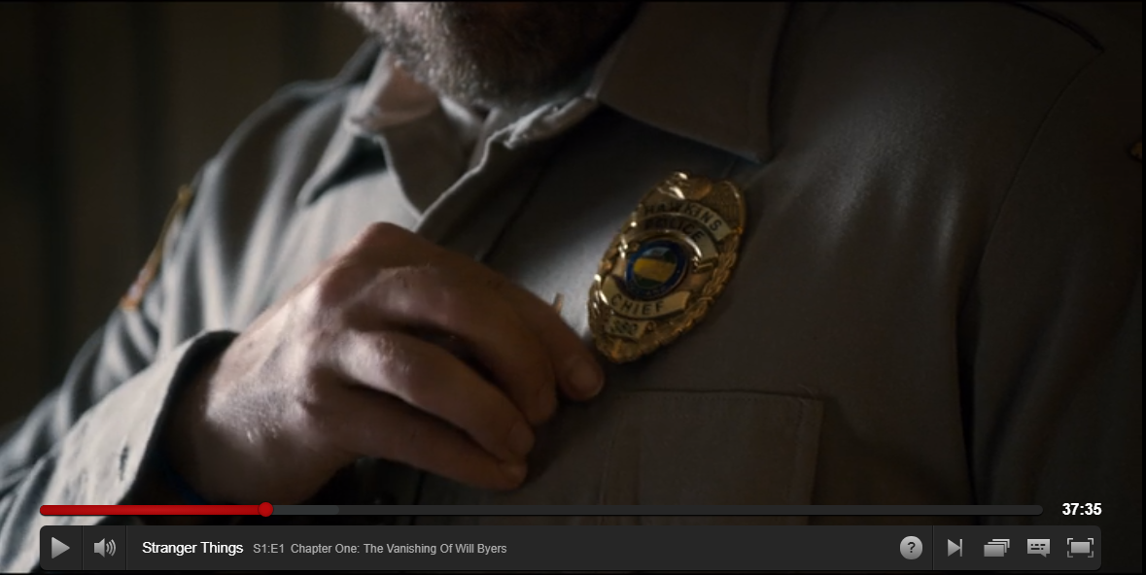
Shot type:
How are the audience to respond (read the text)? Consider Hall.
How is character represented?
Why is this shot significant?

Slide 35
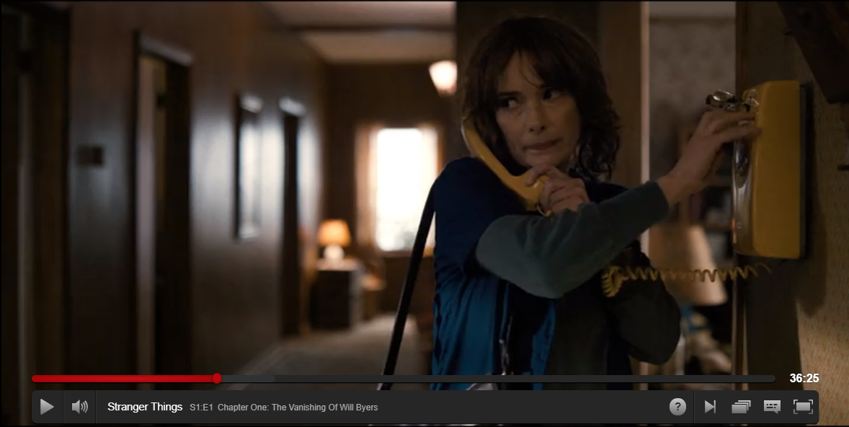
Shot type:
How are the audience to respond (read the text)? Consider Hall.
How is character represented?
Focus on the colour of home in other shots.

Slide 36
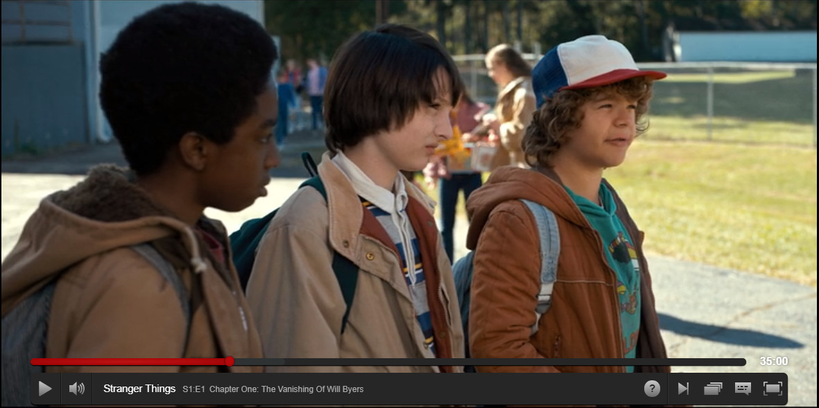
Shot type:
How are the audience to respond (read the text)? Consider Hall.
How is character represented?
Hint. why is Mike in middle?

Slide 37
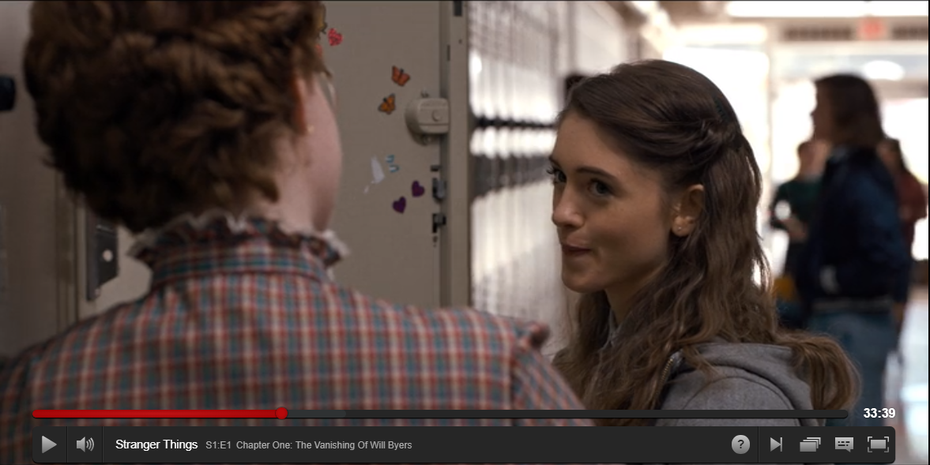
Shot type:
How are the audience to respond (read the text)? Consider Hall.
How is character represented?

Slide 38
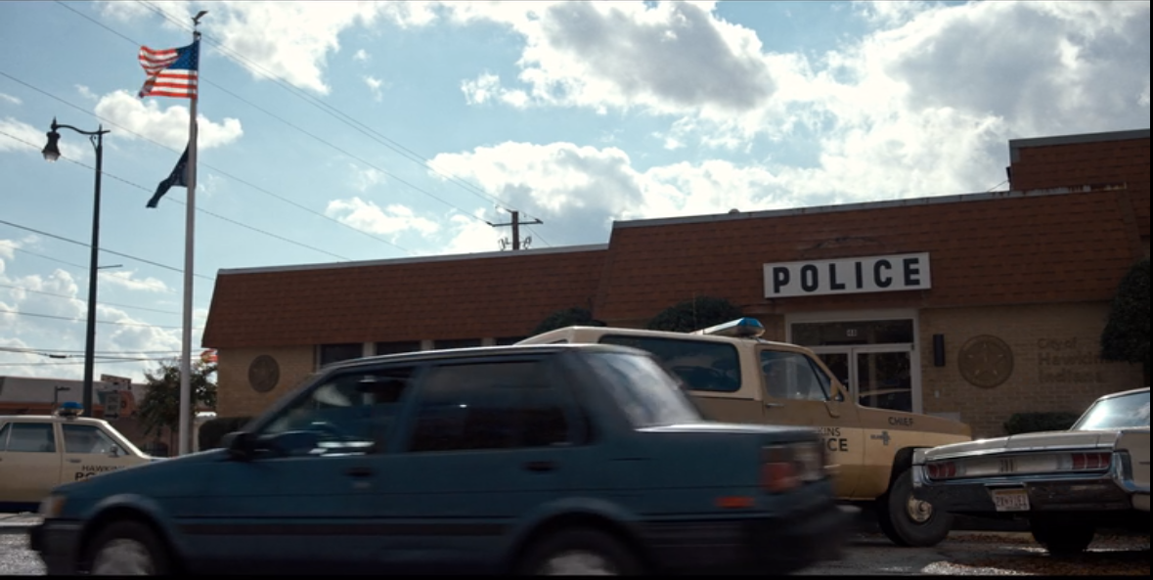
Shot type:
How are the audience to respond (read the text)? Consider Hall.
How is regional/national identity represented?

Slide 39
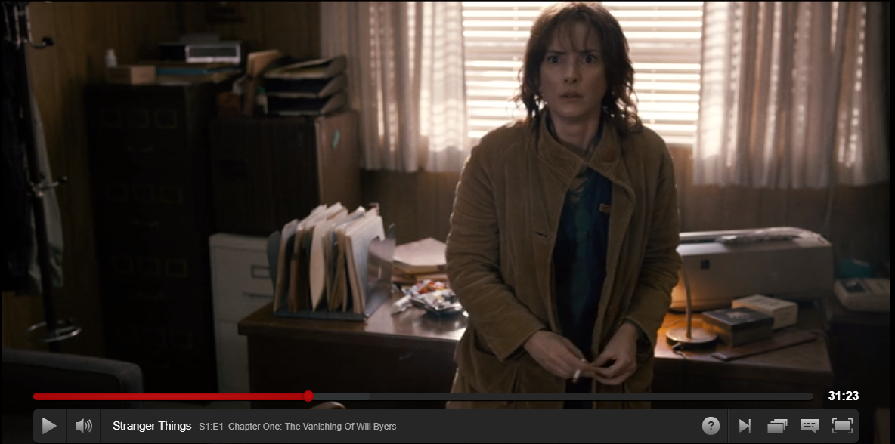
Shot type:
How are the audience to respond (read the text)? Consider Hall.
How is character represented?

Slide 40
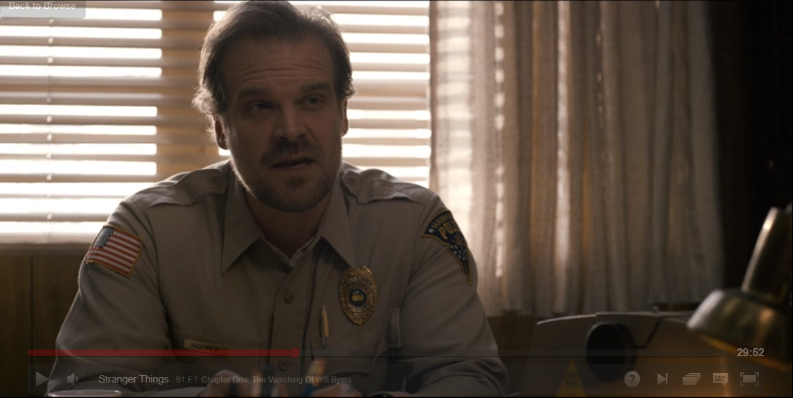
Shot type:
How are the audience to respond (read the text)? Consider Hall.
How is character represented?

Slide 41
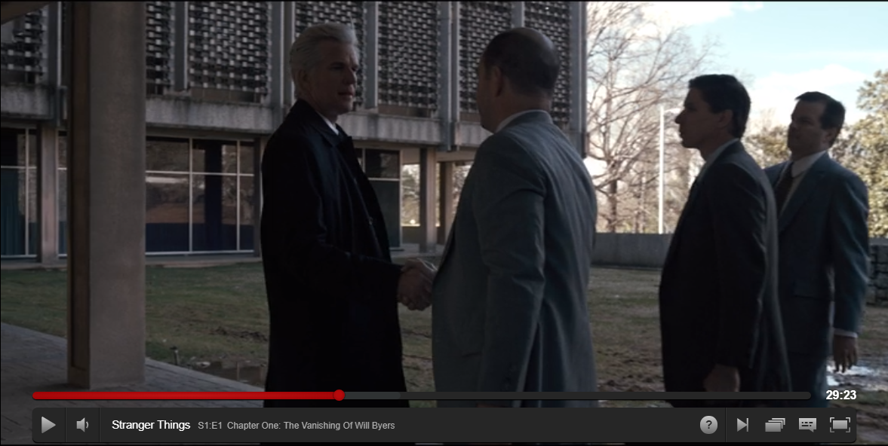
Shot type:
How are the audience to respond (read the text)? Consider Hall.
How is character represented?
This is the main villain (aside from monster).

Slide 42
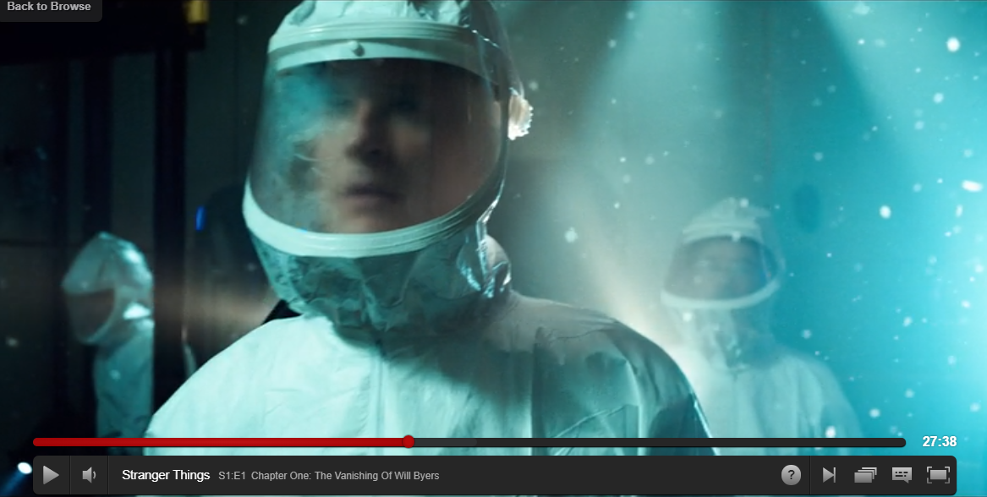
Shot type:
How are the audience to respond (read the text)? Consider Hall.
How is character represented?

Slide 43
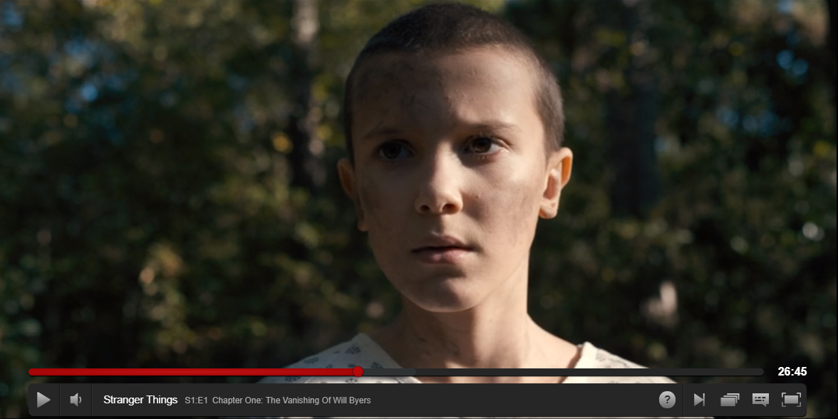
Shot type:
How are the audience to respond (read the text)? Consider Hall.
How is character represented?

Slide 44
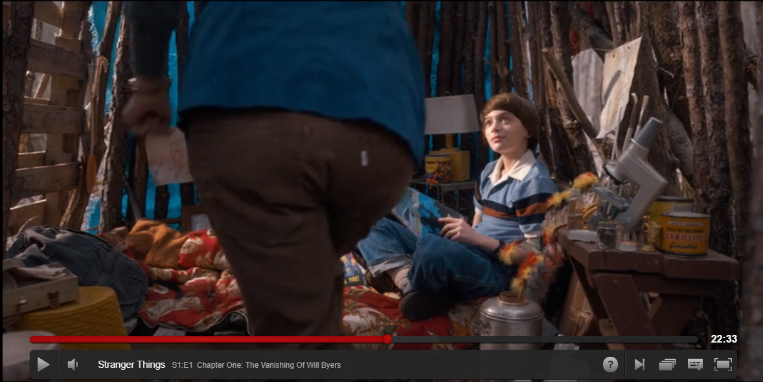
Shot type:
How are the audience to respond (read the text)? Consider Hall.
How is character represented?
This is a flashback scene - contrast with mise-en-scene. What are producers trying to show?

Slide 45
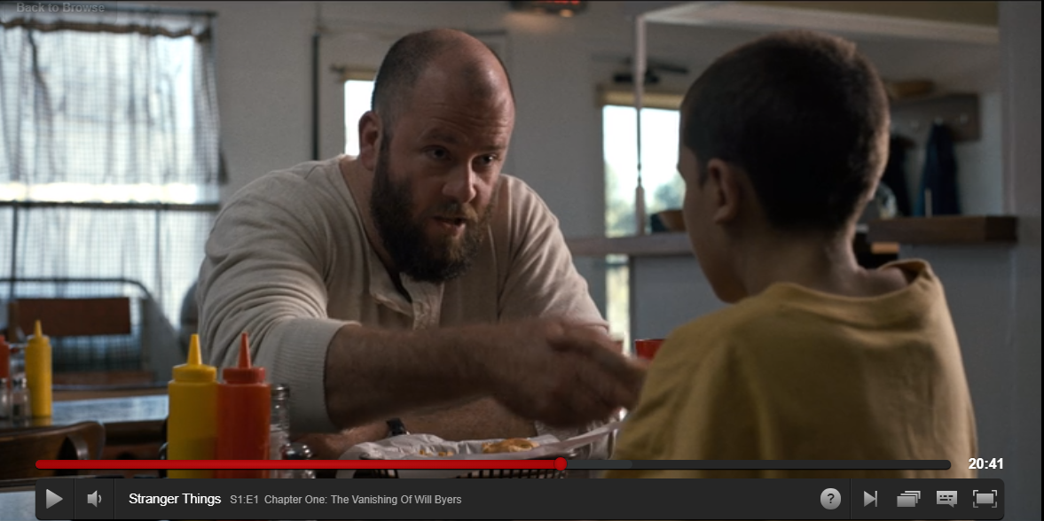
Shot type:
How are the audience to respond (read the text)? Consider Hall.
How is representations of masculinity challenged here?

Slide 46
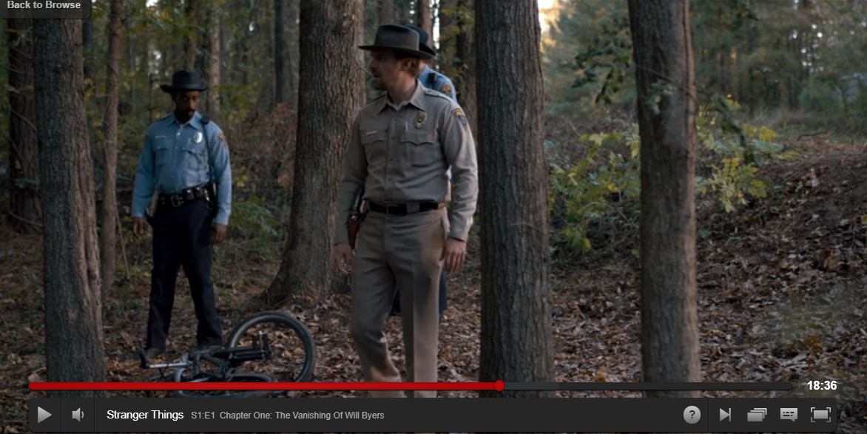
Shot type:
How are the audience to respond (read the text)? Consider Hall.
How is character represented?
Hint. Think about composition of frame and where actors are.

Slide 47
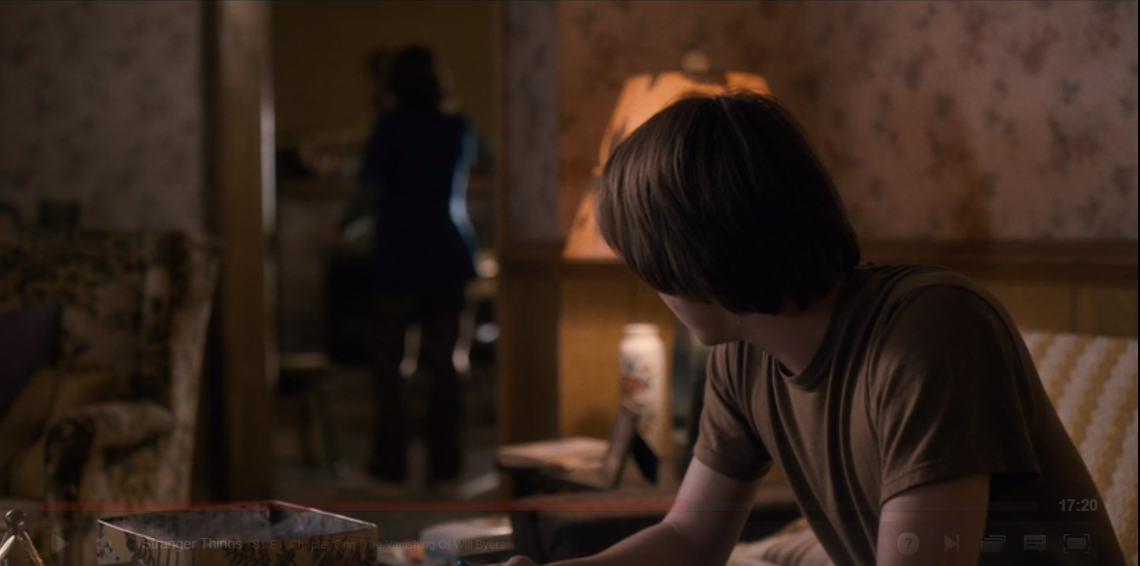
Shot type:
How are the audience to respond (read the text)? Consider Hall.
How is character represented?

Slide 48
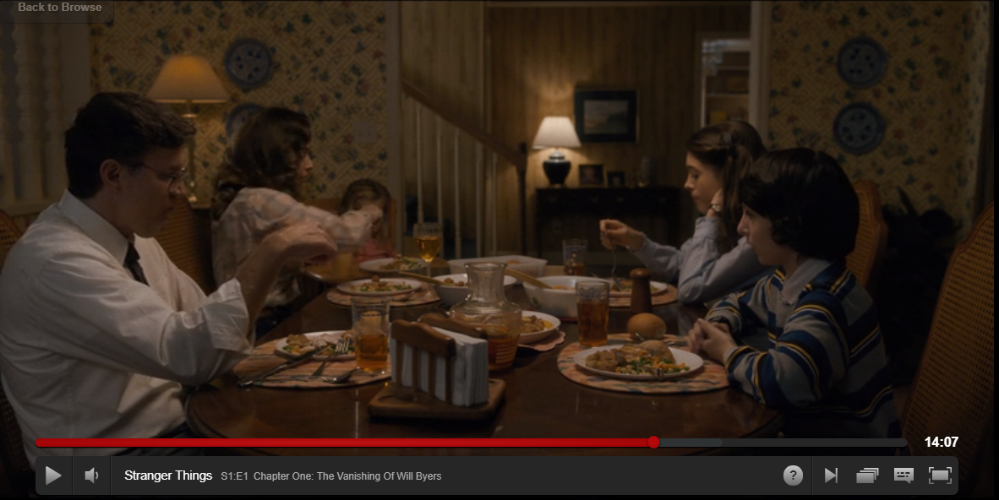
Shot type:
How are the audience to respond (read the text)? Consider Hall.
How is nuclear family represented?

Slide 49
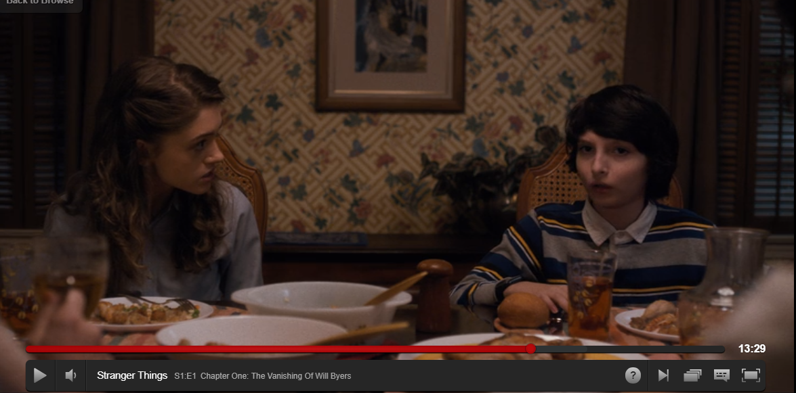
Shot type:
How are the audience to respond (read the text)? Consider Hall.
How is character represented?

Slide 50
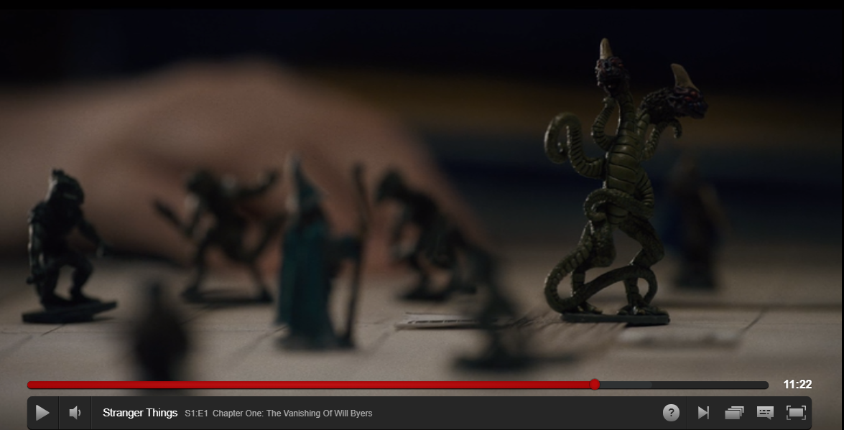
Shot type:
How are the audience to respond (read the text)? Consider Hall.
How is theme of episode represented?

Slide 51
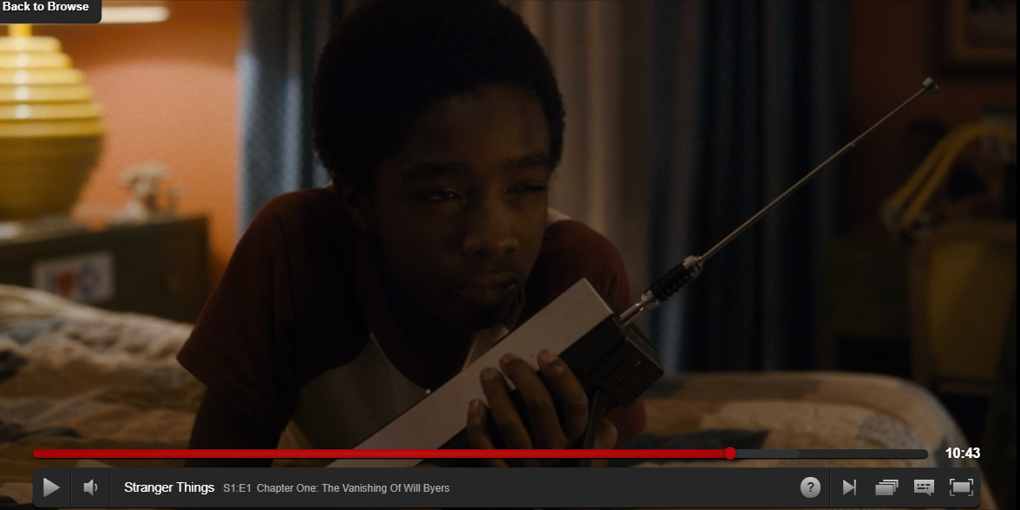
Shot type:
How are the audience to respond (read the text)? Consider Hall.
How is ethnicity represented?

Slide 52
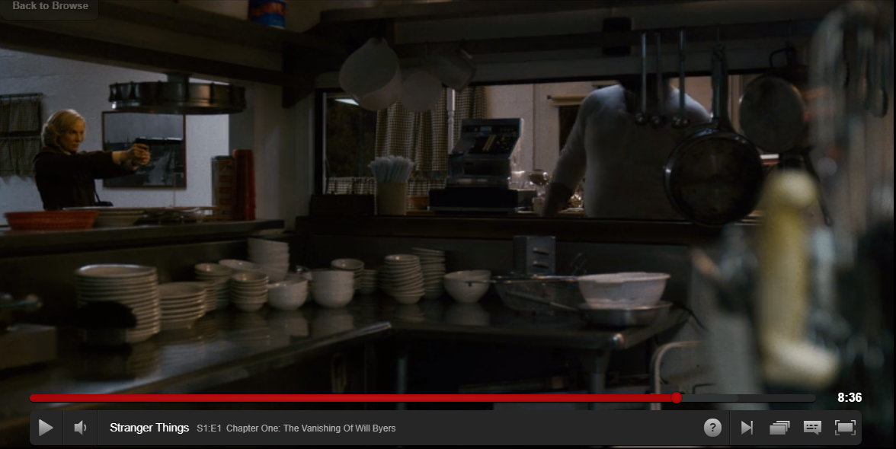
Shot type:
How are the audience to respond (read the text)? Consider Hall.
How is character represented?

Slide 53
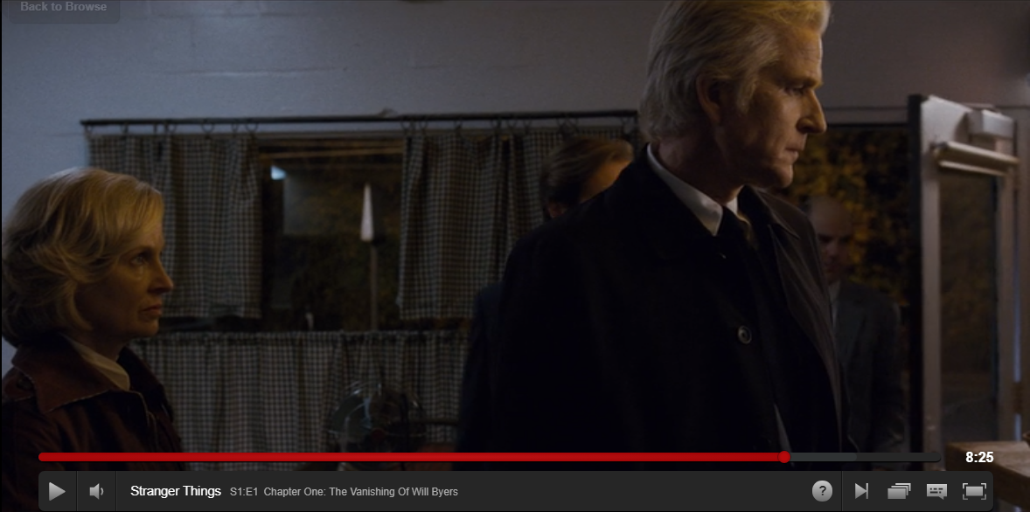
Shot type:
How are the audience to respond (read the text)? Consider Hall.
How is character represented?

Slide 54
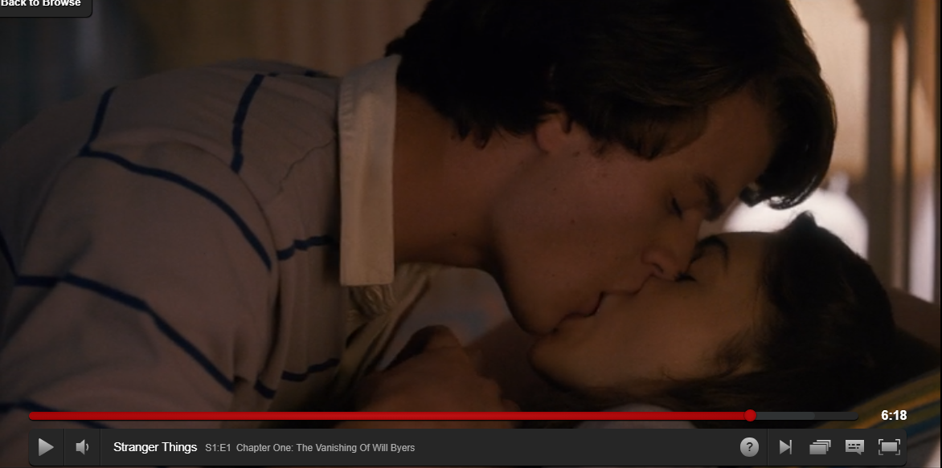
Shot type:
How are the audience to respond (read the text)? Consider Hall.
How is gender represented?

Slide 55
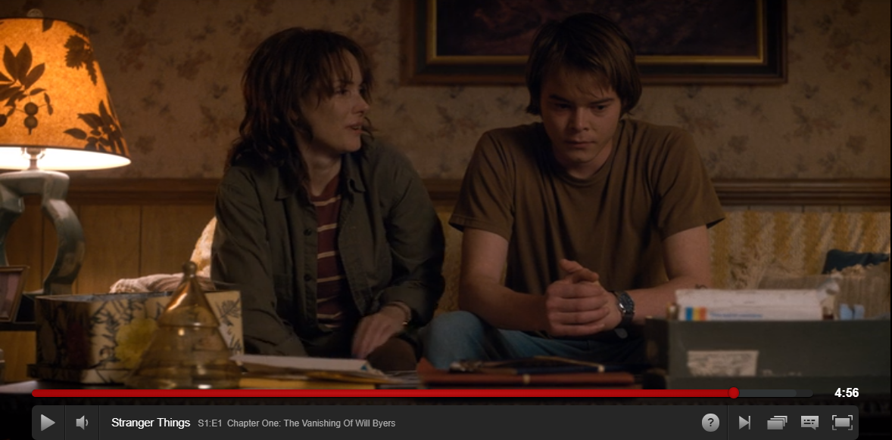
Shot type:
How are the audience to respond (read the text)? Consider Hall.
How is family represented?

Slide 56
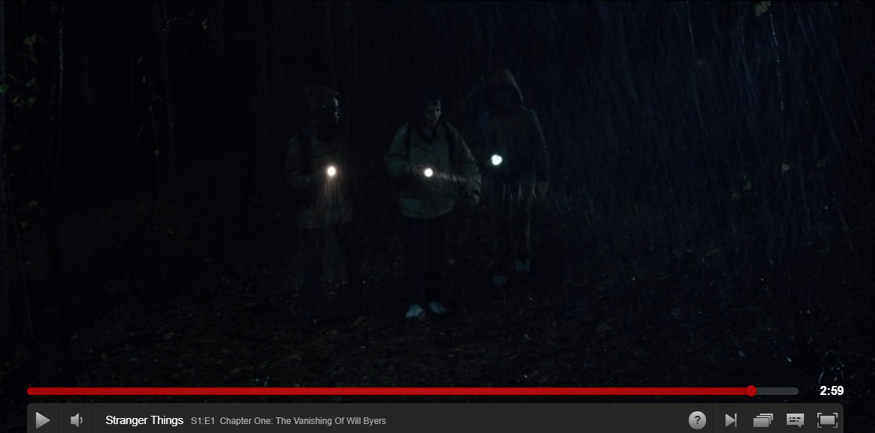
Shot type:
How are the audience to respond (read the text)? Consider Hall.
How is camaraderie represented?
Who is in middle again?

Slide 57
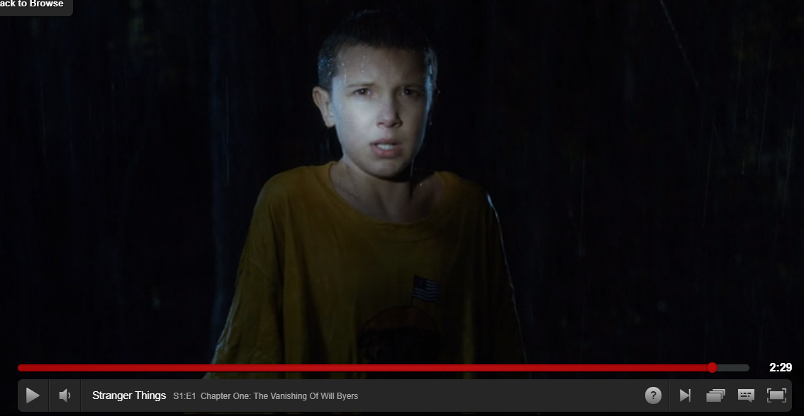
Shot type:
How are the audience to respond (read the text)? Consider Hall.
How is character represented?
What phase of narrative are we in in terms of Todorov? How can we show Propp’s role in this?

