Slide 1
Industry Background to LFTVD

Slide 2


US Network TV - where it came from...
UK TV drama series are usually 6 x 1 hour long.
US TV drama seasons are anything between 12 and 24 x 45 mins long.
US network broadcasters must satisfy their advertisers and hold market share. They are also controlled by federal regulation.
The impact of this on content is a reliance on highly formalised genre conventions and normative values which meet mainstream audience expectations but generate conservative drama.

Slide 3


Along came cable...
Launched in the 1970s HBO was the first US national subscription cable tv channel.
Other major US players include FX, Showtime and AMC.
Many are subsidiaries of media conglomerates (HBO/Warner, FX/Fox).
These subscription based cable channels can take more risks with content and form.
By early 2000s The Sopranos and The Wire won awards, audiences and created ‘water cooler’ tv.
They can break more rules and push more boundaries...

Slide 4



The trouble with UK tv drama?
• UK broadcasters have failed to meet the challenge of the US cable channels move to long form, with their risk-taking content & style.
• BBC and ITV 90s> relied on genre-based, formula drama. Heritage and crime drama are prime examples. Impact of White Paper/Charter renewal?
• Sky co-opted success of US long form with Sky Atlantic.
• Commissioning remains tightly controlled and conservative in outlook.

Slide 5
Changing Platforms - Subscription and VOD
Content viewing via a TV still dominates in UK.
3⁄4 of households (UK) have PVR uptake but it has plateaued
Use of timeshift is increasing.
Growth of SVOD web based channels such as Netflix, Amazon Instant Video & Now TV (Sky) is considerable.
Disney + and Britbox have launched in the last 6 months.

Slide 6
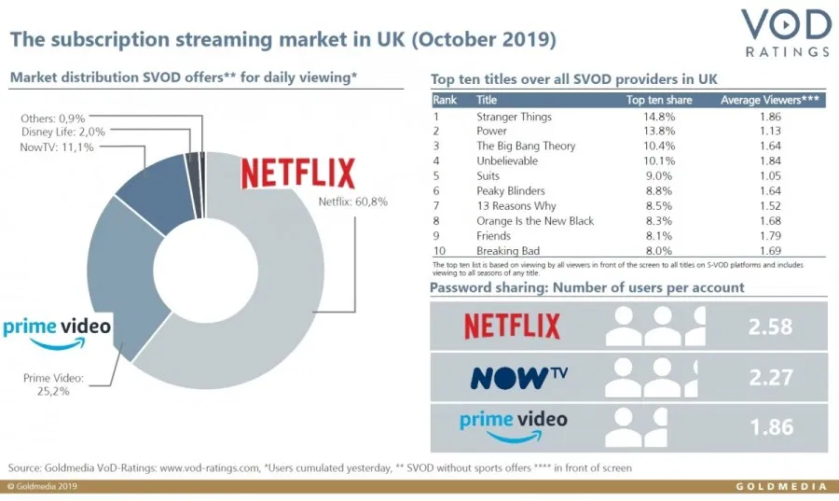

Slide 7

Audiences
Rise of binge-watching started with DVD in late 90s/early C21. Partially due to syndication problems in the UK.
A move from ‘water cooler’ tv to ‘shared universe’ fandom (as with cinema).
US long form drama often uses easter eggs, and mid-season breaks to generate fan intensity and maintain media profile.

Slide 8


Chasing the ABC1 audience
Channel 4 & BBC4 have identified foreign language/subtitled long form shows are ratings winners.

Slide 9


Why are LFTVDs different?
Long form shows challenged the simplistic storylines and stereotypical characters that dominate network TV in US e.g. CSI
HBO (Time Warner) launched The Sopranos in 1999 (to 2007), which was a huge commercial & critical hit. Increasingly these shows were about the crisis of US identity & hegemony.
Other shows followed including The Wire (2002-2008) which won awards and turned US TV into a medium for serious subject matter and critique.
Tap into the zeitgeist.

Slide 10

Genre traits...
High concept
Novelistic
Beyond the binary
About systematic change, not the individual
Ambitious
Cinematic
Flow
Hybrid genre
Submersive/escapism
Unexpected narratives
Audience and fandom

