Slide 1
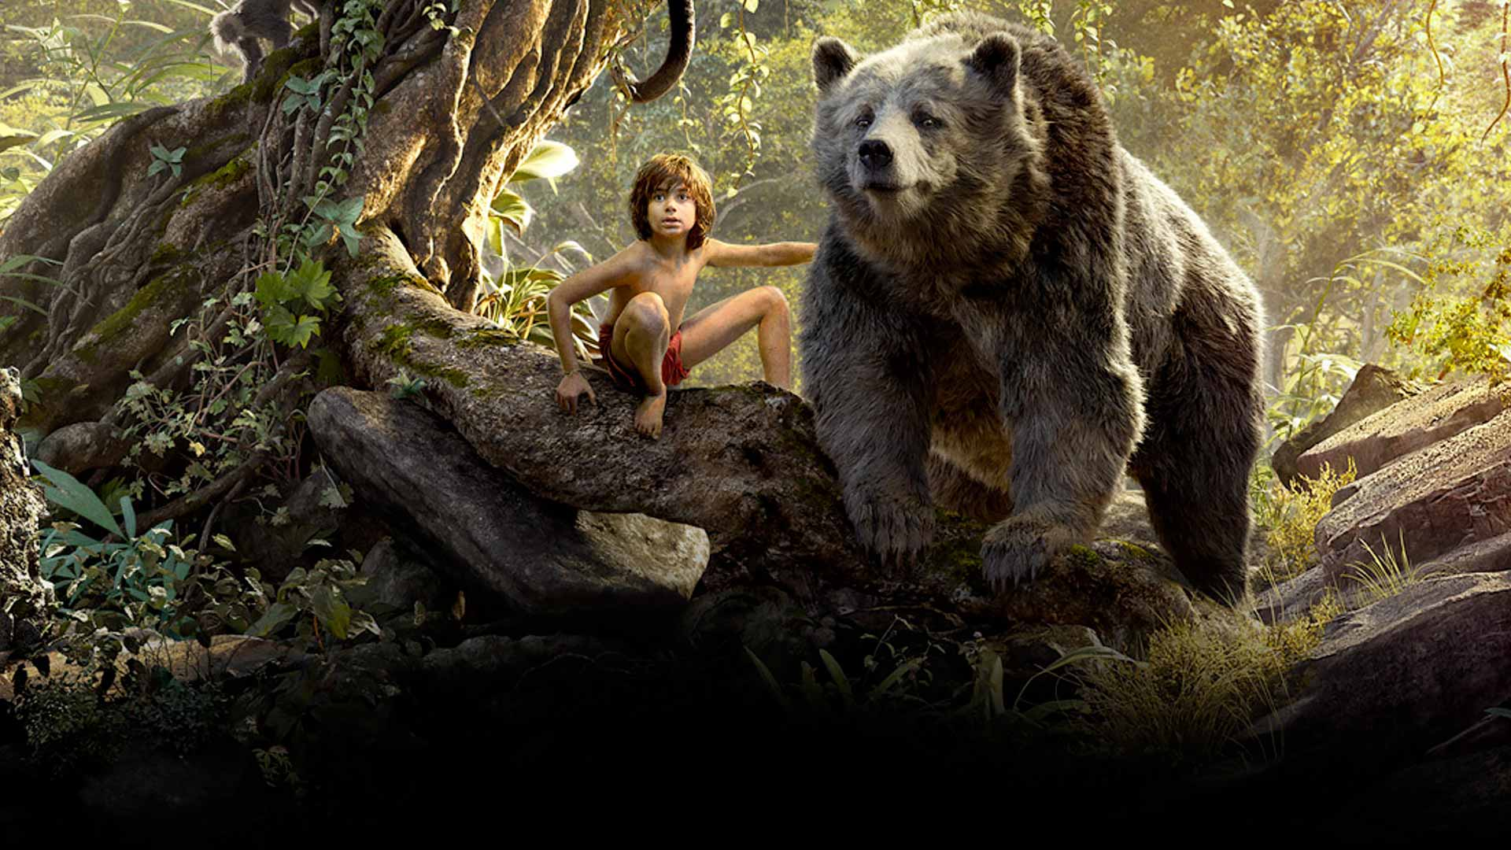
COMPONENT 2 SECTION A: FILM
Regulation

Slide 2
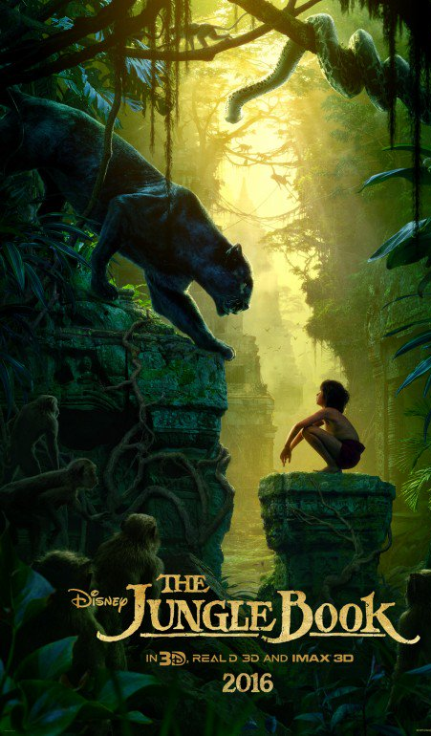
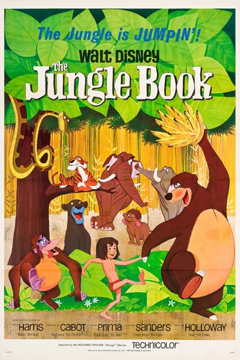
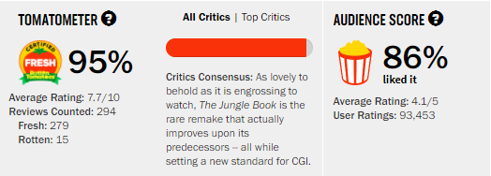
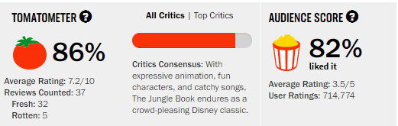
Summarise some of the positive and negative comments.
Are there any comments that stand out to you in particular? Why?
What are the audience appeals of JB67 and JB16 according to the uses and gratifications theory?

Slide 3



Regulation;
Media regulation is the control or guidance of mass media by governments and other bodies.
Classification
Piracy
Copyright

Slide 4
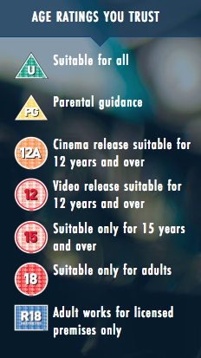
Film Classification;
Before a film is released it has to be reviewed and given a rating in order to protect children from unsuitable and even harmful content in films.
This also gives consumers information they might need about a particular film or video before deciding whether or not to view it.
QUESTION:
A 13 year old recently sneaked into the cinema to watch IT (a 15 certificate). His friend, who is 11, chickened out of watching it on the big screen and instead waited for the DVD release which his Dad bought for him. Who broke the law here?

Slide 5

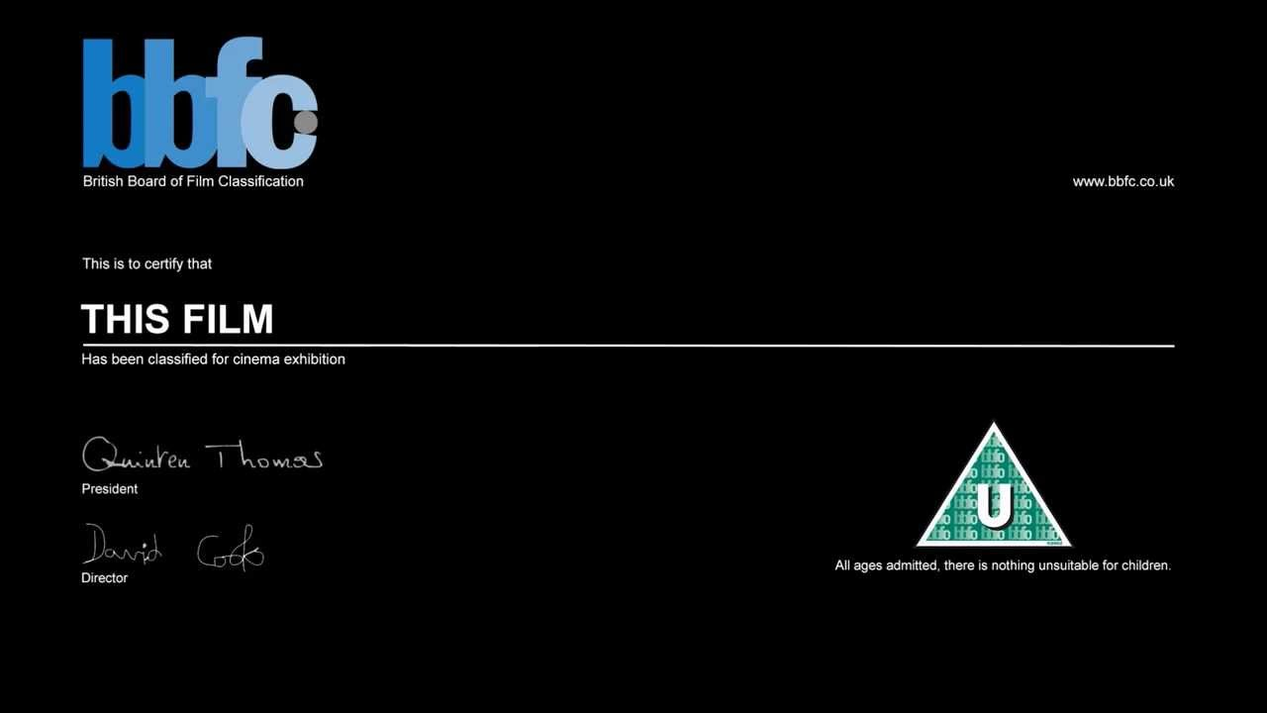

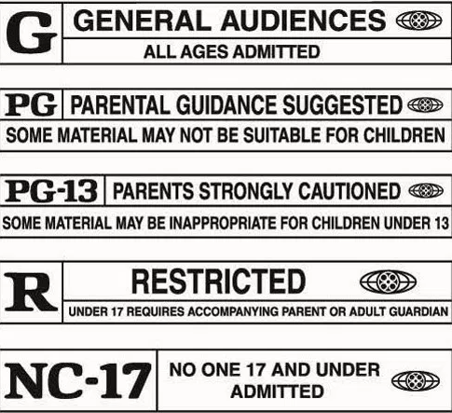
British Board of Film Classification
Not for Profit Organisation: All of the money earned is used in keeping it running.
The BBFC look at issues such as discrimination, drugs, horror, language, imitable behaviour, nudity, sex, sexual violence, theme and violence when making decisions.
They also consider context, the tone and impact of a work (eg how it makes the audience feel) and even the release format (for example, as DVDs are watched in the home, there is a higher risk of underage viewing).

Slide 6

Your Task;
Visit the BBFC website and research the UK certificate ratings for JB67 & JB16. Why were they awarded these ratings? Were any cuts made to the original version in order for it to be passed?
How does the classification vary from country to country? You could look at the MPAA in the US and Kijkwijzer in the Netherlands as a starting point.
What is The Mickey Mouse Protection Act and how does it relate to the Jungle Book Franchise?
EXTENSION QUESTIONS (1000 points each):
What is significant about JB67’s release in relation to certification in the US? Hint - Research the Production Code.
What is piracy and how has Disney tried to tackle it?

Slide 7
Useful articles;
https://arstechnica.com/tech-policy/2018/01/hollywood-says-its-not-planning-another-copyright-extension-push/
https://www.copyrightservice.co.uk/copyright/p01_uk_copyright_law
https://atp.orangenius.com/how-mickey-mouse-keeps-changing-copyright-law/
http://copyright.nova.edu/mickey-public-domain/
http://variety.com/2017/digital/news/entertainment-studios-piracy-lawsuits-1202463987/
https://www.hollywoodreporter.com/news/box-office-jungle-book-overcomes-884619
https://www.forbes.com/sites/scottmendelson/2017/05/16/box-office-disney-pirates-of-the-caribbean-johnny-depp-hackers/#6c6982c72aab
http://www.abc.net.au/news/2017-05-26/disney-fights-off-pirates-but-is-the-cinema-industry-sinking/8560586

