Slide 1

COMPONENT 2 SECTION A: FILM
Exhibition

Slide 2
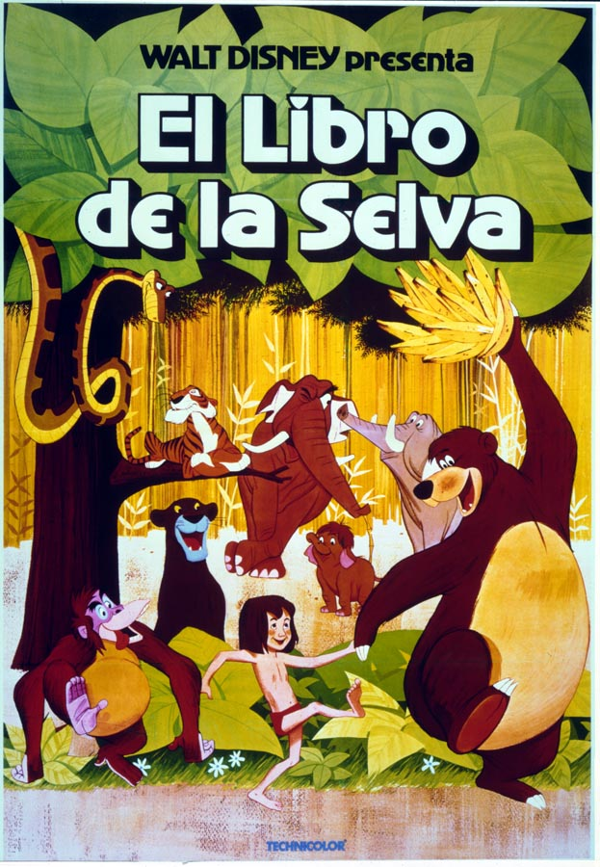
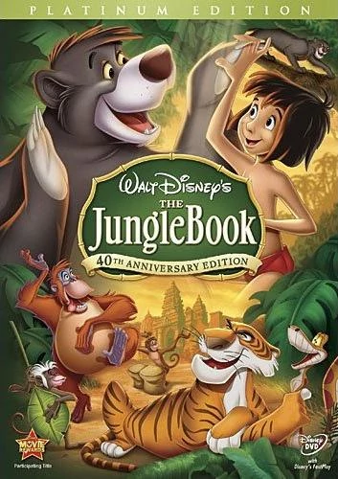
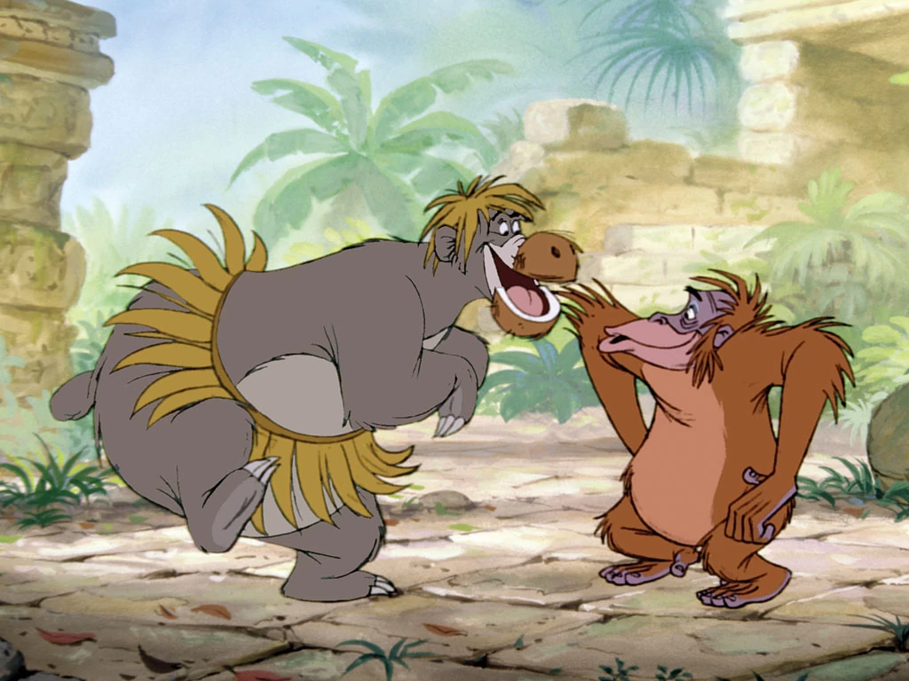
Exhibition = Audience;
Disney was highly aware of how to build and maintain audiences nationally and globally by:
Shaping of the product to appeal more to a family audience
Making the product accessible to global audiences
Re-releasing & Vaulting
Merchandising

Slide 3
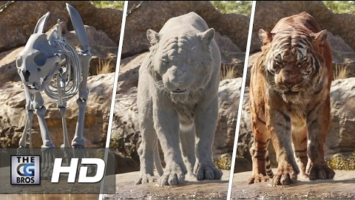
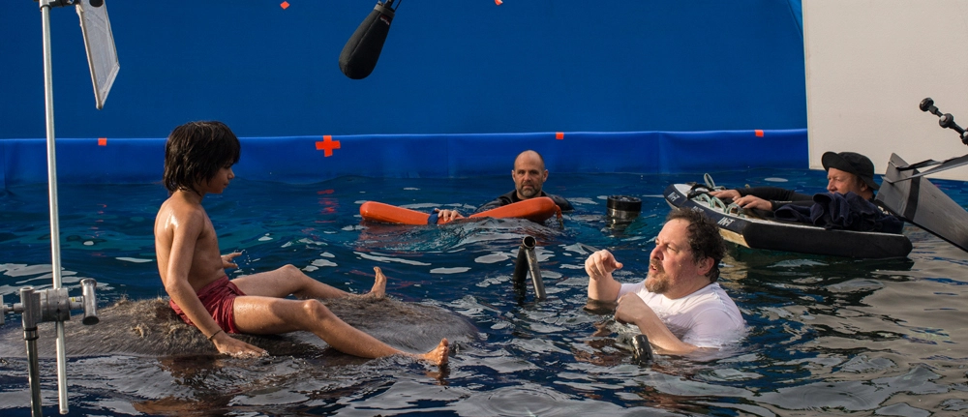
JB16 & the
Male Audience
The movie is playing to not just the coveted Disney female audience, but to all demos. Males have flocked to the film, attracted by the cutting edge technology used for its visual effects

Slide 4
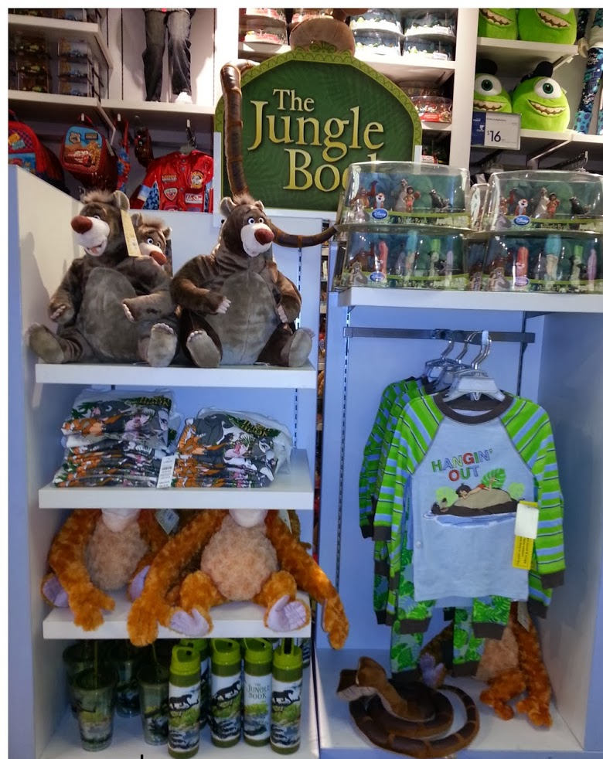
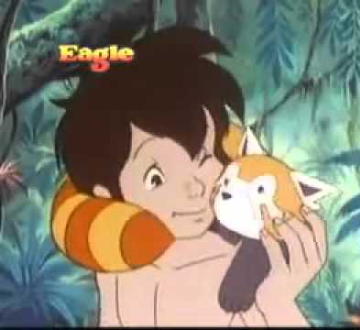
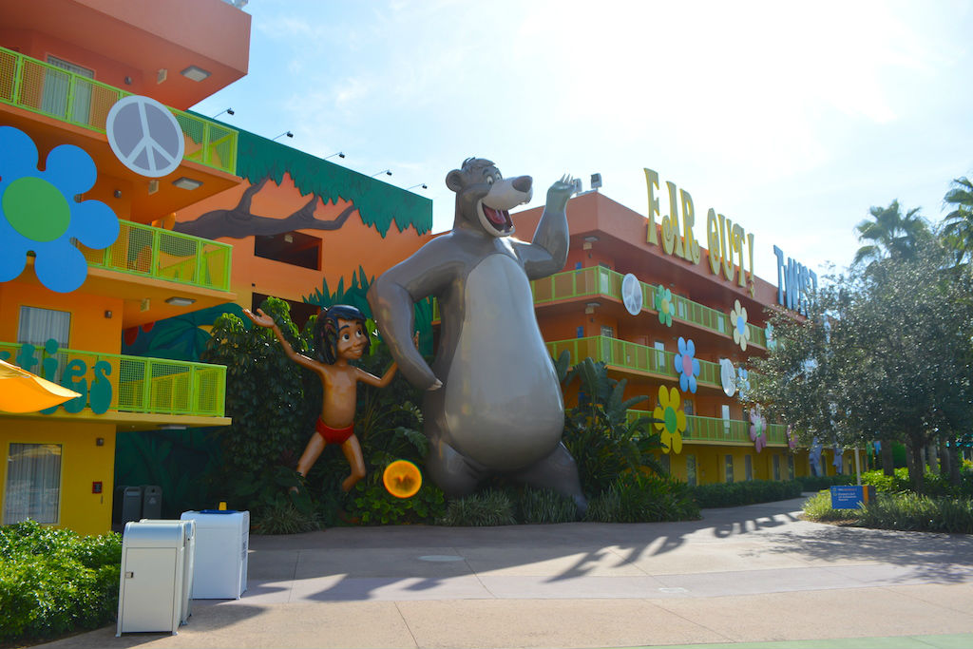
Disney & Synergy
Disney was an early master of synergy and cross promotion. They did this by:
Persuading companies to tie in with their film’s release
Running a character merchandising department
Using TV channel & Theme Parks to promote the product

Slide 5
“Every Disney product is both a commodity and an ad for every other Disney commodity, it is scarcely an exaggeration to say that each story the company tells, each theme the company deploys builds the Disney brand”.
Budd. M (Ed) & Kirsch, M. (Ed). (2005) Rethinking Disney: Private Control, Public Dimensions
Brand loyalty is a pattern of consumer behavior where consumers become committed to brands and make repeat purchases from the same brands over time. Loyal customers consistently purchase products from their preferred brands, regardless of convenience or price.

Slide 6
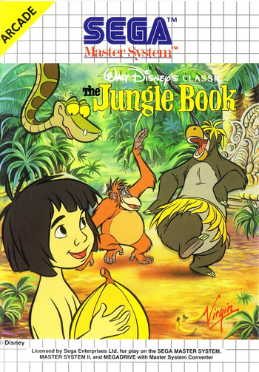
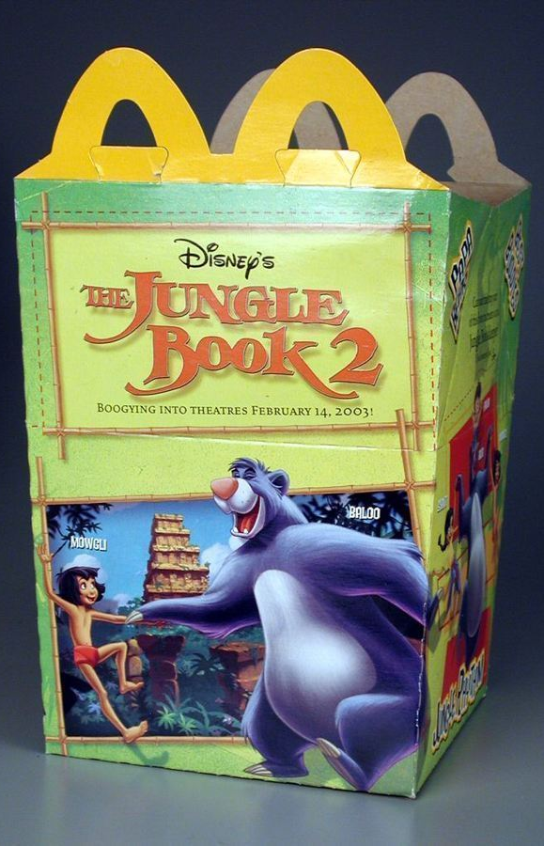
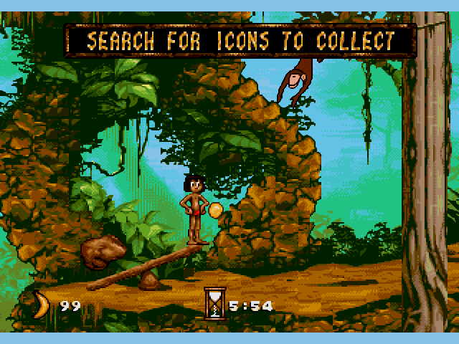
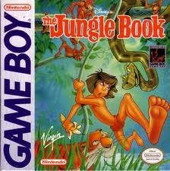
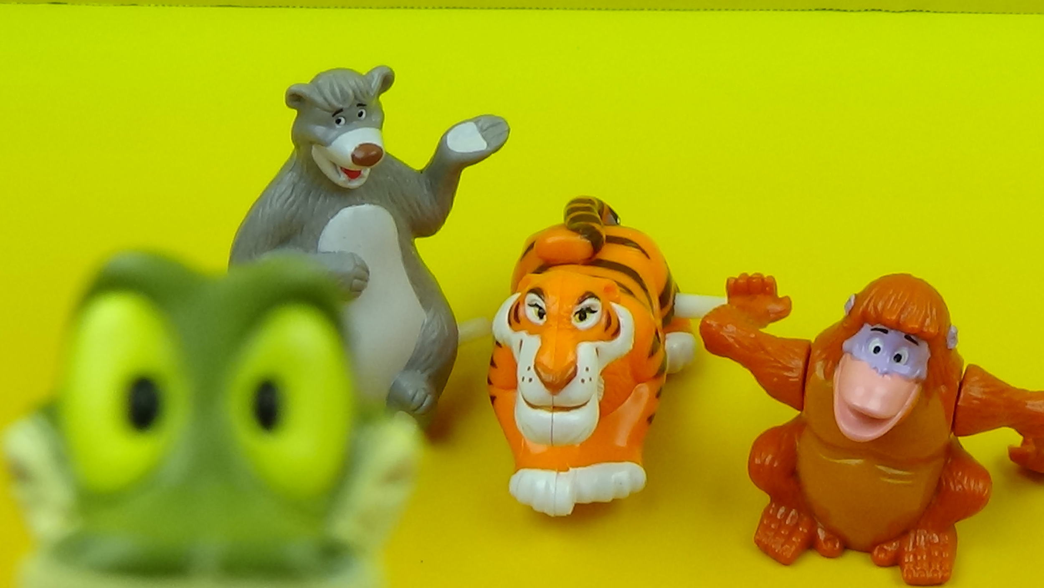
Disney & Synergy
Tie-Ins
A tie-in work is a work of fiction or other product based on a media property.
Tie-ins are authorized by the owners of the original property, and are a form of cross-promotion used primarily to generate additional income from that property and to promote its visibility.

Slide 7
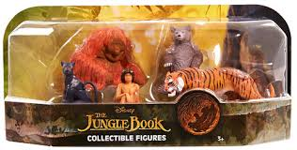
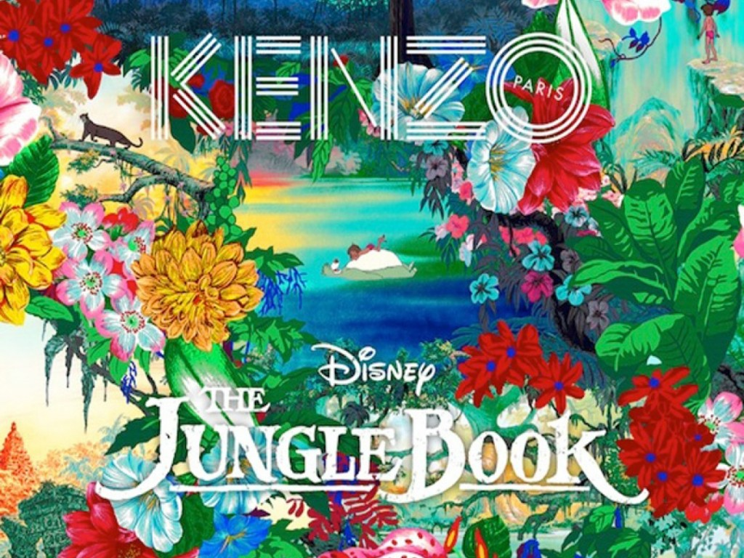
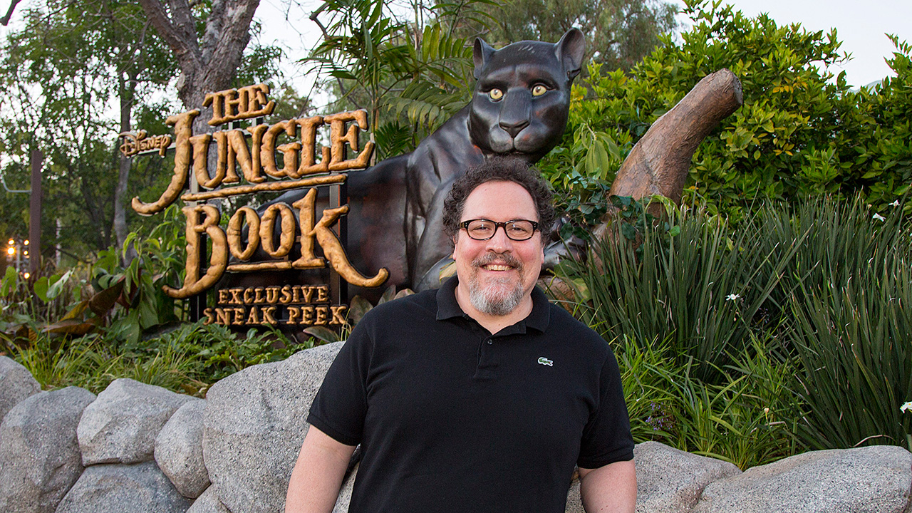
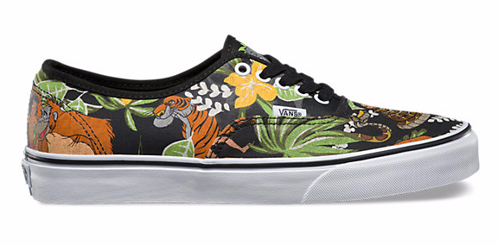
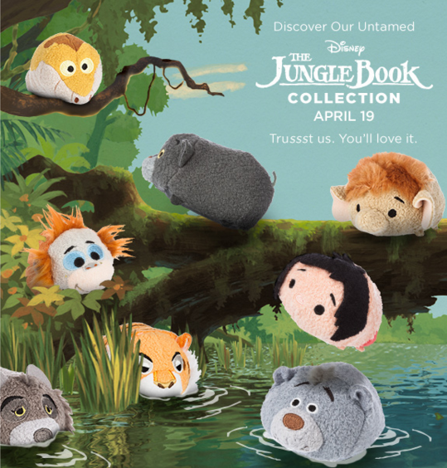
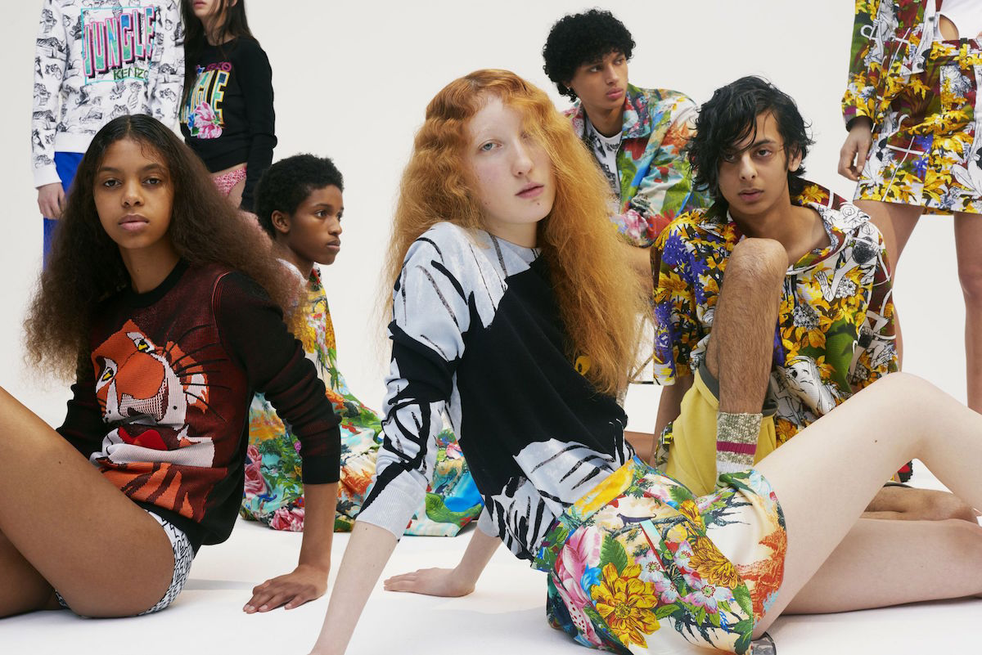
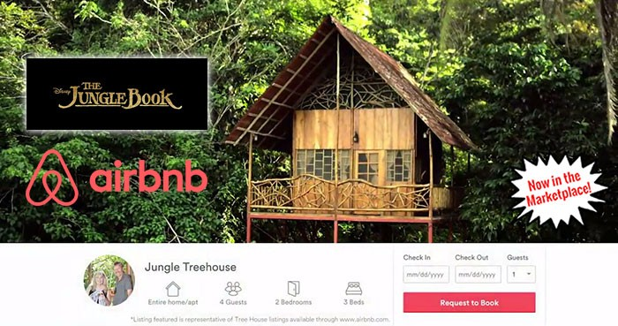
JB16 & Synergy
Disney continues to employ a similar strategy in a modern world...

Slide 8
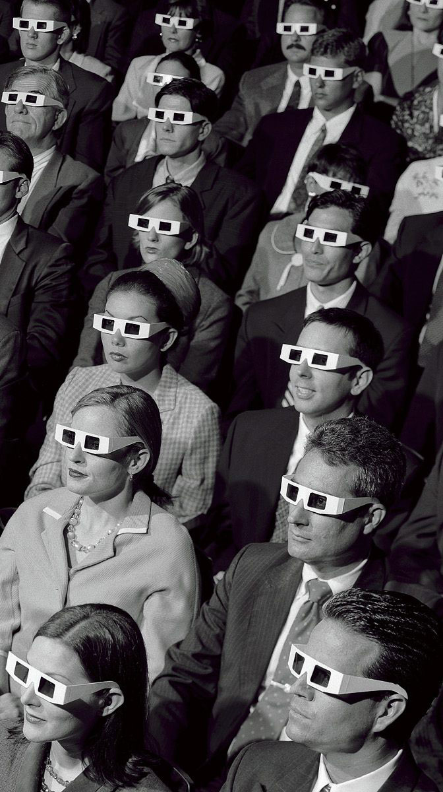
Your Task
What is the audience score for JB67 & JB16 on Rotten Tomatoes?
Summarise some of the positive and negative responses from audiences.
Are there any comments that stand out to you in particular? Why?
In your opinion, why do you think merchandise (and any form of cross promotion) appeals to audiences?

