Slide 1
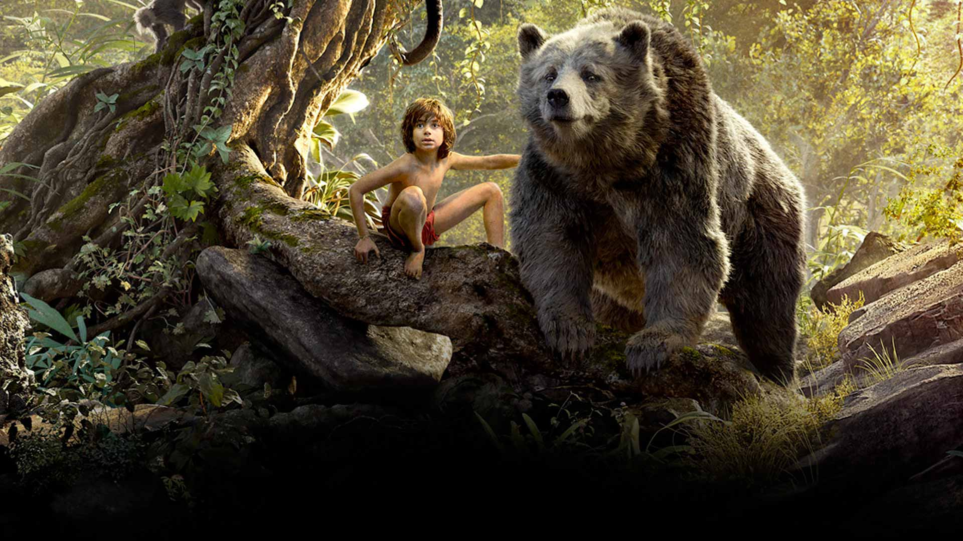
COMPONENT 2 SECTION A: FILM
JUNGLE BOOK 2016

Slide 2
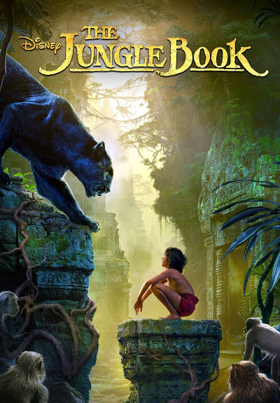
The Jungle Book (2016) was produced by Walt Disney Pictures, directed and co-produced by Jon Favreau, and written by Justin Marks. It was partly based on Disney’s original version but also drew more on Kipling’s original books, giving a rather darker tone.
In some ways it is part of Disney’s on-going policy to create live action versions of its earlier animated classics but, although the film has some live action, by far the largest part of what is seen on screen was produced using CGI
“The Jungle Book exists in a strange limbo-world between live action and animation” Jon Favreau

Slide 3
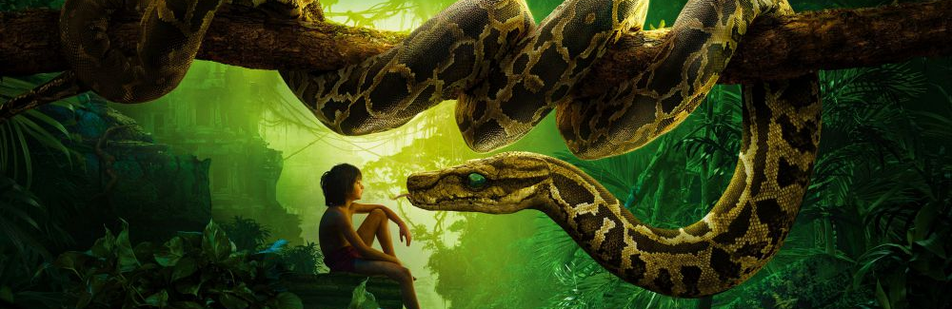
The Jungle Book (2016)
Production

Slide 4
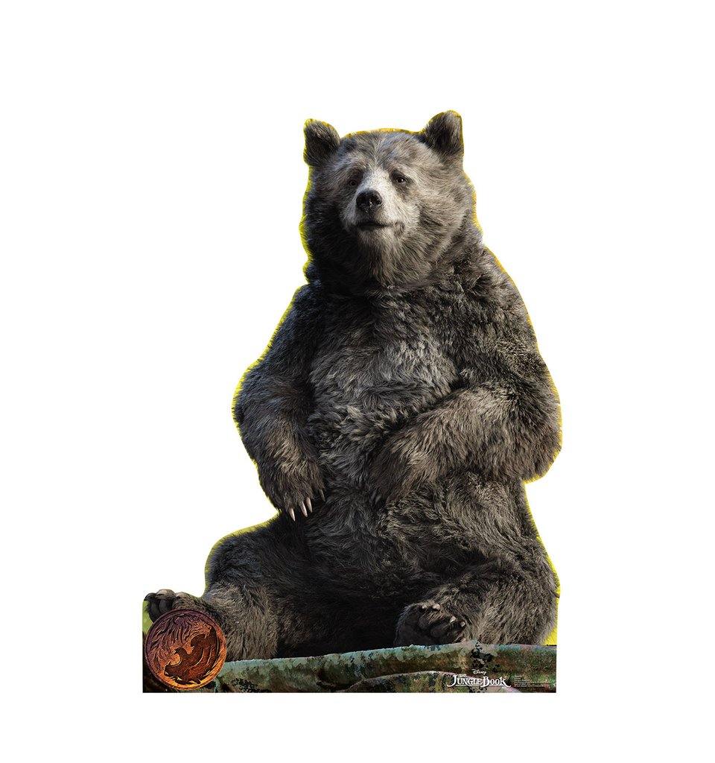
JB16 included some of the original music from the 1967 version partly in order to compete with the Warner version that was simultaneously in production:
‘When Warners raced us on Jungle Book, we thought, Well, we’re putting ‘Bare Necessities’ in the movie because they can’t’ [Sean] Bailey said. ‘We have certain characters and certain depictions of characters and we’re going lean into that. It’s an advantage to us.’

Slide 5
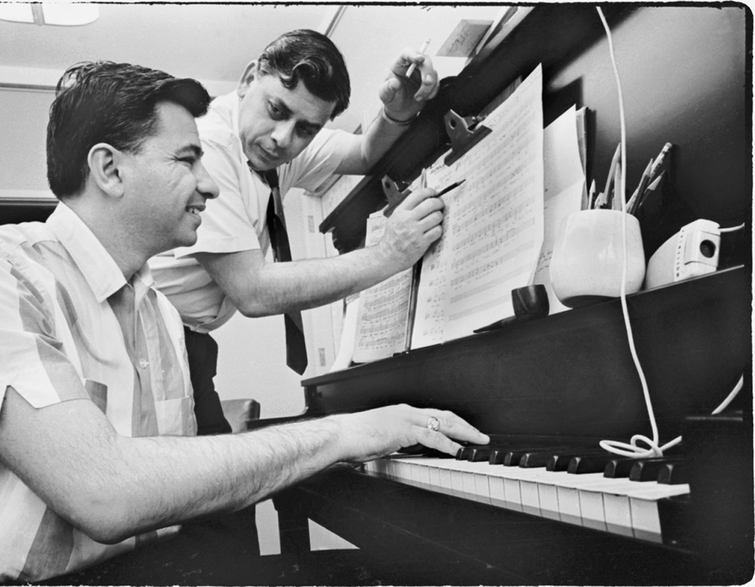
Sean Bailey (the head of Production at the Studios) said that the team were able to call on Disney’s huge archives (called the Morgue):
‘While developing projects, creative teams look at ‘every screenplay page that didn’t make it, every deleted scene, every conceptual drawing.’
There are still people at the company who worked on older films who can help inform the production, too. (When Favreau wanted additional lyrics for ‘I Wan’na Be Like You ‘ in The Jungle Book, he just asked original songwriter Richard Sherman.)

Slide 6
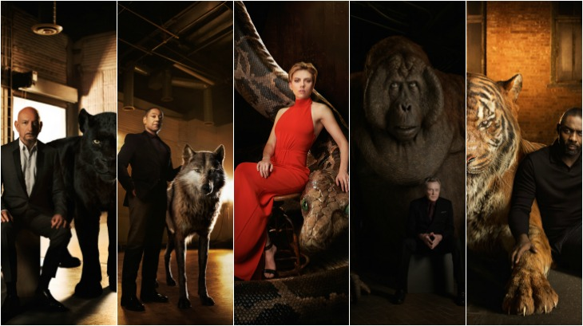

Slide 7

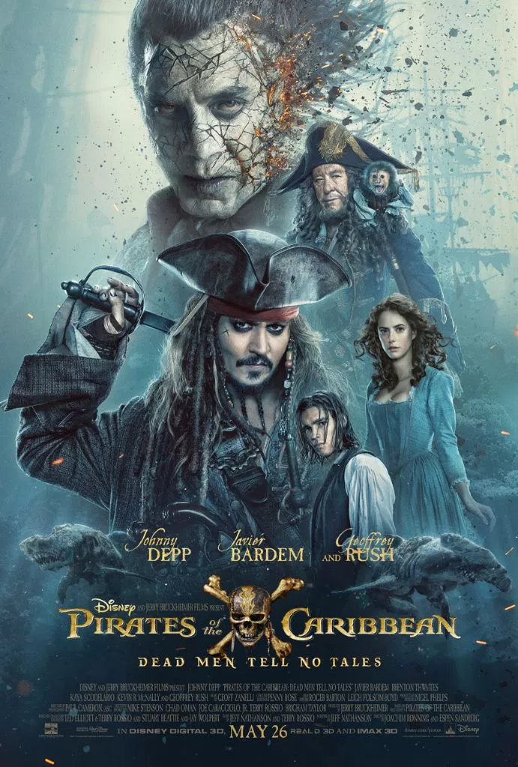
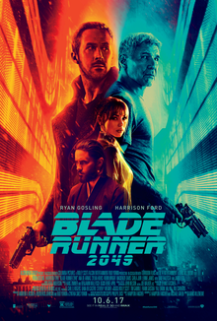
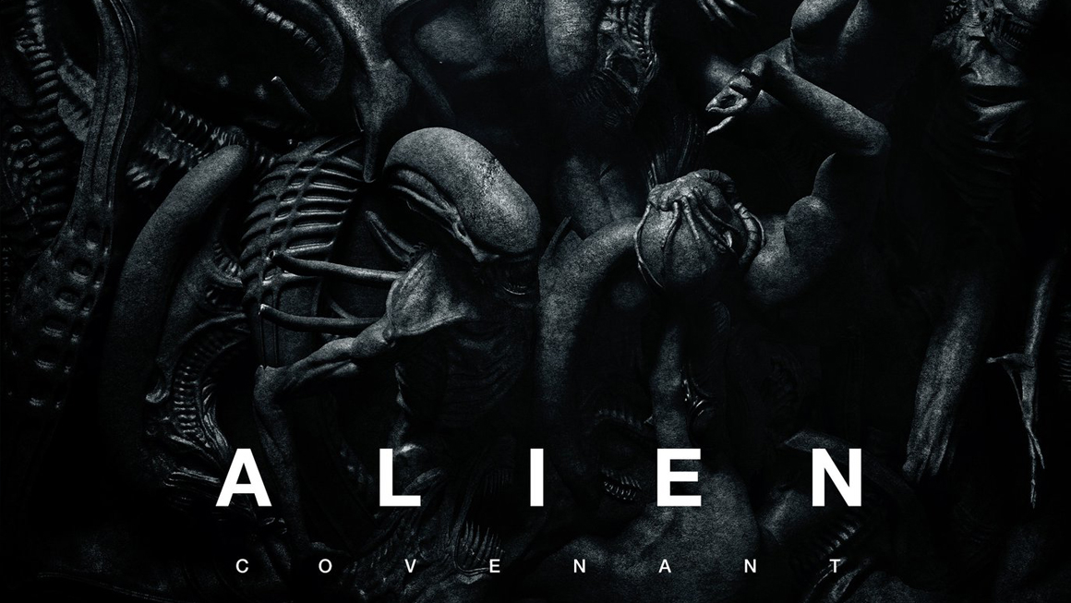
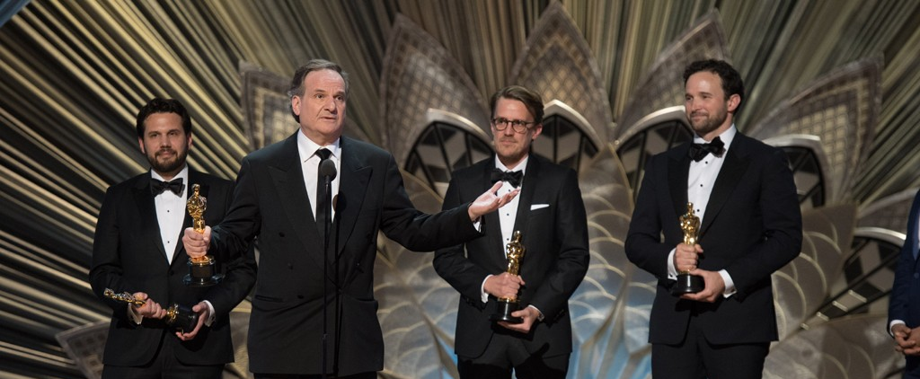
Unlike it’s predecessor, JB16 wasn’t completely made in-house, as Disney used The Moving Picture Company to create the visual effects. The VFX (Visual Effects) won both the BAFTA and Academy Award.

Slide 8
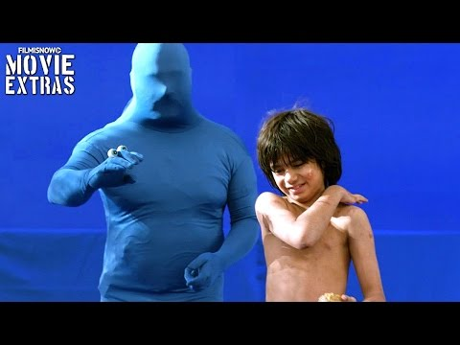
Sean Bailey, president of production for Disney, called JB16 ‘one of the most technologically advanced movies ever made’; as the director noted,
‘I found myself wrestling with the same things as Walt, who used innovative technology for his day, but with a different set of tools and technologies.
JB16 is the result of cutting edge CGI – the animals were created digitally post-production and the one actor in the film (playing Mowgli) acted against a blue screen.

Slide 9
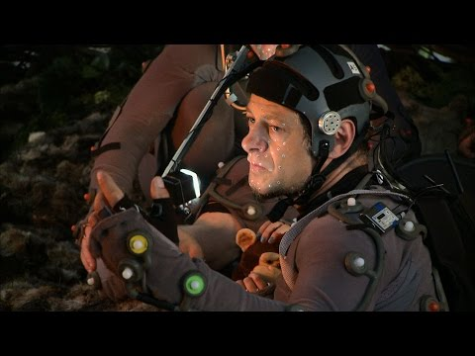
On the set, scenes for The Jungle Book were first filmed using motion capture. ‘We motion-captured the entire movie before we filmed anything and we cut the whole film together,’ says Favreau.
Using that footage, the effects team then built the film’s sets virtually, a process known as previsualisation (previz). ‘Everything was mapped against the virtual sets. We designed the sets like you would for a video game

Slide 10
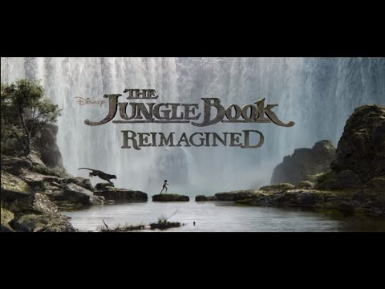
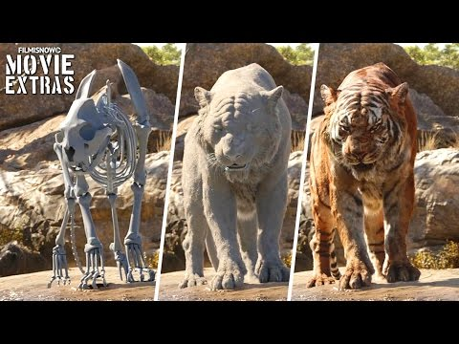
Watch the clips and answer the following questions:
What are the similarities and differences in the production processes used in both Jungle Book movies?
How might the production processes in the 2016 film help it appeal to both new and old audiences?
EXTENSION: How does the Jungle Book franchise demonstrate Disney’s position as a leader of innovation?

Slide 11
Your Task
Research the marketing campaign for the film.
How did they create hype and make the audience excited to see the film?
Consider:
Posters
Trailer
Social Media
Websites
Viral marketing
Release Date
Merchandise
Publicity
What was the budget for JB16?
How much did it take on its opening weekend?
What is the total box office revenue to date?
Which countries have the largest box office figures for JB16?
How does vertical integration relate to JB16?
How has access to a back catalogue of classic movies helped The Walt Disney company to progress in a competitive industry?
How did JB16 move away from WD’s politics and beliefs? Or did they?
How did JB16 impact Warner Bros?
How much revenue did The WD Co make in 2016? How does this compare with their rivals? Were there any losses? How did that impact the company?

Slide 12
Useful links for this task
https://www.nbcnews.com/pop-culture/movies/jungle-book-roars-box-office-103-6-million-debut-n557341
http://theweek.com/articles/617441/how-disneys-new-jungle-book-corrects-years-troubling-racial-under
http://theweek.com/articles/617441/how-disneys-new-jungle-book-corrects-years-troubling-racial-under
https://d23.com/floyd-normans-9-wild-stories-from-the-making-of-the-jungle-book-1967/
http://www.hollywoodreporter.com/news/germany-original-jungle-book-biggest-885953
https://www.nbcnews.com/pop-culture/movies/jungle-book-roars-box-office-103-6-million-debut-n557341
http://www.hollywoodreporter.com/news/summer-box-office-2016-blockbusters-flops-sequelitis-923601
https://www.forbes.com/forbes/welcome/?toURL=https://www.forbes.com/sites/robcain/2016/04/15/disneys-jungle-book-swings-in-china-to-12-million-opening-day-250-better-than-zootopia/&refURL=&referrer=#7d44f2aa2a1f
http://www.boxofficemojo.com/movies/?id=junglebook2015.htm

