Slide 1
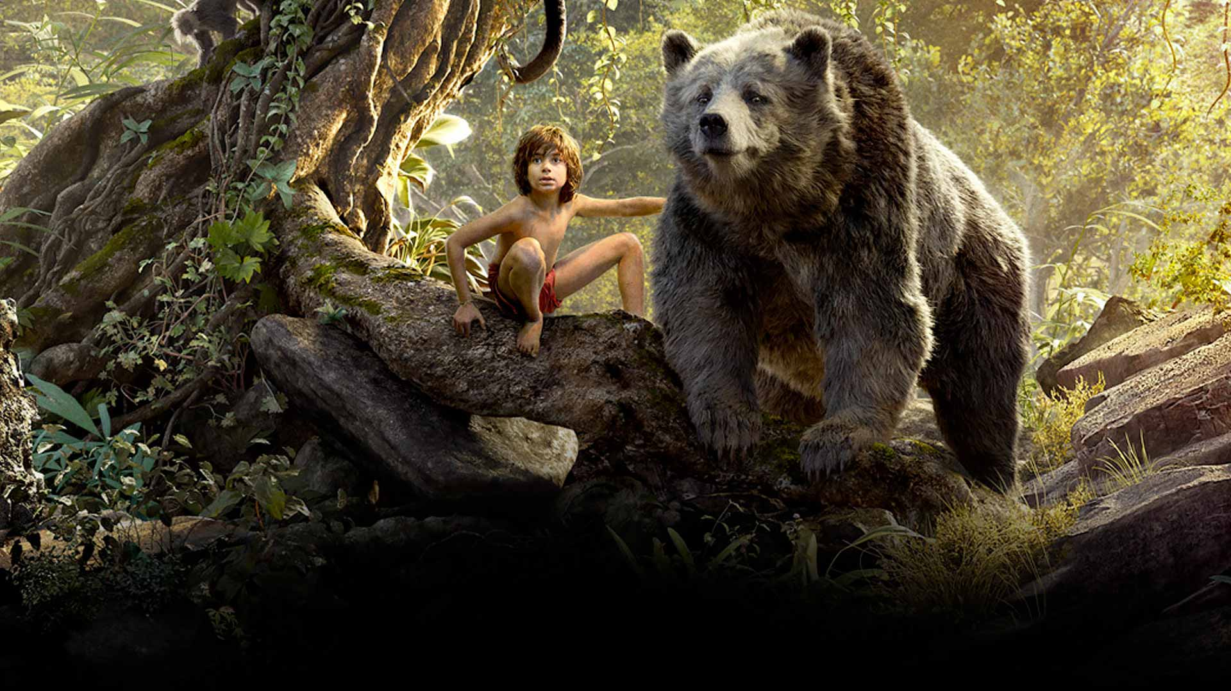
COMPONENT 2 SECTION A: FILM
Disney & the Digital revolution

Slide 2
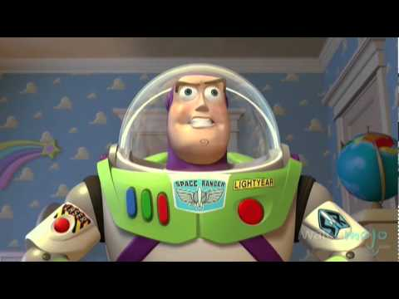
How Pixar helped Disney to evolve...

Slide 3
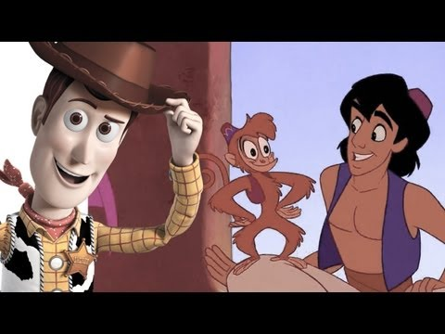
The move to CGI
(Computer Generated Imagery)

Slide 4
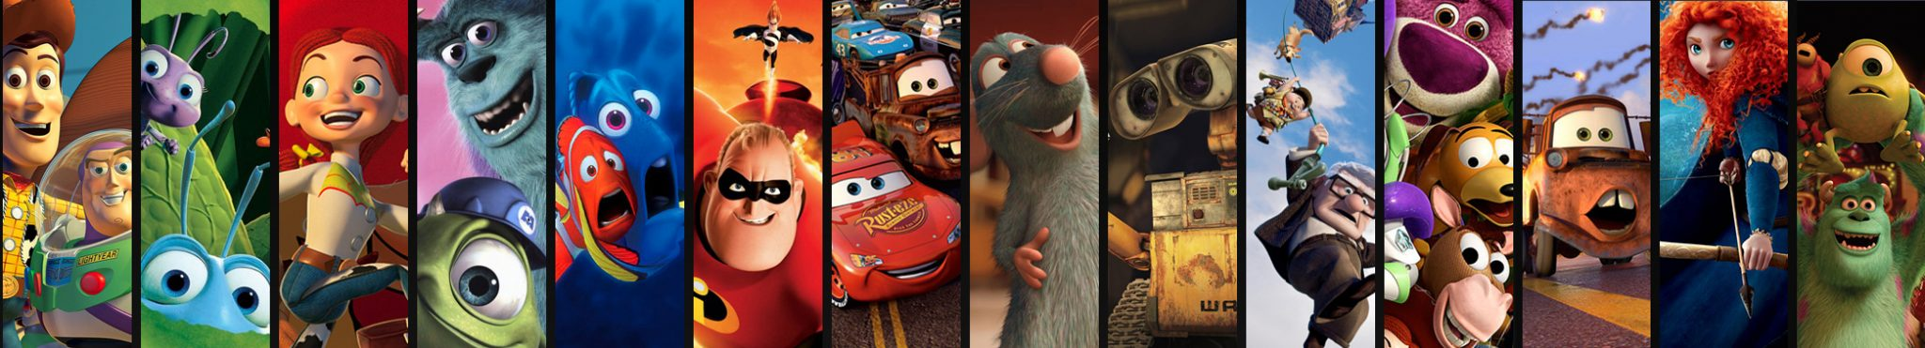
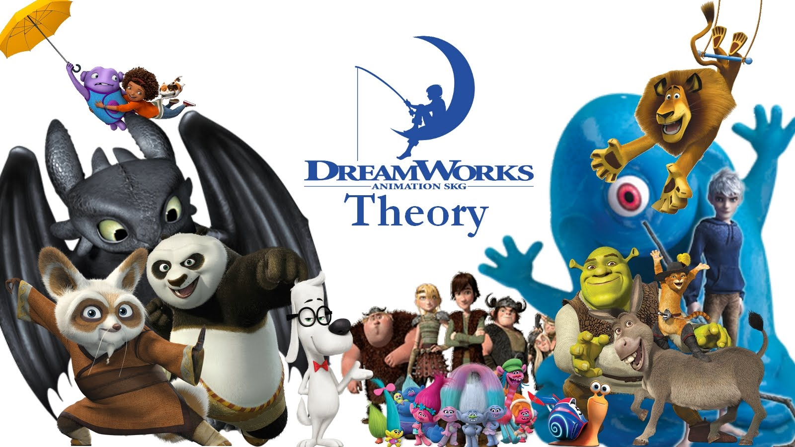
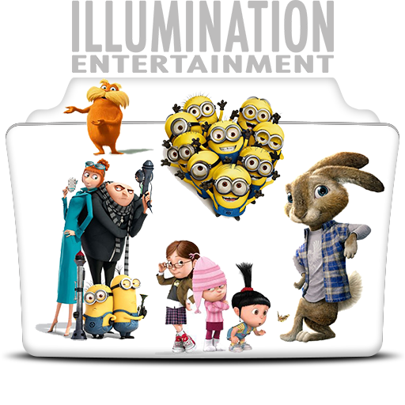
Do you think Walt Disney would have approved of the move to CGI?

Slide 5
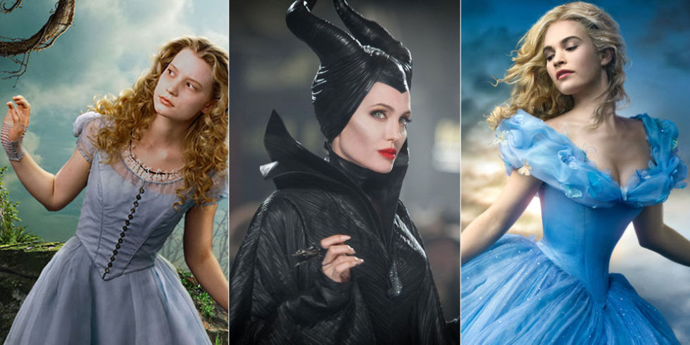
Why are Disney producing so many remakes? How does it benefit them as a business?
Why are audiences so excited by remakes? What do remakes offer them?
The Era of the Remake

Slide 6
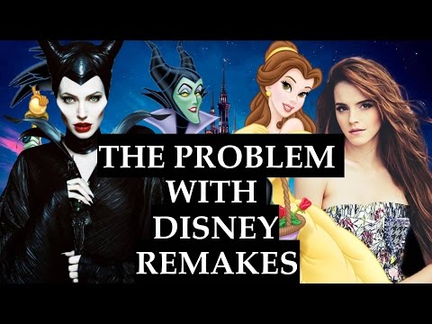

Slide 7
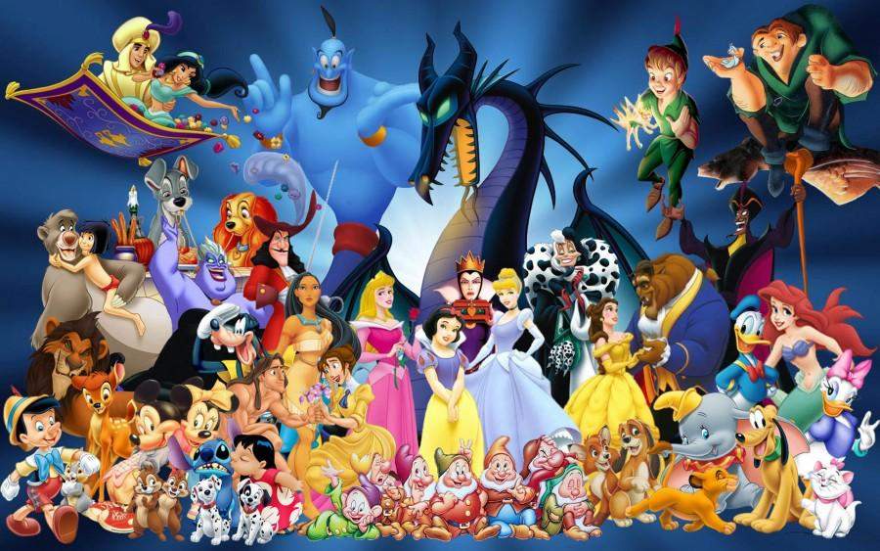
Your Task
You have been asked to produce the next Disney movie. You have complete creative freedom to do whatever you want; whether you create an entirely new idea or remake an existing movie.
What would your ideas be for the storyline?
Would it be an original story or a re-make? If it’s a remake would it be an origin story or a carbon copy?
How would you appeal to old and new audiences?
Extension: How would you utilise Disney as a conglomerate to produce the movie?
You will pitch your idea to the class in our next lesson.
Good luck!

