Slide 1
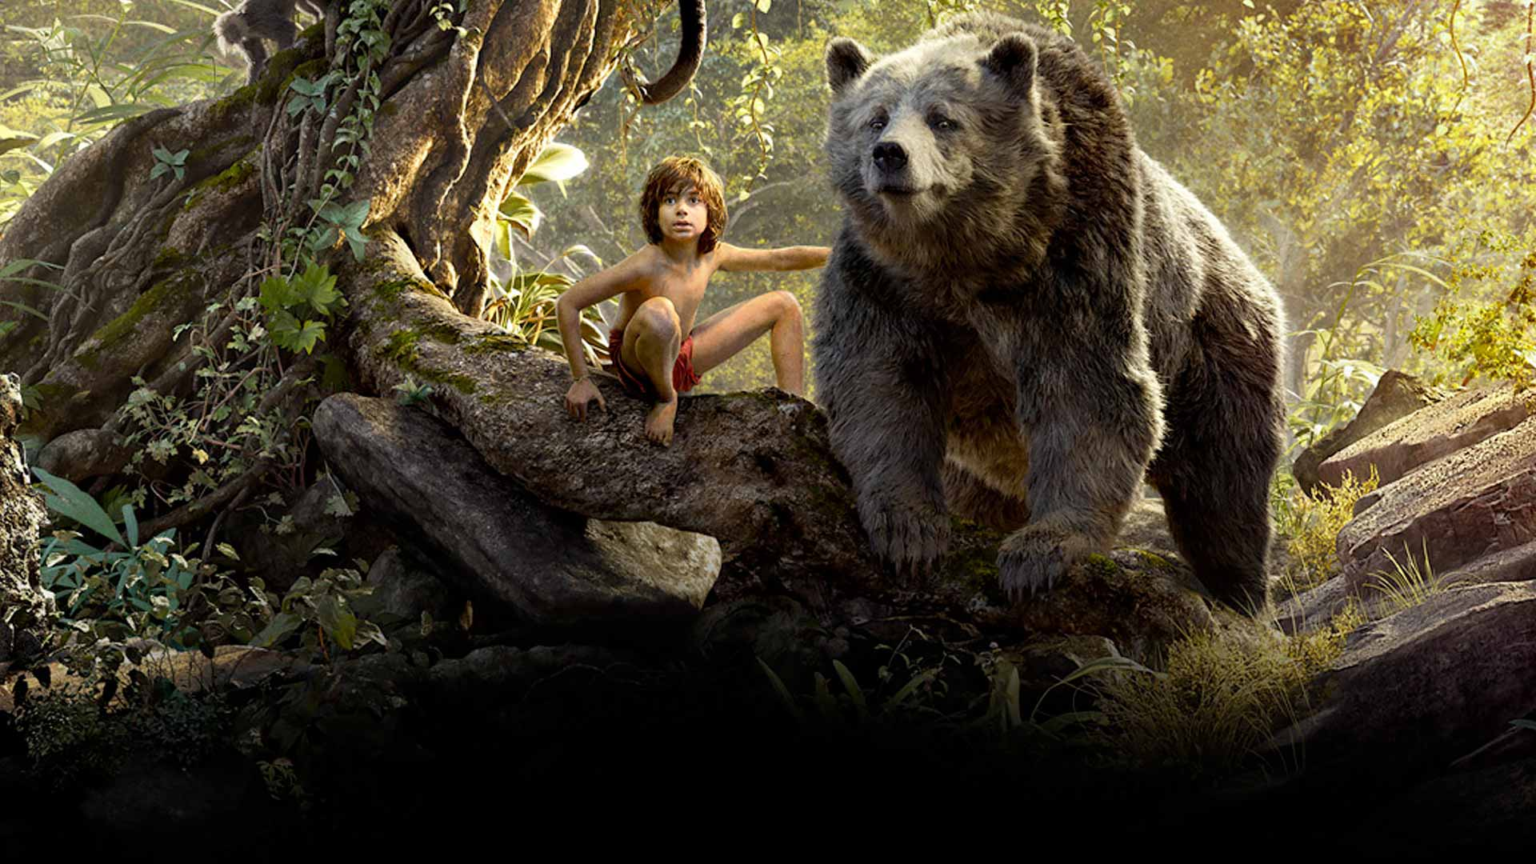
COMPONENT 2 SECTION A: FILM
Jungle Book 1967

Slide 2
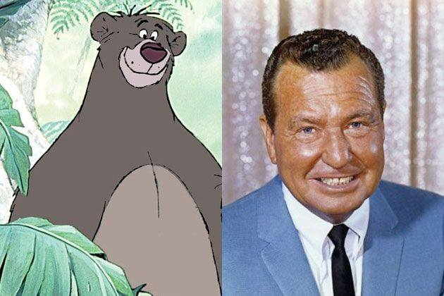
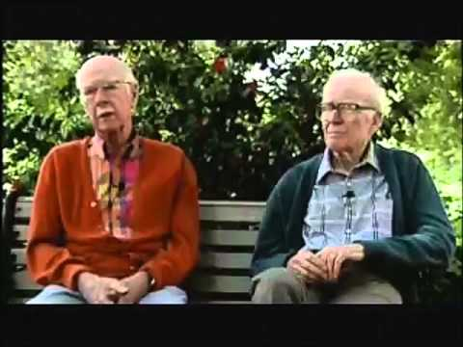
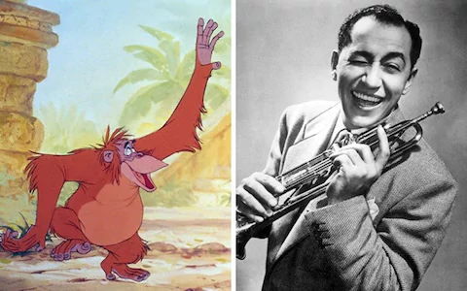
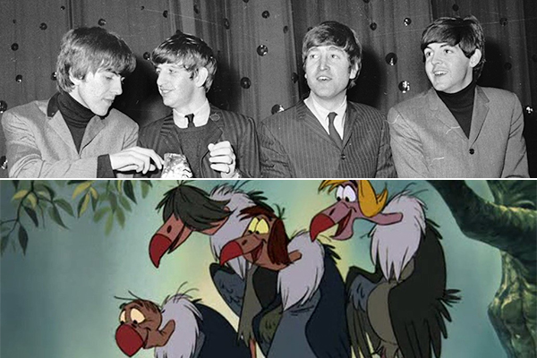
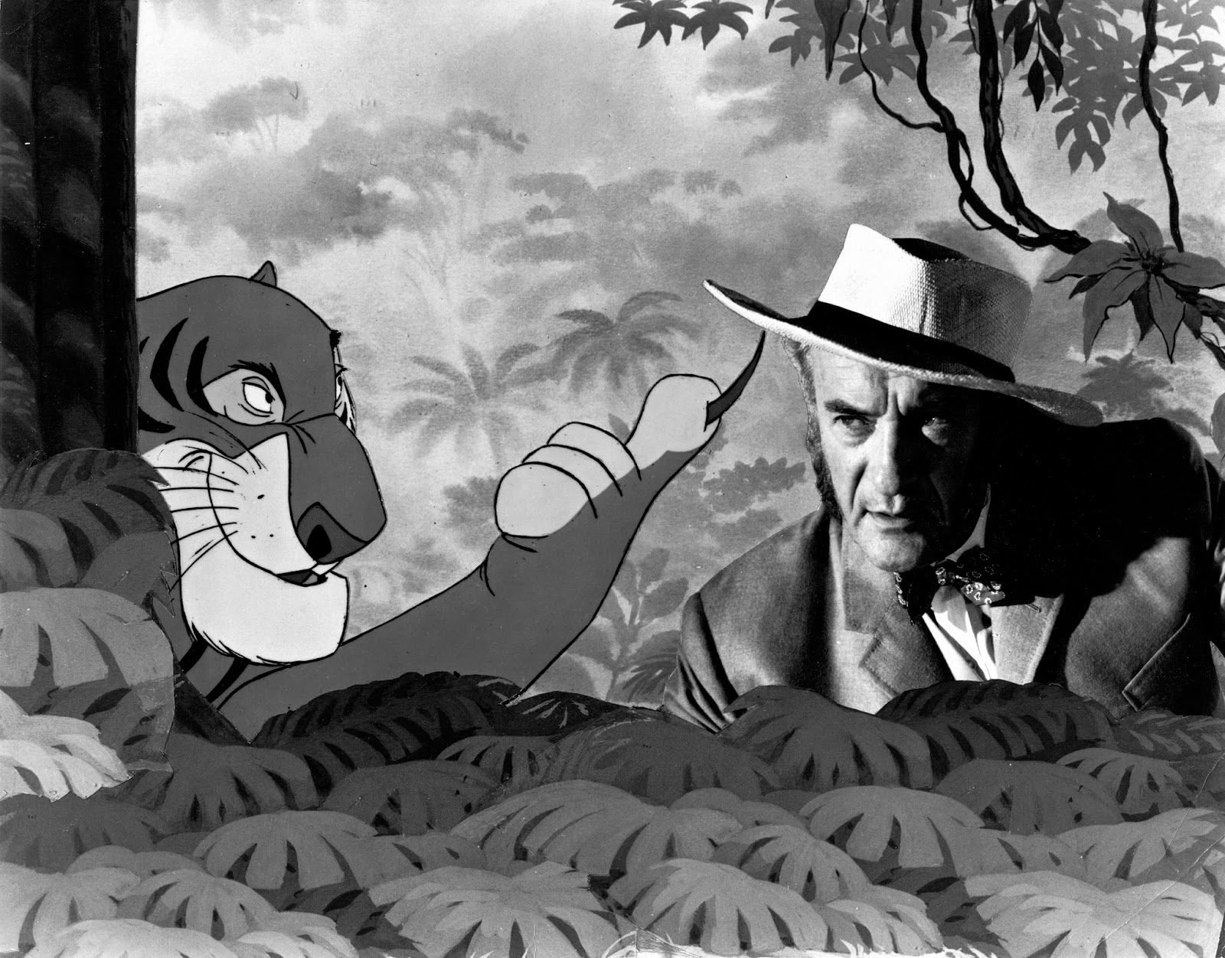
Voice Casting
This was the first picture were famous people were cast for the voices. The actors were encouraged to improvise and then the characters were animated from the voices.
Phil Harris
Louis Prima
The Beatles (Almost)
George Sanders

Slide 3
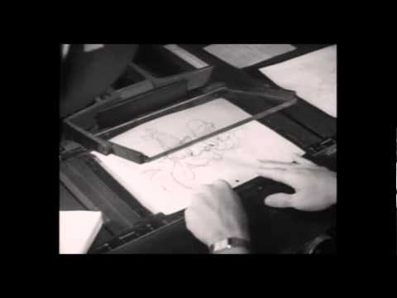
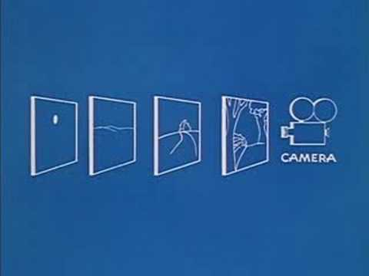
Technology;
Cel Animation: A cel, short for celluloid, is a transparent sheet on which objects are drawn or painted for traditional, hand-drawn animation.
Multiplane Camera: was used in the traditional animation process that moves a number of pieces of artwork past the camera at various speeds and at various distances from one another.

Slide 4
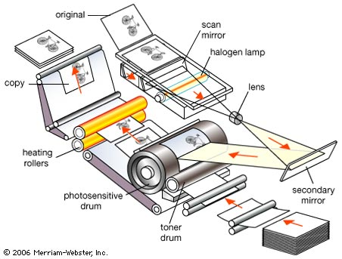
Xerography;
The Jungle Book also used xerography (rather like photocopying), copying the animator’s drawings onto a light-sensitive aluminium plate and then onto cels, unlike the old, painstaking hand-inking process, tracing them from paper drawings.
The animators had to draw using thick black lines, as delicate ones couldn’t be picked up by the copier, and it affected the final art style by creating rougher, sharper lines but generally the animators were pleased.

Slide 5
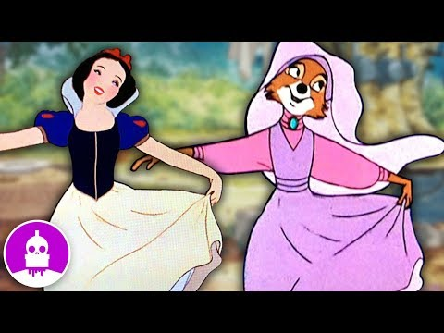
Shot
recycling
Pinocchio, Fantasia and Bambi were productions that went way over budget and were financial losses for the company.
So Disney studios began to use a method of recycling old shots in order to speed up the process and therefore to save money.

Slide 6
COMPONENT 2 SECTION A: FILM
Context

Slide 7
JB 1967
‘The past is another country…’
When we study historical set texts, we must consider how over time attitudes, values and cultures change too. This lesson, we are going to focus on the context of the 60s - including Disney in the 60s, social contexts of the time and the film industry.
What once may have been accepted, may no longer be now. A film rated adult many years ago, may be a PG now, due to changes in regulation, audiences and cultural attitudes.

Slide 8
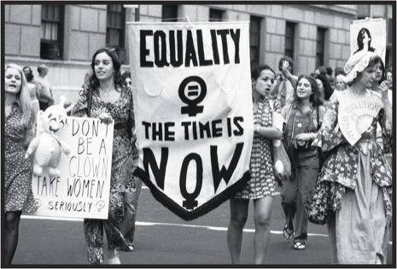
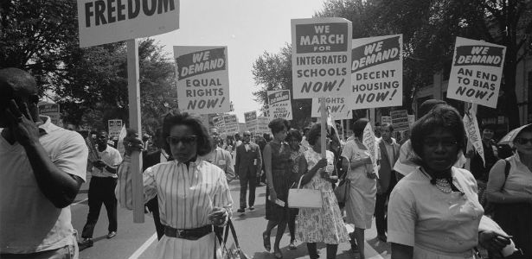
Social Context
The era of the 1960s was one of great change. A time when the world was emerging from a lengthy period of post WW2 conservatism and tradition.
Youth culture was less concerned with fashion and music alone and more aware of the power of political action.
The 60s saw the development of global social action - Black civil rights movement, second wave feminism and anti-war protests.

Slide 9
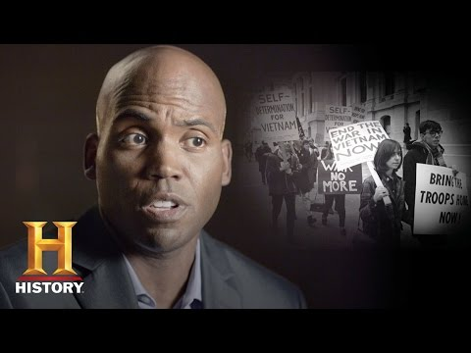
Social Context
Large aspects of society can be seen to shift during this period. Laws and attitudes were challenged:
    Sexuality
    Divorce
    Drugs
    Education
    Capital Punishment
    Human Rights

Slide 10
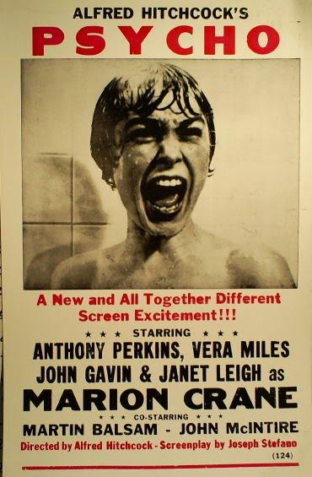
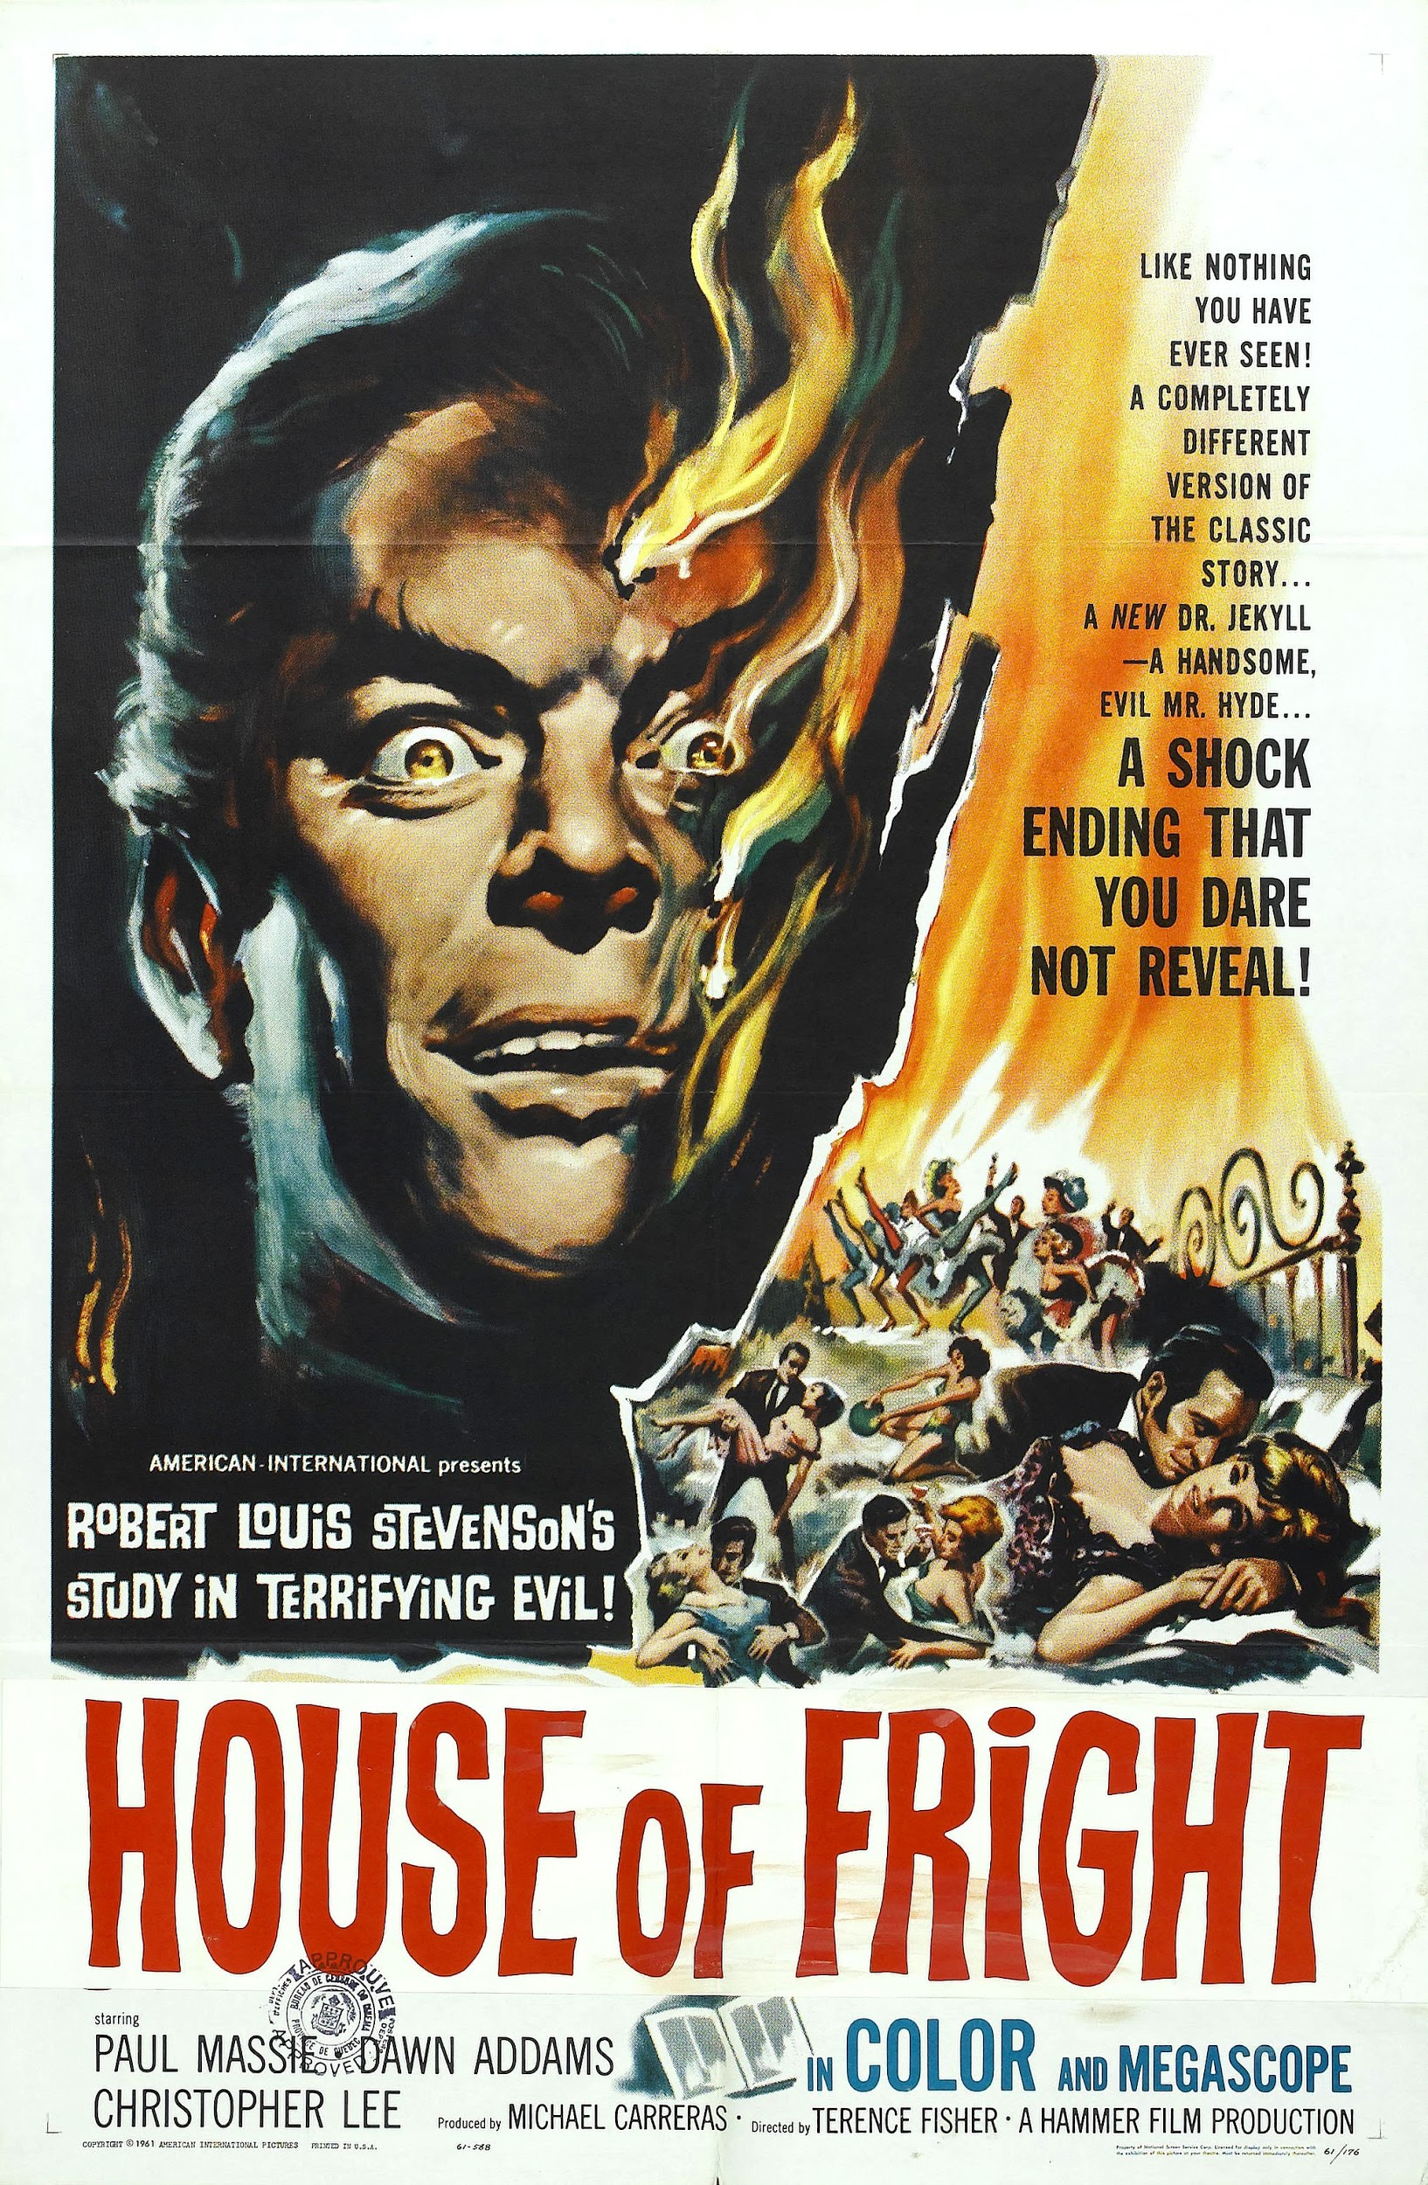
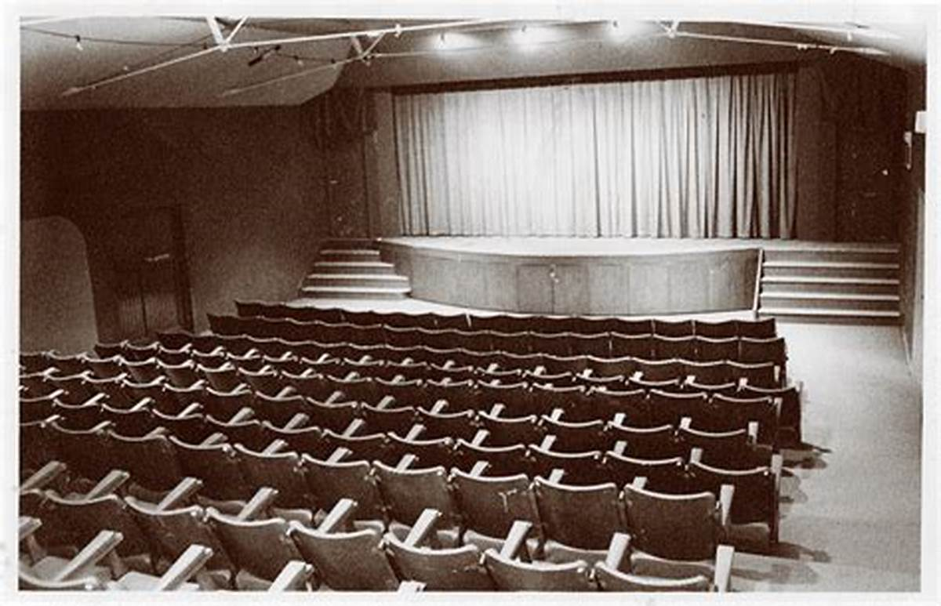
The film industry
In terms of film, the 1960s was a difficult time for cinema. Increasing competition from TV saw a downturn in cinema-goers and younger audiences chose rock and pop music as entertainment over film. Cinemas built in the heyday of the 1920s and 1930s were becoming outdated and many closed or were turned into bingo halls.

Slide 11
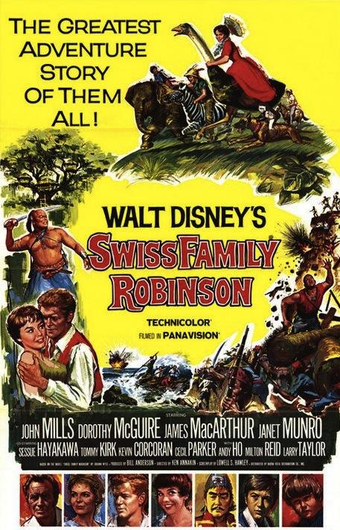
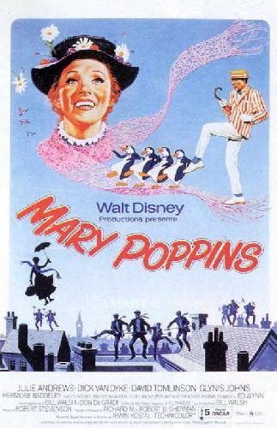
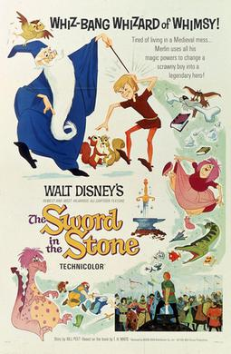
Disney in the 60s
Disney had a fixed demographic whose tastes were to some degree unchanging, partly due to the fact that Disney products were aimed at young children and families. Therefore, the Disney brand carried a degree of expectation and certainty allowing it more success than some other studios.
This enabled Disney to continue to produce films with a similar aim as those of the 1940s and 50s.

Slide 12
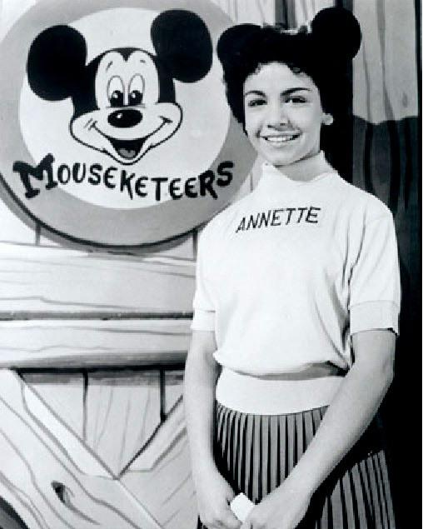
Disney in the 60s
Disney had already opened theme parks in the 1950s and continued throughout this time to trade off the identity of its animated characters, as well as promote its parks through the marketing of new releases.
The theme parks became a major source of revenue, focusing on both adult nostalgia and the appeal to children of making the characters and their worlds seem ‘real’.
Disney also diversified branching into TV, targeting children and making the most of its back catalogue of cartoons. Audience participation was encouraged through the establishing of the ‘mouseketeers’ Disney family.

Slide 13
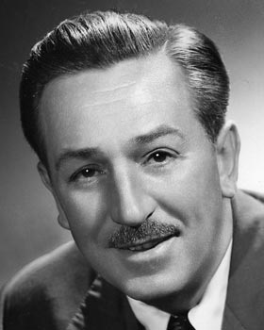
Walt Disney
Walt had a significant influence on the production, narrative and values of the movies created at this time. His emphasis on family and family values are apparent. Walt saw himself as standing for all that was good and decent in America.
As such, in an age of social change and upheaval, Disney’s products were viewed as traditional and trusted by parents.
However Walt’s values were also those of a Right-wing Republican.

Slide 14
COMPONENT 2 SECTION A: FILM
Economics & ownership

Slide 15
Your research tasks
Research the marketing campaign for the film.
How did they create hype and make the audience excited to see the film?
Consider:
Posters
Trailer
Viral marketing
Release Date
Merchandise
Publicity
Jungle Book (1967)
What was the budget for JB67?
How much did it take on its opening weekend?
What is the total box office revenue to date?
Which countries have the largest box office figures for JB67?
How does vertical integration relate to JB67?
How did Walt Disney feel about box office takings?
How are WD’s politics and beliefs evident in JB67?
How did WD’s death impact the Walt Disney Company

Slide 16
Useful links for this task
https://www.nbcnews.com/pop-culture/movies/jungle-book-roars-box-office-103-6-million-debut-n557341
http://theweek.com/articles/617441/how-disneys-new-jungle-book-corrects-years-troubling-racial-under
http://theweek.com/articles/617441/how-disneys-new-jungle-book-corrects-years-troubling-racial-under
https://d23.com/floyd-normans-9-wild-stories-from-the-making-of-the-jungle-book-1967/
http://www.hollywoodreporter.com/news/germany-original-jungle-book-biggest-885953
https://www.nbcnews.com/pop-culture/movies/jungle-book-roars-box-office-103-6-million-debut-n557341
http://www.hollywoodreporter.com/news/summer-box-office-2016-blockbusters-flops-sequelitis-923601
https://www.forbes.com/forbes/welcome/?toURL=https://www.forbes.com/sites/robcain/2016/04/15/disneys-jungle-book-swings-in-china-to-12-million-opening-day-250-better-than-zootopia/&refURL=&referrer=#7d44f2aa2a1f
http://www.boxofficemojo.com/movies/?id=junglebook2015.htm

