Slide 1
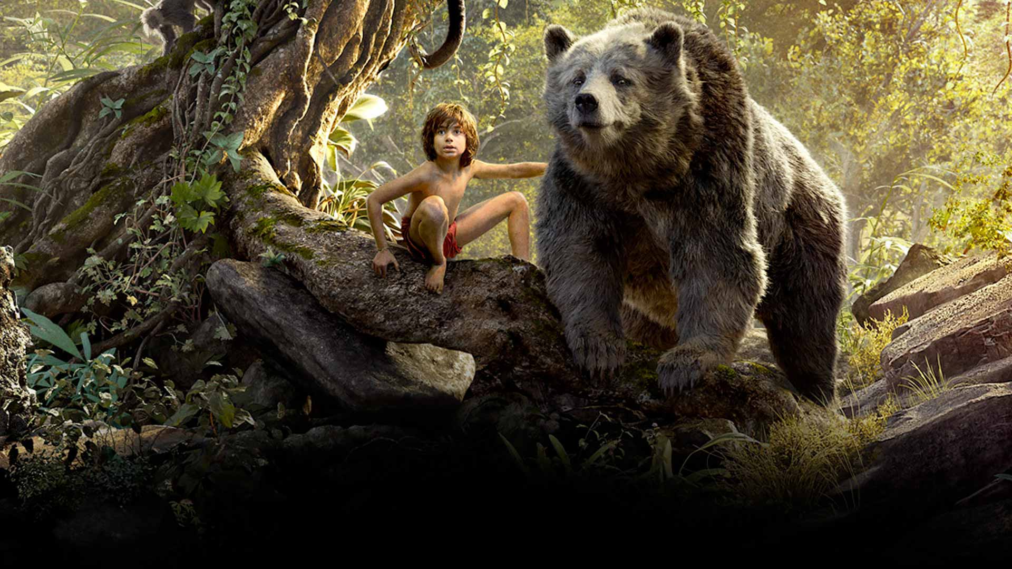
COMPONENT 2 SECTION A: FILM
Media Ownership

Slide 2

STARTER
Pick out 5 of the most important things you learn about the film industry in this video...

Slide 3
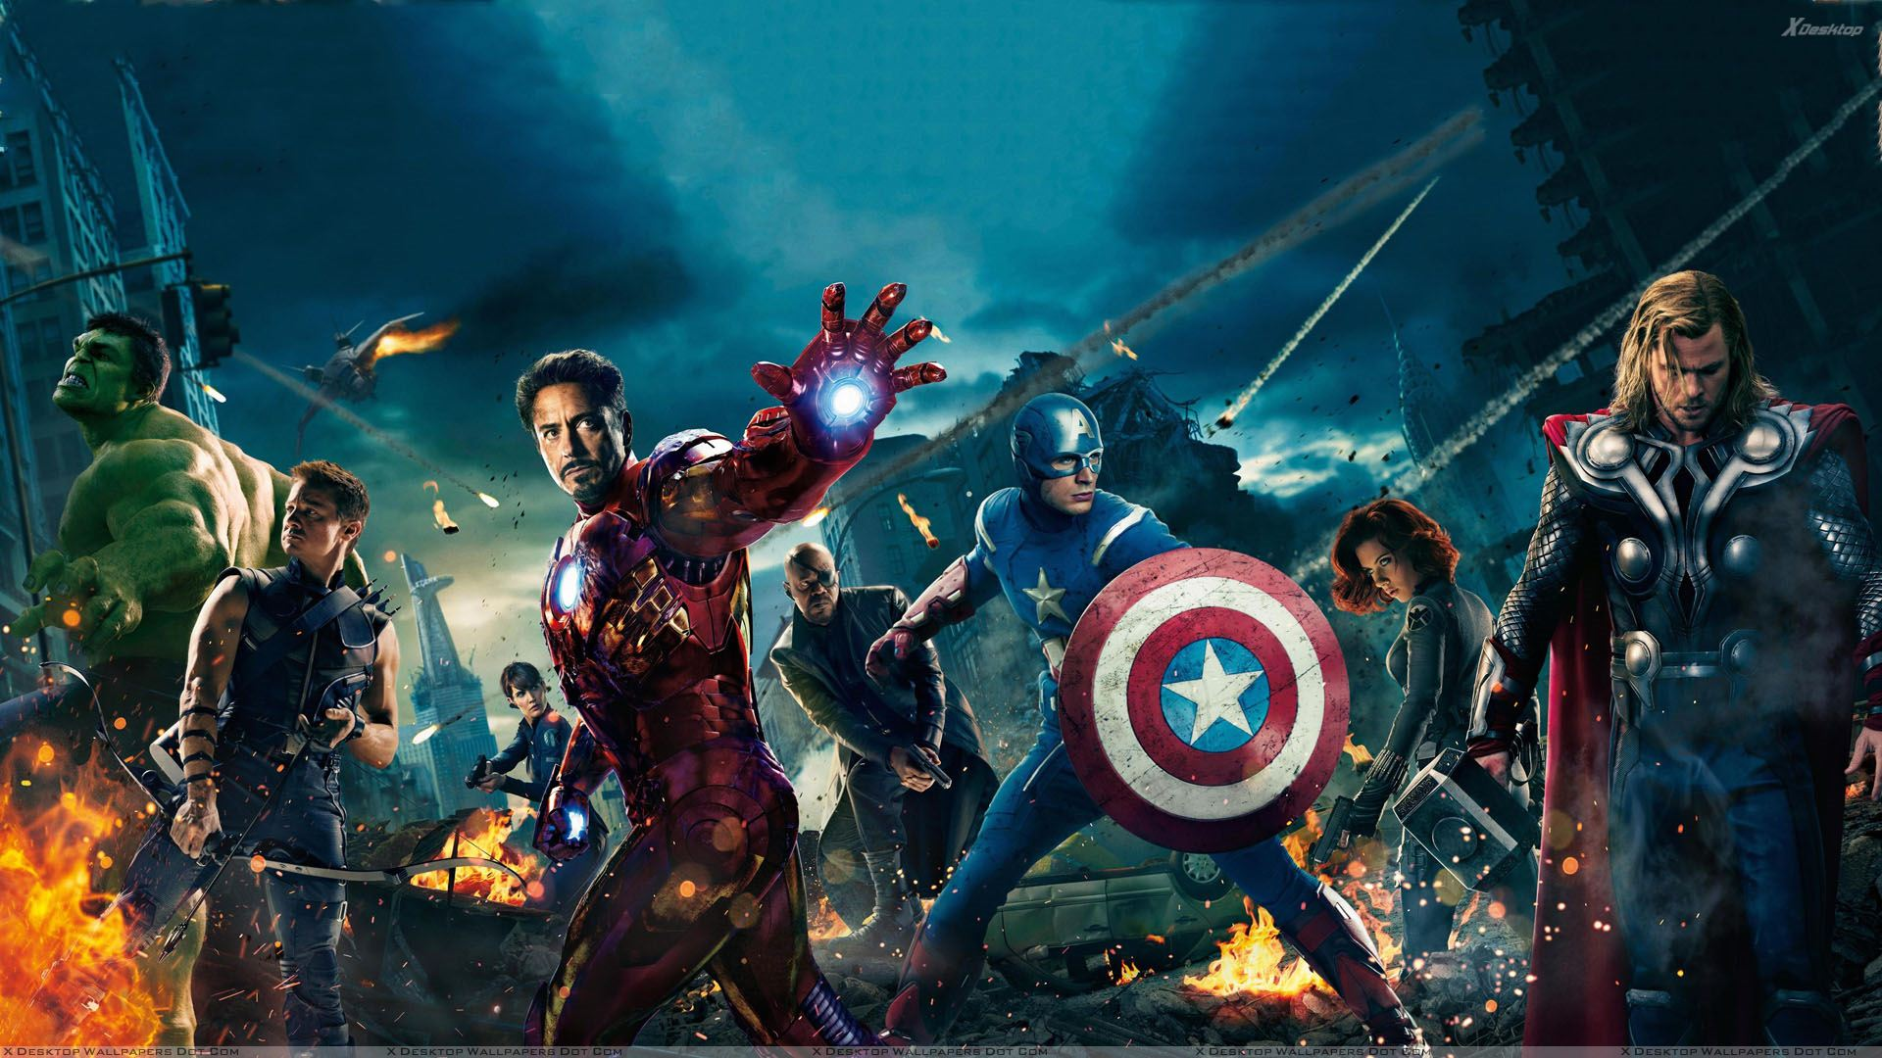
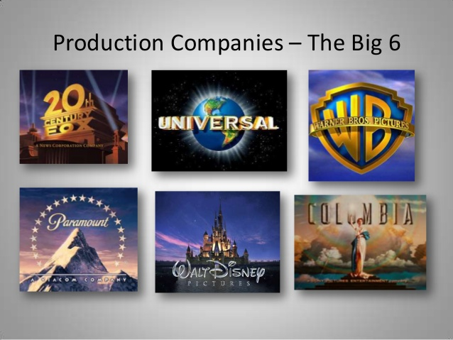

Mainstream film;
Mainstream films have a wide release, usually international. They have bigger budgets and more conventional narratives. The are usually Hollywood films made by one of the BIG 6.
4
83% of the films you watch are made by one these companies (or it’s subsidiaries)
Paramount dropped out in 2016
Disney bought Fox in 2018
Oligopoly; a state of limited competition, in which a market is shared by a small number of producers or sellers

Slide 4
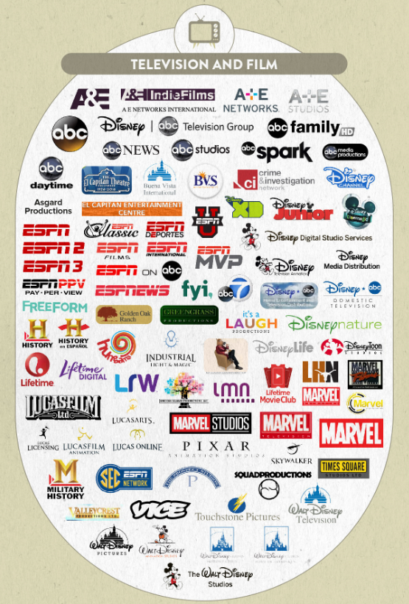
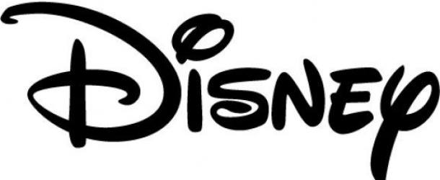
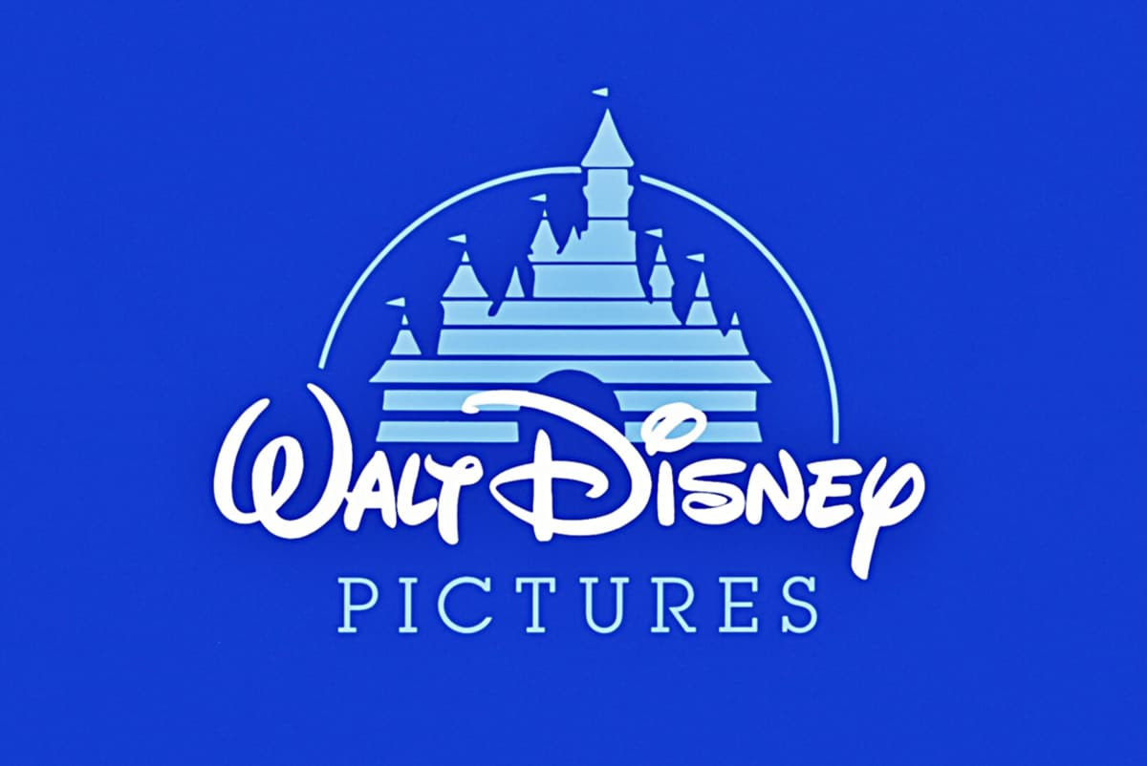
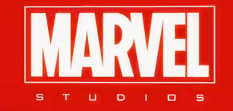


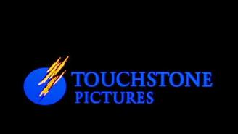


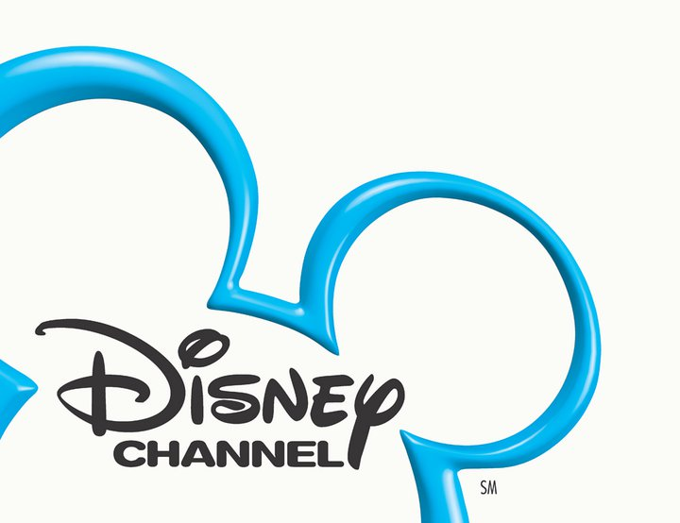


What does a Big 6 4 company
look like?
Conglomerate; a company that owns numerous companies involved in mass media enterprises, such as television, radio, publishing, motion pictures, theme parks, or the Internet.
‘Subsidiaries’

Slide 5
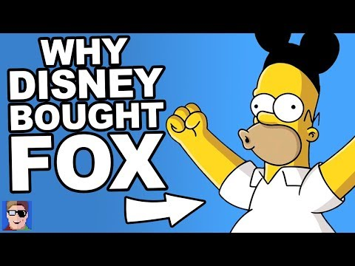
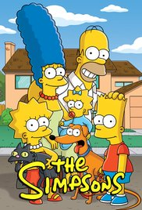
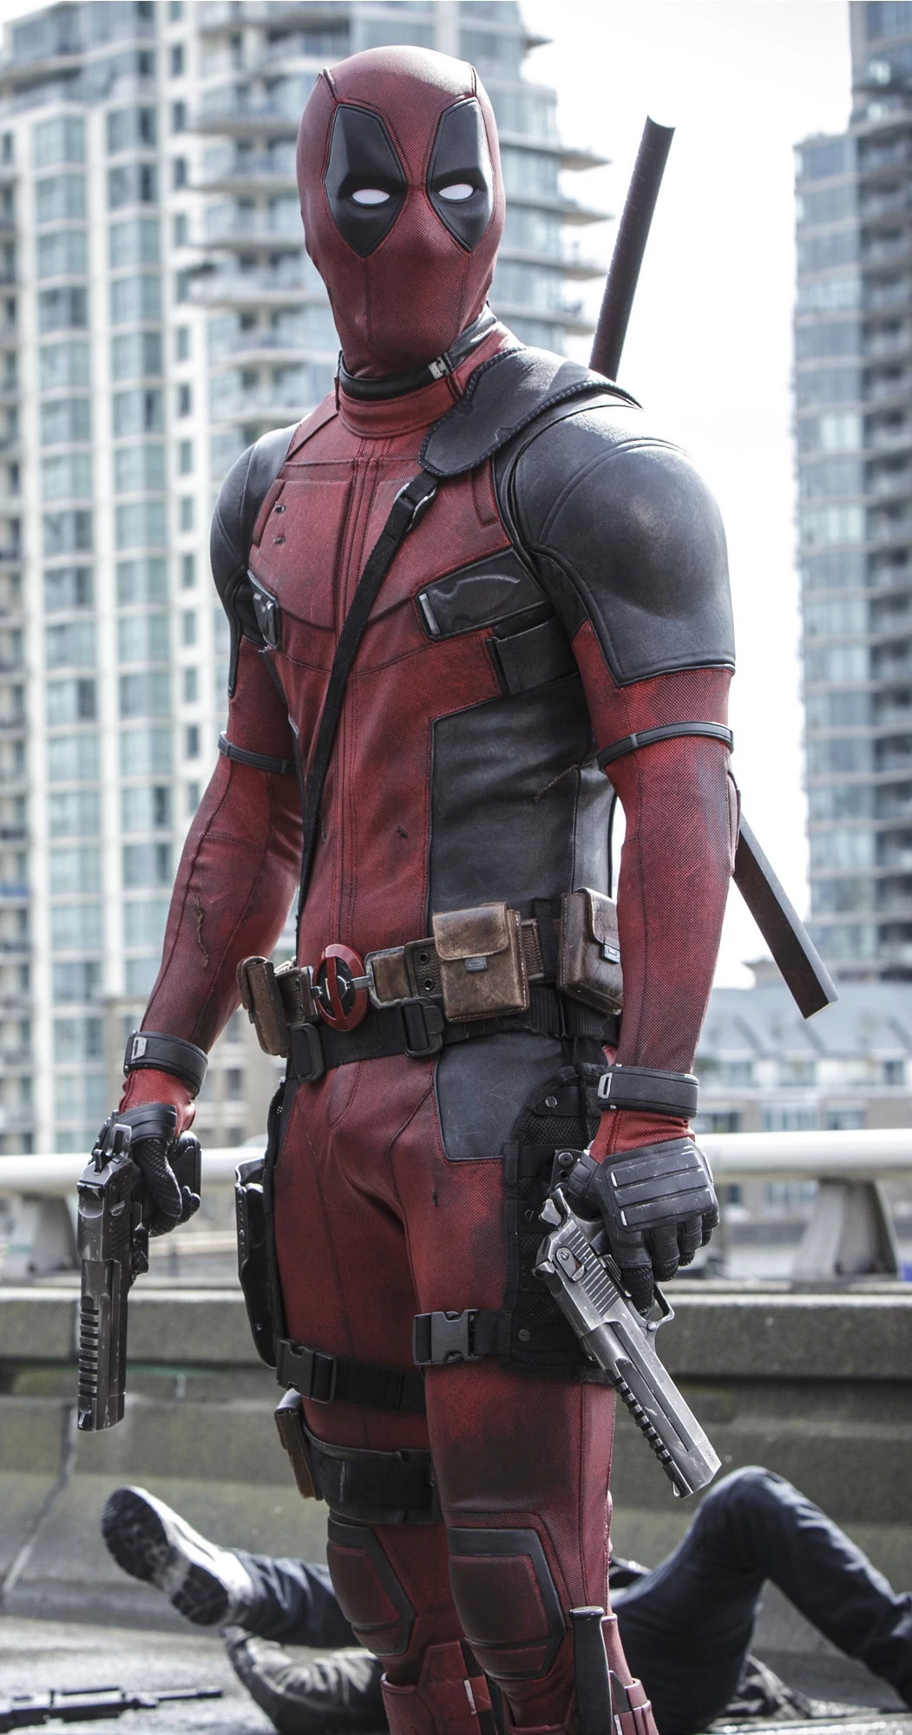

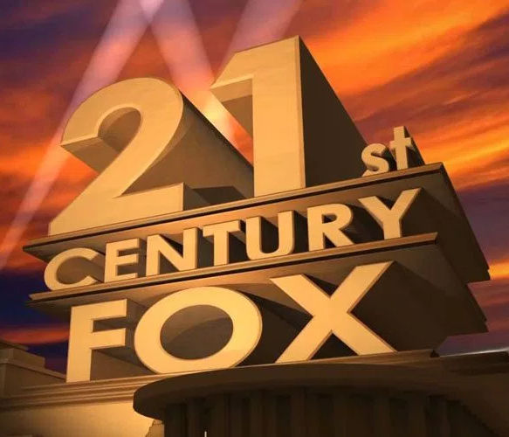

Slide 6
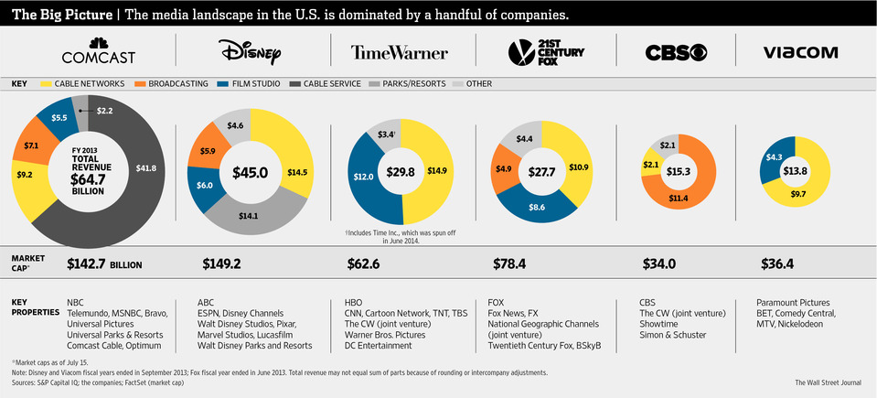
The Big 6 Media Conglomerates;

Slide 7
Media Survey
Make a list of the last 10 TV shows you watched.
Find out who produces each of them and produce a graph to show the proportions of each company.
Do another graph showing where you viewed each (e.g. something could be produced by the BBC, but you watched it on Netflix.)
Now do the same for the last 10 films you watched. One graph for who produced them, one graph for where you accessed them.
Display your results in a pleasing way.

Slide 8
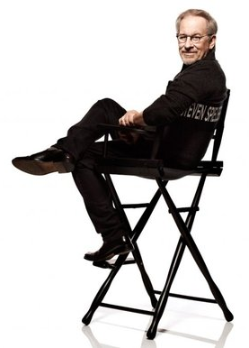

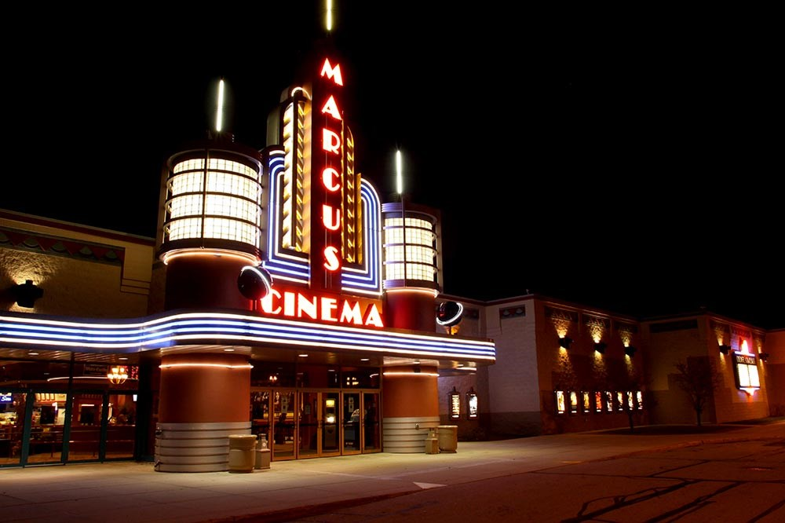

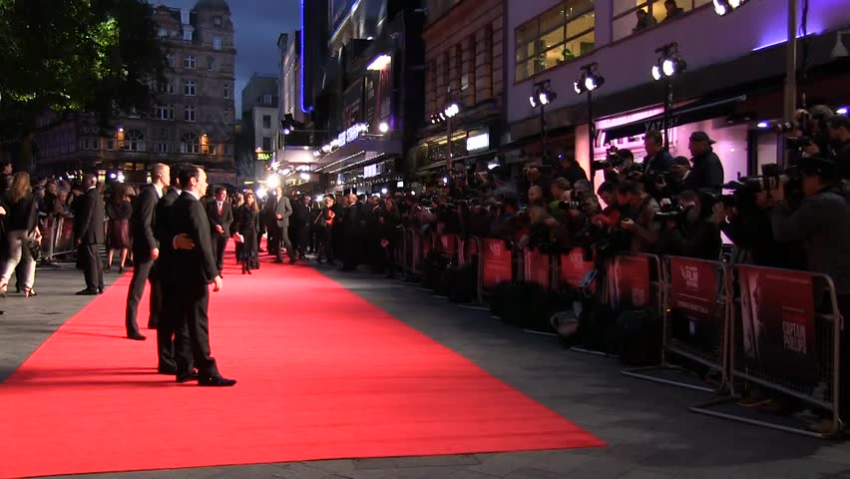
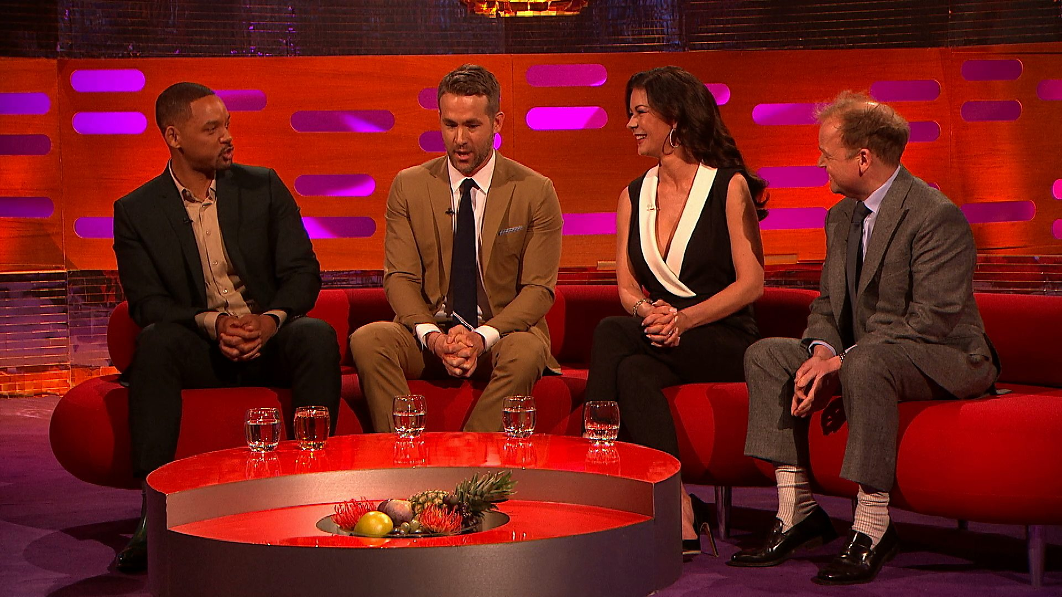

From Script to Screen;
Production
Distribution
Exhibition
Scriptwriting
Producing
Directing
Editing
CGI
SFX
Set Design
Costume
Make-Up
Casting

Slide 9
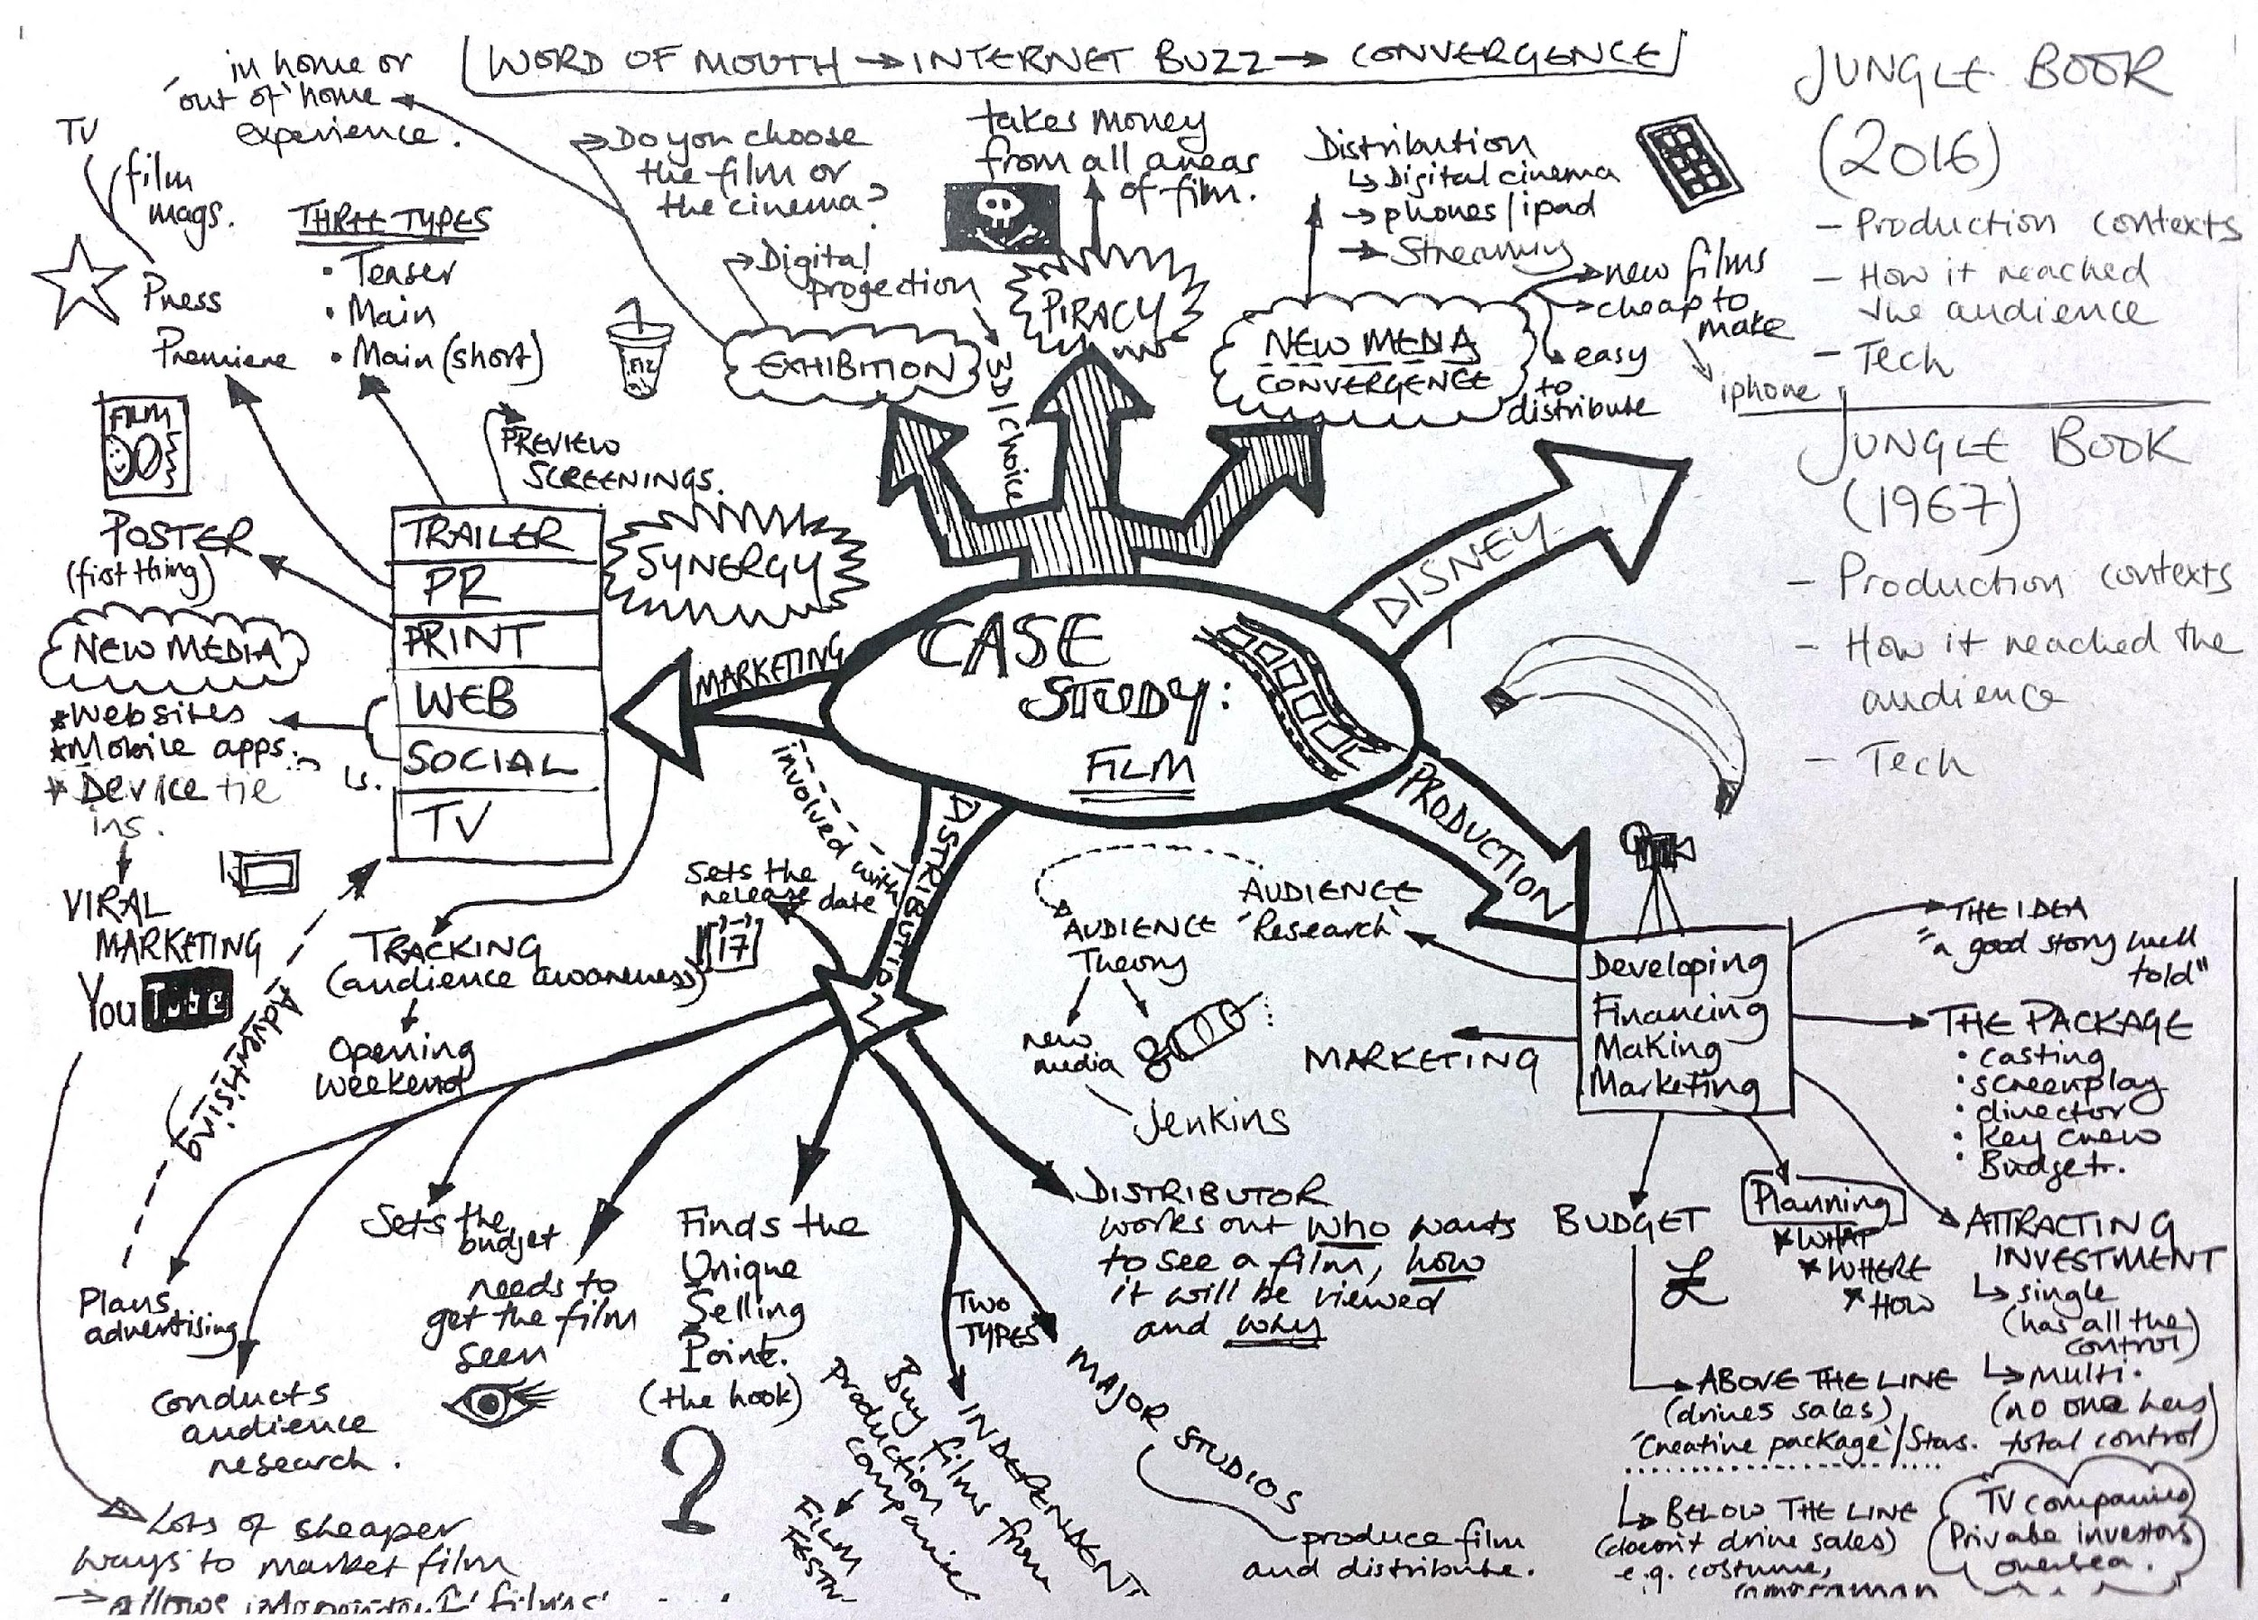

Slide 10
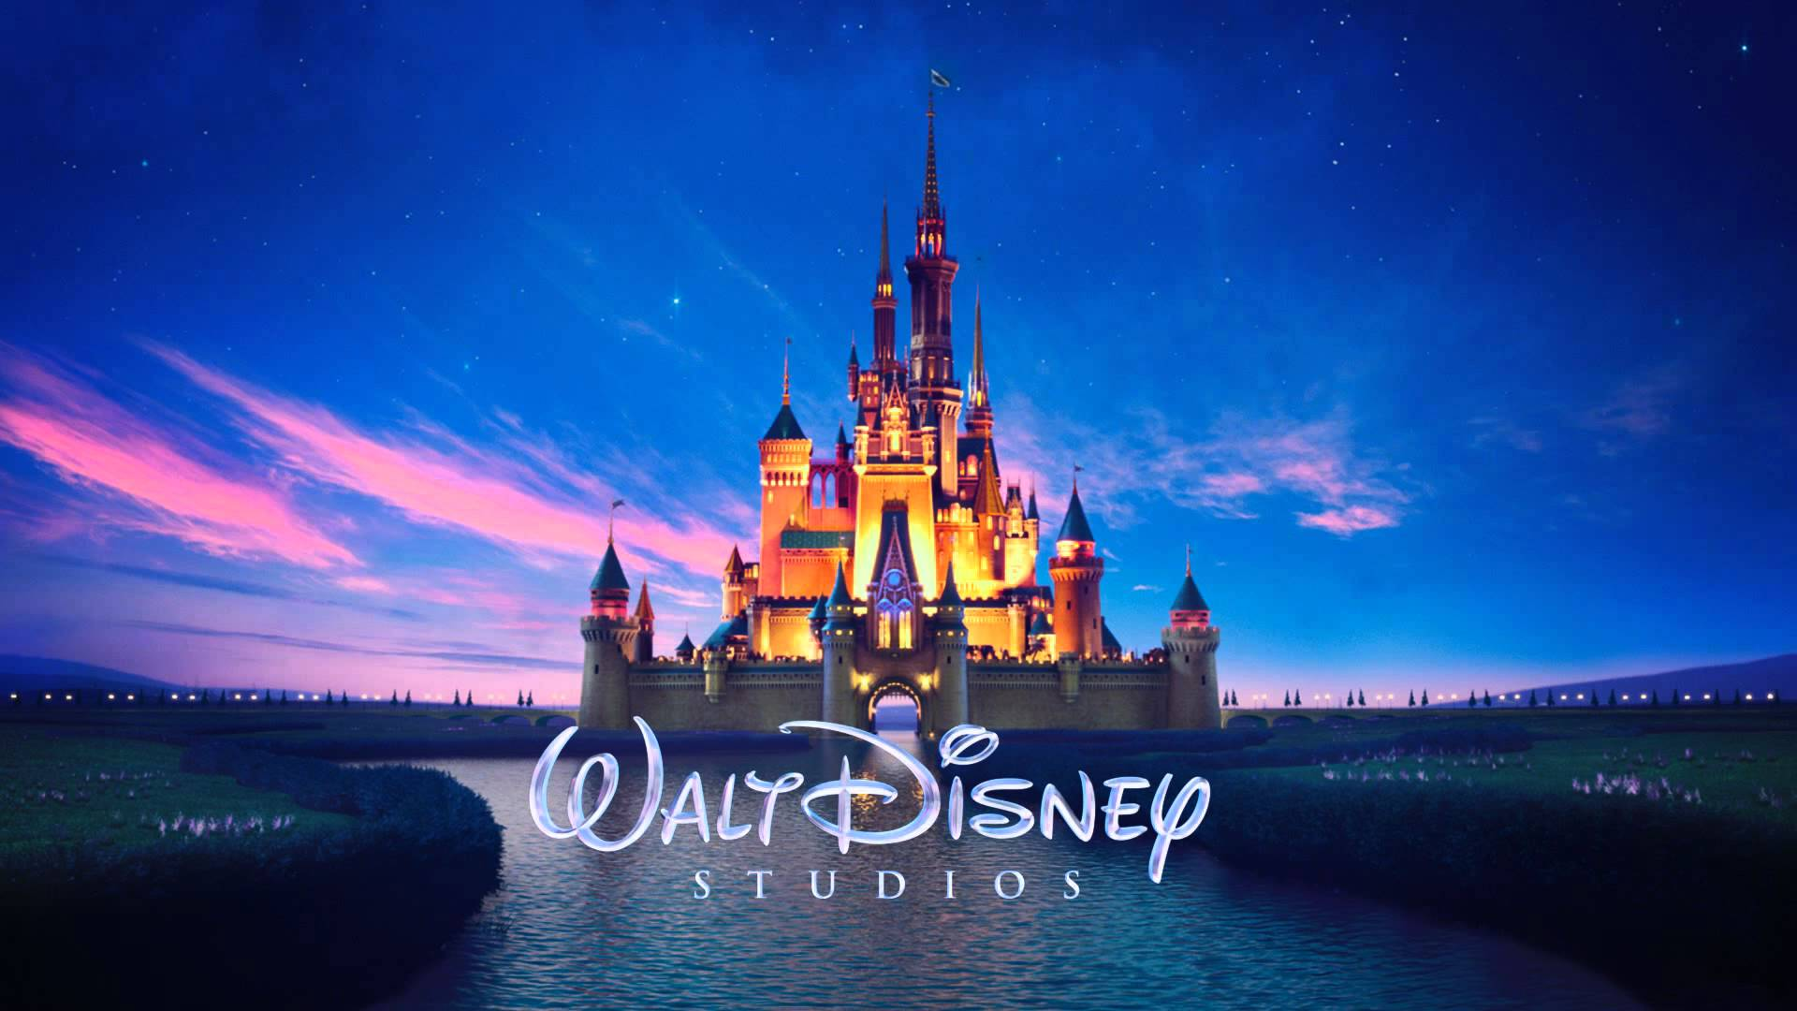
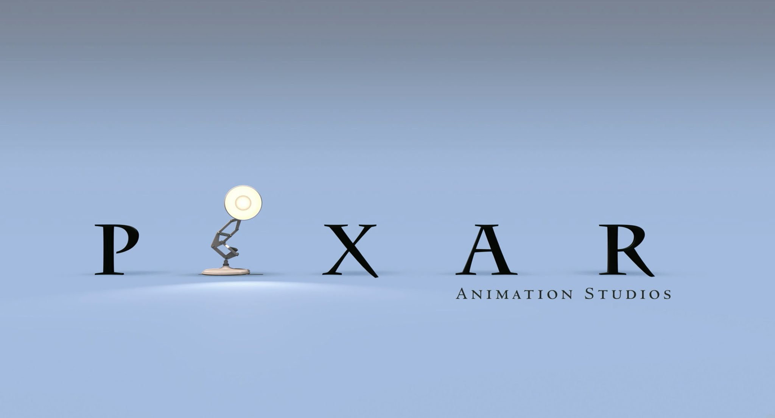



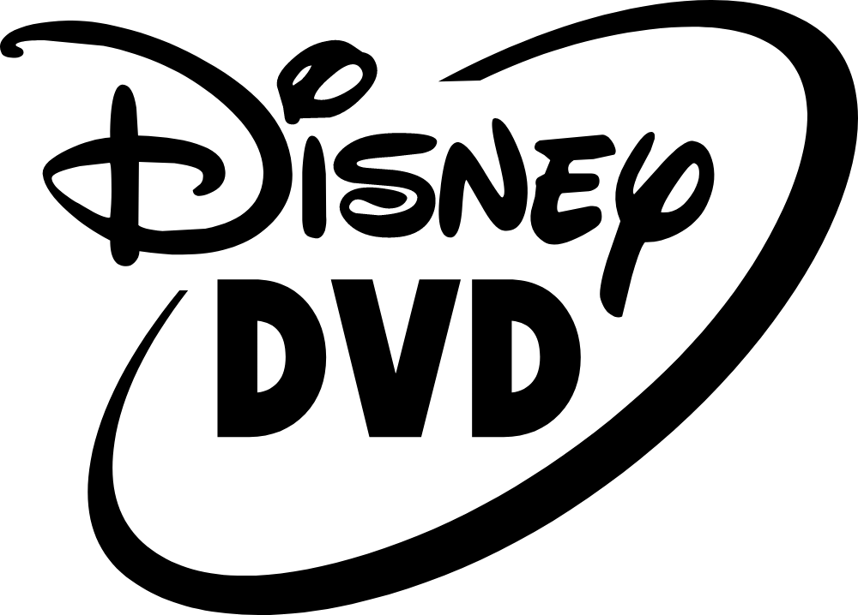
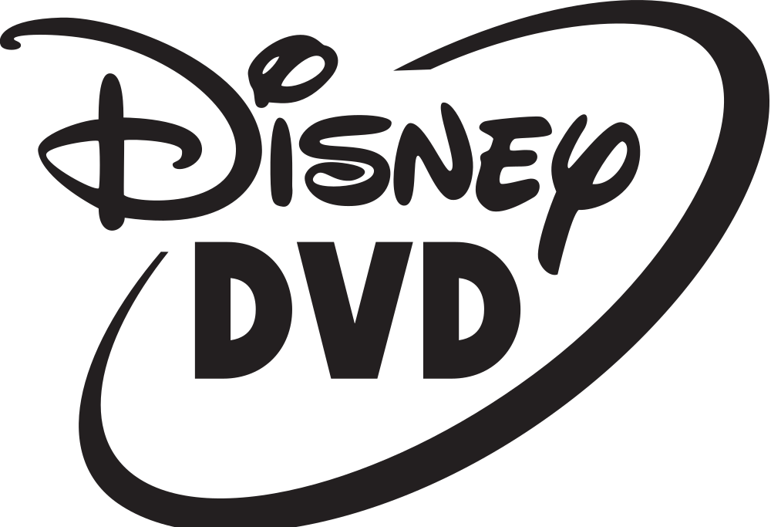
Types of Ownership;
Often a single parent company will own multiple companies in the film industry. This is divided into two types of ownership...
Production
VERTICAL
The parent company owns multiple companies across different stages of the film industry
Production
Distribution
Exhibition
HORIZONTAL
The parent company owns multiple companies at the same stage of the film industry. These are called subsidiaries.
Exhibition

Slide 11
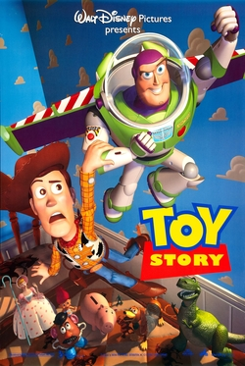
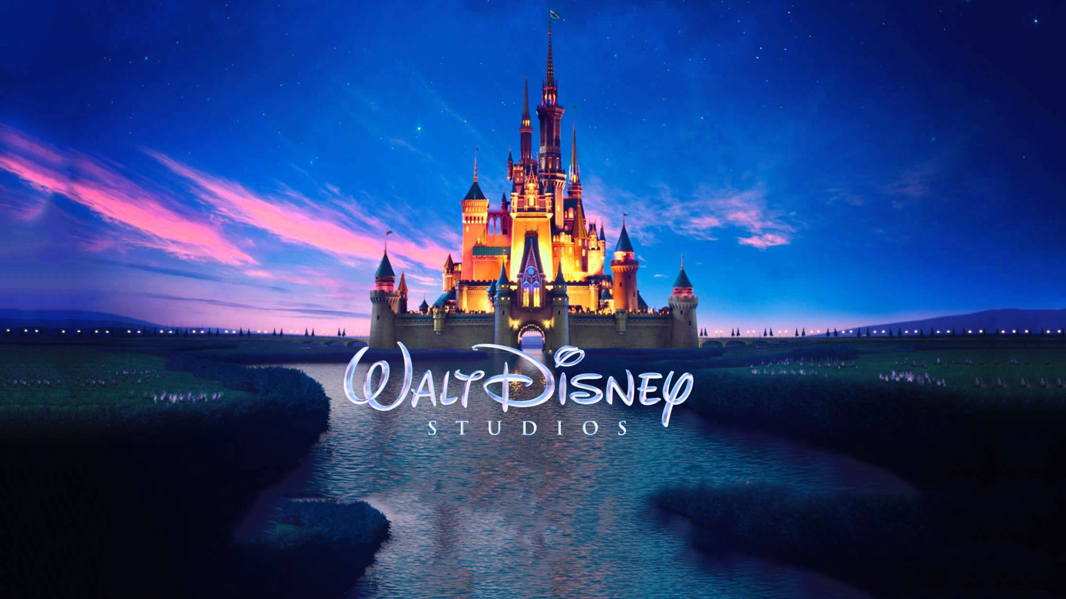
Horizontal Integration;
Production
When a company wishes to grow through a horizontal integration, it is looking to acquire a similar company in the same industry.
It may be seeking to increase its size, diversify its product offerings or services, achieve economies of scale, reduce competition, or gain access to new customers or markets.
Distribution
Exhibition

Slide 12
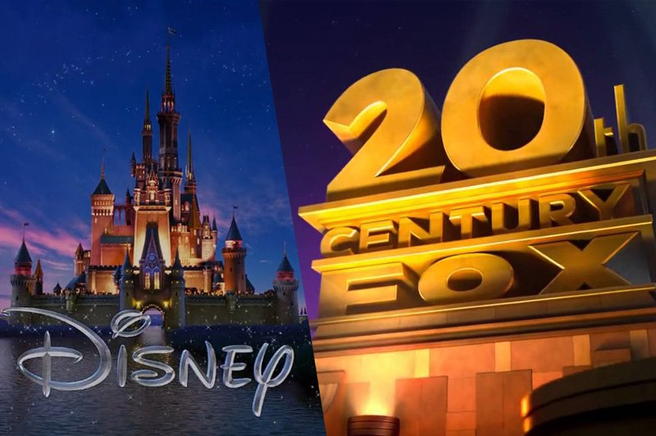
What are the positives and negatives are of one company owning so much of the media industry?

Slide 13

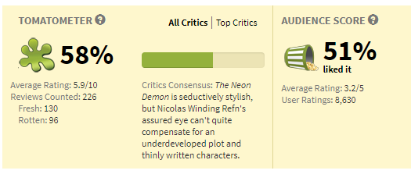




Media Ownership Issues...
The effect on Indie film...
Production
Robbie Collin of The Daily Telegraph gave the film five out of five stars, stating,
"When the film reaches its logical end point, Refn just keeps pushing, and eventually lands on a sequence so jaw-dropping – almost certainly a sly, glossy-magazine refashioning of Luis Buñuel and Salvador Dali's groundbreaking surrealist short Un Chien Andalou – that all you can do is howl or cheer."
Distribution
Released in 2016
Budget $7 Million
Box Office $3.4 million

Slide 14
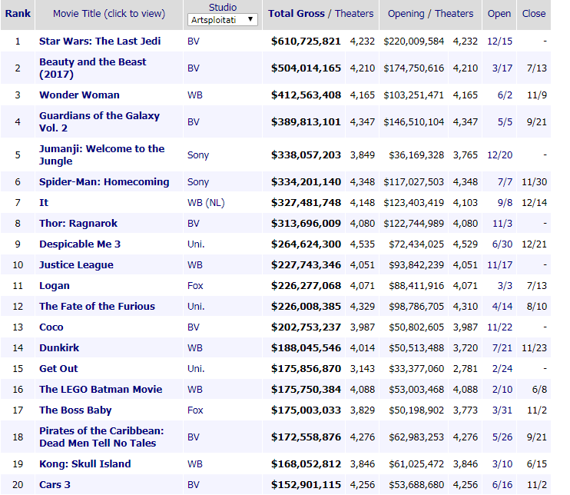

Media Ownership Issues...
The effect on content diversity...
Based on an existing Franchise
A remake
A new product

Slide 15
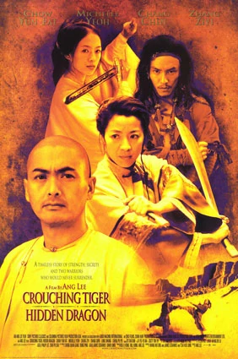
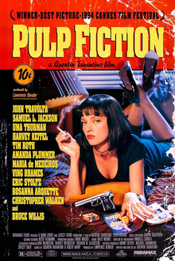
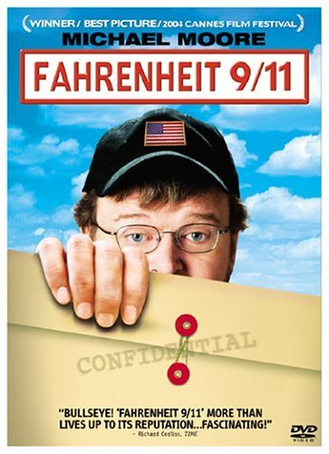
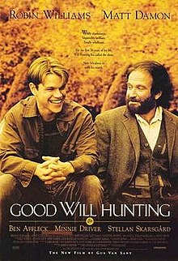

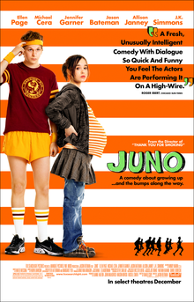
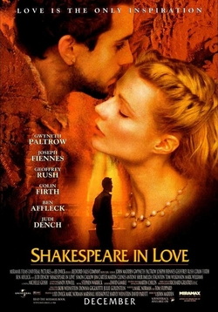



Top 10 Indie Films of all time
Make a list of all the Independent films you know of
Do you have any idea which indie film is the most successful indie film to date?
Indie Film = A film that is produced by a company not owned by the Big 6.
10
9
8
7
6
5
4
3
2
1

Slide 16

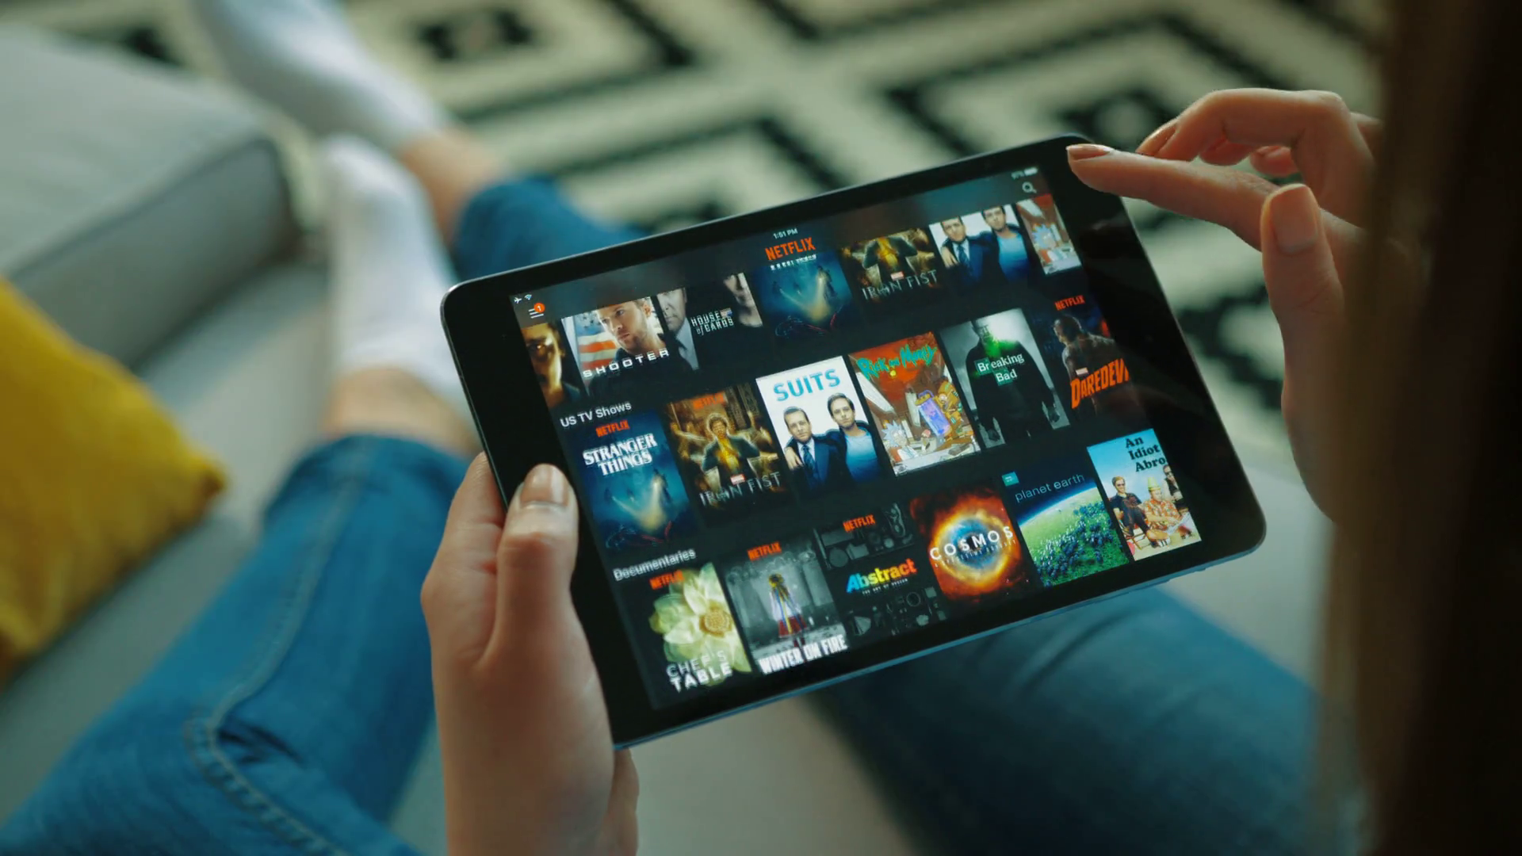



How technology is changing the game...

Slide 17
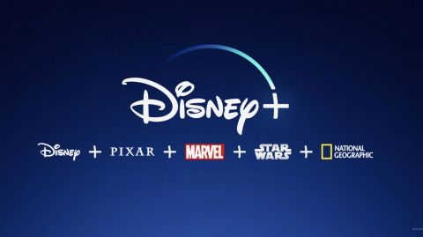

Slide 18
A new map...
Re-create the mindmap, with reference to the new information you have and the rise of streaming.
Good mindmaps have colour and pictures.
You can use the original mindmap as a base – but it needs things added in.
You will not be able to complete the ‘Jungle Book’ bits yet – leave room.

Slide 19
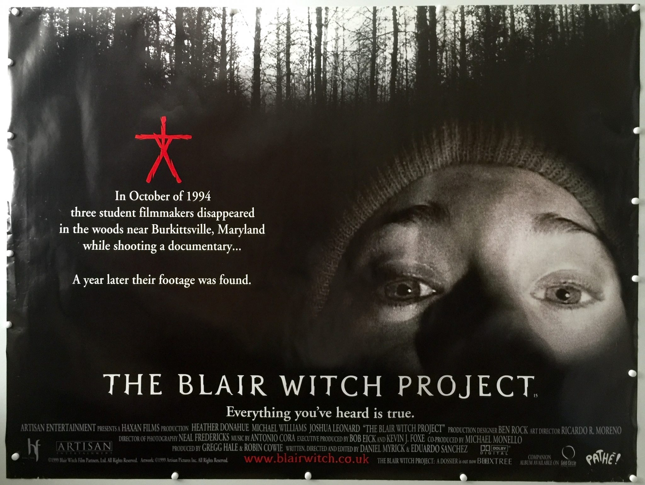
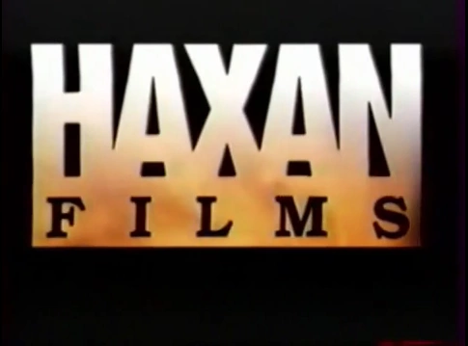
1999: The Internet;
Budget: $60,000
Box Office: $248.6 million

Slide 20
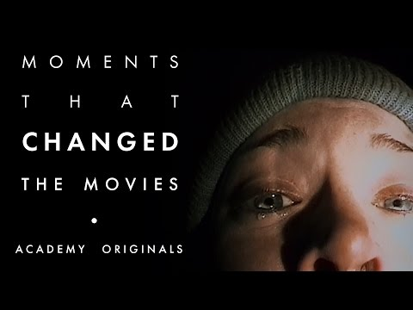

Slide 21
COMPONENT 2 SECTION A: FILM
The Walt Disney co

Slide 22
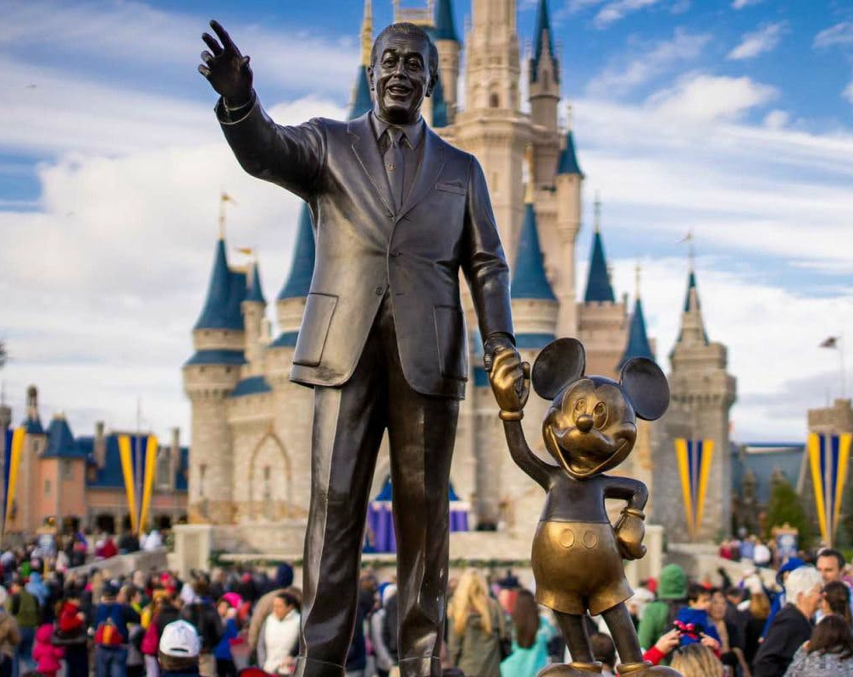
Starter
How much do you know about Disney?
Mindmap your thoughts

Slide 23
Film
Set Texts:
Jungle Book 1967
Jungle Book 2016
What we will explore:
INDUSTRY
HISTORICAL & ECONOMICAL CONTEXT

Slide 24
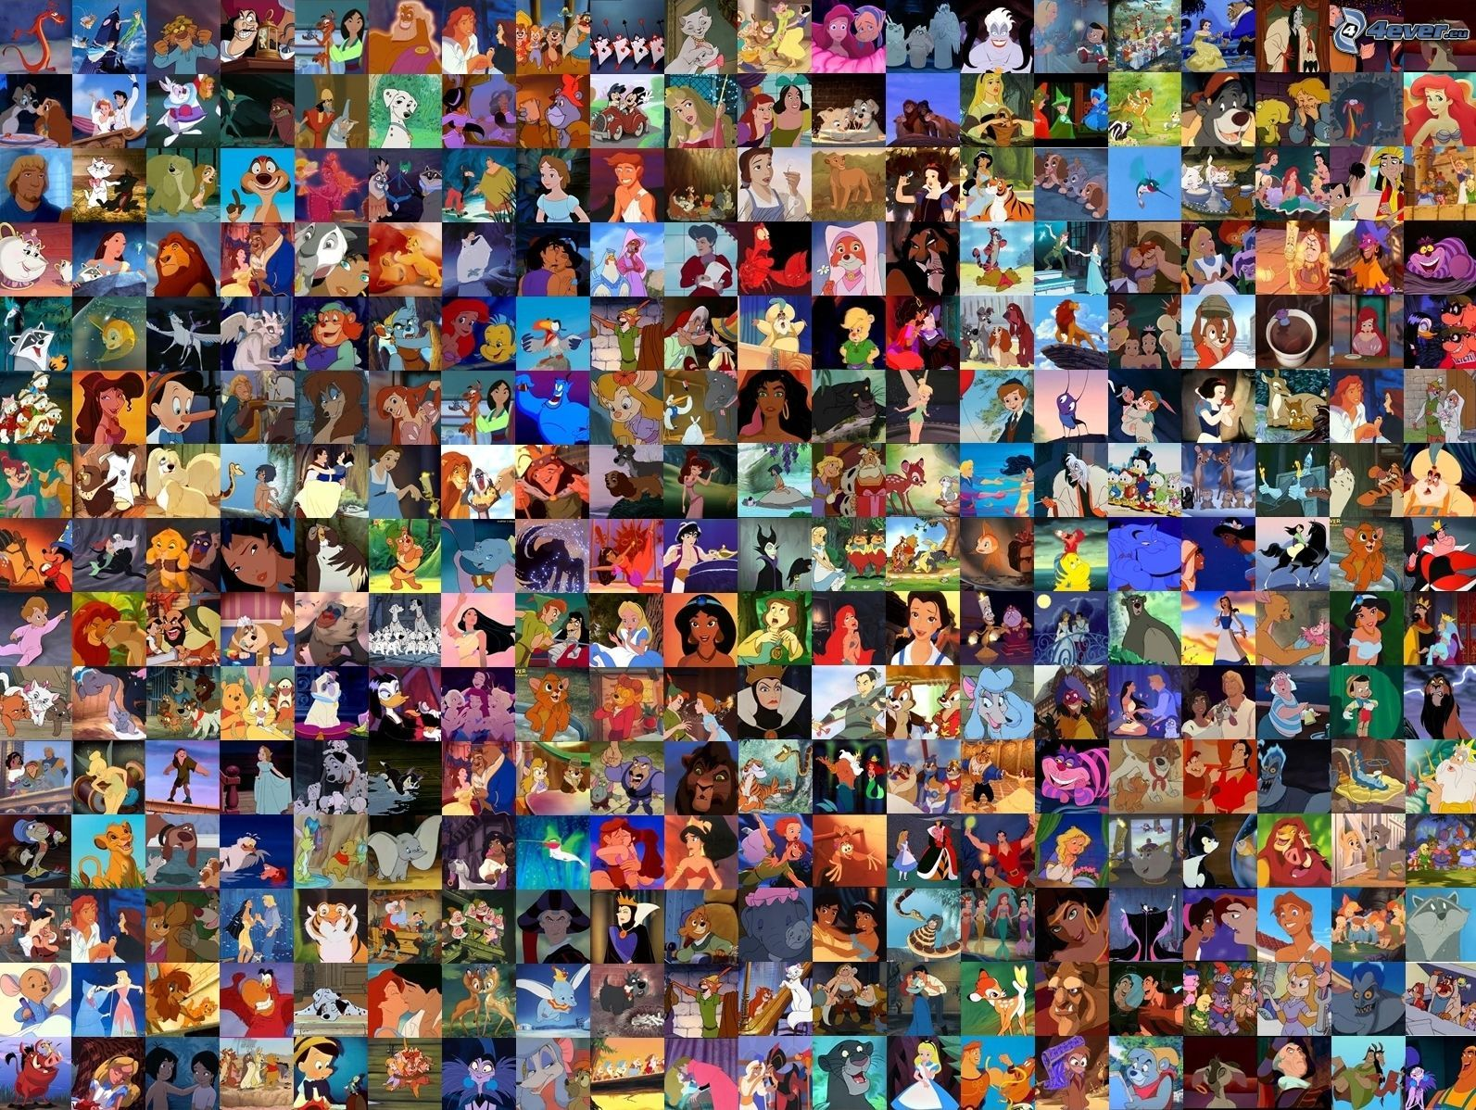

Your Task;
Produce a timeline
of the key dates in Disney’s history

Slide 25
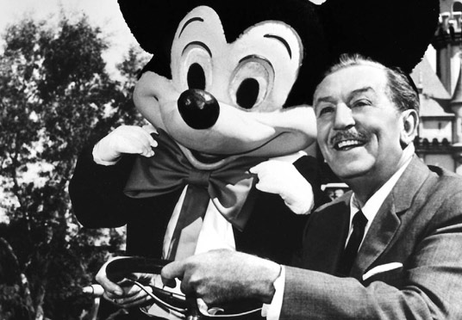
Elias Walt Disney
1901-1966

Slide 26
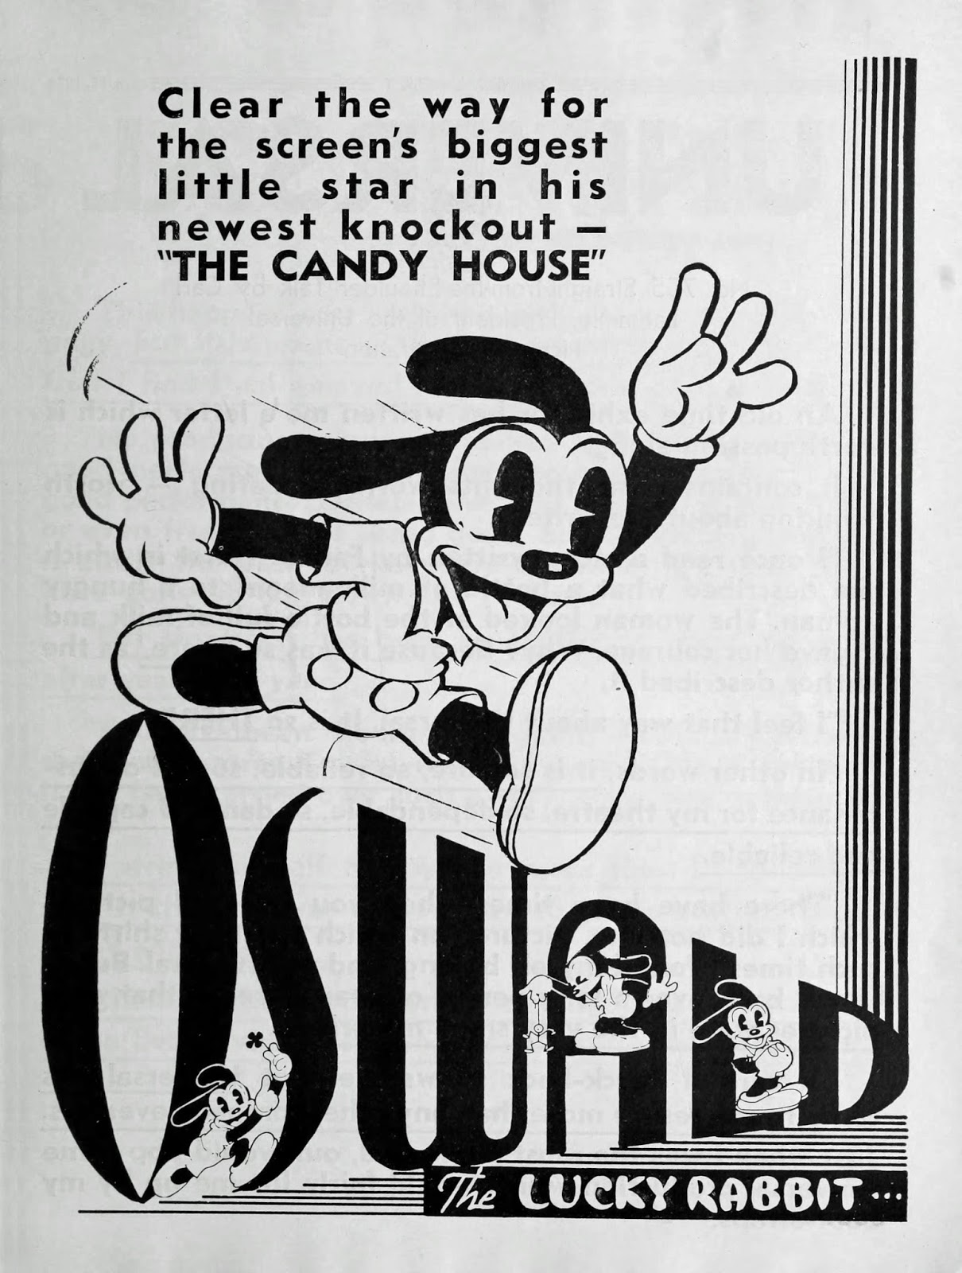
Oswald the Lucky Rabbit
In the 1920’s Disney and his brother Roy moved to Hollywood along with friend and colleague Ubbe Eert Iwerks, and the three began the Disney Brothers' Studio. Their first deal was with New York distributor Margaret Winkler, to distribute their ‘Alice in Cartoonland’ cartoons and a character called ‘Oswald the Lucky Rabbit’. A few years later, Disney discovered that Winkler and her husband, Charles Mintz, had stolen the rights to Oswald, along with all of Disney’s animators, except for Iwerks.

Slide 27
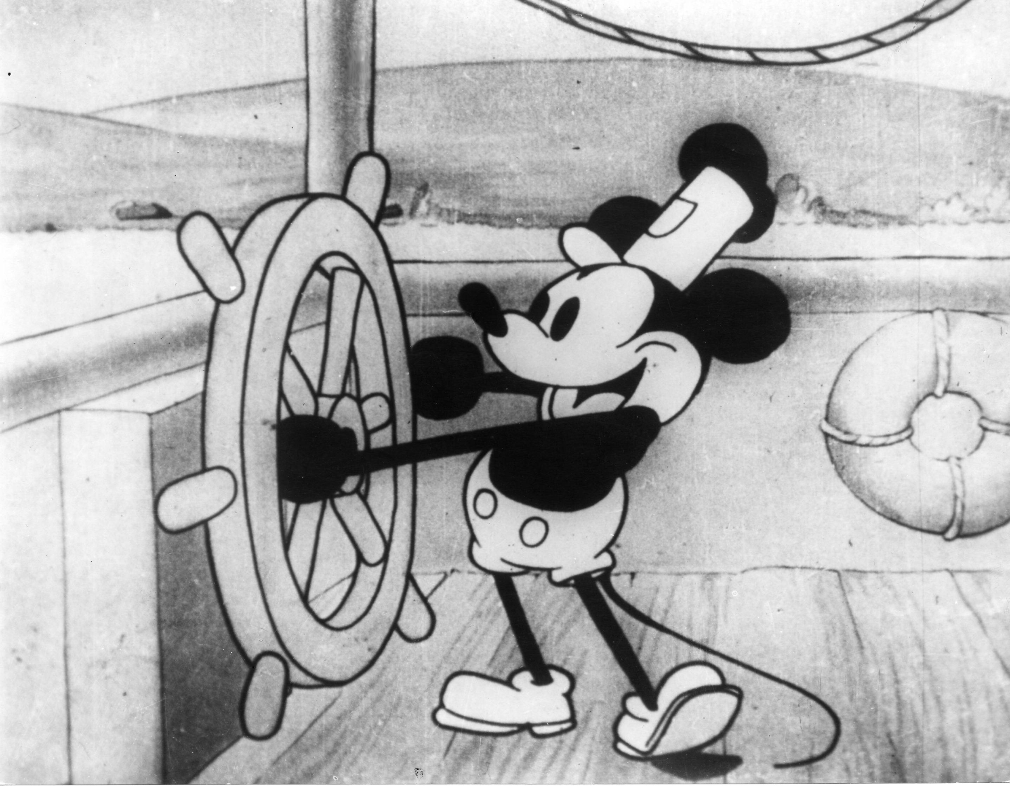
Mickey Mouse
Right away the Disney brothers and Iwerks produced three cartoons featuring a new character; Mickey Mouse. The first animated shorts featuring Mickey were Plane Crazy and The Gallopin' Gaucho, both silent films for which they failed to find distribution. When sound made its way into film, Disney created a third, sound-and-music-equipped short called Steamboat Willie. With Walt as the voice of Mickey, the cartoon was an instant sensation.

Slide 28
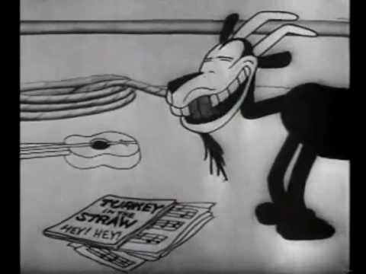
Steamboat Willie
1928

Slide 29
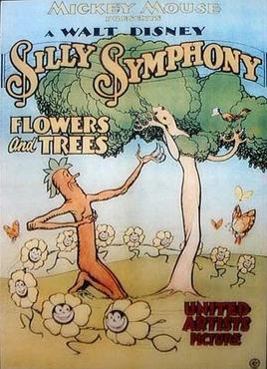
The Silly Symphonies
In 1929, Disney created Silly Symphonies, which featured Mickey's newly created friends, including Minnie Mouse, Donald Duck, Goofy and Pluto. One of the most popular cartoons, Flowers and Trees, was the first to be produced in color and to win an Oscar

Slide 30
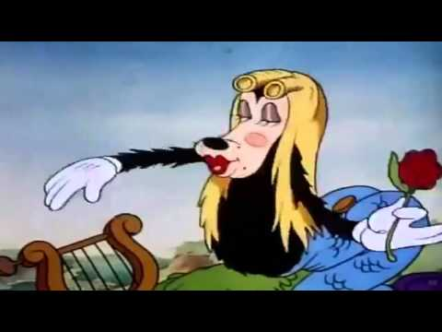
The Three Little Pigs
1933

Slide 31
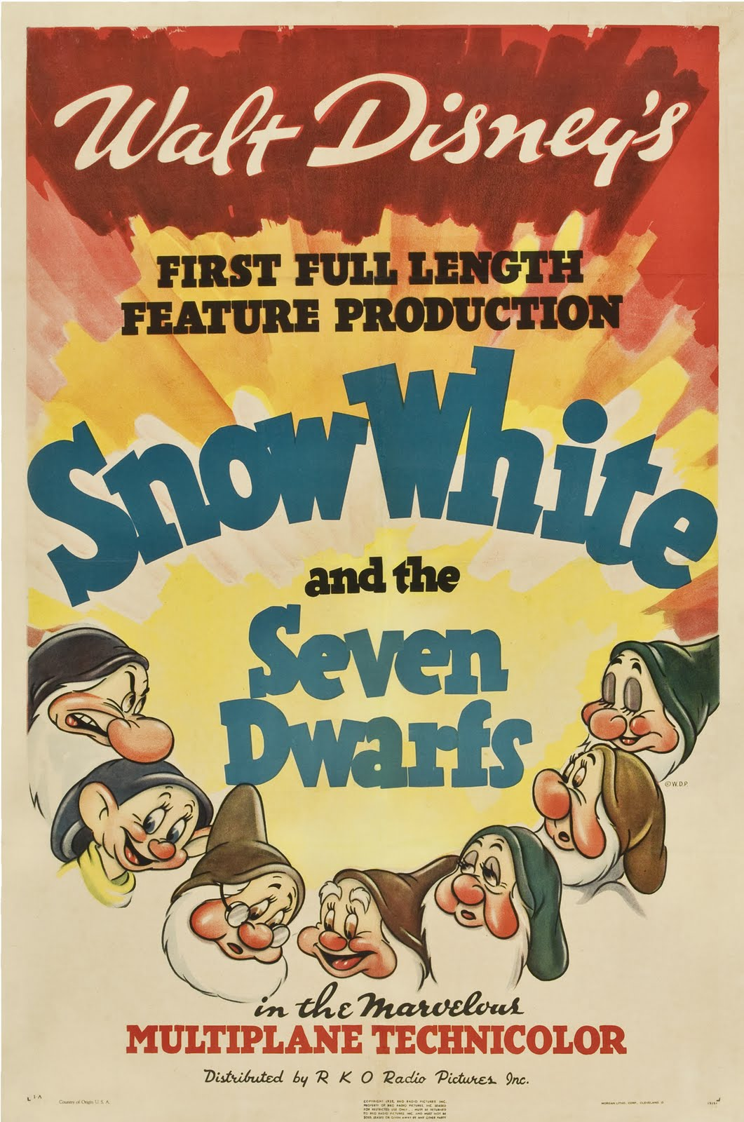
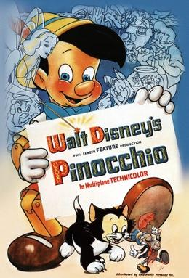
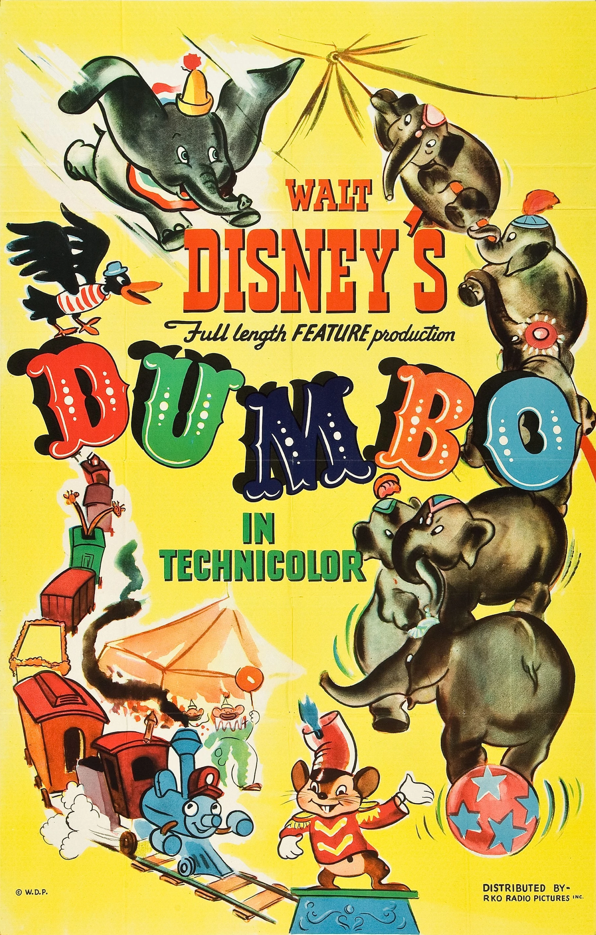


Feature Length Animation
1940
1941
1937
1942
1940

Slide 32



TV Entertainment

Slide 33

Disneyland
1955

Slide 34


Disney’s
last movies...

Slide 35

The Legacy
In December 1966, Walt Disney died of Lung Cancer. His brother Roy O. Disney oversaw the building and financing of Walt Disney World until he died late in 1971, and for the next decade the Company was led by a team including Card Walker, Donn Tatum and Ron Miller — all originally trained by the Disney brothers. After Roy’s death, his son continued his involvement with the brand until 2006.
Further Reading

Slide 36

Touchstone Pictures
Moviemaking was changing in America in the early 1980s. Audiences were diminishing for the family films that had been the mainstay of the Company for many years, and Disney was not meeting the competition for films that attracted the huge teenage and adult market. To reverse that trend, Disney established a new label, Touchstone Pictures, with the release of Splash in 1984.

Slide 37


The 90’s
Disney animation began reaching even greater audiences, with The Little Mermaid being topped by Beauty and the Beast which was in turn topped by Aladdin (1992). The Disney Channel and the Disney Store also grew to record heights.
https://www.youtube.com/watch?v=-pkhvaq54m4

Slide 38

Animation 2.0
Toy Story, the world’s first computer animated feature film, was produced by Pixar for Walt Disney Studios. 1995
Pixar began in 1979 as the Graphics Group, part of the Computer Division of Lucasfilm before it was acquired by Apple Computer co-founder Steve Jobs in 1986. The Walt Disney Company bought Pixar in 2006 at a valuation of $7.4 billion

Slide 39

In 2006, Robert A Iger took over as CEO of the Walt Disney Company.
He has overseen the acquisitions of Pixar, Marvel, Lucas Film and 21st Century Entertainment

Slide 40


Slide 41



Slide 42









Media Ownership Issues...
The effect on audiences...
10 political messages you didn’t realise were hidden in disney movies
How Disney is cultivating our children’s imaginations

Slide 43
Out-Dated Cultural Depictions
https://www.theguardian.com/film/2019/nov/14/disney-attaches-warnings-of-outdated-cultural-depictions-to-classic-films

Slide 44


Slide 45

The effects of a global audience
The recent remake of ‘Beauty & The Beast’ caused controversy for portraying an openly gay man.
An Alabama theater boycott the movie, Russia banned kids younger than 16 from seeing it, Malaysian censors’ requested to remove the corresponding scene, and comment boards are littered with conservative outrage.

Slide 46


