Slide 1
Deutschland 83
Representation

Slide 2
Task 1
Make some notes on paper on
What representations are present in episode 1 (e.g Gender)?
Are they generally positive or negative?
Why do you think this is?

Slide 3
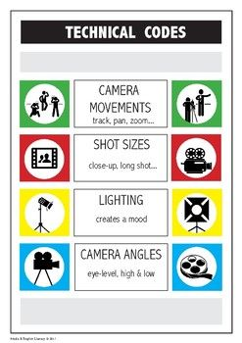
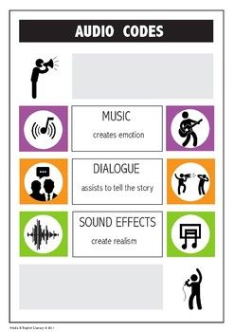
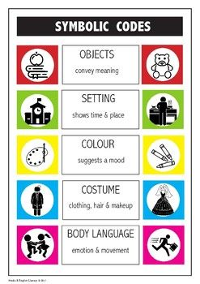
As a reminder, things to look for when talking about representation:
And editing! What is shown next to each other, where are the cross cuts? What is the pace of editing?

Slide 4
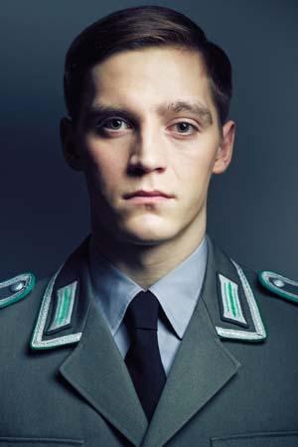
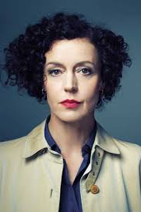
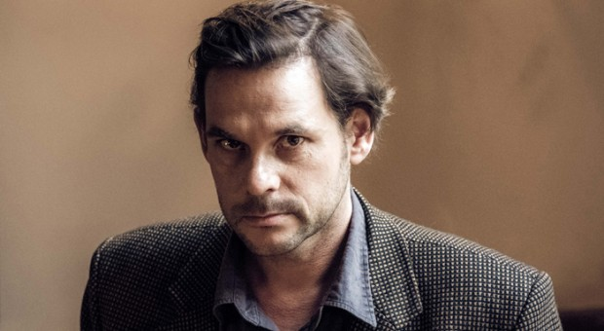

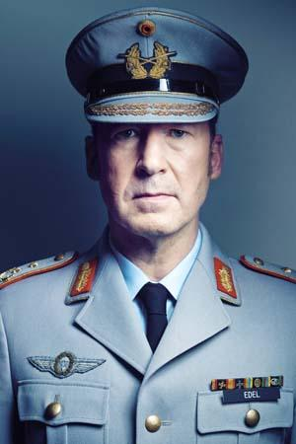
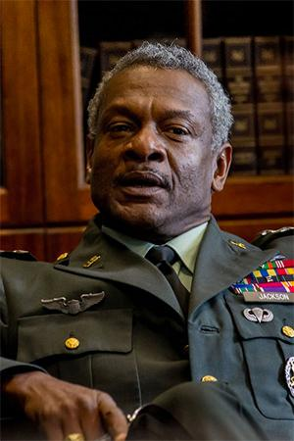
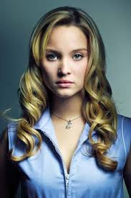
Now make some notes on how the following following represented:
Tischbier
Martin/Moritz
Leonora
Alex Edel
General Edel
General Jackson
Annette

Slide 5
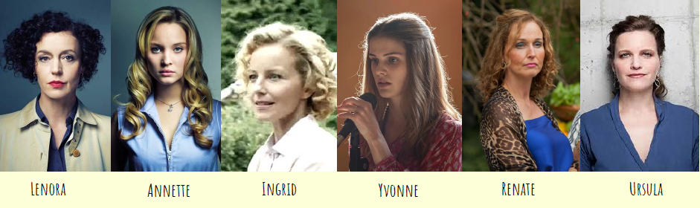
Task 2 : Focus on the women: what do you notice about their representation?

Slide 6
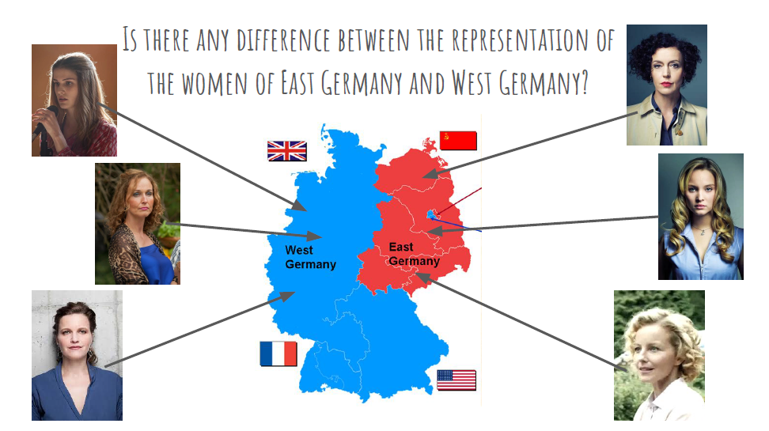

Slide 7
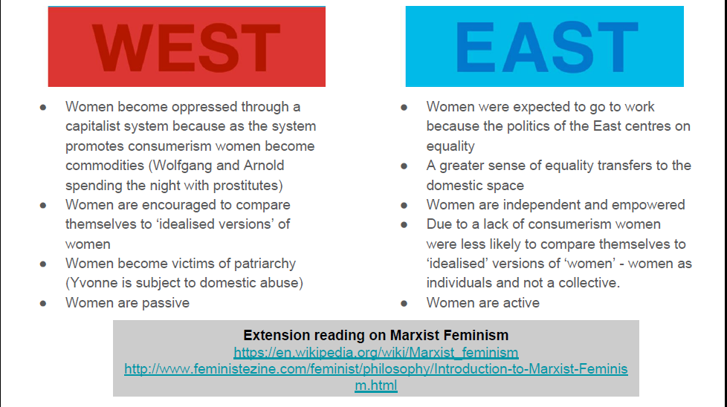

Slide 8
Task 3: Continue this sentence
The gender representations in D83 are/are not surprising because… (try for 200 words!)

Slide 9
Final task: Pick a character...
Pick one character we have met in episode 1, and look at how their representation is constructed.
Go back to the episode and find where they are introduced.
Using the four analysis areas (cinematography, editing, sound and mise-en-scene), and screen grabs if possible, explore how this is initial representation is created.
Upload your response as a Google Doc, Slides or a video or audio file.

