Slide 1
Audience in ST

Slide 2
Audiences
Primary/secondary
Demographics
Psychographic
Uses and gratifications
How many different audience groups could enjoy Stranger Things and why?
Notes:
🍐 This is a Pear Deck Text Slide
🍐 To edit the type of question, go back to the "Ask Students a Question" in the Pear Deck sidebar.

Slide 3

Marketing
Twitch tie in – Haunted Basement
Cinematic trailer -
VR - https://startvr.co/stranger-things-vr/

Slide 4
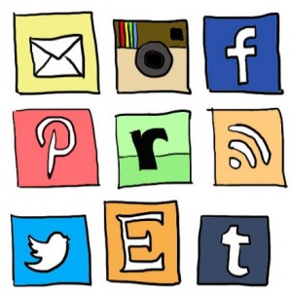
Marketing – Social Media
https://www.facebook.com/StrangerThingsTV/
https://twitter.com/Stranger_Things
https://www.youtube.com/channel/UChmpTxQ0Gp8KEJKsqzeg9Lg
https://www.instagram.com/strangerthingstv/?hl=en

Slide 5

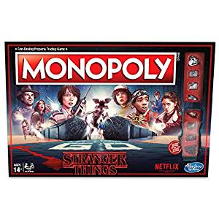


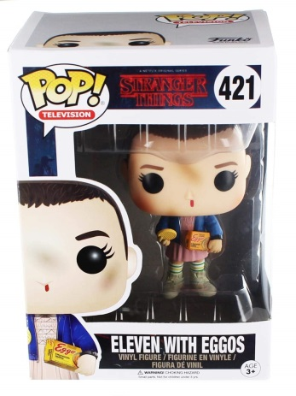
Fandom and Merch
https://strangerthings.fandom.com/wiki/Stranger_Things_Wiki
https://www.tumblr.com/tagged/stranger-things
https://www.fanfiction.net/tv/Stranger-Things-2016/
https://www.deviantart.com/search?q=stranger%20things
https://www.redbubble.com/shop/stranger+things+fandom
#justiceforbarb

Slide 6
Nostalgia Marketing
Millenianls - Millennials, also known as Generation Y (or simply Gen Y), are the demographic cohort following Generation X and preceding Generation Z. Researchers and popular media use the early 1980s as starting birth years and the mid-1990s to early 2000s as ending birth years, with 1981 to 1996 a widely accepted definition. Millennials are sometimes referred to as "echo boomers" due to a major surge in birth rates in the 1980s and 1990s, and because millennials are often the children of the baby boomers. The characteristics of millennials vary by region and by individual, and the group experiences a variety of social and economic conditions, but they are generally marked by their coming of age in the Information Age, and are comfortable in their usage of digital technologies and social media.

Slide 7
Audience theories...

Slide 8
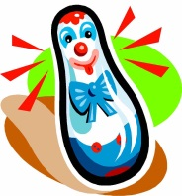
1
violent behaviours are learned through modelling
Humans learn much of their behaviour through social interaction.
Social learning can occur as a result of first-hand experiences.
Social learning can also occur by watching others’ experiences.
Audiences can copy media representations of negative behaviour
Representational modelling can have a powerful effect on the behaviours of media audiences.
Modelled behaviours by role models and the vivid visual encoding systems of media products further concentrate the effects of representational modelling.
Violence is an endemic feature of media content.
Bandura
Media modelling effects
2
Three theorists who might challenge Bandura’s thinking:
Stuart Hall: would argue that media products do not produce a cause and effect learning response – audiences decode the media they engage with using contextual knowledge.
Henry Jenkins: emphasises the positive effects of media consumption – suggesting that the media forges communities and allows audiences to express themselves in positive and creative ways through fan engagement.
Gerbner: would argue that the media should not be measured just in terms of its impact on individual learning behaviours but also on the cumulative effect of mass media consumption on wide social attitudes.
?
A

Slide 9
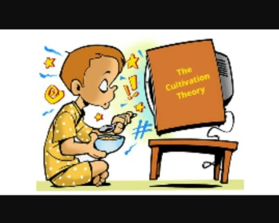
1
media products shape attitudes and perceptions of the world at large
Storytelling performs an encutluration role helping to shape our attitudes and social values.
Mass media has replaces other institutions, most notably religion and education as the principle constructor of symbolic storytelling.
Television has had a homogenising effect on society – we all watch or engage in the same symbolic stories as a result of mass media.
Television schedules are saturated with violent content that cultivates a widespread fear in society – ‘mean world syndrome’.
The media can produce resonance or mainstreaming effects on audiences.
Gerbner
Cultivation Theory
2
media consumption leads audiences to accept established power structures and mainstream ideologies
Mass media narrative create symbolic representations of power that affect our real-world view.
Mass media products over-exaggerate the power and scope of real-world authorities.
Mass media products marginalise alternative viewpoints as a result of middle-of-the-road reportage.
Three theorists who challenge Gerbner’s thinking:
Stuart Hall: would argue that media products do not produce a cause and effect response – audiences decode the media using contextual knowledge.
Henry Jenkins: emphasises the positive effects of media consumption – suggesting that the media forges communities and allows audiences to express themselves in positive and creative ways through fan engagement.
Bandura: would argue that the media directly impacts and individual’s behaviour and induces consumers to be violent. Gerbner, in contrast, suggest that media consumption prompts attitudinal rather than a behavioural response.
?
A

Slide 10
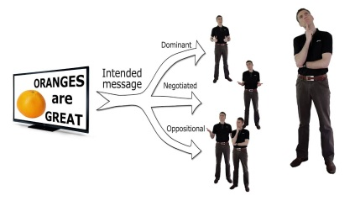
1
encoding and decoding
Professional media encodes messages using visual and aural cues.
Media encoding is affected by institutional context, media production processes and genre-driven routines.
Media products are polysemic as a result of their use of visual signs.
Audience do not necessarily decode meanings that media produces effect in a straightforward way.
Audiences can misread products if they are too complex or untranslatable.
dominant, negotiated and oppositional readings
Media products reinforce dominant ideologies and cultural hegemonies.
Dominant ideologies are subject to change – again, the media plays a crucial role in effecting those changes.
Audience use ‘situated logics’ to decode media messages.
Audiences can produce reading of products that accept the dominant ideologies they construct.
Audiences can use their contextual knowledge to read against the grain of a media product and to thus produce negotiated or oppositional decodings.
Stuart Hall
Reception Theory
2
Three theorists who might challenge Hall’s thinking:
Gerbner: would suggest that audiences find it difficult to resist the effects of media products. Gerbner’s mainstreaming theory would suggest that even the least susceptible audience members experience attitudinal change as a result of media exposure.
Bandura: his Bobo doll experiments would suggest that the media has a casual effect on audience behaviours and prompts audiences to copy behaviours they have seen in the media.
Guantlett: would argue that media products do not necessarily reinforce cultural hegemonies. Contemporary media products offer a wide range of identities and subversions that often work in opposition to dominant ideologies.
?
A

Slide 11
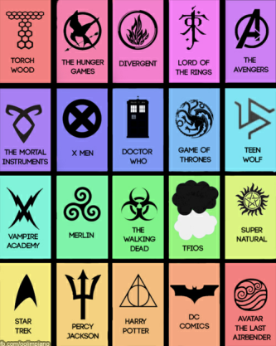
1
fans appropriate media texts, producing readings that are not fully authorised by the media producers
Jenkins suggest that audience are able to used professional texts as ‘creative scaffolding’ on which they craft their own reading of products.
Textual poaching can be used by marginalised fans to explore alternative readings to mainstream culture.
Textual poaching in the digital age can take many forms, including fanfiction, remix culture, fan art or video parodies.
2
fans and media makers have converged as a result of digital technology
Digital technologies have brought audiences and producers together.
The digital revolution has expanded the scope of fandoms.
Producers use their fans digital labour to promote and market media.
Contemporary media producers deliberately construct material to engage fan interest.
Jenkins:
Fandom
3
fans use participatory culture to effect wider social change
Participatory culture is distinctly different from the commercial activities of Web 2.0.
Participatory culture allows individual to share and develop ideas with like-minded community.
Participatory culture can create social change.
Three theorists who might challenge Jenkins’s thinking:
Curran and Seaton: argue that the internet is dominated by an oligopoly of commercial companies thus minimising the potential effect of participatory culture.
Hesmondhalgh: might agree that the internet has resulted in audience-producer convergence, but would argue that the media industry is still heavily reliant upon traditional marketing activities to reduce product risk. Media makes might engage in fan-based listening activities to construct or adapt products, but formulaic product design (using stars/genre codes) remains a consistent focus of product content.
Livingstone and Lunt: suggest that the global nature of the net and the volume of material uploaded make effective regulation very difficult. New technology might open up the media to democratising forces and the development of new communities, but it is also open to potential abuse.
?
A

Slide 12
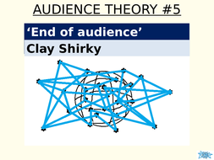
1
everybody makes the media
Shirky highlights the revolutionary impact of digital technology in speeding up media production processes.
Media consumption patterns have changed from a broadcast model that involves one sender and many recipients to a many-to-many model.
Traditional media, Shirky argues, uses a ‘filter then publish’ model to provide quality content.
Shirky suggest that the internet has resulted in a ‘publish now, filter later’ model due to lower production costs and reduced entry barriers to media production.
Clay Shirky:
The end of audience
2
everyday communities of practice
Audiences actively shape their own rules of engagement with professional media products.
Digital technologies have resulted in an explosion of what Shirky calls ‘communities of practice’.
Two theorists who might challenge Shirky’s thinking:
Curran and Seaton: argue that the internet continues to be dominated by an oligopoly of commercial companies.
Hesmondhalgh: might agree that the internet has resulted in audience-producer convergence, but would argue that the media industry is still heavily reliant upon traditional marketing activities to reduce product risk.
?
A

